Slide 1
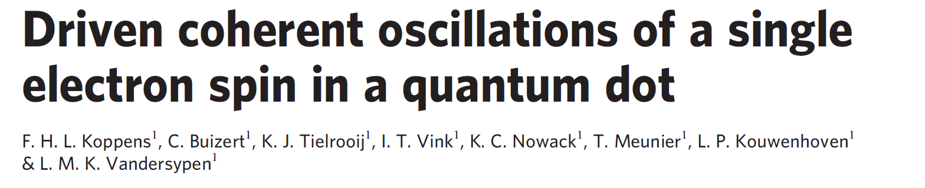
Journal Club Talk
Simon Svab, 4/21/20

Slide 2
Overview
Control of spin state confined in DQD via ESR:
ESR spin state spectroscopy
Demonstration of Rabi oscillations

Slide 3
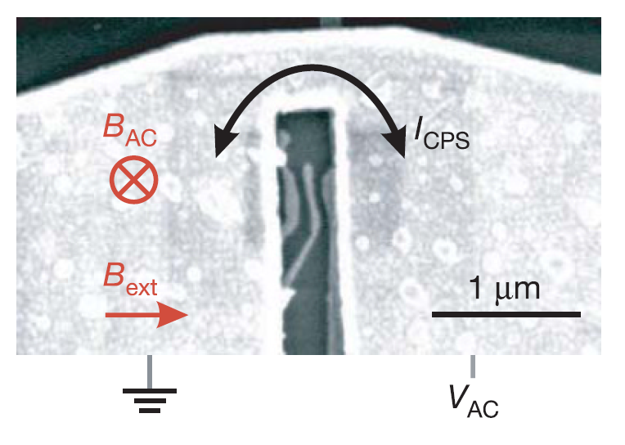
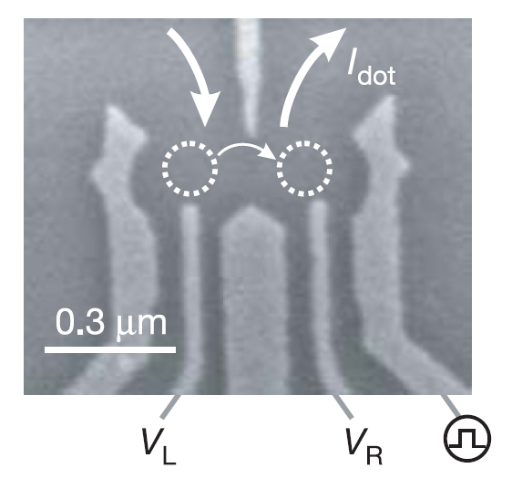
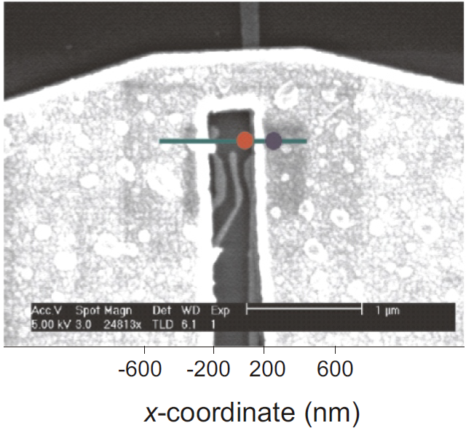
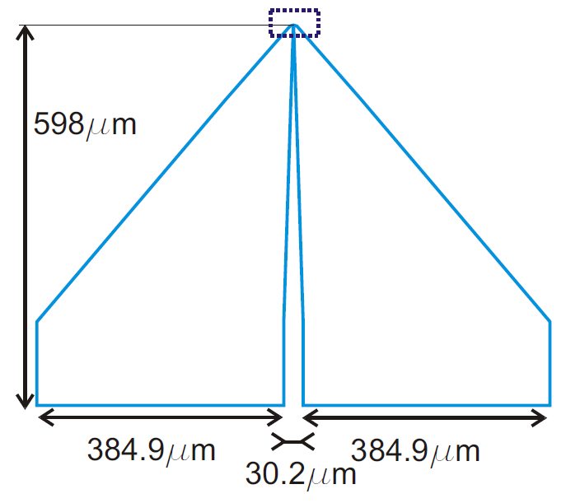
Device
Termination of coplanar stripline (Au) on top of the gates
rise time 150ps

Slide 4
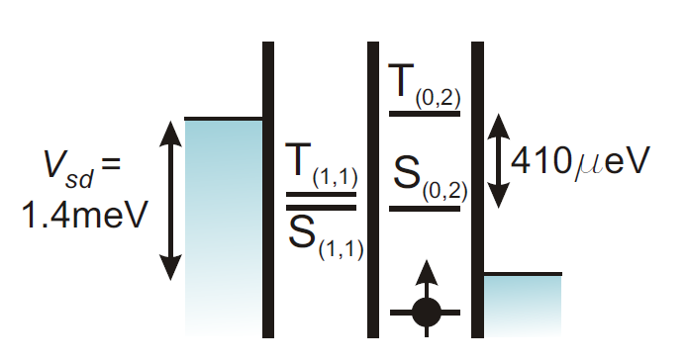
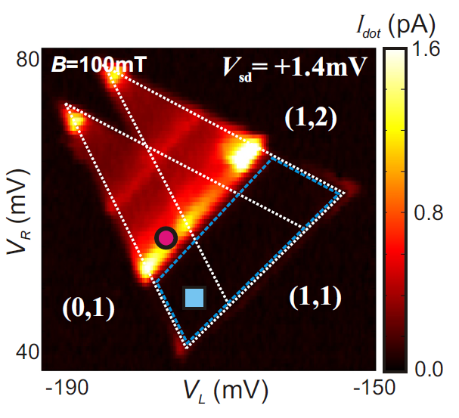
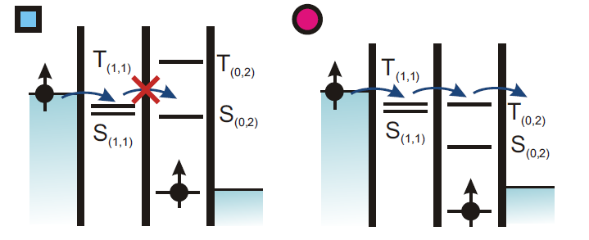
Transport in spin-blockade regime (1)
Pauli spin blockade
T(0,2) not energetically accessible
Right dot potential pulled down

Slide 5
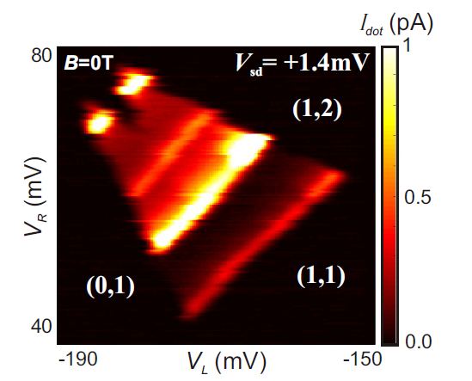
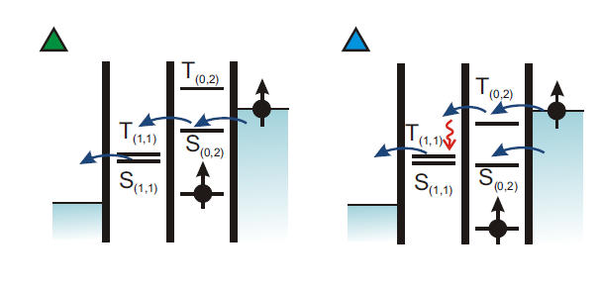
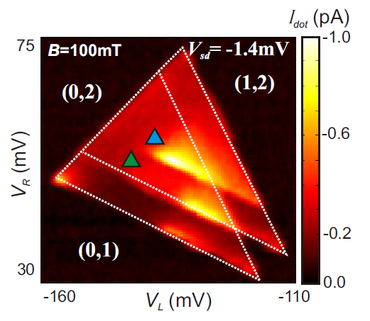
Transport in spin-blockade regime (2)
Bias reversed → No spin-blockade
B-field turned off: Nuclear field admixes singlet with triplets
→ Spin-blockade lifted

Slide 6
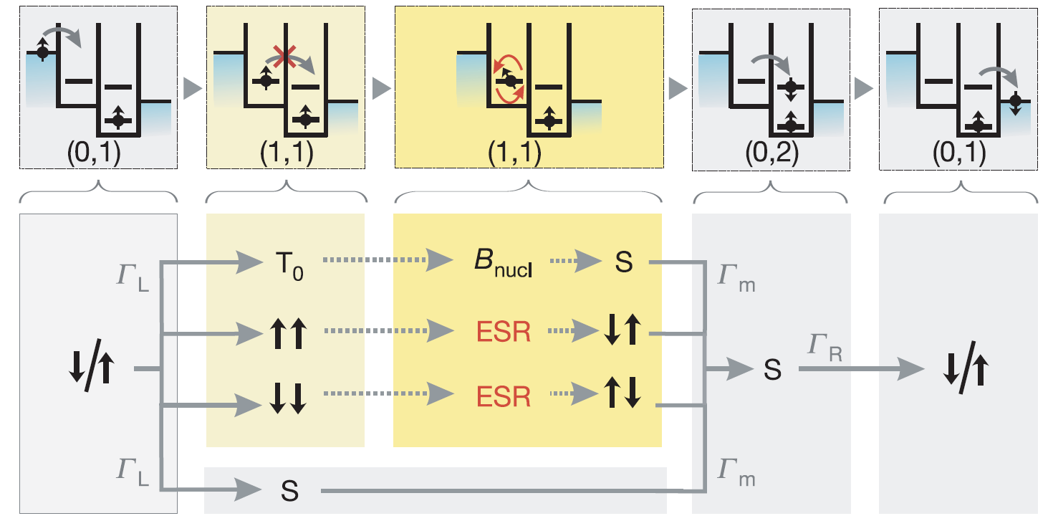
Transport in spin-blockade regime (3)

Slide 7
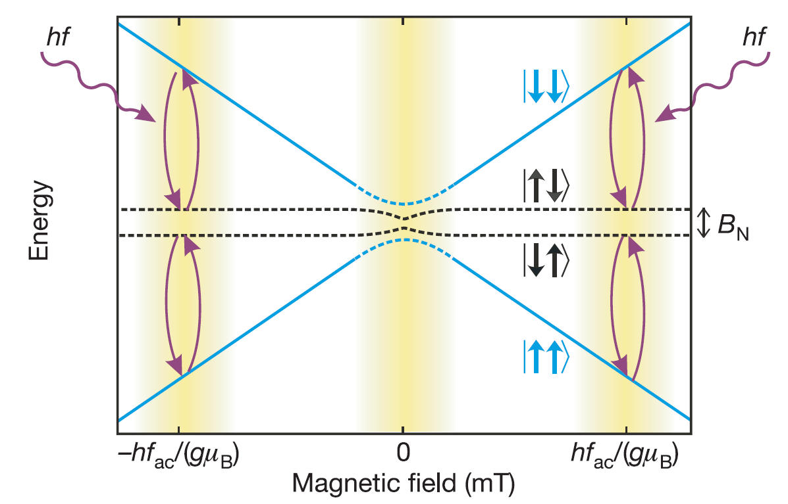
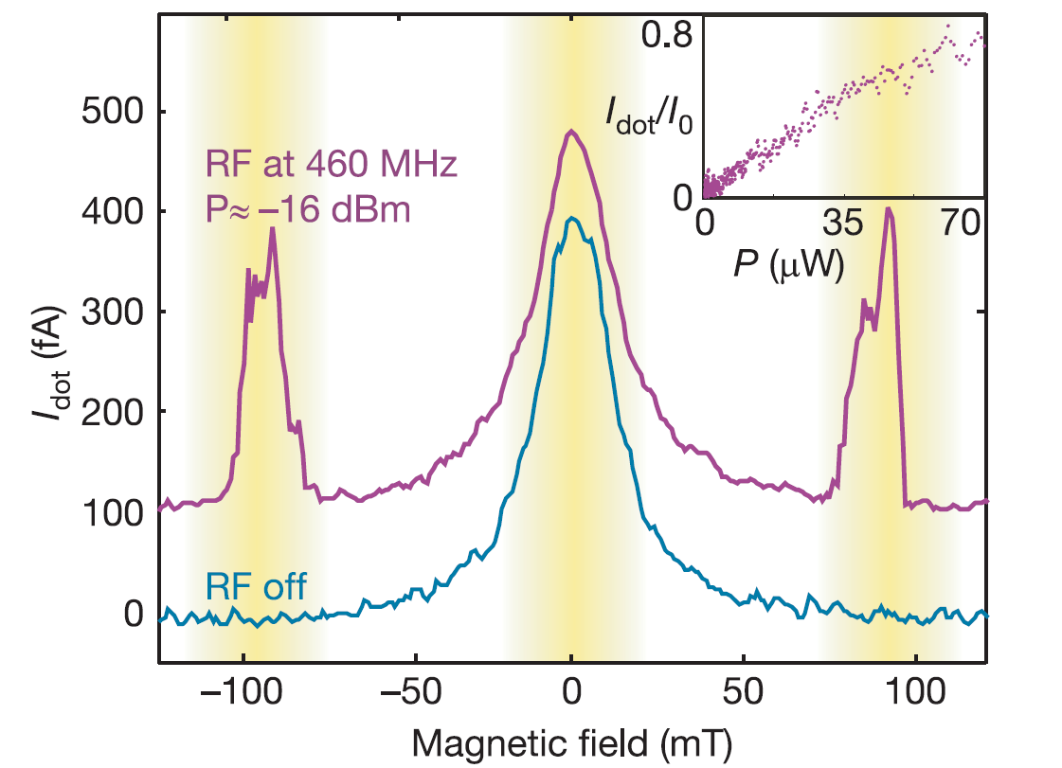
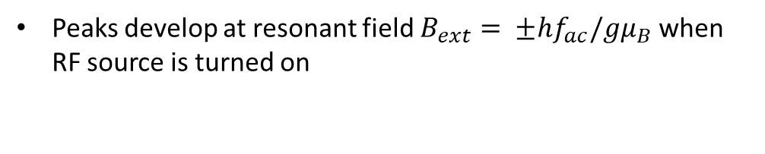
ESR spin state spectroscopy (1)
Peaks develop at resonant field $B_{ext}= ±hf_{ac}/gμ_{B}$ when RF source is turned on

Slide 8
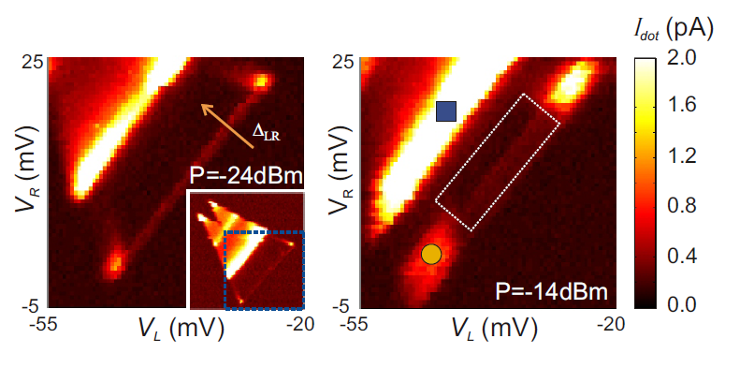
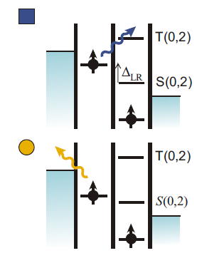
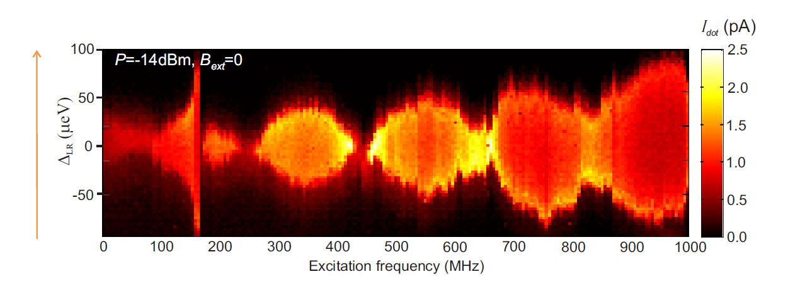
ESR spin state spectroscopy (2)
Photon-assisted tunneling due to electric fields at high RF powers
Countermeasure: RF signal split to CPS and right gate (attenuated)

Slide 9
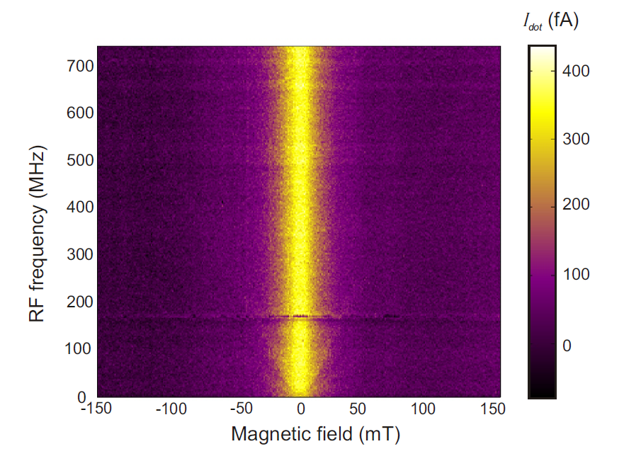
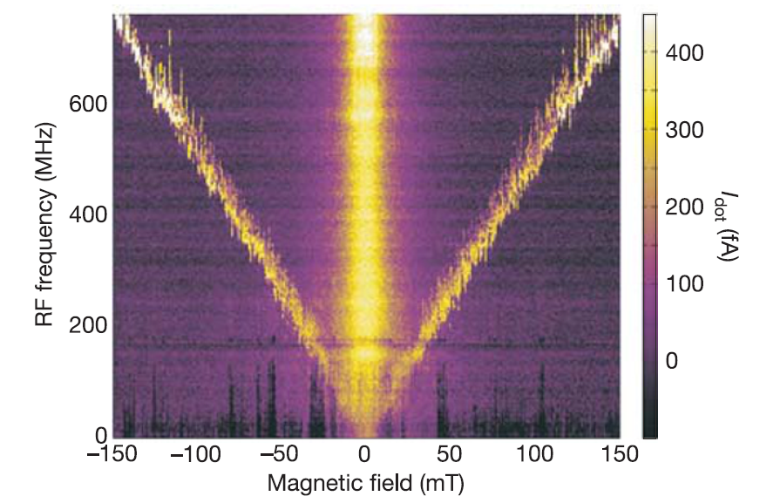
ESR spin state spectroscopy (3)
RF signal on ESR stripline
RF signal on right gate instead

Slide 10
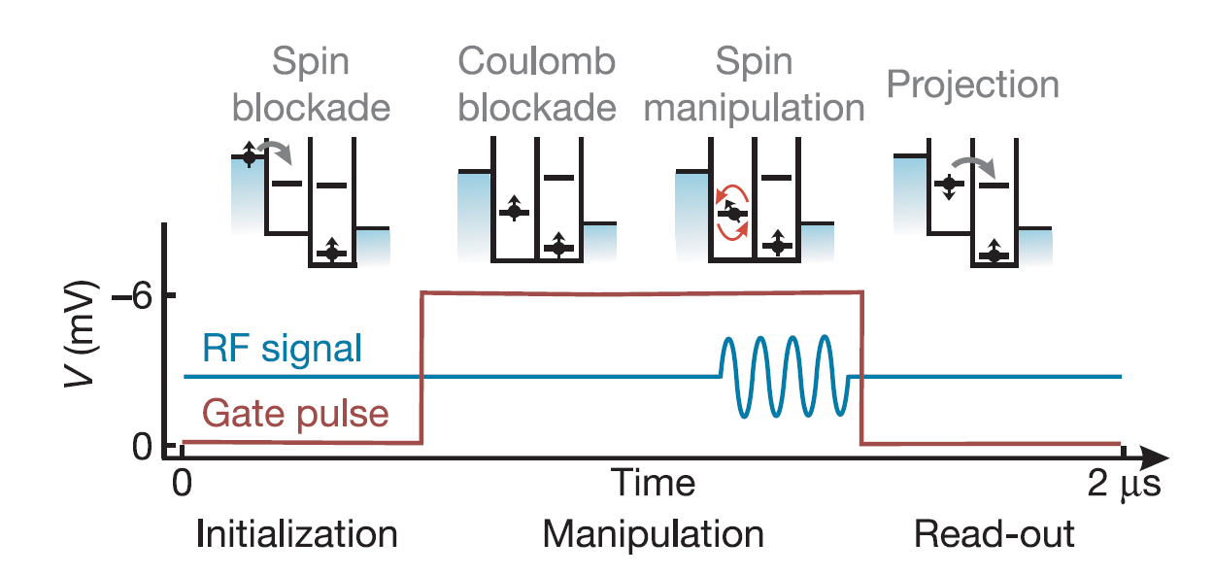
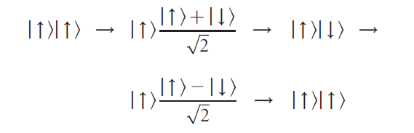
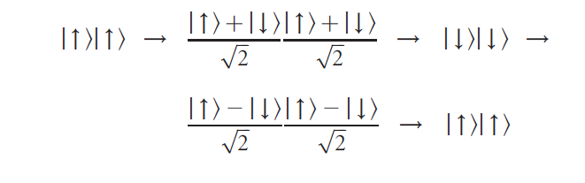
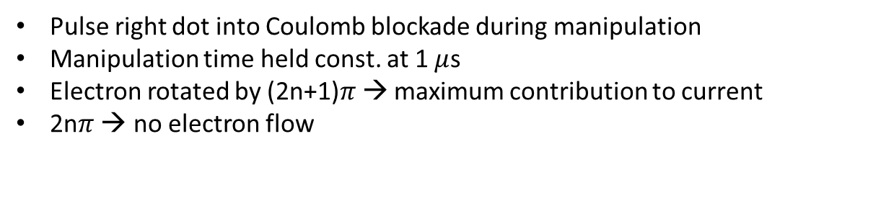
Coherent manipulation of the electron spin
RF burst on resonance with one of the spins
On-resonance with both spins: current oscillates twice as fast
(only at highest powers, not observed in their experiment)
Pulse right dot into Coulomb blockade during manipulation
Manipulation time held const. at 1 $μ$s
Electron rotated by (2n+1)$π$→ maximum contribution to current
2n$π$ → no electron flow

Slide 11
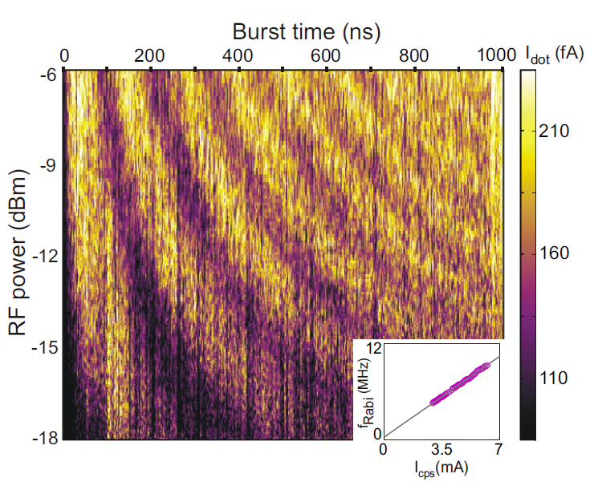
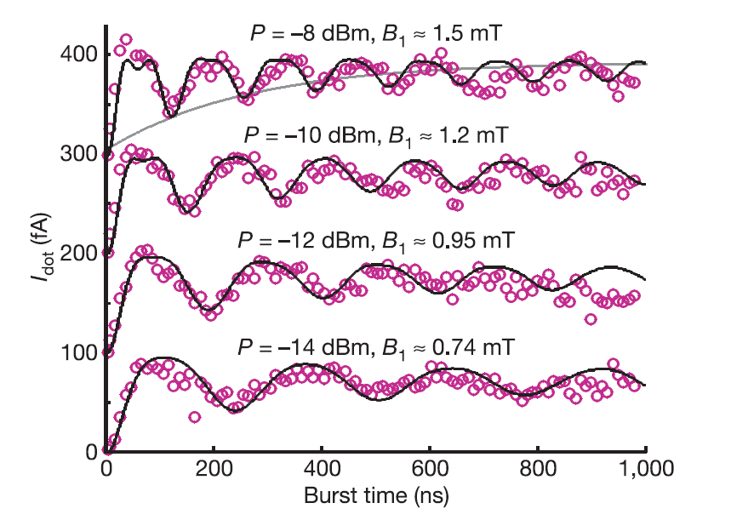
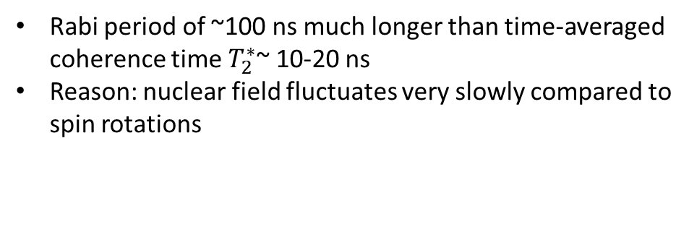
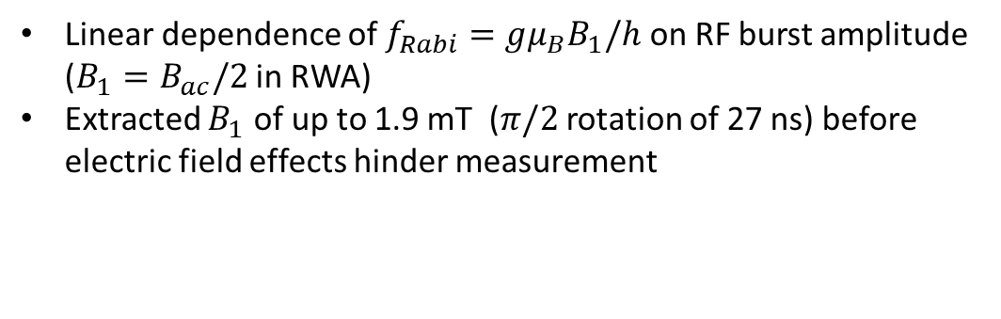
Coherent manipulation: Rabi oscillations
Linear dependence of $f_{Rabi}=gμ_{B}B_{1}/h$ on RF burst amplitude ($B_{1}=B_{ac}/2$ in RWA)
Extracted $B_{1}$ of up to 1.9 mT ($π/2$ rotation of 27 ns) before electric field effects hinder measurement
Rabi period of ~100 ns much longer than time-averaged coherence time $T_{2}^{∗}$~ 10-20 ns
Reason: nuclear field fluctuates very slowly compared to spin rotations

Slide 12
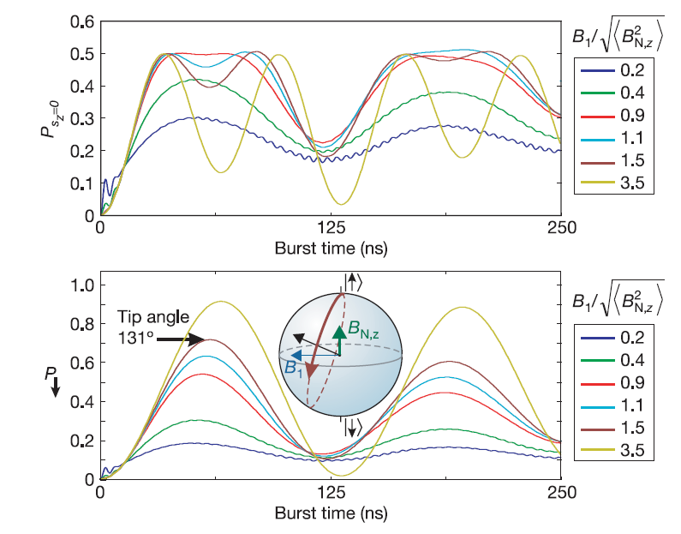
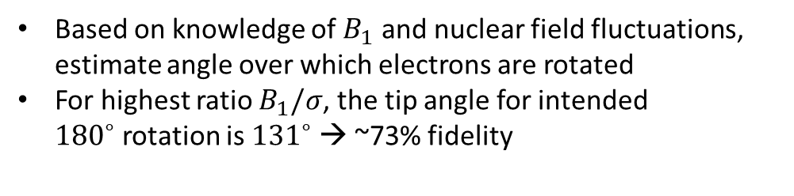
Quantum gate fidelity
Numerical calculation:
Based on knowledge of $B_{1}$ and nuclear field fluctuations, estimate angle over which electrons are rotated
For highest ratio $B_{1}/σ$, the tip angle for intended ${180}^{∘}$rotation is ${131}^{∘}$→ ~73% fidelity

