Slide 1
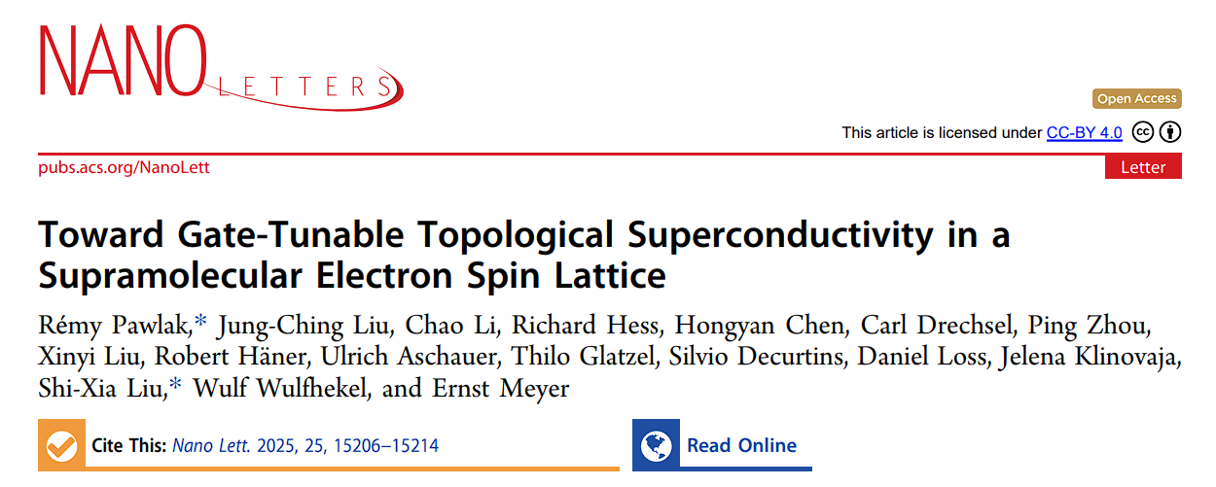
Journal club 10/07
Pierre-Armand Barbieri

Slide 2
Journal club 10/07
Pierre-Armand Barbieri
Goal : create a topological superconductor with a lattice of radical molecules

Slide 3

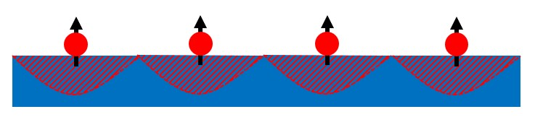
How to build a Shiba lattice ?
Magnetic impurity
superconductor
YSR bound state
Start with a single impurity :
Spin array makes YSR overlap, creating Shiba bands :

Slide 4
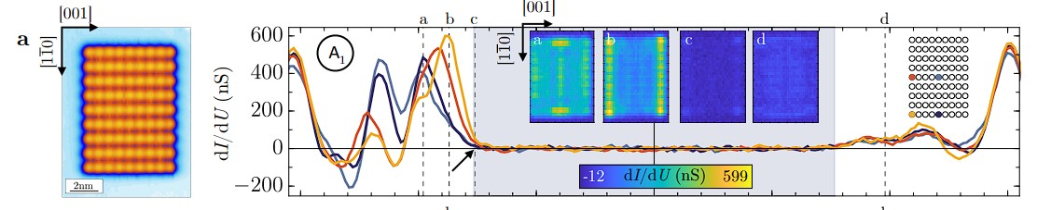
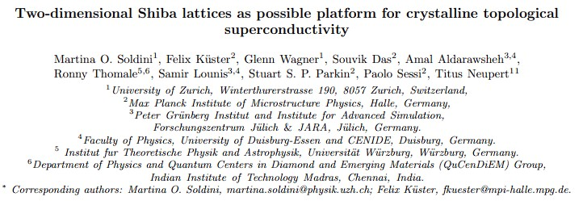
How to build a Shiba lattice ?
Similar to Andrea’s journal club paper :

Slide 5
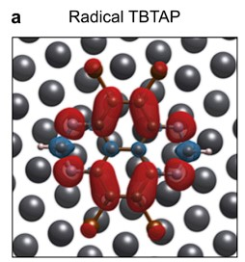
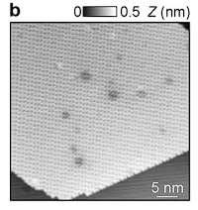
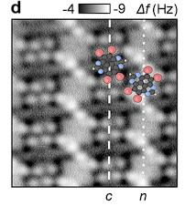
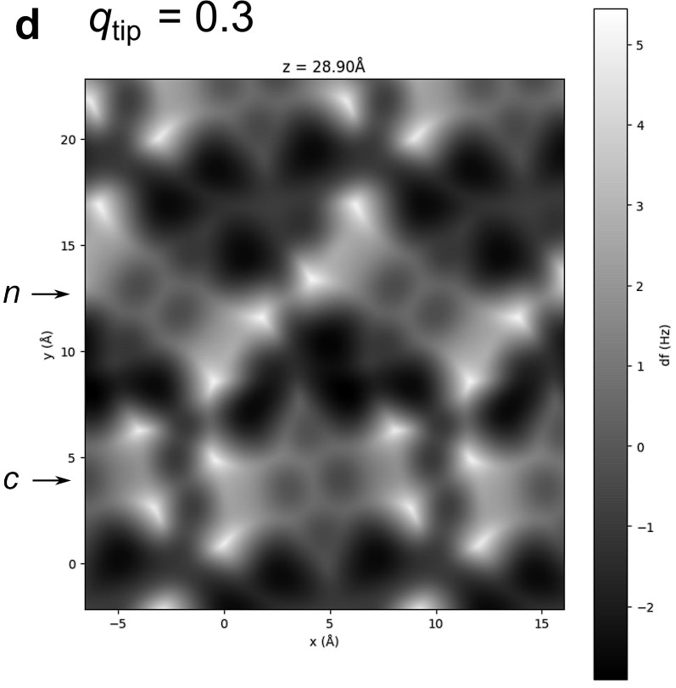
The molecular self assembly :
4,5,9,10-tetrabromo-1,3,6,8- tetraazapyrene (TBTAP) molecule
supramolecular assembly of gate-tunable radical molecules on superconducting Pb(111)
DFT simulation in agreement with experimental measurements

Slide 6
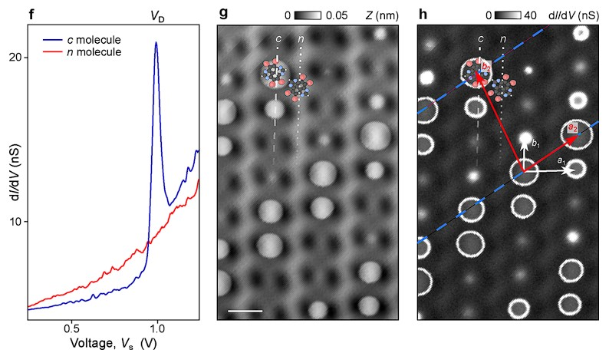
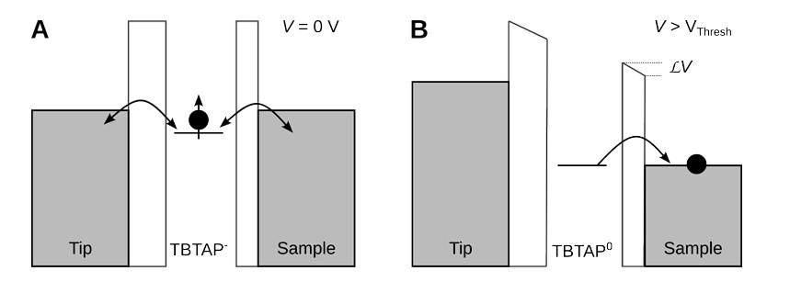
Charged and non charged molecules :
Molecule in the charged row show a discharg event at a threshold voltage Vd.

Slide 7
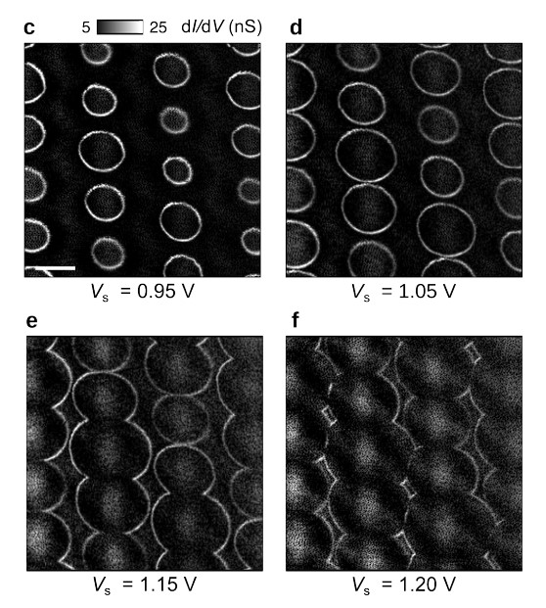
Ring like features :
At Vs = Vd, the tip can is just able to induce discharge underneath the it, dot pattern in the differential conductance map.
When Vs is increases, a ring appear as the tip is able to discharge around the center too.
The ring diameters linearly increase with Vs as the electric field of the tip discharge more efficiently the molecule even at larger lateral (X, Y ) distances.
If the bound state can “communicate”, the ring hybridize.
You still have discharge in the ring, but the tunnelling current does not change drastically as voltage increases (low dI/dV).

Slide 8
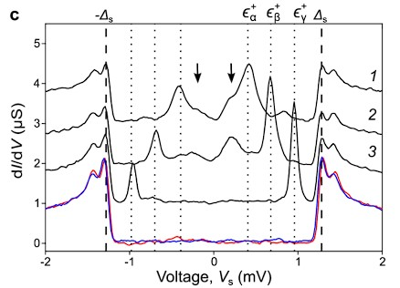
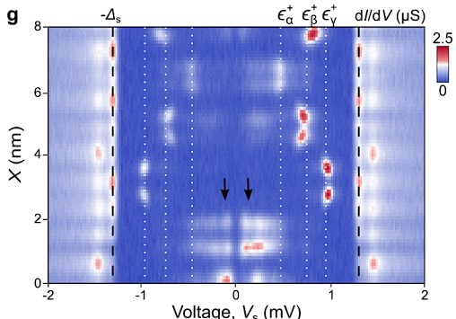
dI/dV spectra :
Each molecul show in gap states
The black arrows show low energy mod that are more intense at the edge

Slide 9
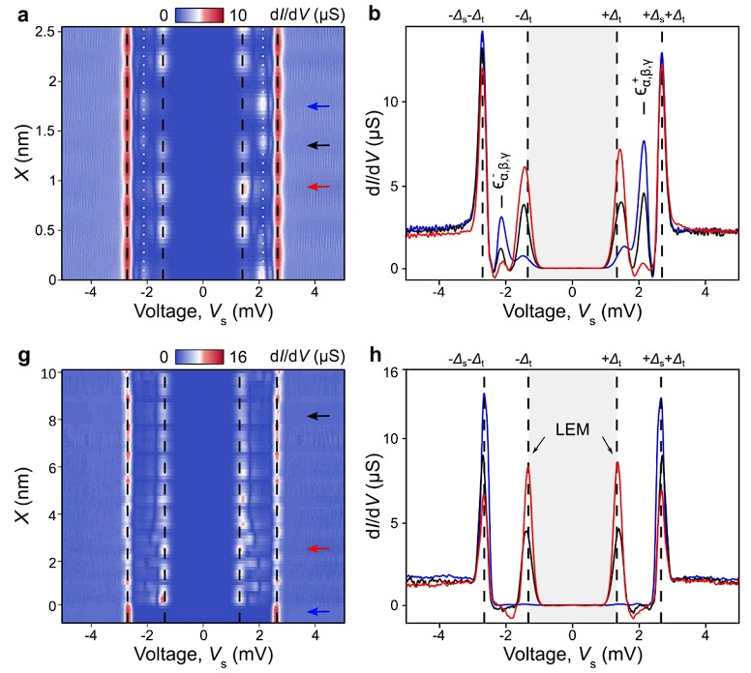
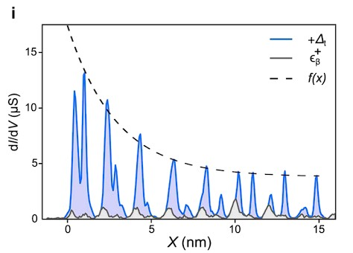
Investigate the Low Energy Modes (LEM) :
YSR states do not have 0 energy, they show a electron hole assymetry
When scaning near the edge, we see clear electron hole symetric zero energy modes
Stronger at the edge

Slide 10
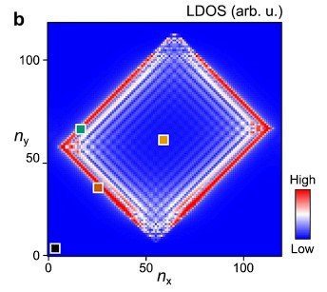
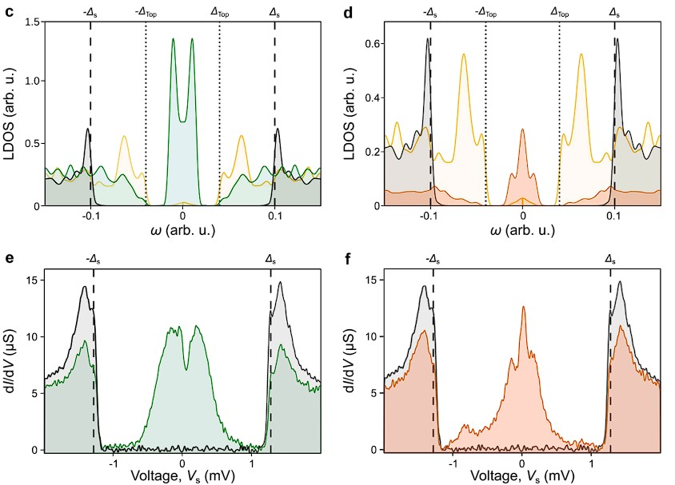
Tight binding model :
LDOS theoretical prediction in great agrement with dI/dV spectra
the strong anisotropy of the system, leads to two perpendicular edge states with distinct behaviors
Short decay length but large localization length
Theoretical
Experimental

Slide 11
Conclusion:
Caracterised theyr radical molecul lattice
Showed the existence of YSR bound states
Showed the existence of low energy modes located at the edge

Slide 12
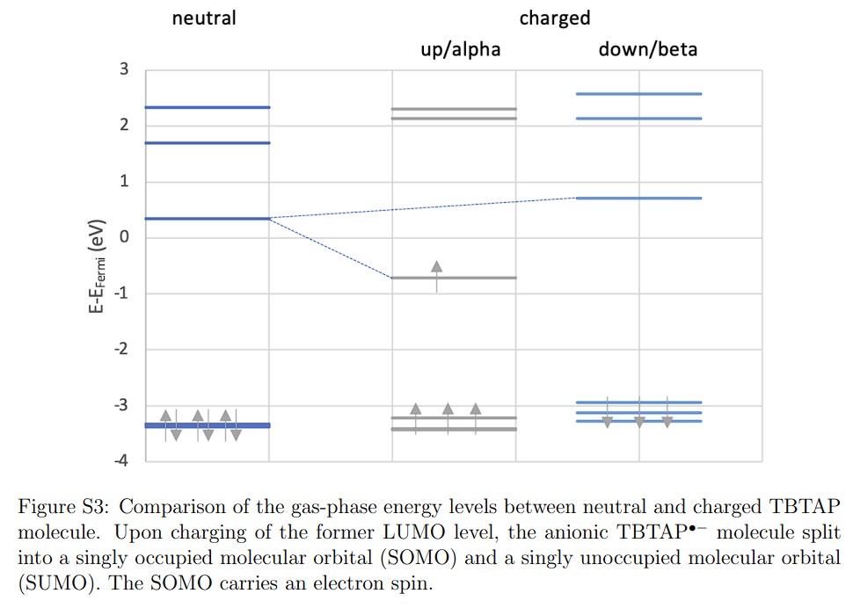

Slide 13
