Slide 1
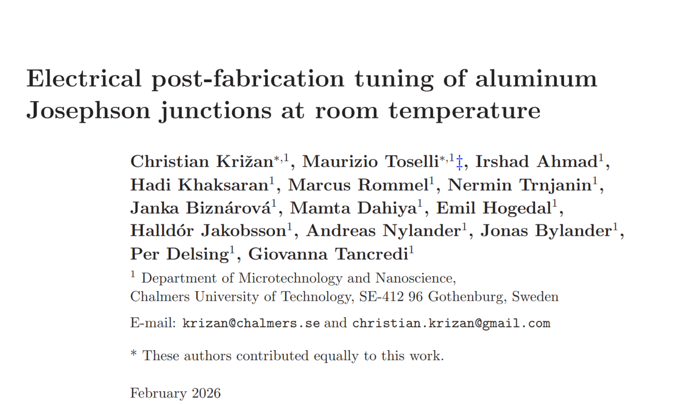
Journal Club
Presenter: Maryam Taghilou
Date: 18.06.2026

Slide 2
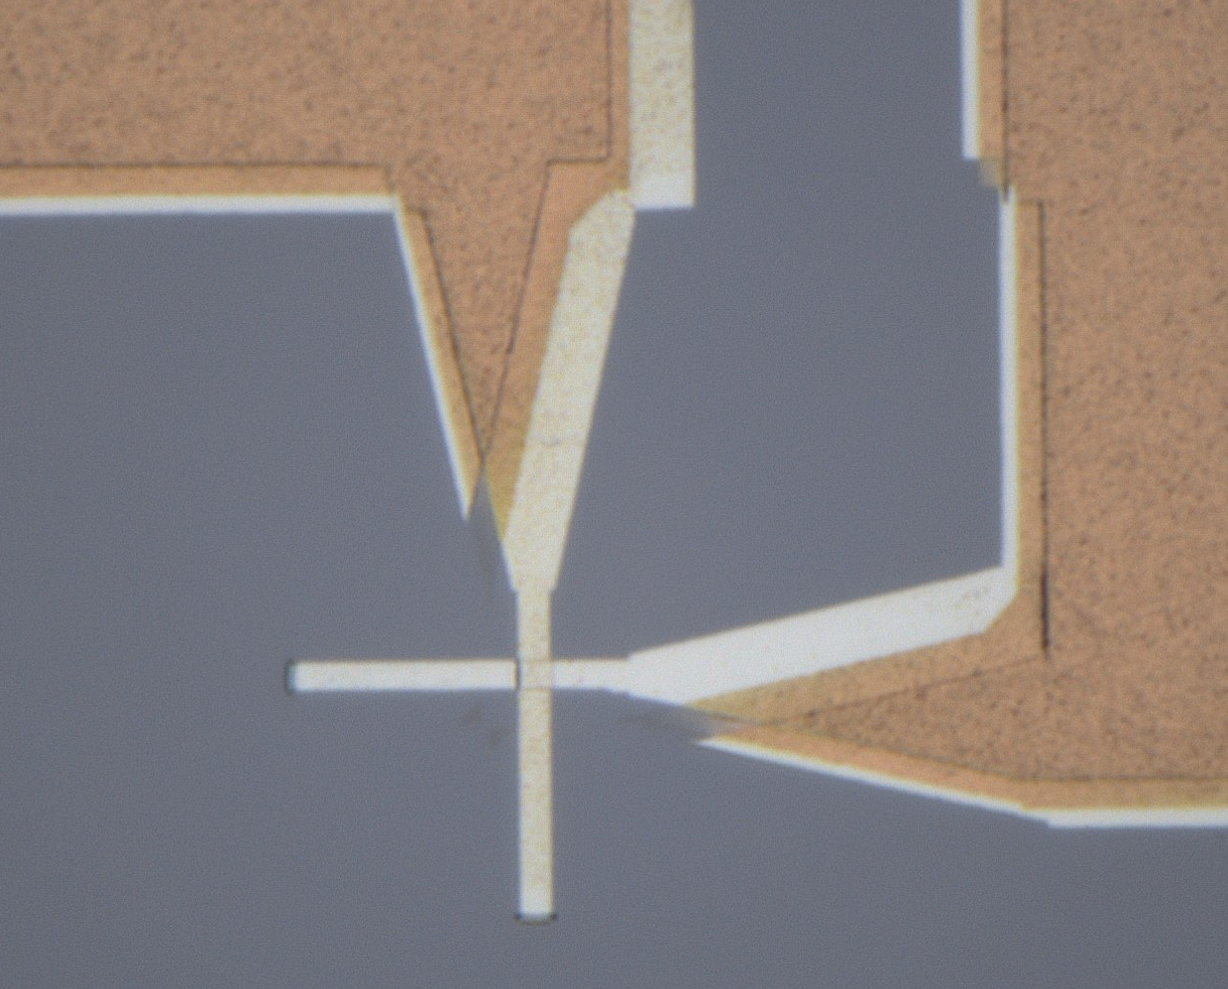
Tunnel junction applications
Josephson junctions
Thermometers
SIS
Normal and hybrid junctions: NIN / NIS
• Superconducting qubits
• SQUIDs
• CBTs
• Shot-noise thermometers
• NIS thermometer
Detectors
Electronic coolers
Hybrid junctions: NIS / SIS
NIS junctions
• bolometers
• Selective extraction of hot electrons

Slide 3
Junction paramter manipulation
Fabrication-stage control
Design parameters such as junction area
Oxidation time
Temperature: Annealing or cooling down during fabrication
Post-fabrication manipulation
Annealing: heating, Laser, Ebeam
Alternating bias assisted annealing (ABAA)

Slide 4
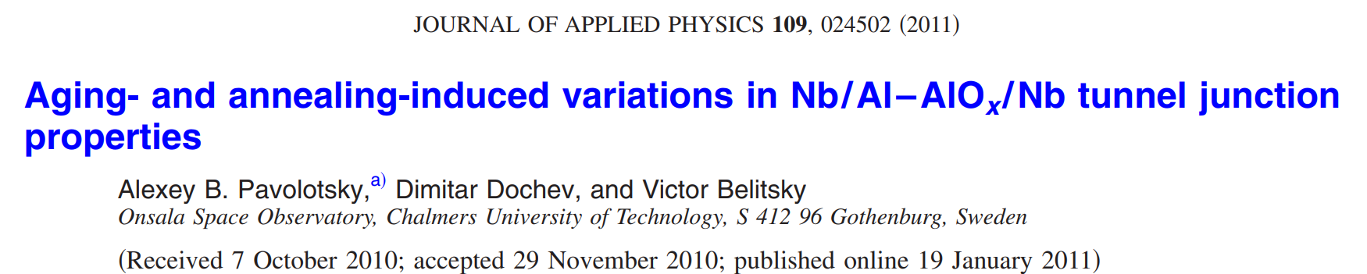
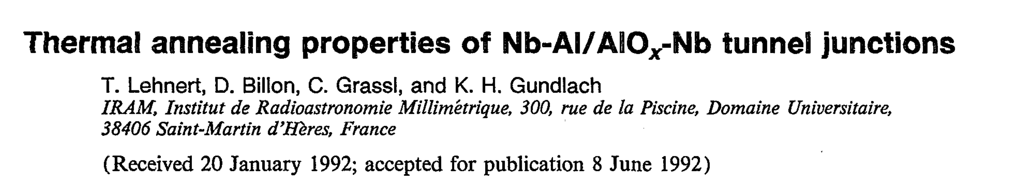
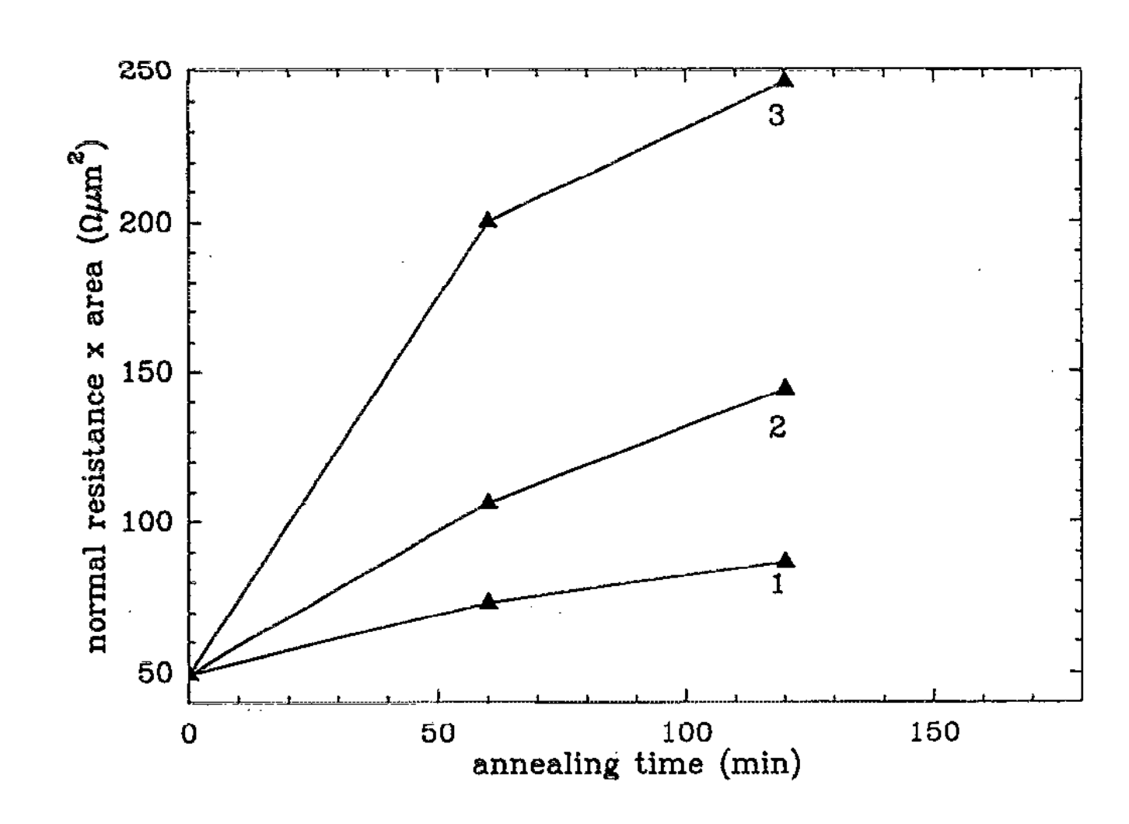
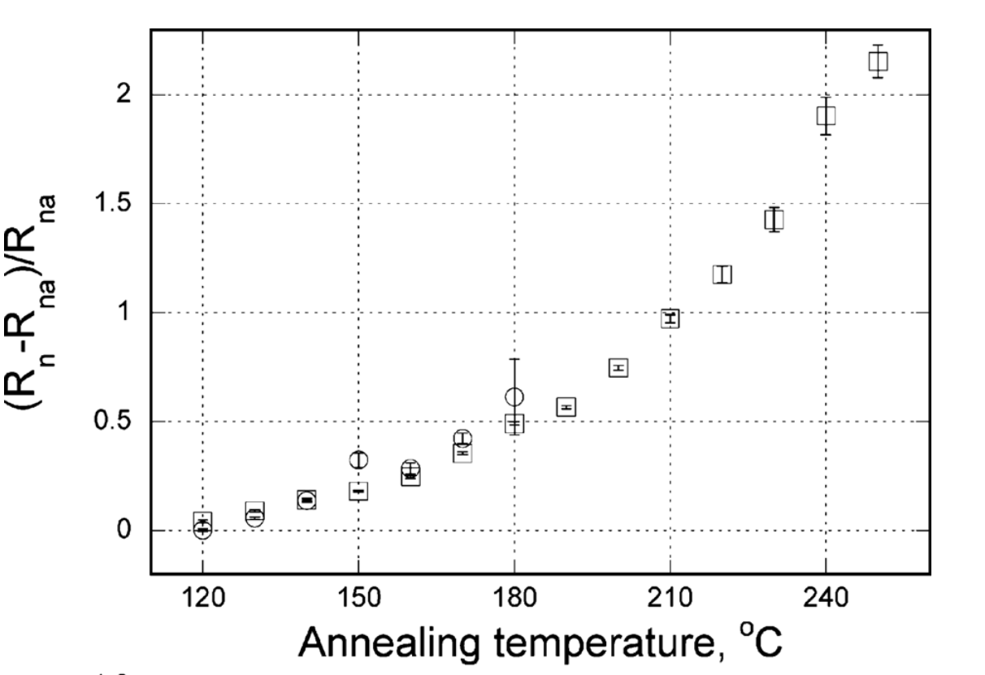
Examples of Manipulation using Anealing:
240C
220C
200C
Nb/Al–AlOx /Nb
130nm/10nm/30nm
Oxidation time: 1h
Junction Area: 4 um2
Nb 200 nm/Al 7 nm–AlOx15 mins /Nb 100nm.
Annealing for 1 hour.
Area: 2-3 um2

Slide 5
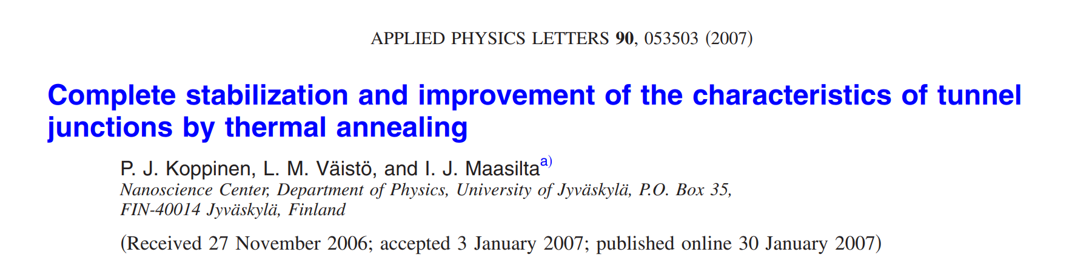
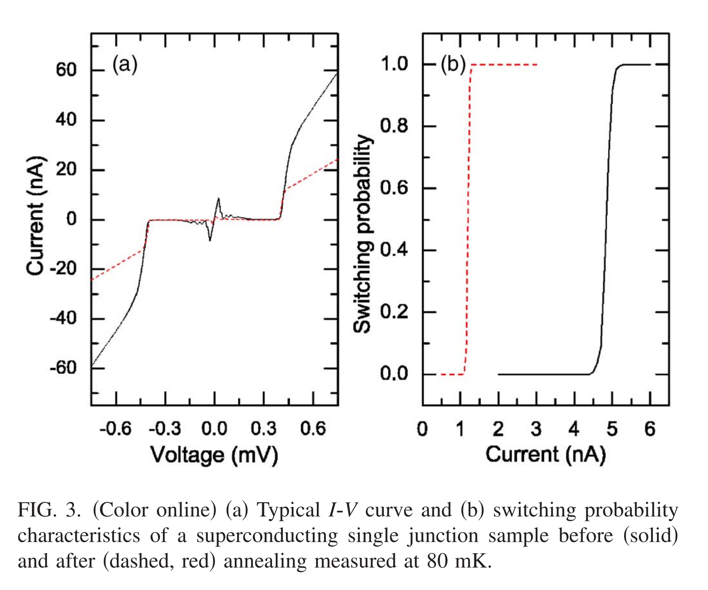
Al 55nm–AlOx(thermally grown in situ in pure oxygen at 0.2–0.5 mbar for 3–5 min)–Al samples were annealed between 350 and 450 °C.
junction area of 0.05 or 0.15 um2 . 1 to 100 kohm. increased 1.5–3 times . supercurrent is reduced in accordance with the increase of tunneling resistance.

Slide 6
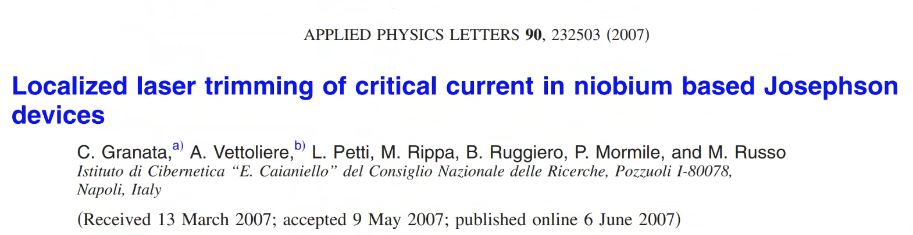
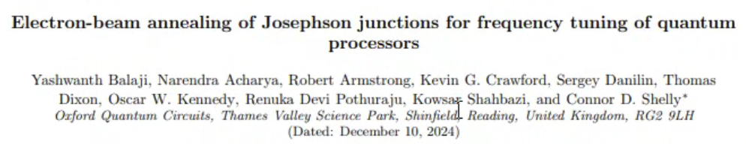
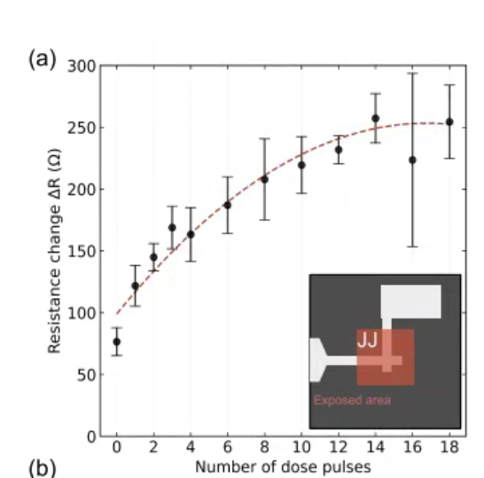
Jun:150×600 nm2,0.1 mbar,oxidation,Al.AlOx.Al 15/45nm
Dose: 50 uC/cm2, Right field: 0.25 um2
Increasing resistance up to 60% from 13.6 to 21.6 $Ω$
focused Ar+ laser beam , A thermographic imaging allows controlling the temperature distribution
30 s at T=170 °C reduction of 40% of the critical current Ic going from 120 to 70 A. 13.6 to 21.6 ohm.
The Josephson junctions are window-type with an area of 4*4 um2 and separated by 14 m. A beam spot of 30u m
2.22*10ˆ5 W/cm2 ,landa= 500 nm
reduceing the resistance spread 3.11 % to 1.48 %

Slide 7
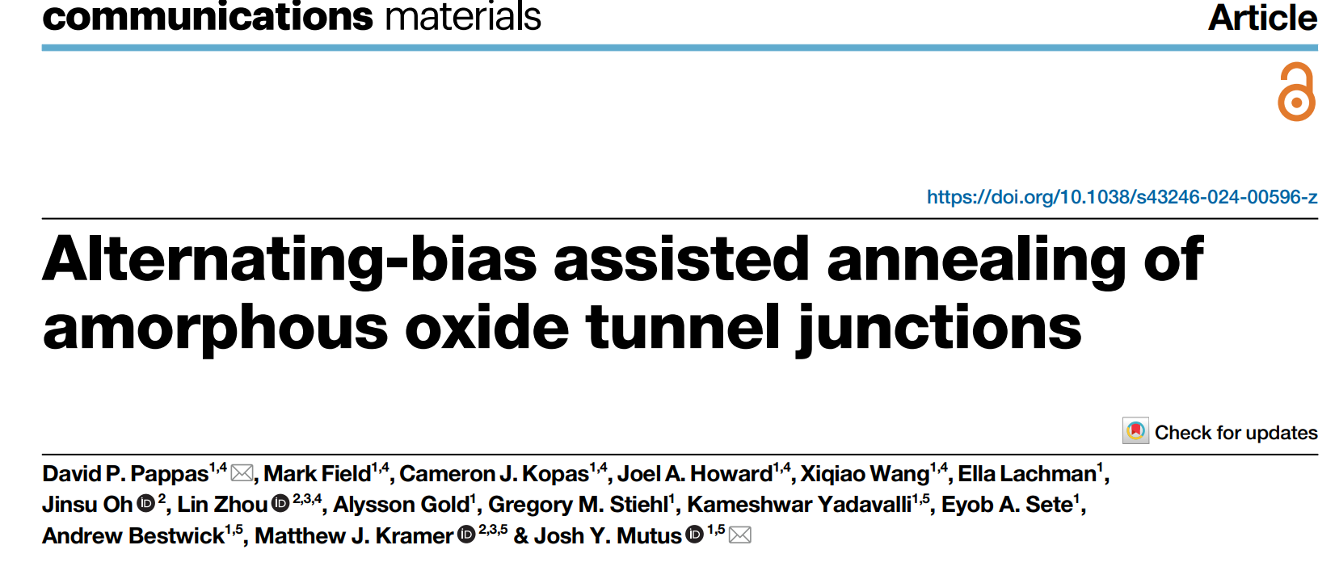
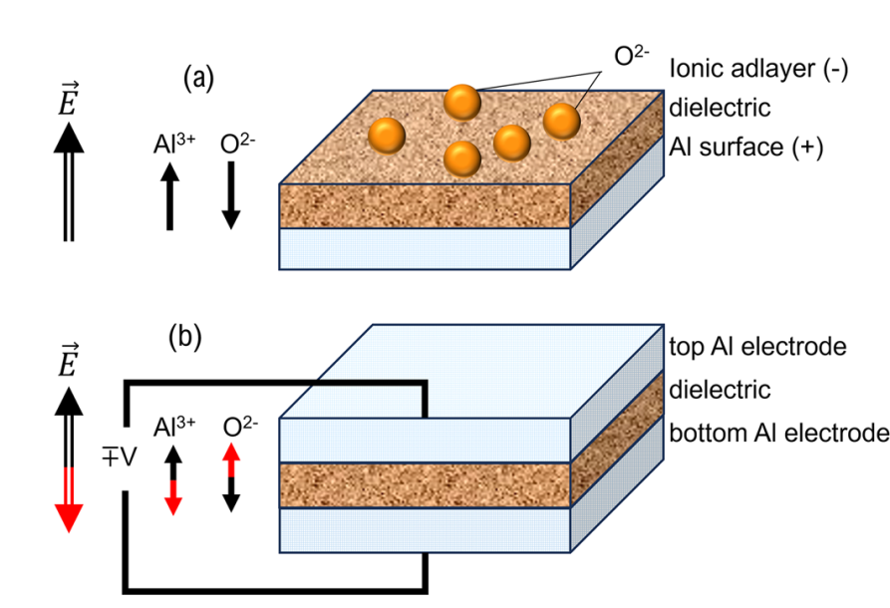
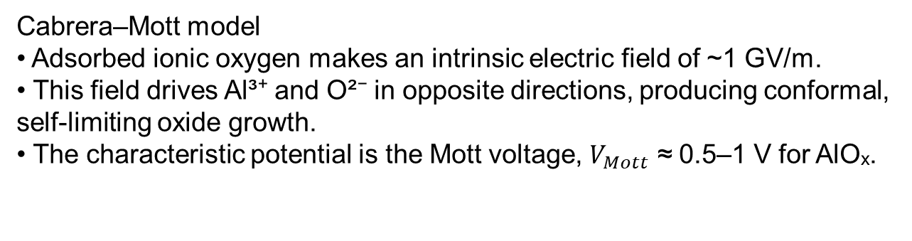
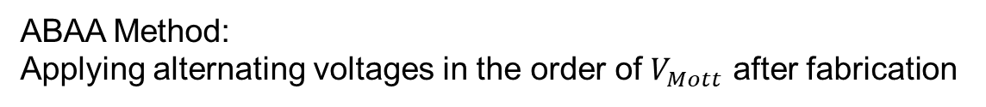
Cabrera–Mott model
• Adsorbed ionic oxygen makes an intrinsic electric field of ~1 GV/m.
• This field drives Al³⁺ and O²⁻ in opposite directions, producing conformal, self-limiting oxide growth.
• The characteristic potential is the Mott voltage, $V_{Mott}$ ≈ 0.5–1 V for AlOₓ.
ABAA Method:
Applying alternating voltages in the order of $V_{Mott}$ after fabrication

Slide 8
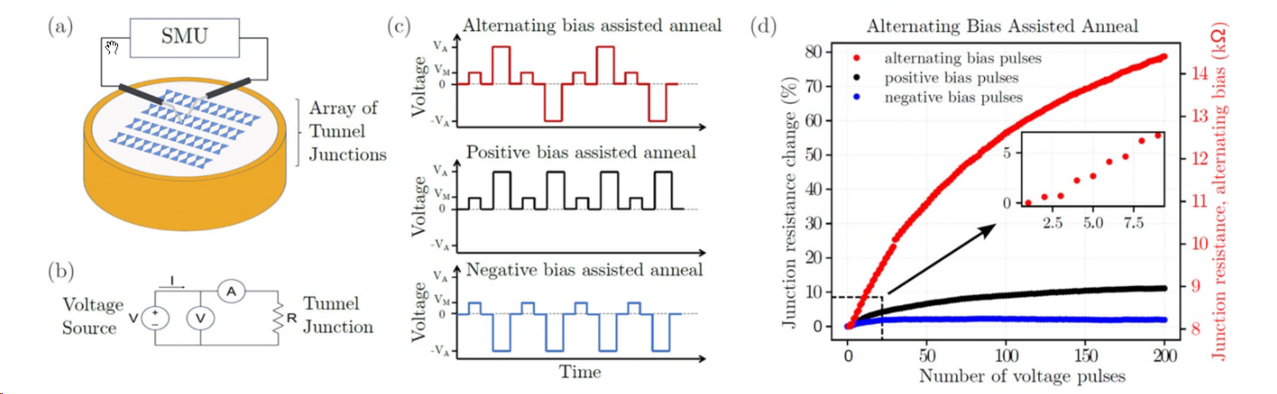
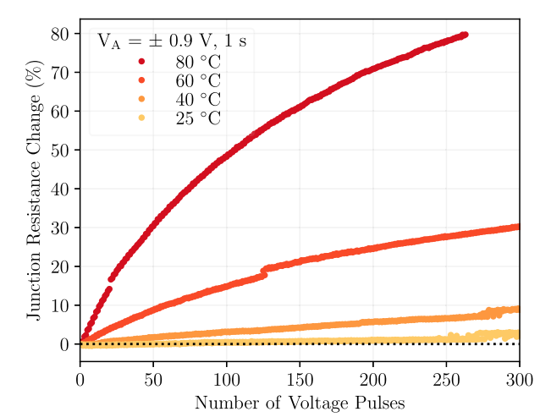
Resistance Manipulation
Voltage Pulses +-
Annealing at 80C gives maximum R change
Vm=0.9 V, 1s
VA=10 mV 0.5 s
R= 10 kohm
Areaj= 1.5*0.2 um^2

Slide 9
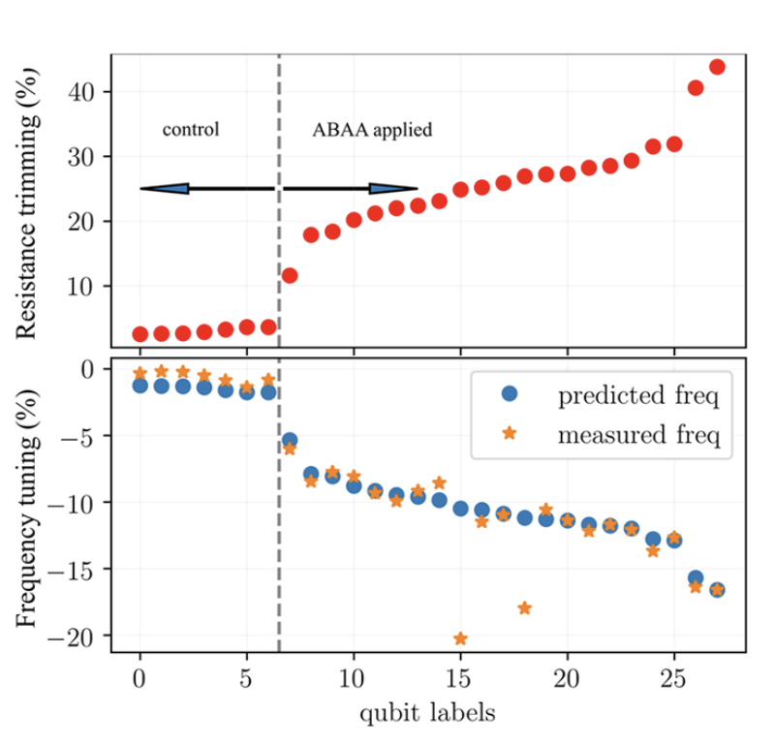
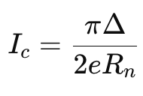
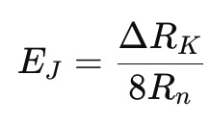
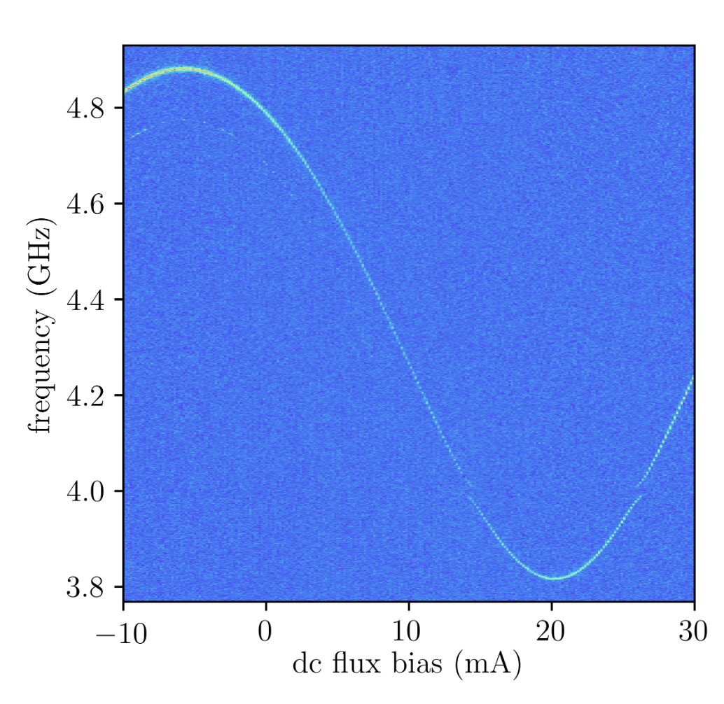
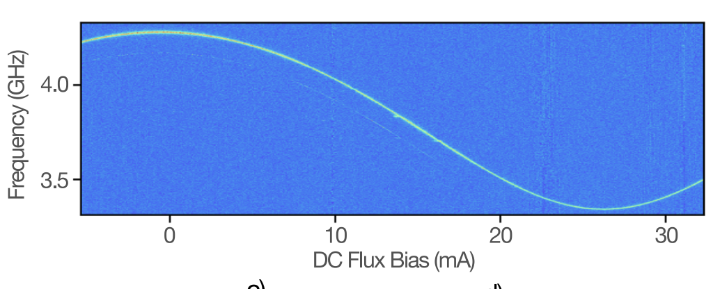
Manipulation of Transmon Qubit Frequency
Manupulation of
Transmon Qubit Frequency
Tunability of Qubit frequency
Absence of TLS coupling in ABAA treated samples
no ABAA
No TLS coupling with Transmon
ABAA
Ic: 20 to 30 nA

Slide 10
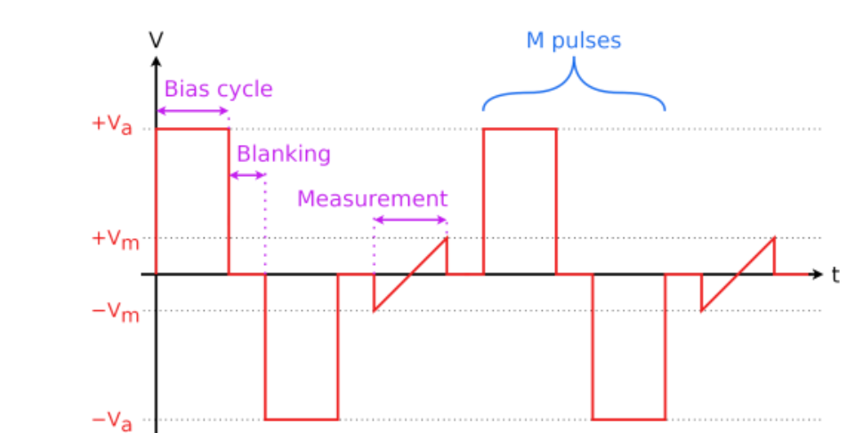
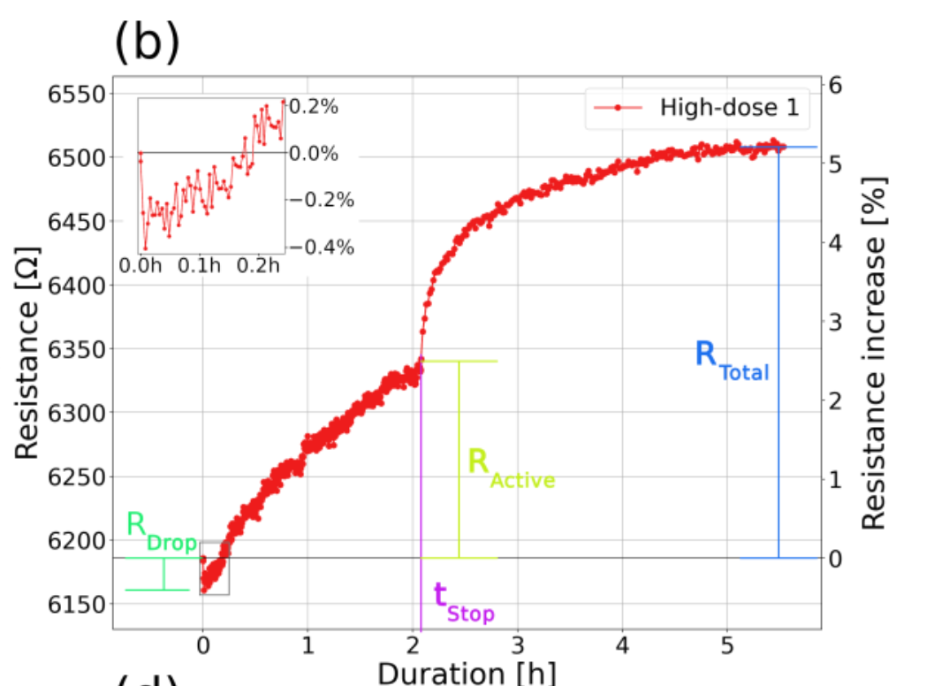
Manipulation Protocol
Initial Resistance drop
Resistance grows with pulsing
Logarithmic R growth after pulsing is stopped
150 nm*600 nm

Slide 11
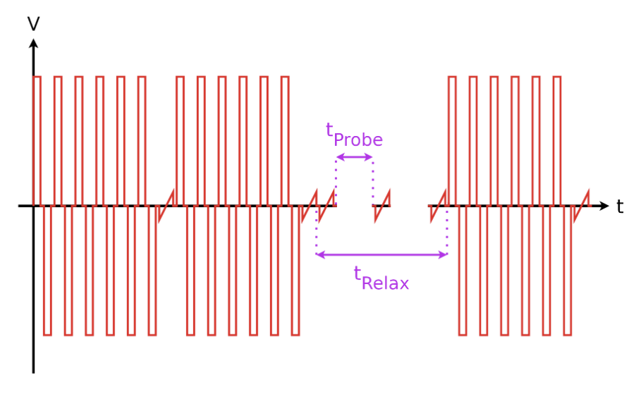
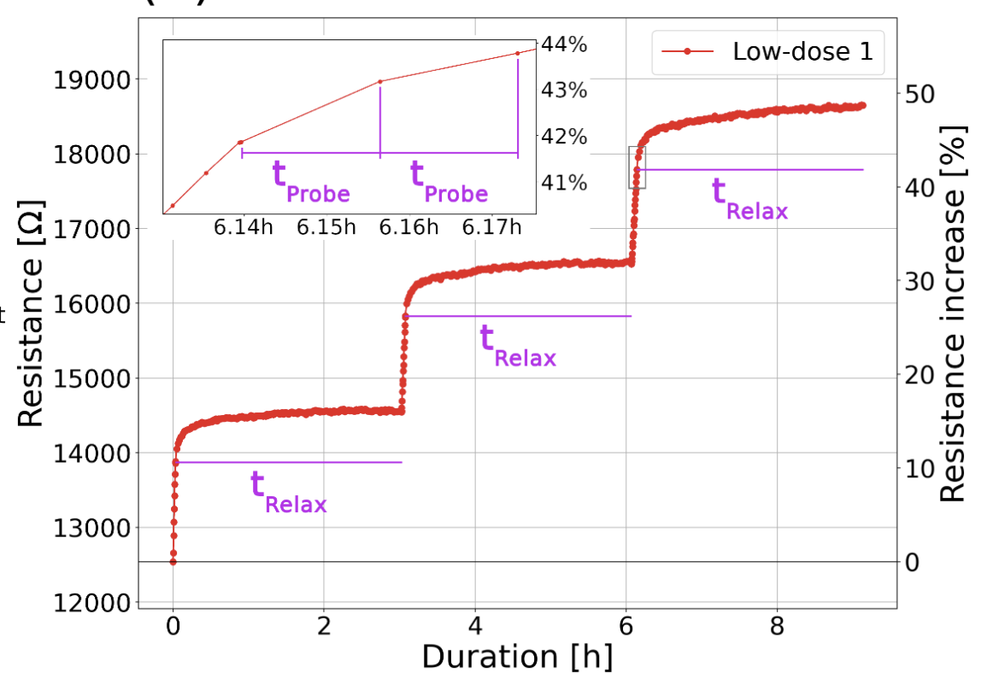
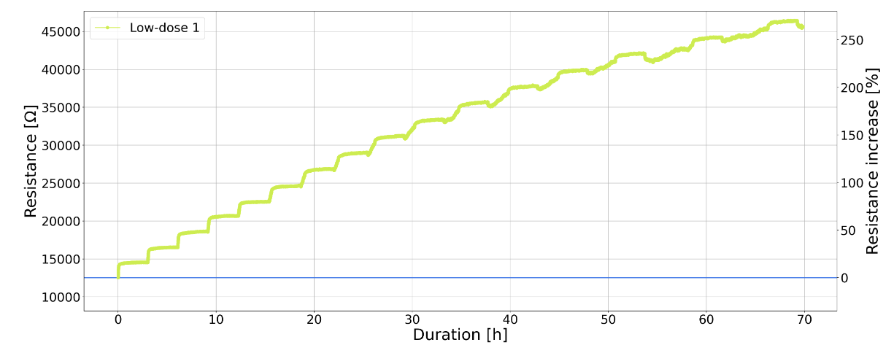
Voltage-Pulse Manipulation and Resistance Drift
Applying train of pulses
No pulse during t_Relax
Resistance increase up to 270%
270% corresponds to 2 GHz
Blank t: 100ms, palse t: 200 ms, measure t: 20 ms

Slide 12
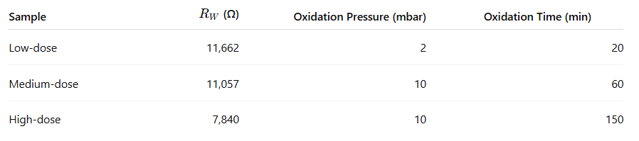
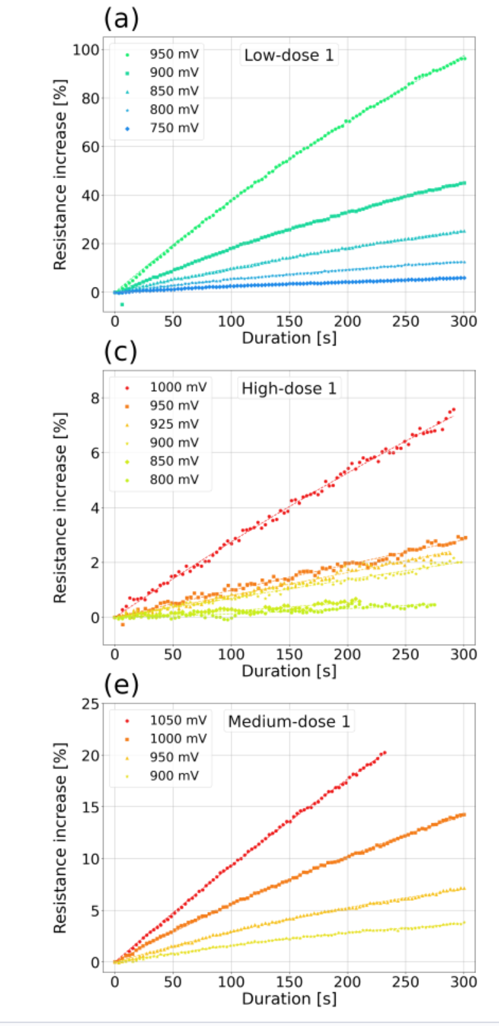
Effect of Oxidation Dose on Resistance increase
Three different junctions
Lower oxidation dose→ max manipulation

Slide 13
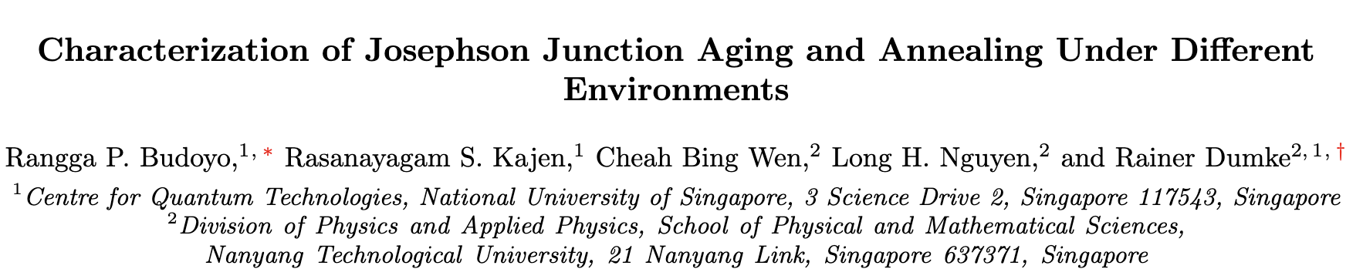
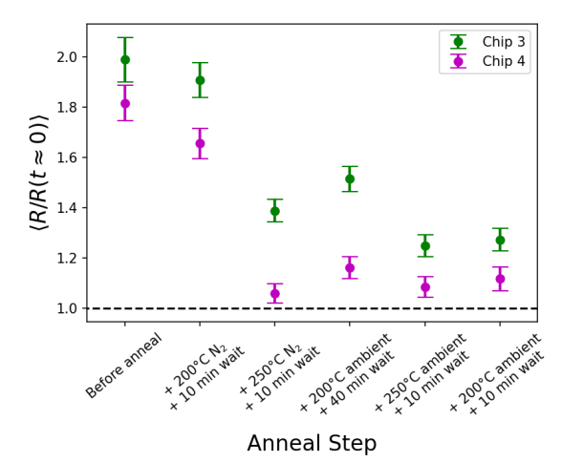
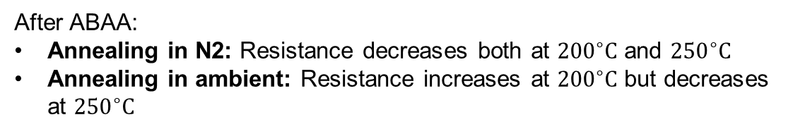
How to decrease the resistance after ABAA?
After ABAA:
Annealing in N2: Resistance decreases both at ${200}^{∘}C$ and ${250}^{∘}C$
Annealing in ambient: Resistance increases at ${200}^{∘}C$ but decreases at ${250}^{∘}C$

Slide 14
Summary
Effect of ABAA on junctions with different oxidation dose
Max change (270%) → minimum oxidation dose
Annealing in N2 reverses the resistance change after ABAA
Thank you for your attention

Slide 15
Appendix

Slide 16
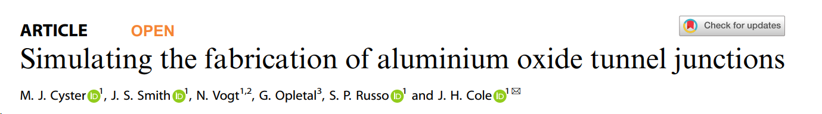
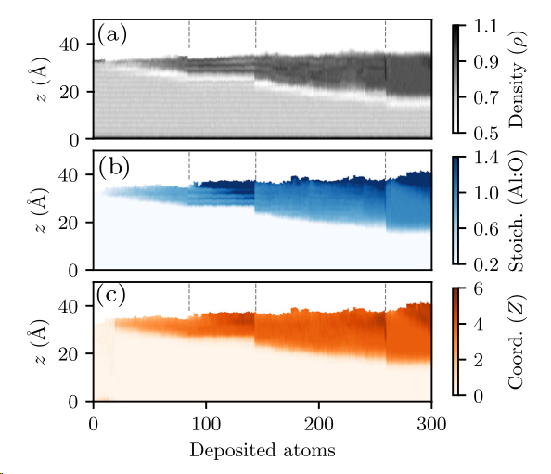
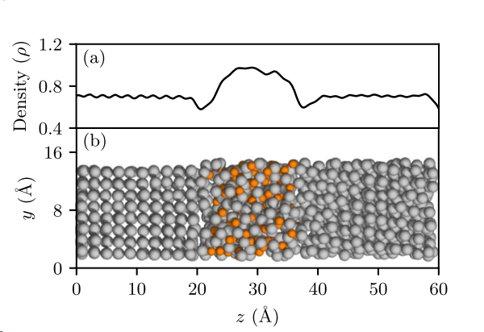

Slide 17
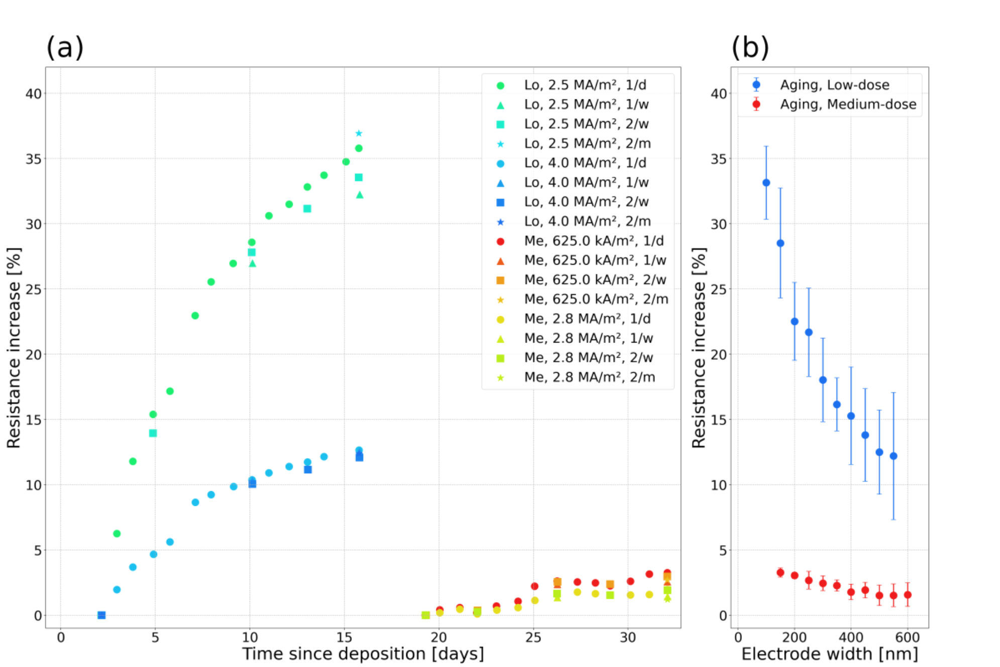

Slide 18
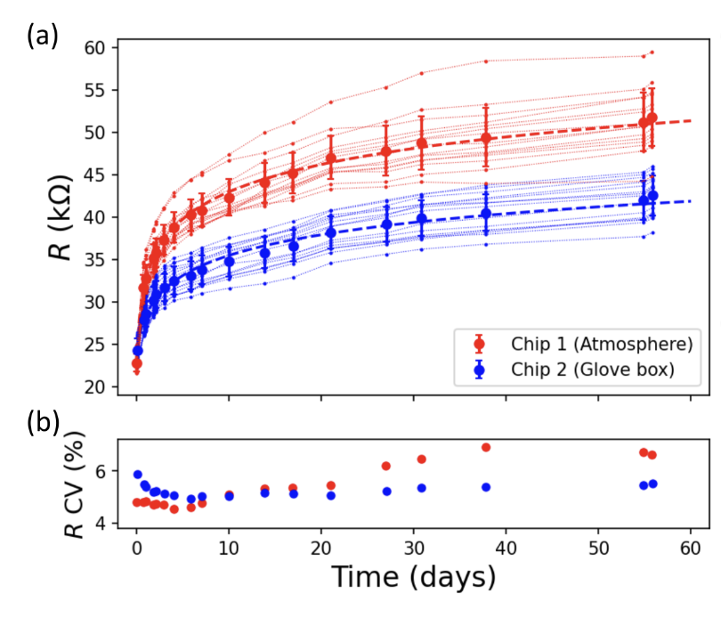
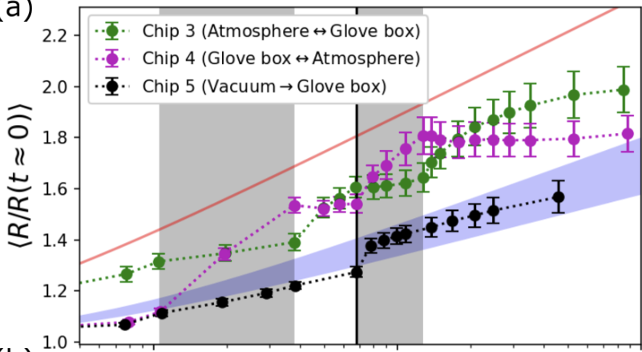


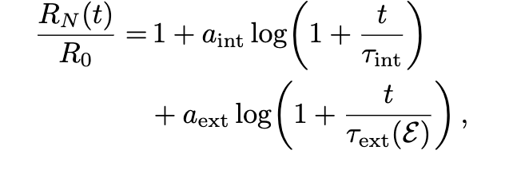
Aging Effect in Different environments:
two coupled “reservoirs”: an internal reservoir and an external reservoir

