Slide 1

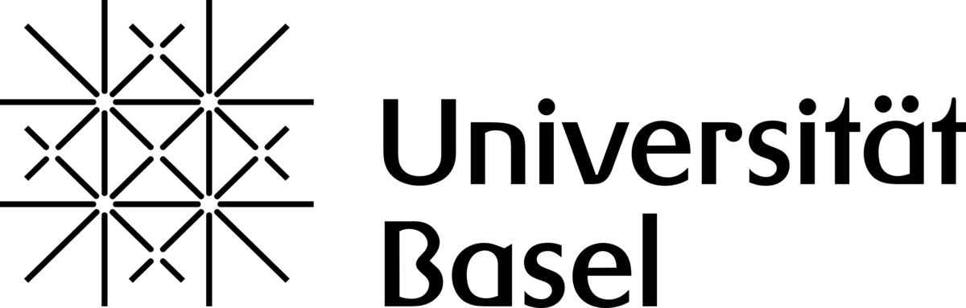
When Valley and Spin Physics met together
(Almost) a Journal Club
Speaker: Artemii Efimov
17 April 2026

Slide 2

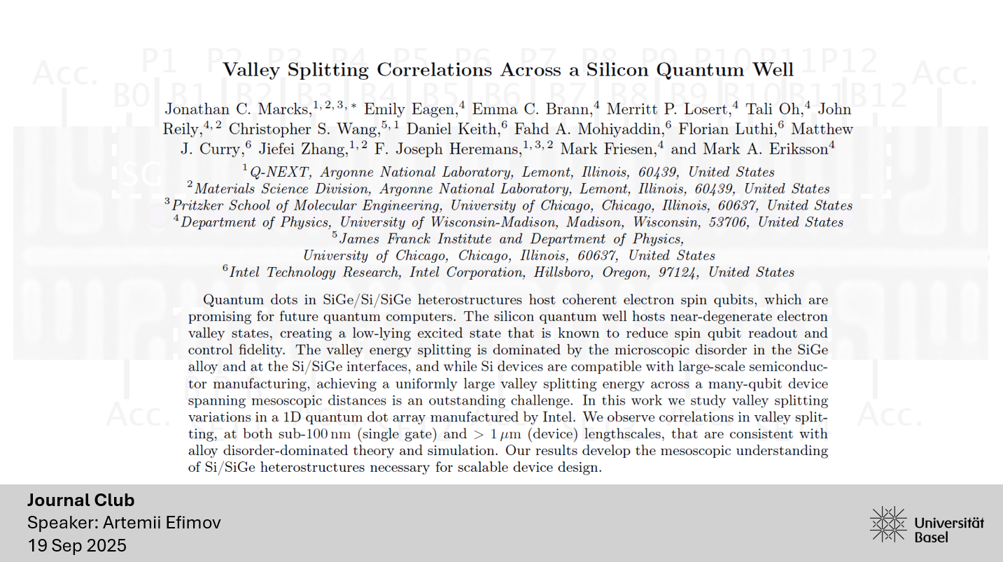

Slide 3
Valleys: INTRO
Tensile strain and spatial quantization:
Lattice mismatch of Si with SiGe
Vertical electric field + mass anisotropy in Si/SiO2
sharp disruptions of the periodic crystal potential at the QW interfaces:
Random distribution of Ge atoms in SiGe*
Interface sharpness&disorder of Si/SiO2 interface
4x
Energy
6-fold degenerate
CB minimum
Bulk
2x
Valley splitting

Slide 4
Valleys: INTRO
High valleys-low valleys: ∼20–200 meV (Si/SiGe), 20-40meV (Si-MOS)
Orbital level spacings in a quantum dot
(∼1–10 meV, but depends on dot size)
Valley splitting ΔEv (∼0.01–1 meV)
Zeeman splittings (∼0.01–0.1 meV at Tesla-scale fields)
Energy
6-fold degenerate
CB minimum
Bulk
Valley splitting
P. Weitz, R. J. Haug, K. von Klitzing, and F. Schaffler, Surf. Sci. 361/362, 542 (1996).
Valley splitting theory of SiGe/Si/SiGe quantum wells
Mark Friesen1,*, Sucismita Chutia1, Charles Tahan2, and S. N. Coppersmith1 (PRB, 2007)

Slide 5


Slide 6
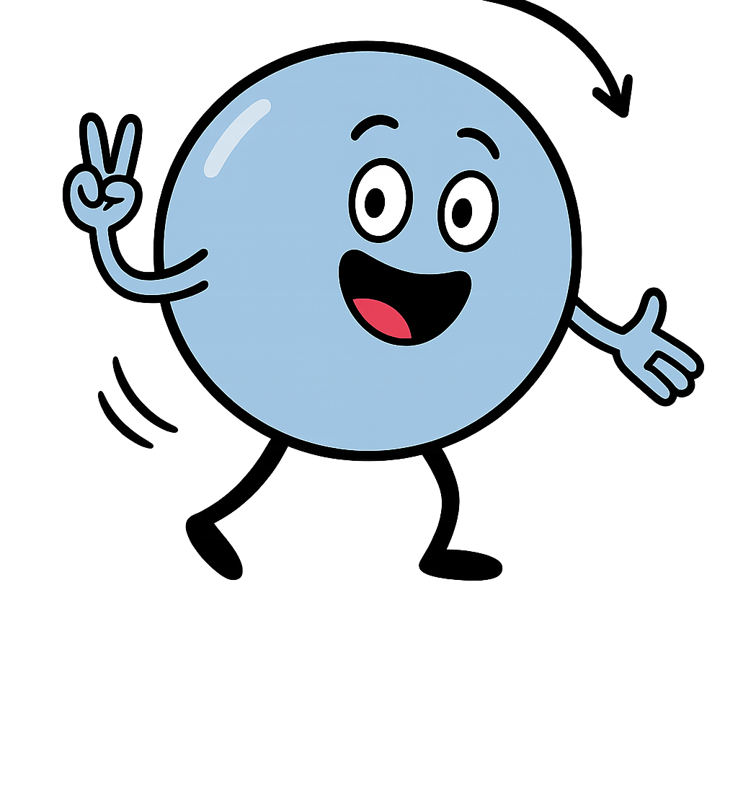
Connection
Musicality
Partnership
Turns
Patterns
Preps
…
Entanglement
Coherence
Fidelity
Flips
Gate operations
Initialization

Slide 7

Rhythm ⬄ Driving (aka Qubit Manipulation)

Slide 8



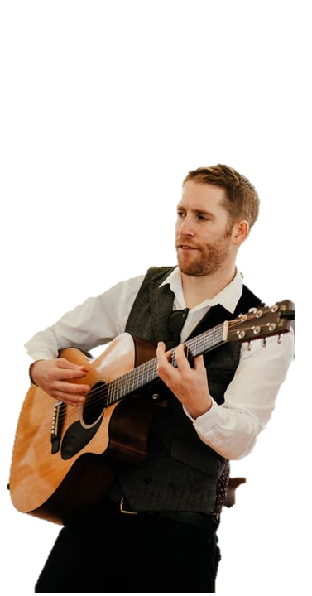

Slide 9
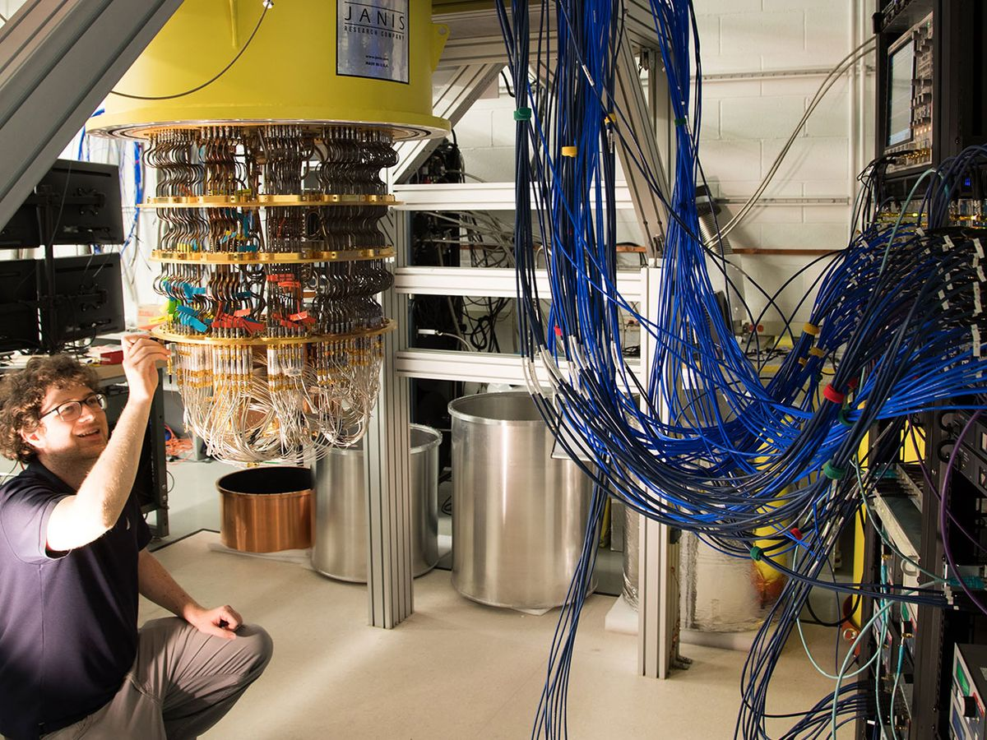
Many musicians ⬄ many RF lines in the fridge

Slide 10
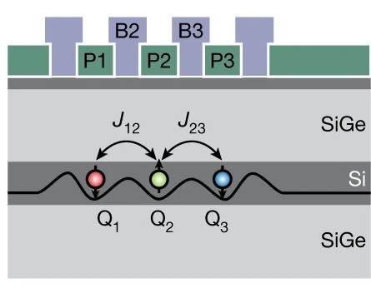
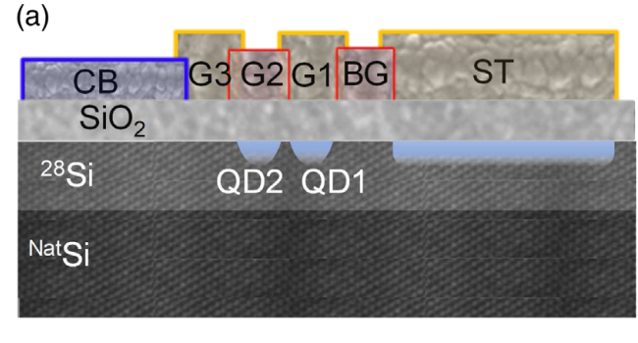
Example of a SI-MOS device
Example of a Si/SiGe device
Can be very small, here 5.9nm!
Larger valley splitting
CMOS compatible fabrication
Lower disorder => lower charge noise
Seems can be used in CMOS too!

Slide 11
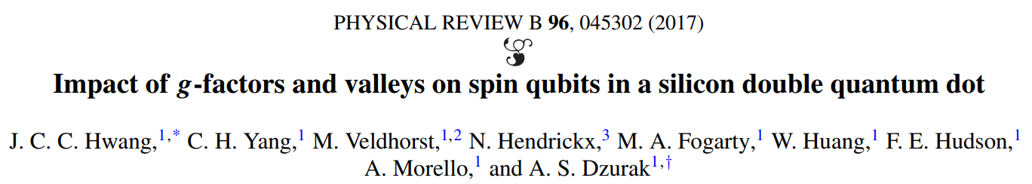
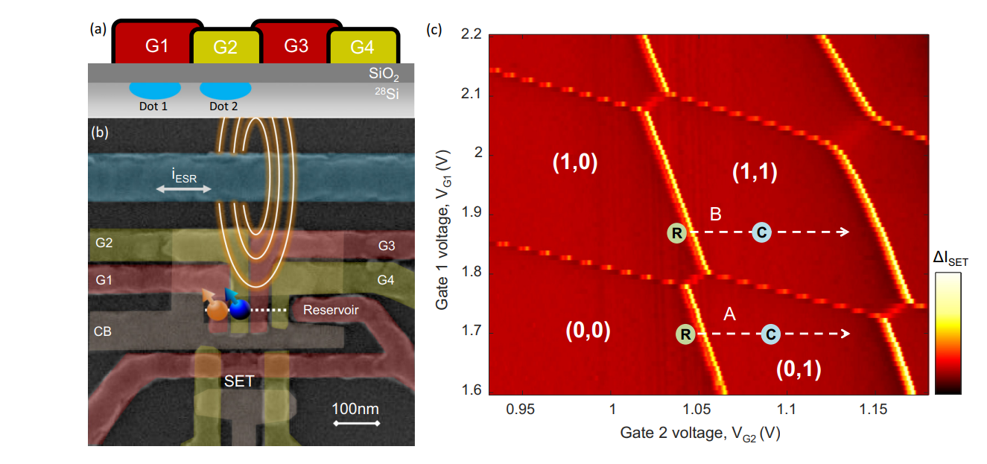
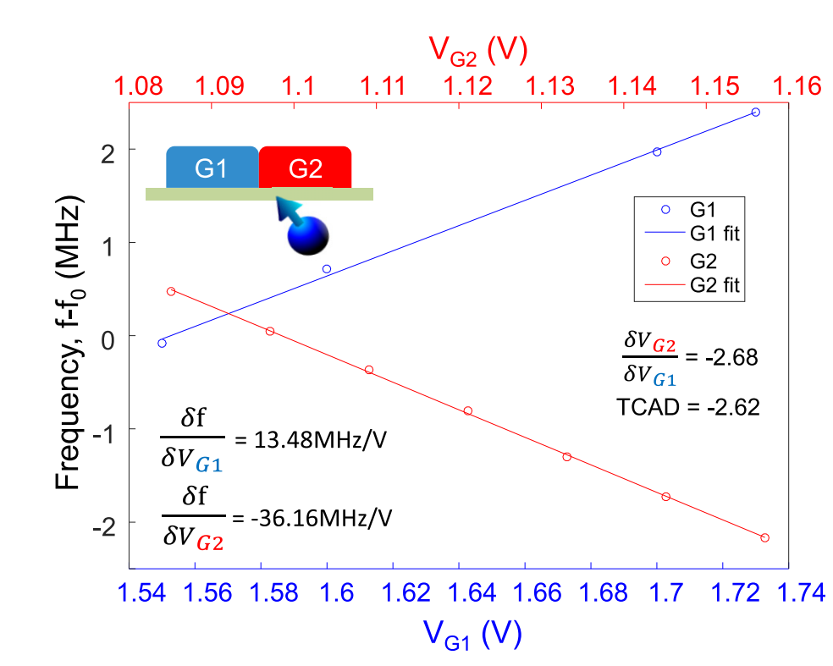
SPIN-VALLEY MIXING
Warning: Elzerman readout, not a Pauli spin blockade
“Regular” Stark Shift
$$E→wavefunction shape →SOI →g →f_{Larmor}$$

Slide 12
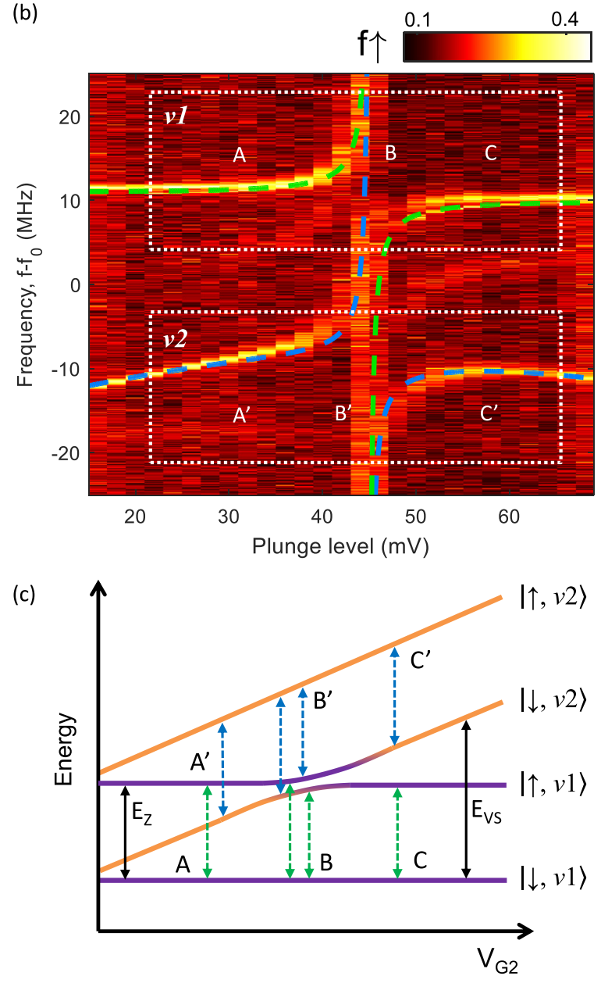
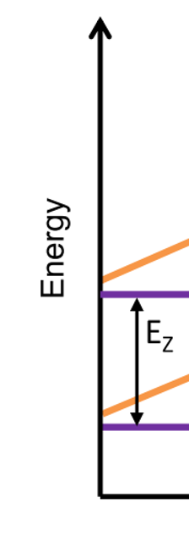
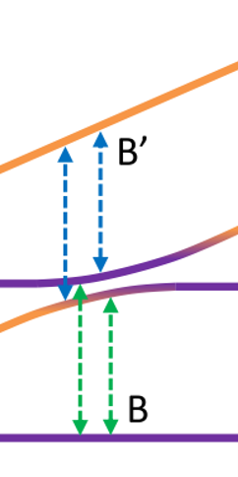
SPIN-VALLEY MIXING
Warning: Elzerman readout, not a Pauli spin blockade
Valley splitting at zero gate voltage

Slide 13
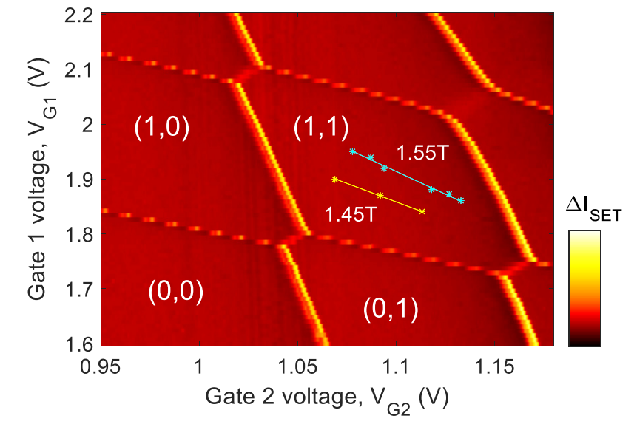

Anticrossing location across charge stability diagram
Valley voltage tunability
$$640 μeV/V$$

Slide 14
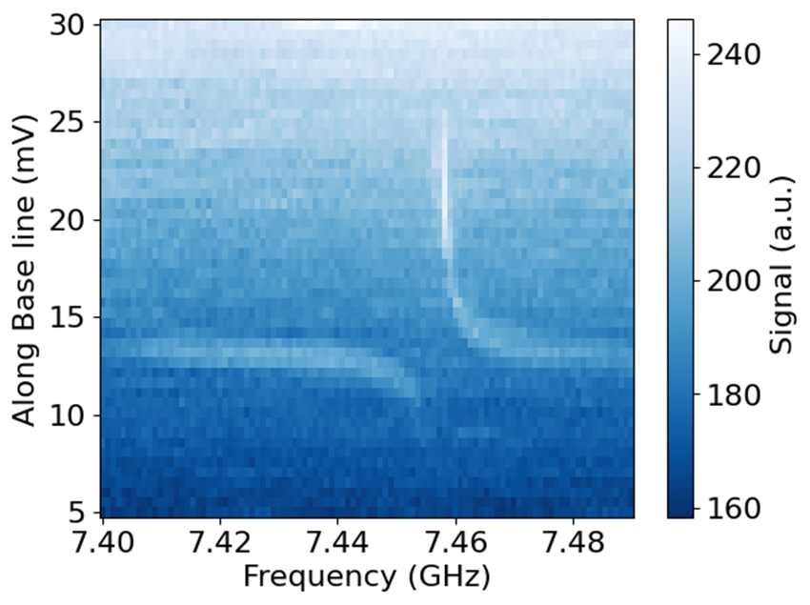
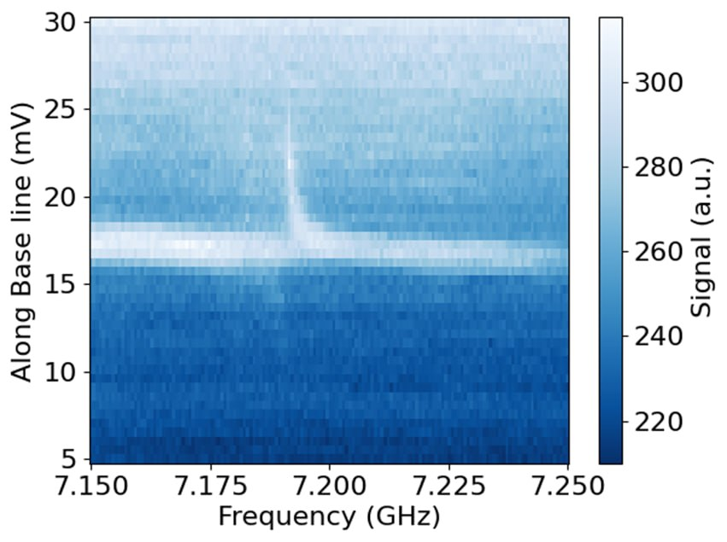
B || Bx
B || By

Slide 15
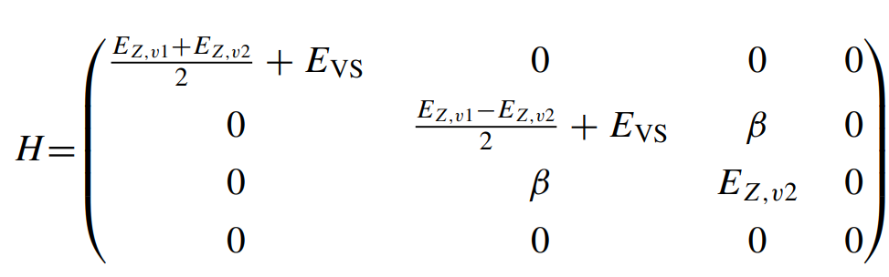
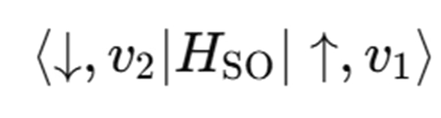

B || Bx
B || By
$$β=43 MHz$$
“intervalley SO coupling”

Slide 16
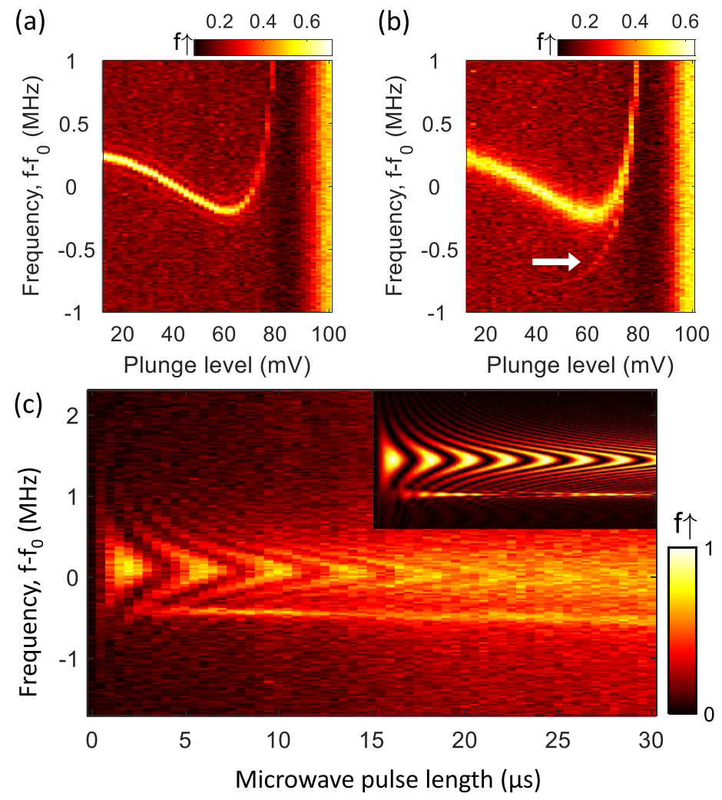
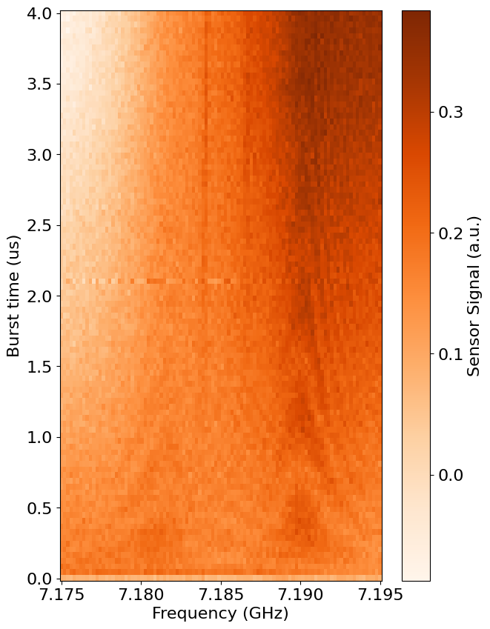

$$J=250kHz$$

Slide 17
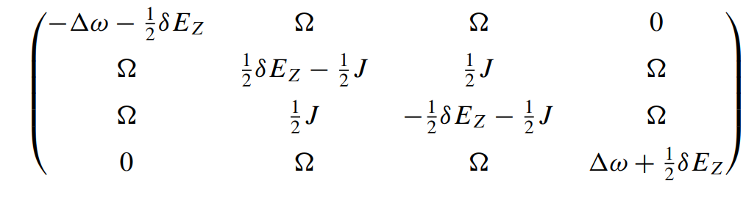
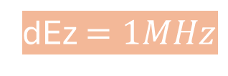
$$J=250kHz$$
dEz $=1MHz$

Slide 18
SPIN-VALLEY MIXING
Warning: Elzerman readout, not a Pauli spin blockade
B-field = ca. 1.45T
In conclusion, we have analyzed a spin qubit formed in a Si MOS double quantum dot system, where the qubit is weakly exchange coupled to a neighboring spin. The ESR spectrum shows an anticrossing in the resonance frequency that is consistent with an intervalley spin-orbit coupling, with a strength of 43 MHz. Previous qubit devices [14] reported a δEZ between two neighboring dots that varies between 20 and 40 MHz. The findings here also reveal a mechanism that can be exploited for qubit operations when the g-factor difference is 045302-4 IMPACT OF g-FACTORS AND VALLEYS ON SPIN . . . PHYSICAL REVIEW B 96, 045302 (2017) small, with our simulation result suggesting a δEZ of 1 MHz. This has allowed us to observe ESR-driven transitions between the T− and T+ state, which requires only the use of a single ESR pulse to simultaneously rotate two individual spins. This could be used in future to add flexibility to qubit operations in large-scale silicon quantum dot systems.

Slide 19
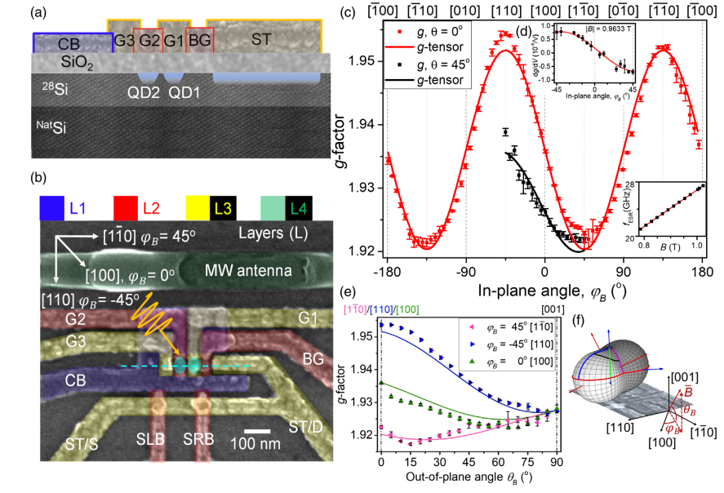
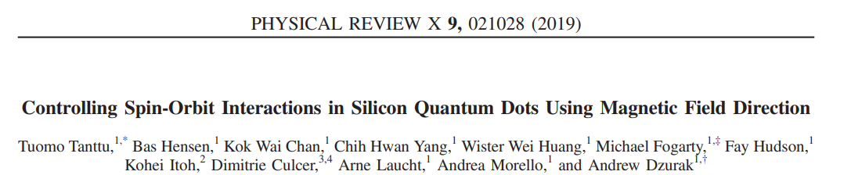
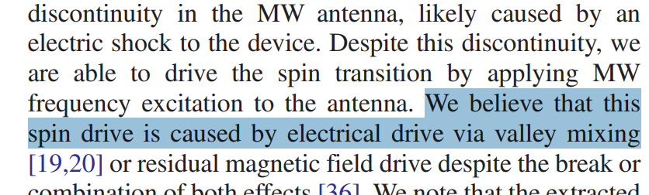

Slide 20
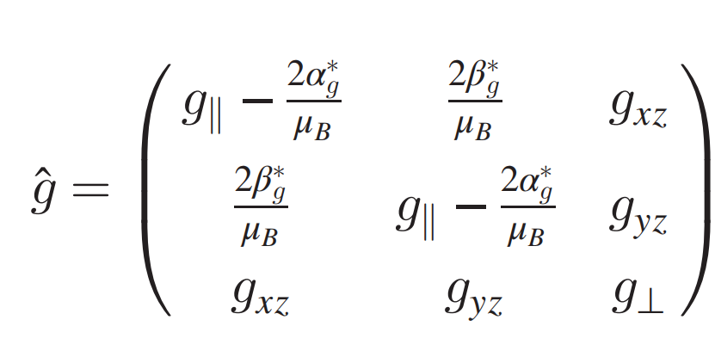
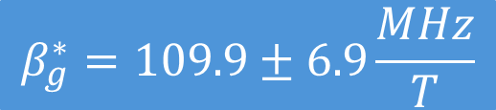
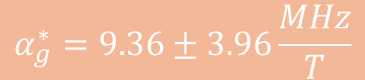
Rashba SOI (structural inversion asymmetry)
Dresselhaus SOI (bulk inversion asymmetry)
Interface inversion asymmetry SOI
Dresselhaus SOI
Rashba SOI
$$β_{g}^{∗}=109.9±6.9\frac{MHz}{T}$$
>
$$α_{g}^{∗}=9.36±3.96\frac{MHz}{T}$$
$$β=\left(178±11\right)∗{10}^{−13}eV cm$$
$$α_{g}=\left(15.2±6.4\right)∗{10}^{−13}eV cm$$

Slide 21
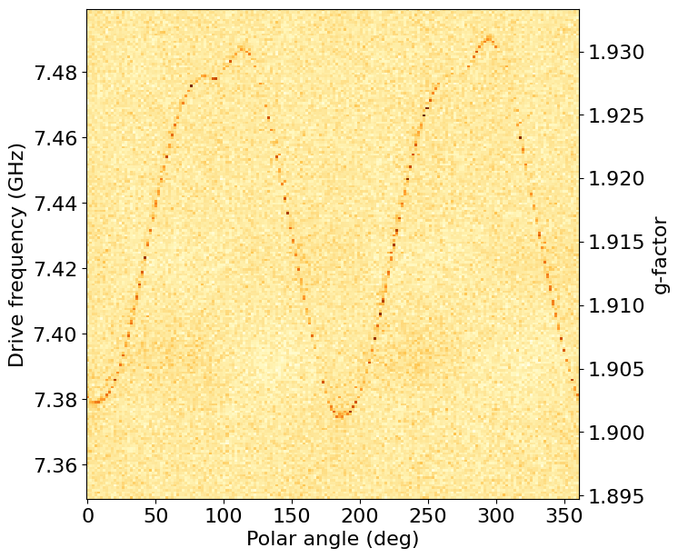
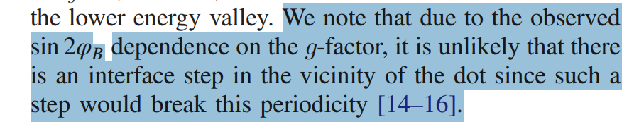
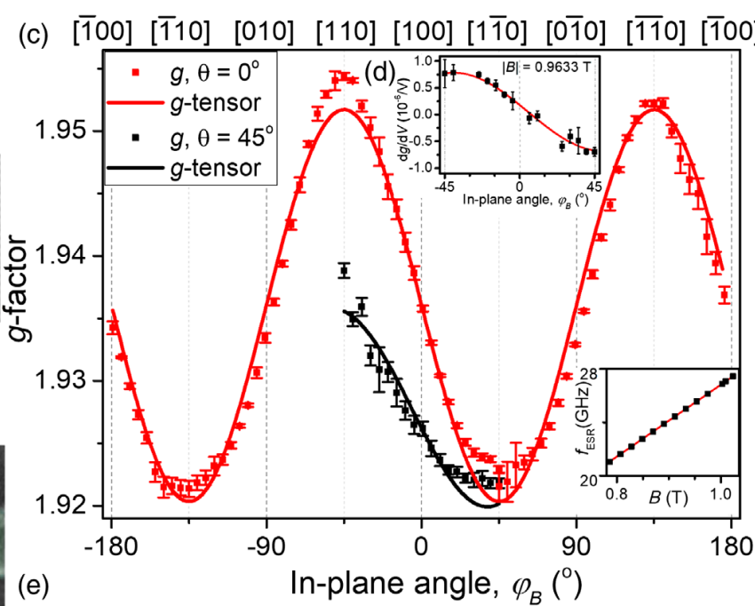
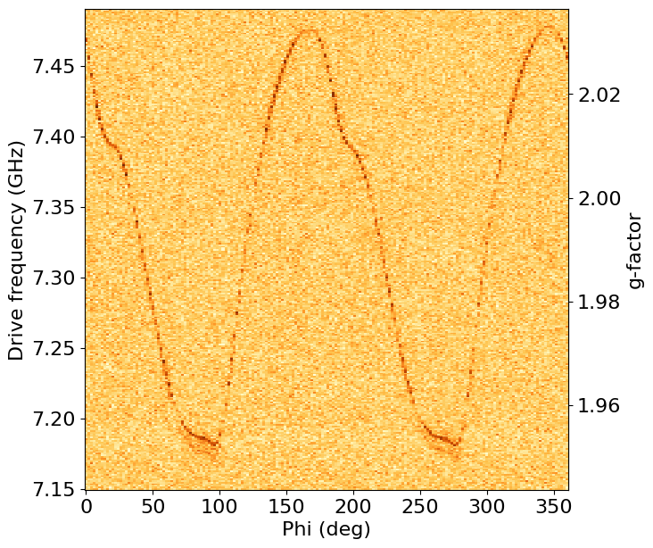

Slide 22
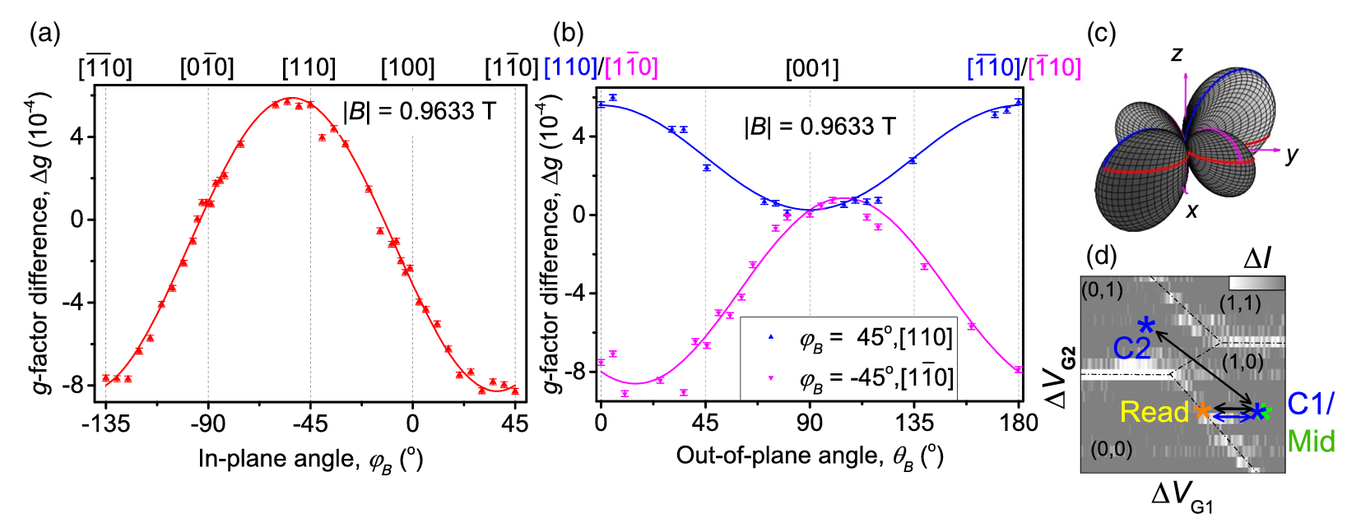

Slide 23
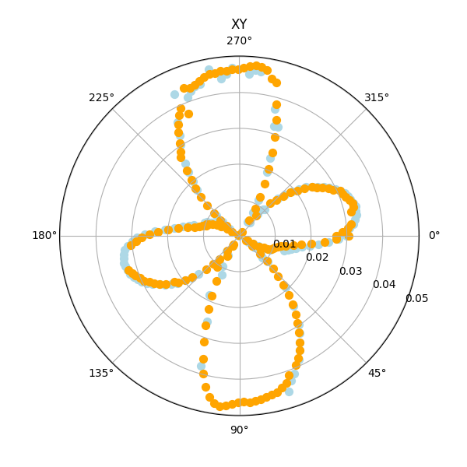
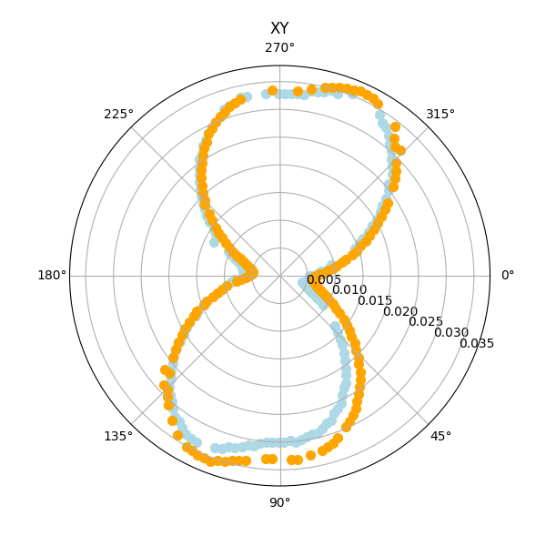
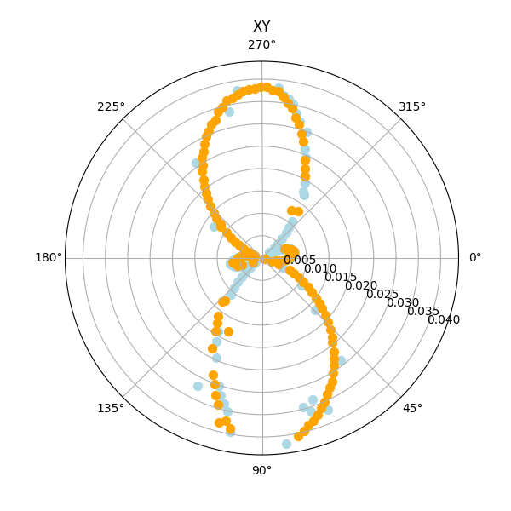
|g-2|
XY
XZ
YZ
Blue: 40-31 transition
Orange: 04-13 transition
23

Slide 24
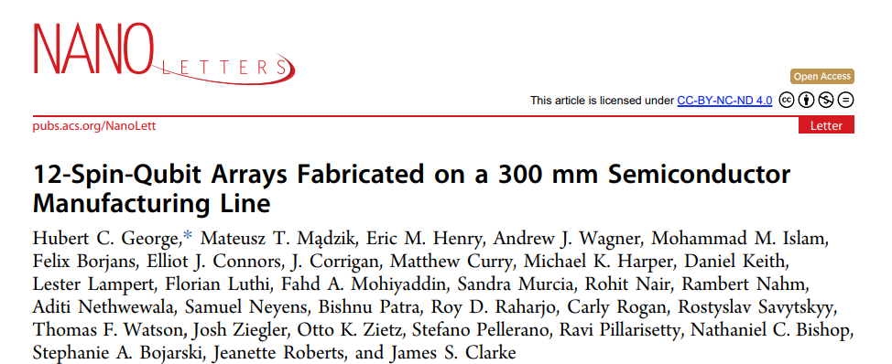
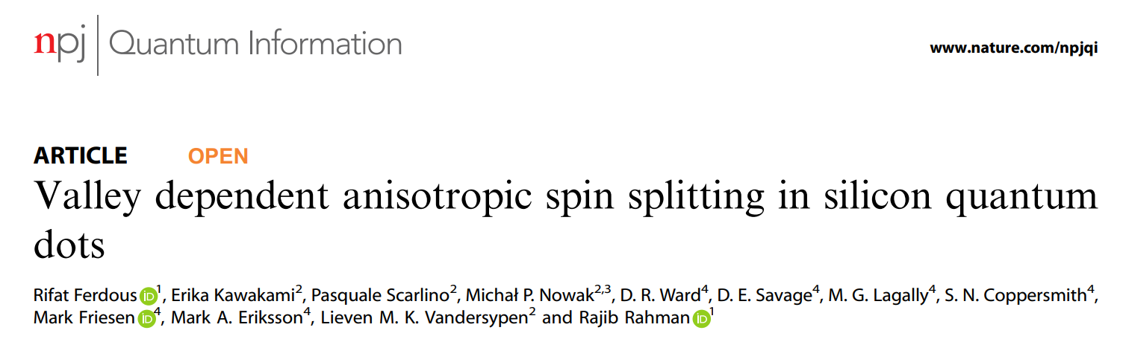
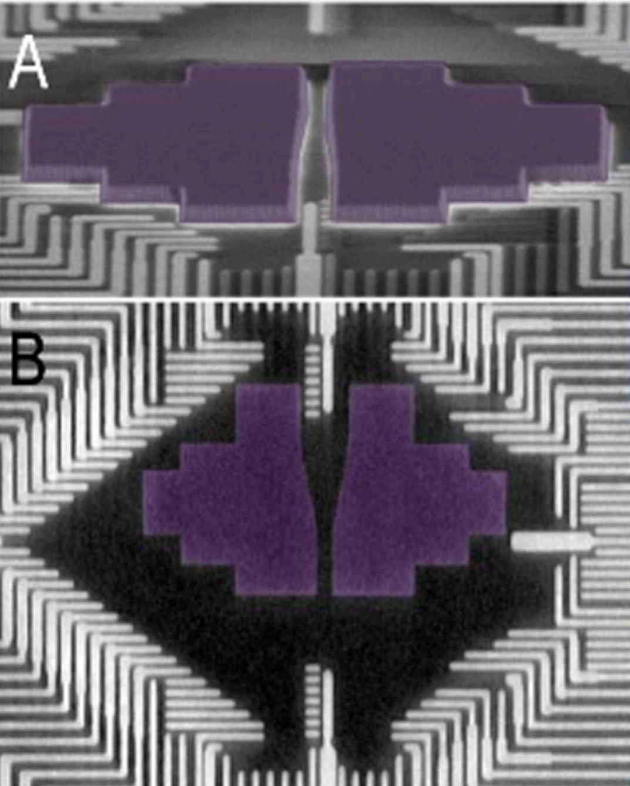
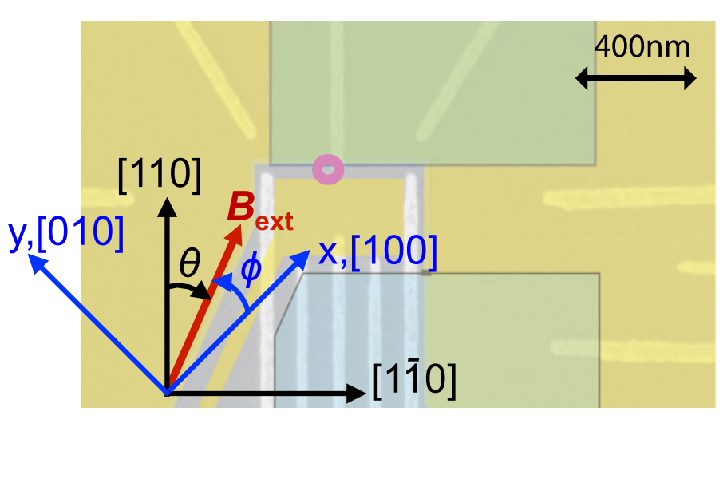

What if we bring a µ-magnet inside?
Si/SiGe!!
$$B=B_{ext}+B_{micro}^{θ}+ΔB^{θ}$$

Slide 25
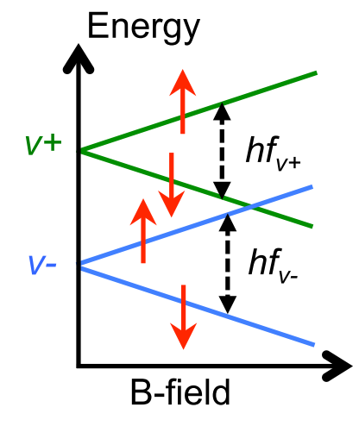
Working far above the anticrossing
Evs << Ez

Slide 26
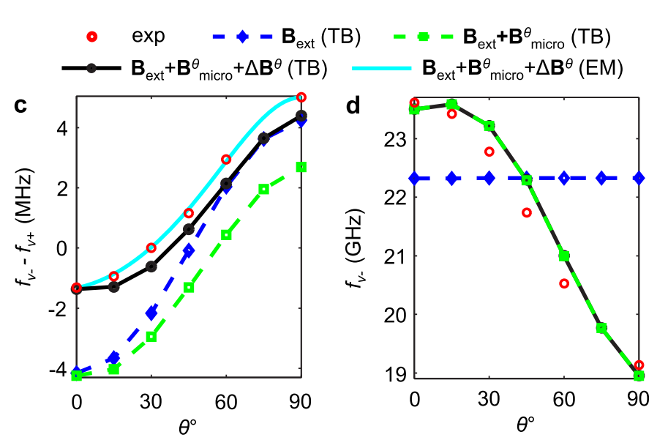


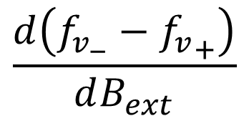

What if we bring a µ-magnet inside?
Si/SiGe!!
$$B=B_{ext}+B_{micro}^{θ}+ΔB^{θ}$$
$$f_{v_{−}}−{f_{v}}_{+}$$
Interface quality -> Device/Qubit dependency
$$B_{ext}=0.8 T$$
$$\frac{d\left(f_{v_{−}}−{f_{v}}_{+}\right)}{dB_{ext}}$$
SOI origin
26

Slide 27
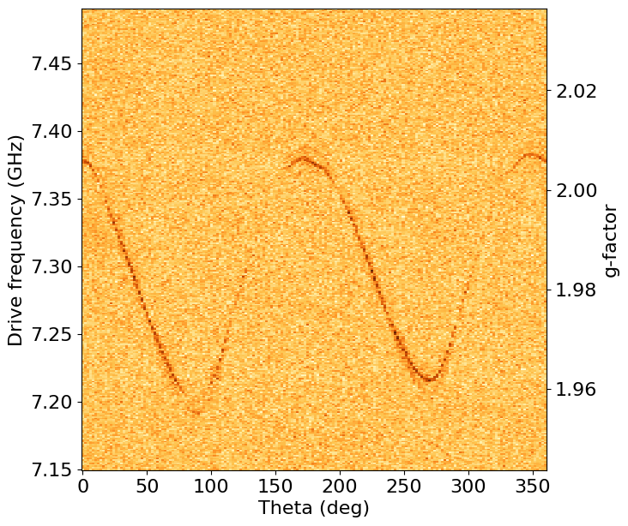
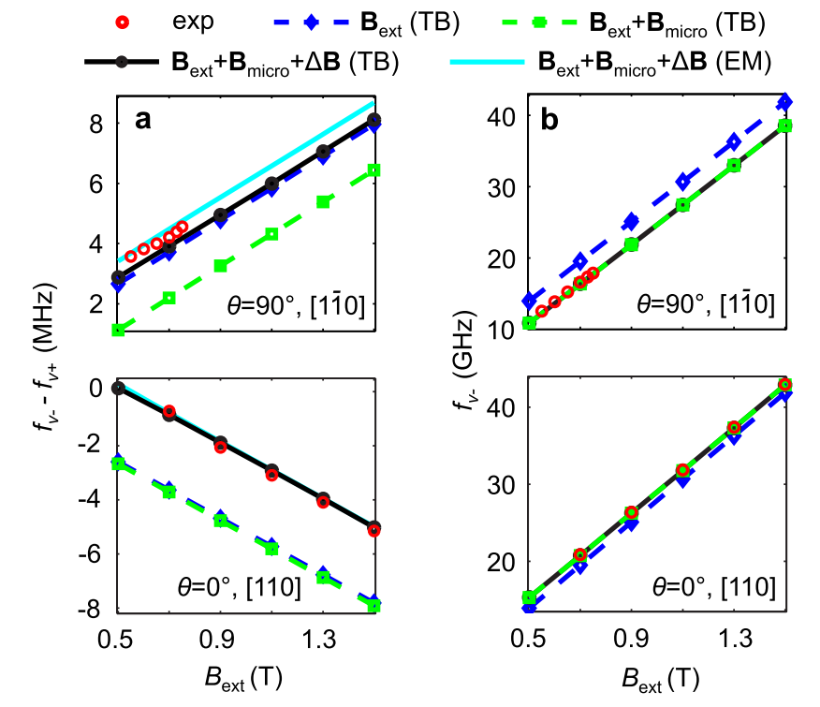
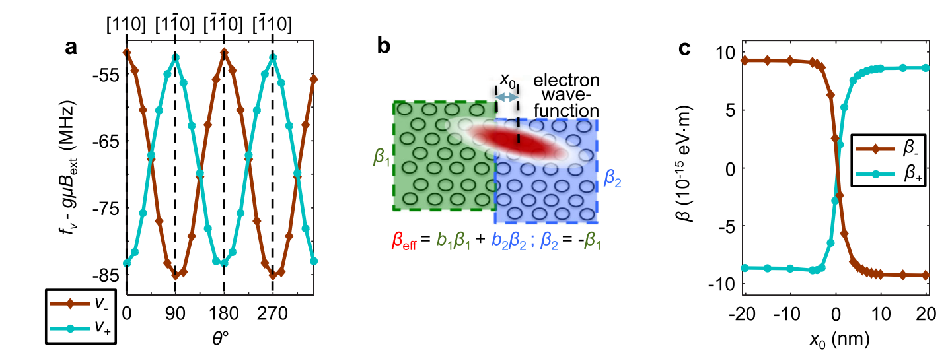
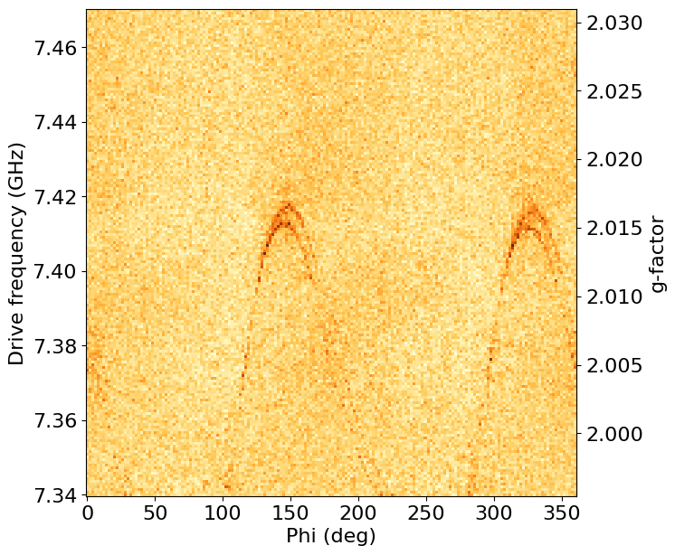

Slide 28
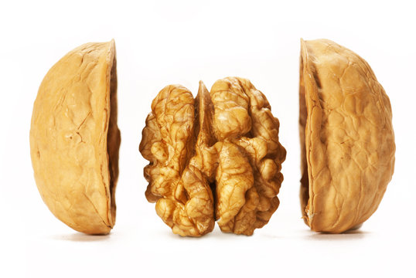
Valley splittings:
Unavoided yet sometimes parasitic, sometimes useful effect
Both Si-MOS and Si/SiGe:
more careful treatment to interface physics
Driving mechanism: can be mixed!
Ferdous, R., et al. Valley dependent anisotropic spin splitting in silicon quantum dots, npj Quantum Inf 4, 26 (2018).
J. C. C. Hwang et al, Impact of 𝑔-factors and valleys on spin qubits in a silicon double quantum dot, Phys. Rev. B 96, 045302 (217)
T. Tanttu et al, Controlling Spin-Orbit Interactions in Silicon Quantum Dots Using Magnetic Field Direction, Phys. Rev. X 9, 021028 (2019)
Could be interesting as well:
Gilbert, et al. On-demand electrical control of spin qubits. Nat. Nanotechnol. 18, 131–136 (2023)
Corna, A., et al. Electrically driven electron spin resonance mediated by spin–valley–orbit coupling in a silicon quantum dot. npj Quantum Inf 4, 6 (2018)

Slide 29
