Slide 1
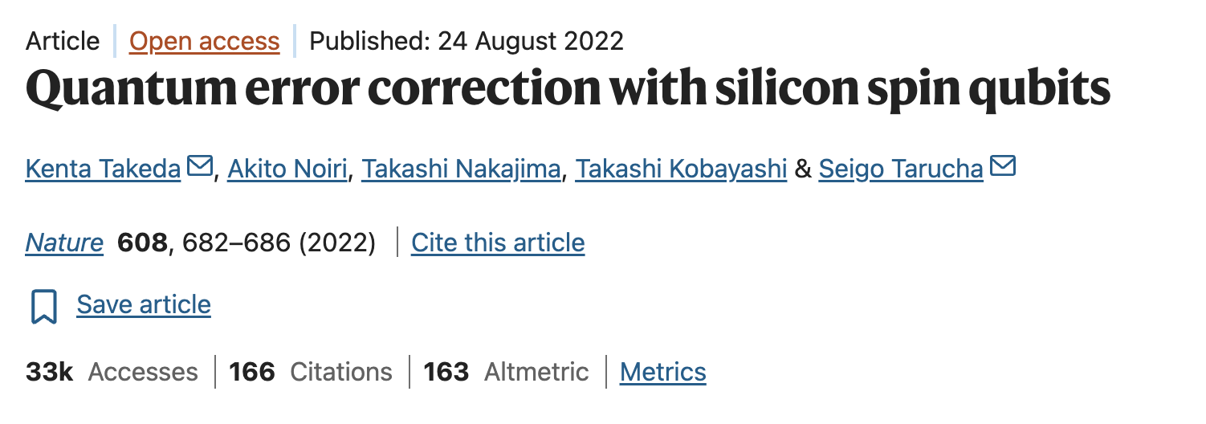
Quantum Error Correction
Aakash Shandilya

Slide 2
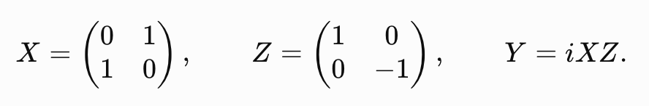
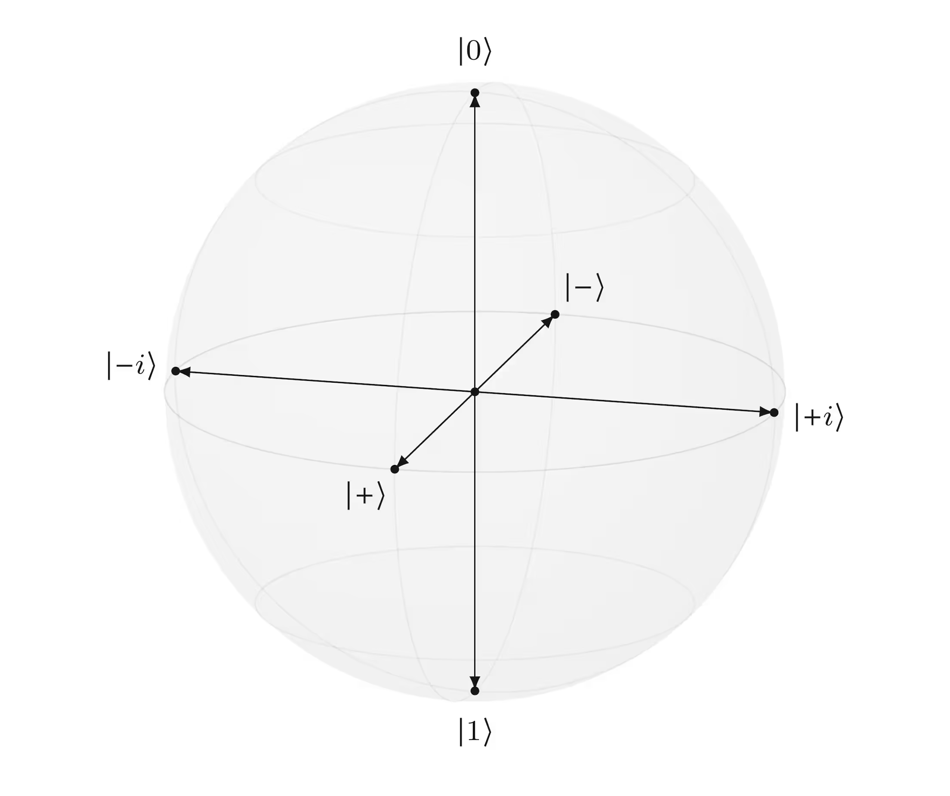


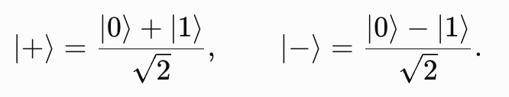
Why Quantum Error correction is needed
Single qubit errors
Bit flip
Phase flip

Slide 3
Why Quantum Error Correction is hard
Quantum states cannot be cloned.
Measurement of the qubit collapses its state.
The correction apparatus can also be faulty.

Slide 4
Quantum Error correction chain
Logical state
Encode into multiple physical qubits
A physical error occurs
Measure parity checks
Logical state is restored
Collect parity outcomes = syndrome
Compare syndrome with lookup table
Localise the most likely error
Apply a correction
Decode

Slide 5


Encode
Let’s assume a 3 Qubit system, with a bit flip error.
Arbitrary state of the data Qubit
We define, logical states
So, the arbitrary logical qubit is now encoded as
The extra qubits added are called Ancillas.

Slide 6


Parity checks
Z gate also gives parity
Combining Z gates for multiple physical qubits
These parity checking S gates are called Stabilisers.

Slide 7




An example
State before the error
Parity checks
Error syndrome

Slide 8

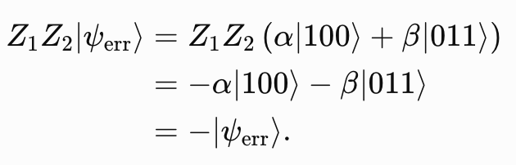


A bit flip error occurs on qubit 1.
Parity checks
Error syndrome

Slide 9
Syndrome table
Error | Z₁Z₂ | Z₂Z₃
No error | +1 | +1
X₁ | -1 | +1
X₂ | -1 | -1
X₃ | +1 | -1

Slide 10
Quantum Error correction chain
Logical state
Encode into three physical qubits
A physical error occurs
Measure parity checks
Logical state is restored
Collect parity outcomes = syndrome
Compare syndrome with lookup table
Localize the most likely error
Apply a correction
Decode

Slide 11

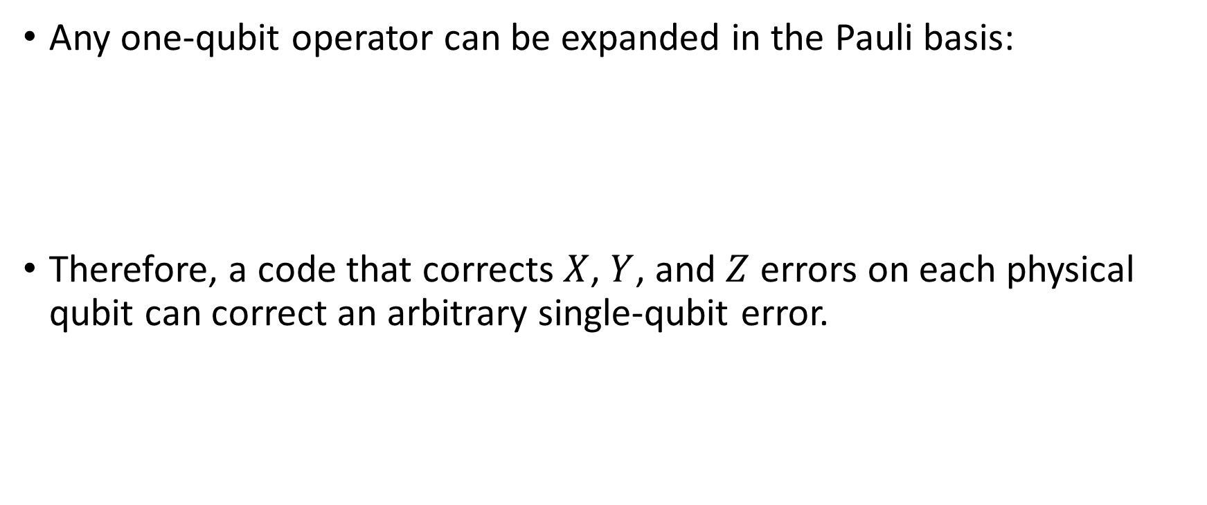
Correcting arbitrary single qubit errors
Any one-qubit operator can be expanded in the Pauli basis:
Therefore, a code that corrects $X$, $Y$, and $Z$ errors on each physical qubit can correct an arbitrary single-qubit error.

Slide 12
Let’s now see an experimental demonstration

Slide 13
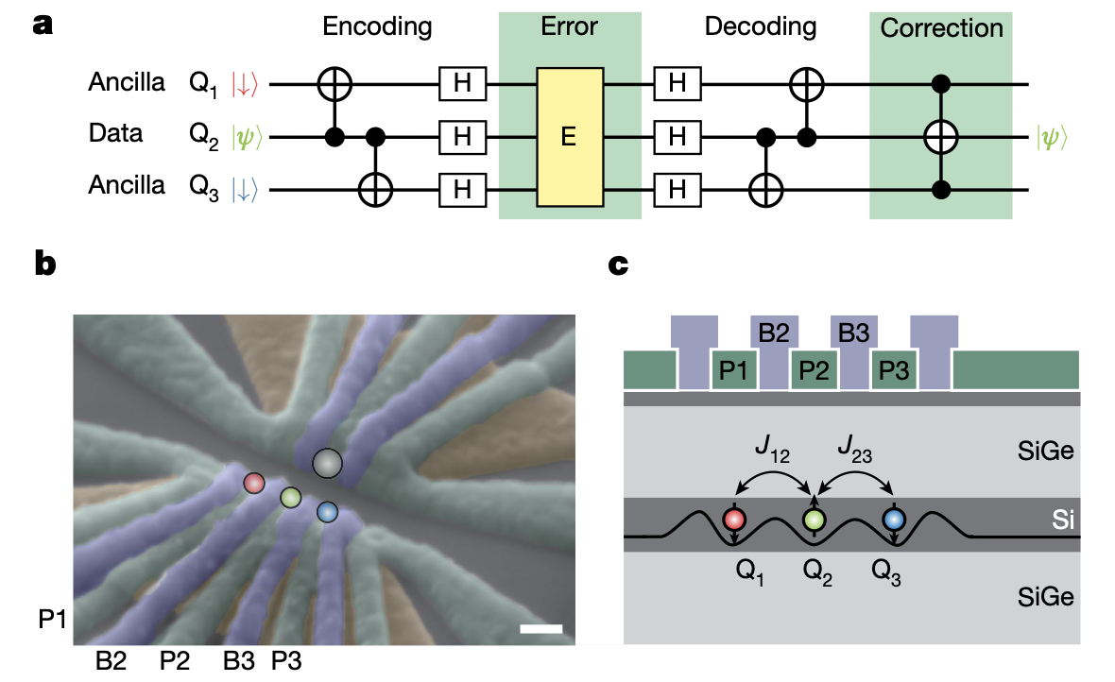

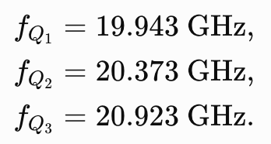
The device
The applied external magnetic field is
The three spin-resonance frequencies are approximately

Slide 14
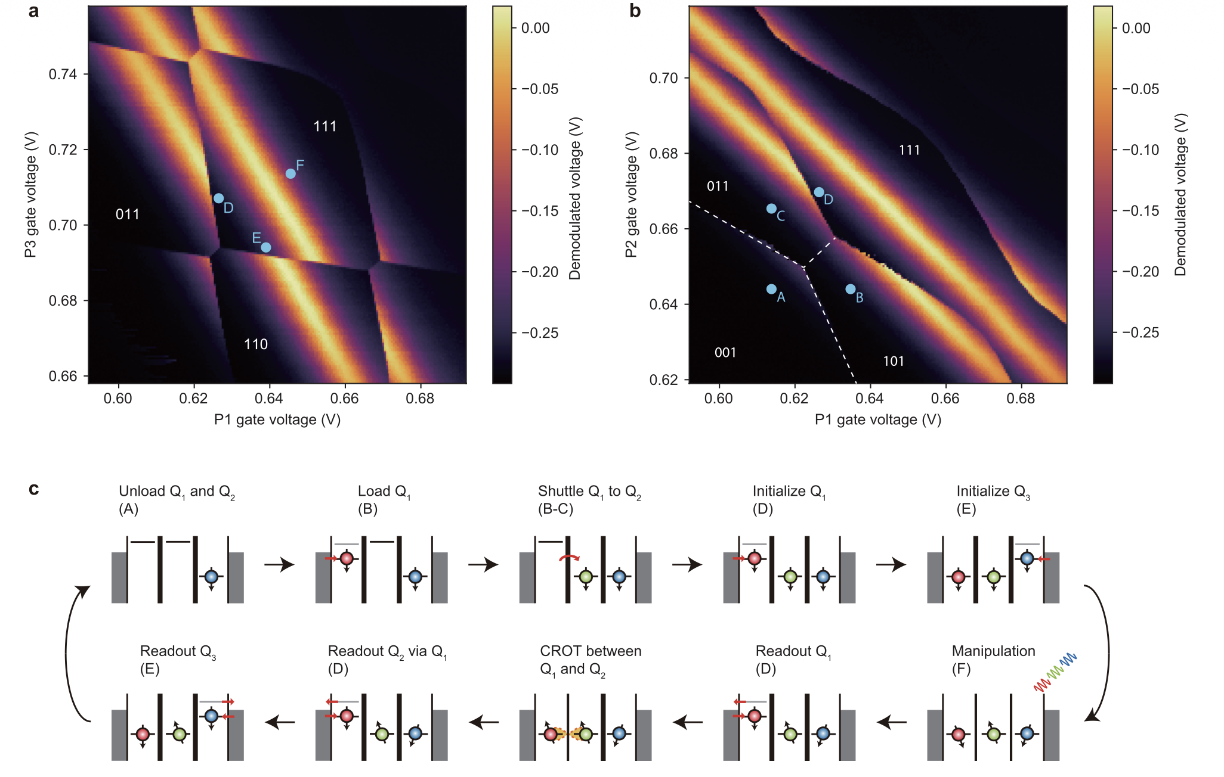
Initialisation and readout mechanisms
Energy selective Elzerman readout is used
The readout durations of each qubit are:
  600 µs for Q1
  200 µs for Q2
  500 µs for Q3

Slide 15
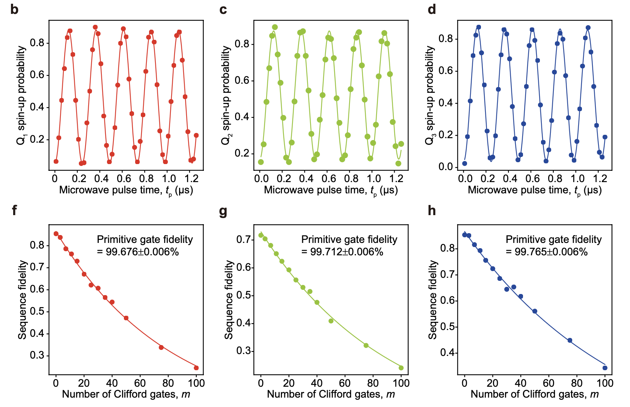

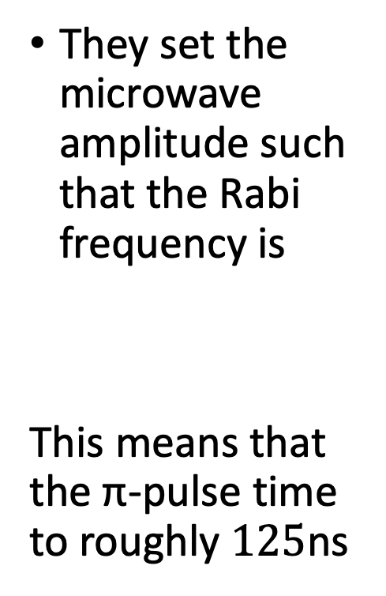
Spin qubit control
They set the microwave amplitude such that the Rabi frequency is
This means that the π-pulse time to roughly $125$ns

Slide 16
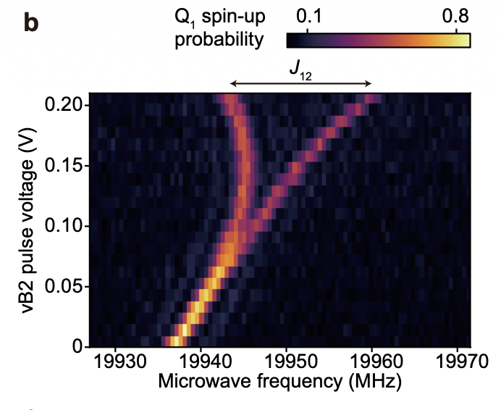
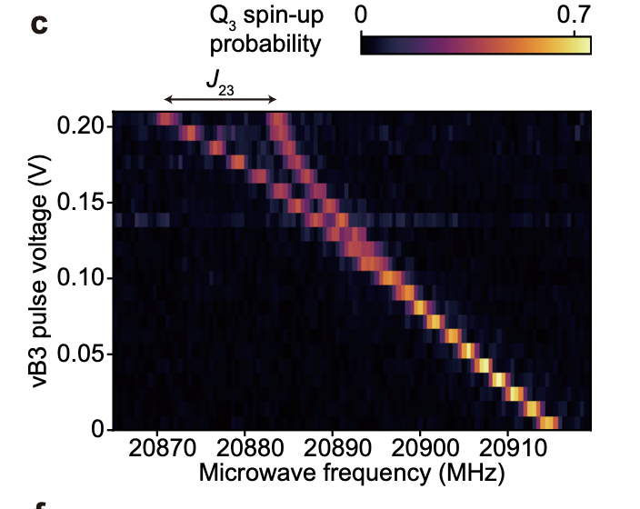
Two qubit exchange control
Activate exchange coupling and measure the resonance frequency of one of the coupled spins.
Without exchange, the transition frequency is independent of the neighbouring spin.
With exchange, the resonance splits according to whether the neighbouring spin is parallel or antiparallel.

Slide 17
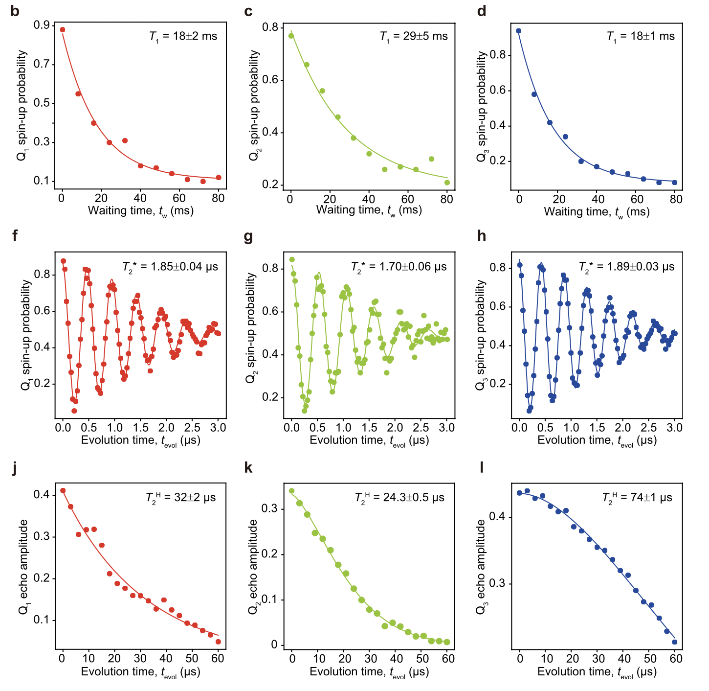

Relaxation and Dephasing
Since
During a few microsecond experiment, the main problem is the loss of relative phase.
Therefore, they implement a phase flip code.

Slide 18





Generation of GHz state (Encoding)
Initial state
Encoding:
  CNOT from Q2 to Q1,
  CNOT from Q2 to Q3,
  Hadamard on all three qubits.
Average fidelity
(GHZ state)

Slide 19
Quantum Error correction chain
Logical state
Encode into three physical qubits
A physical error occurs
Measure parity checks
Logical state is restored
Collect parity outcomes = syndrome
Compare syndrome with lookup table
Localize the most likely error
Apply a correction
Decode

Slide 20
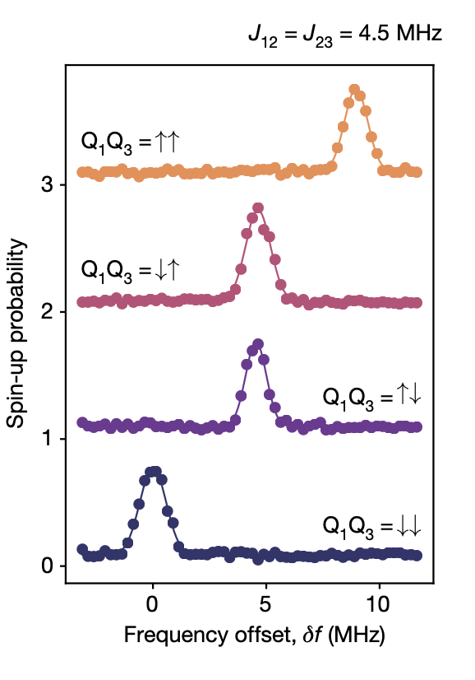

Exchange dependent resonance of the qubit

Slide 21


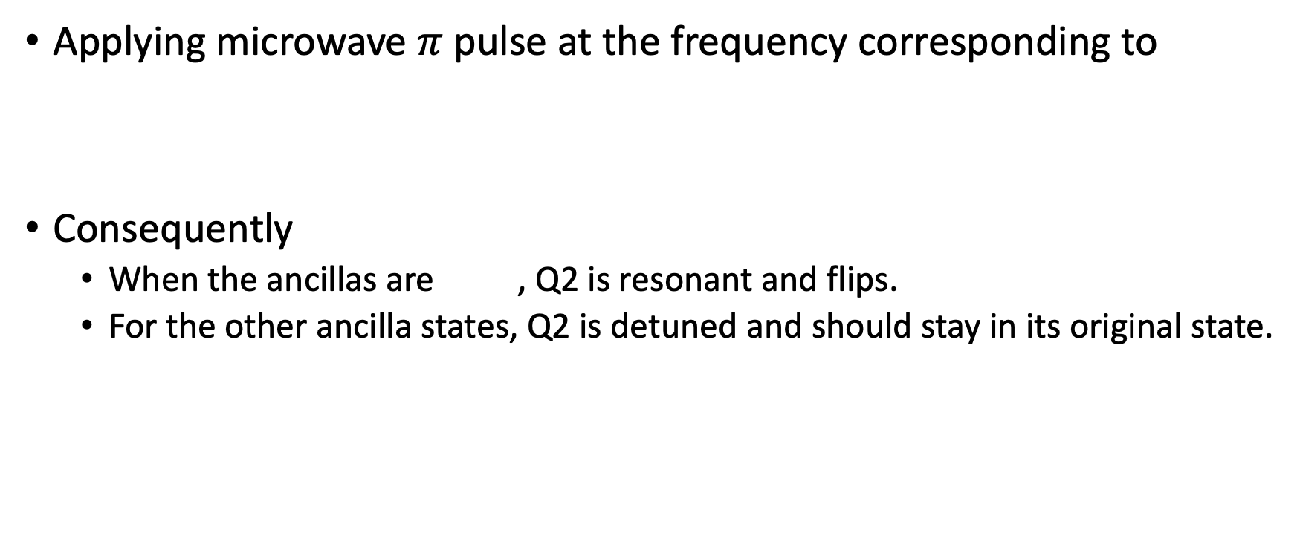
iToffoli
Applying microwave $π$ pulse at the frequency corresponding to
Consequently
  When the ancillas are , Q2​ is resonant and flips.
  For the other ancilla states, Q2 is detuned and should stay in its original state.

Slide 22

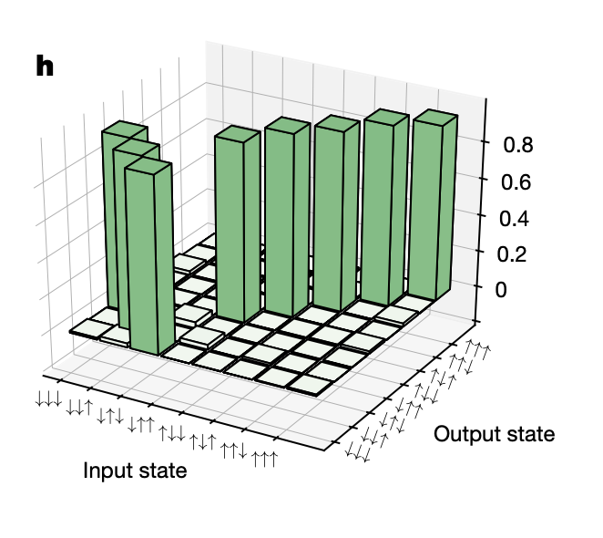
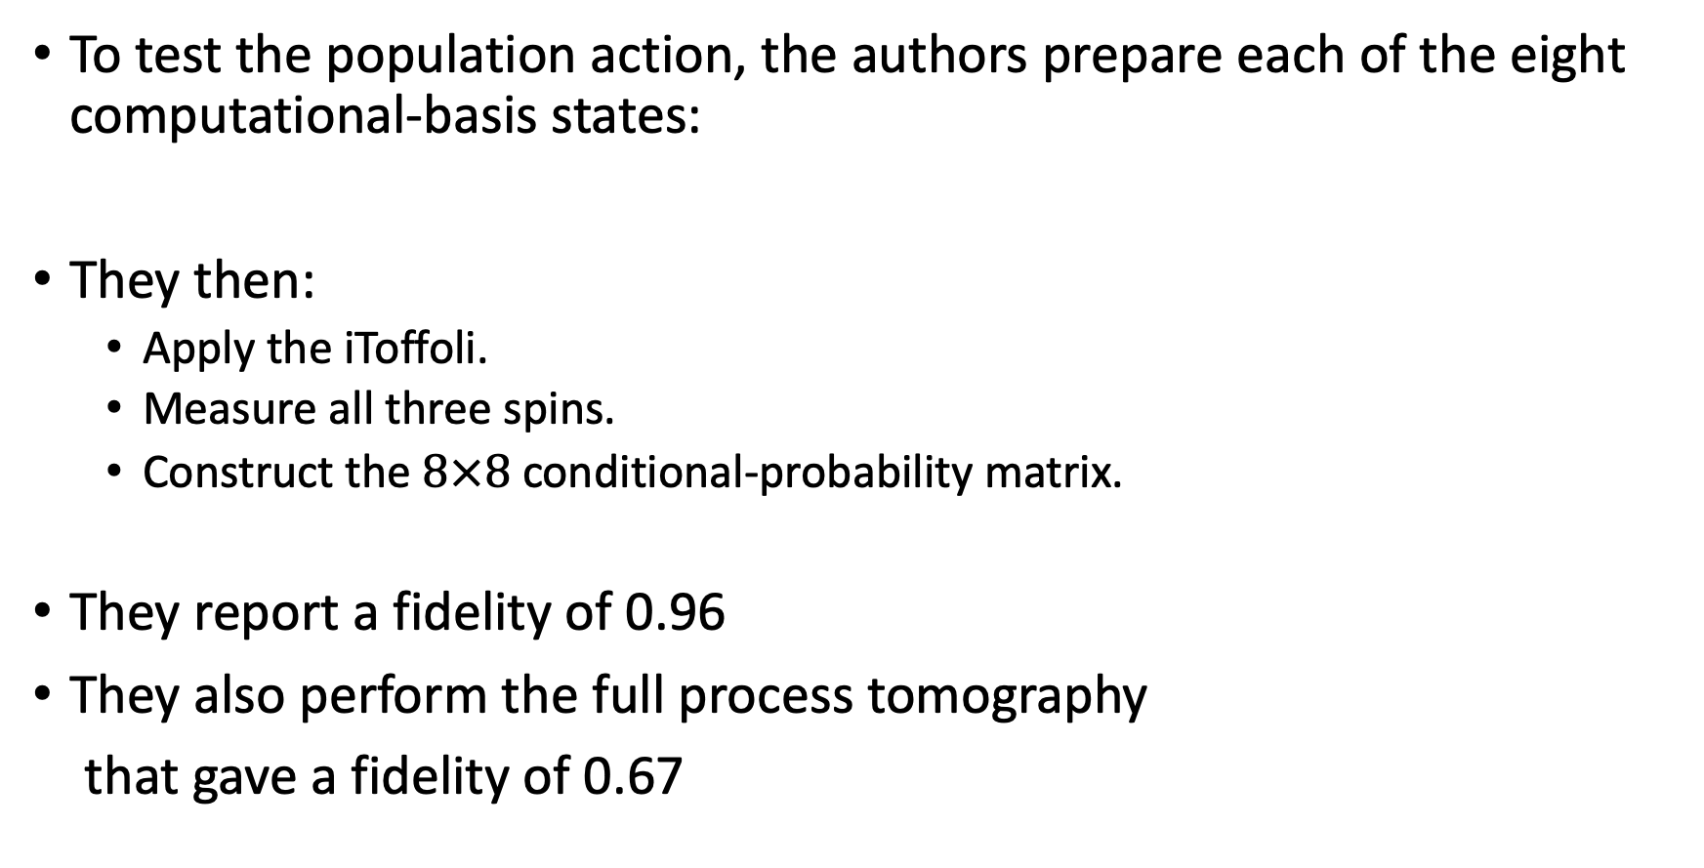
But, does it actually work
To test the population action, the authors prepare each of the eight computational-basis states:
They then:
  Apply the iToffoli.
  Measure all three spins.
  Construct the $8×8$ conditional-probability matrix.
They report a fidelity of 0.96
They also perform the full process tomography
that gave a fidelity of 0.67

Slide 23
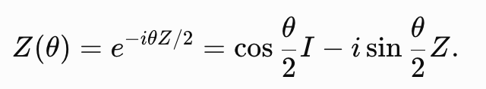
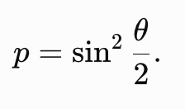
Correction of a deliberate error
They apply a controlled phase rotation on Q2
So, the effective error probability is

Slide 24


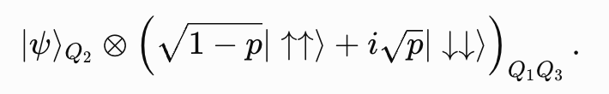
After decoding, the state of Q2 is
And the Q2 error syndrome is
The iToffoli flips the data qubit only in this branch:
The final state therefore becomes

Slide 25
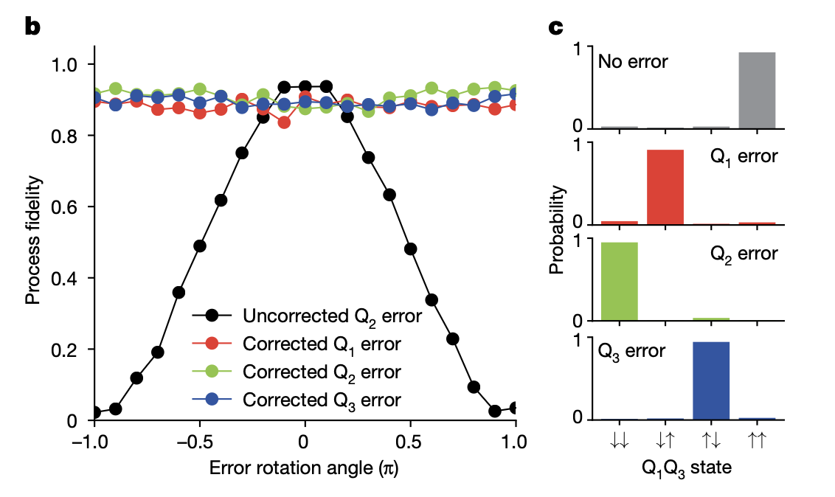
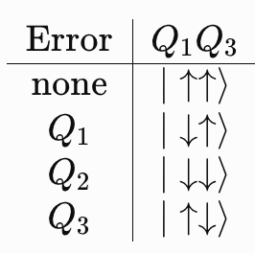
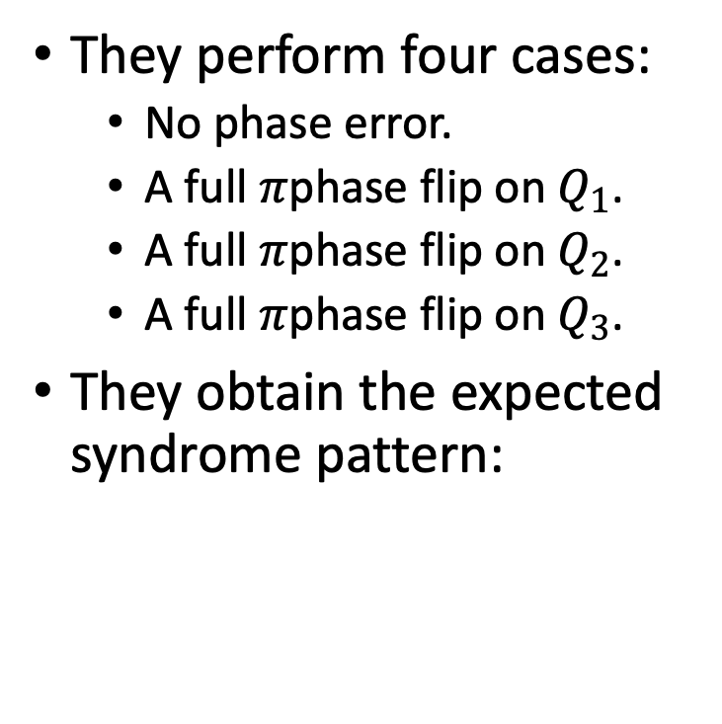
Deliberate error on all qubits and correction
They perform four cases:
  No phase error.
  A full $π$phase flip on $Q_{1}$.
  A full $π$phase flip on $Q_{2}$.
  A full $π$phase flip on $Q_{3}$.
They obtain the expected syndrome pattern:

Slide 26
Applying this to natural dephasing
They perform three types of experiments
  Physical qubit: No encoding, decoding and correction
  Uncorrected encoded qubit: Only encoding and decoding, no correction.
  Corrected encoded qubit: Encoding, decoding and correction.
Results:
Their conclusion: The code suppresses the effect of natural dephasing relative to an uncorrected encoded circuit, but the correction gate errors prevent it from surpassing the physical qubit.
Case | T₂
Physical qubit | 1.44 ± 0.02 μs
Uncorrected encoded qubit | 1.12 ± 0.03 μs
Corrected encoded qubit | 1.36 ± 0.04 μs

Slide 27
Conclusion
Demonstrated three-qubit quantum error correction in silicon spin qubits.
Encoded one data qubit into a three-qubit entangled state.
Detected single-qubit phase errors through ancilla syndromes.
Corrected the data qubit using a resonantly driven iToffoli gate.
The corrected logical qubit did not yet outperform the physical qubit because the correction gates introduced additional errors.
Further improvement in multiqubit gate fidelity is needed to achieve a clear logical advantage.

