Slide 1
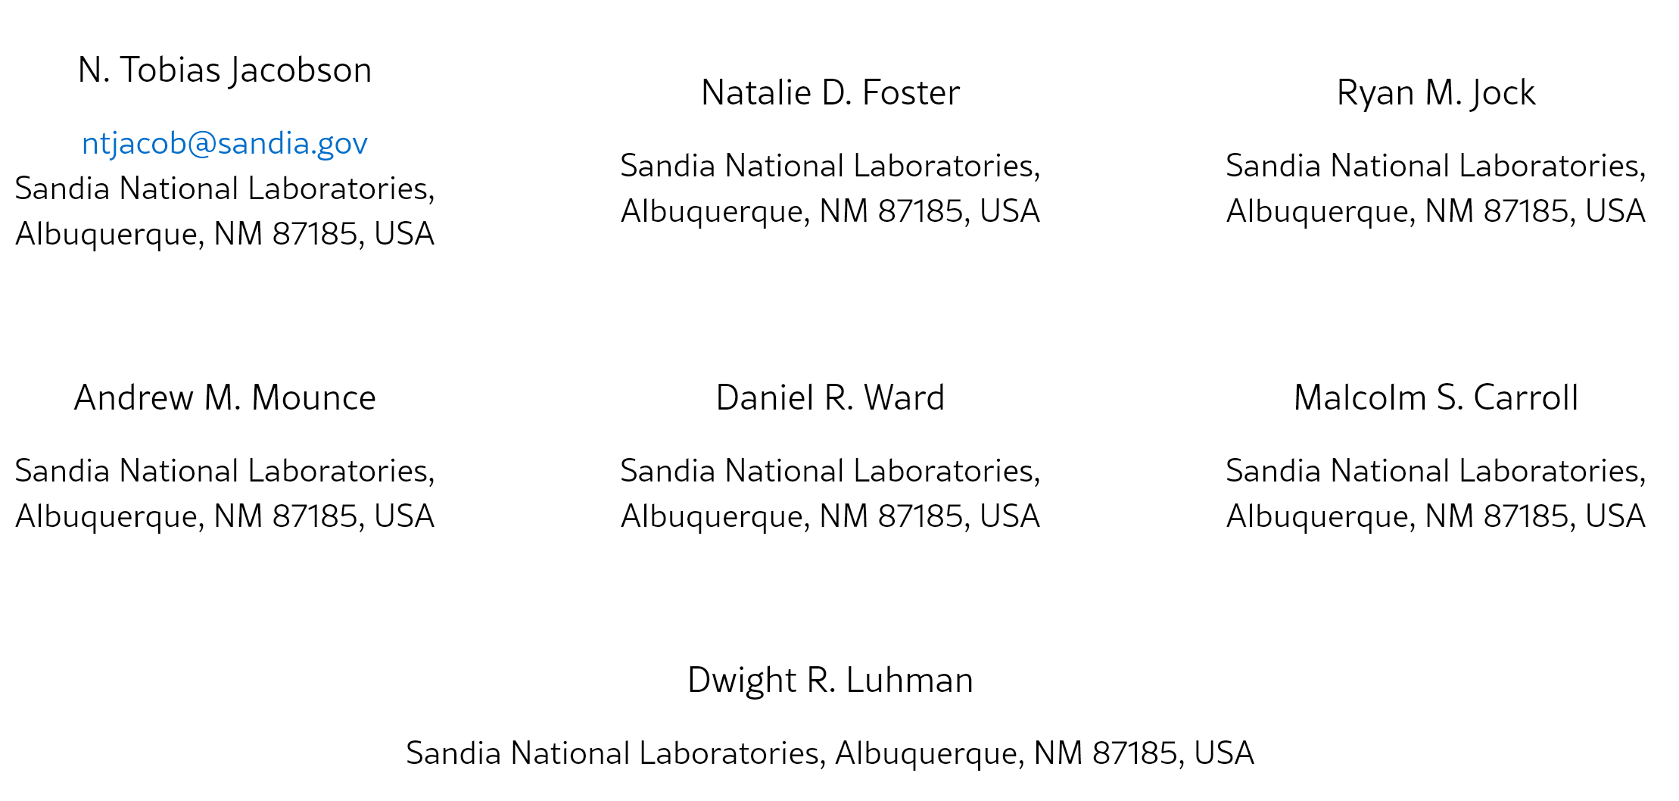
Journal Club : Anisotropic spin-valley coupling in SiMOS and Si/SiGe quantum dots
30/07/2026
Luc PACHOT

Slide 2
Context / motivations
Quantify and compare spin-valley coupling in two leading silicon qubit platforms: SiMOS and Si/SiGe.
Qubit driving, Coherence, sensitivity to noise

Slide 3
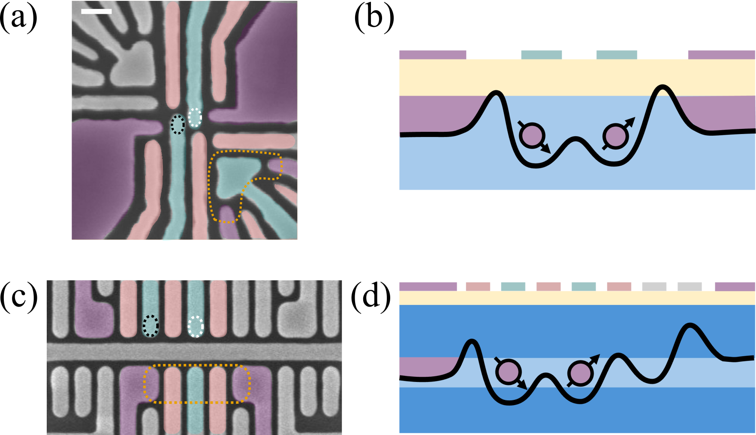







Devices & Setup
$$SiO_{2}$$
$$Si MOS$$
$$Si$$
$$SiGe$$
$$Si/SiGe$$
$$Si$$
$$SiGe$$
Experiment - Devices & Setup

Slide 4
KEY FINDINGS
SiMOS exhibits an order of magnitude larger spin-valley coupling
Both material systems share the same anisotropic symmetry
the g-factor differences are comparable
→ “optimizing spin-valley coupling to avoid or exploit this mechanism for qubit operation.”

Slide 5
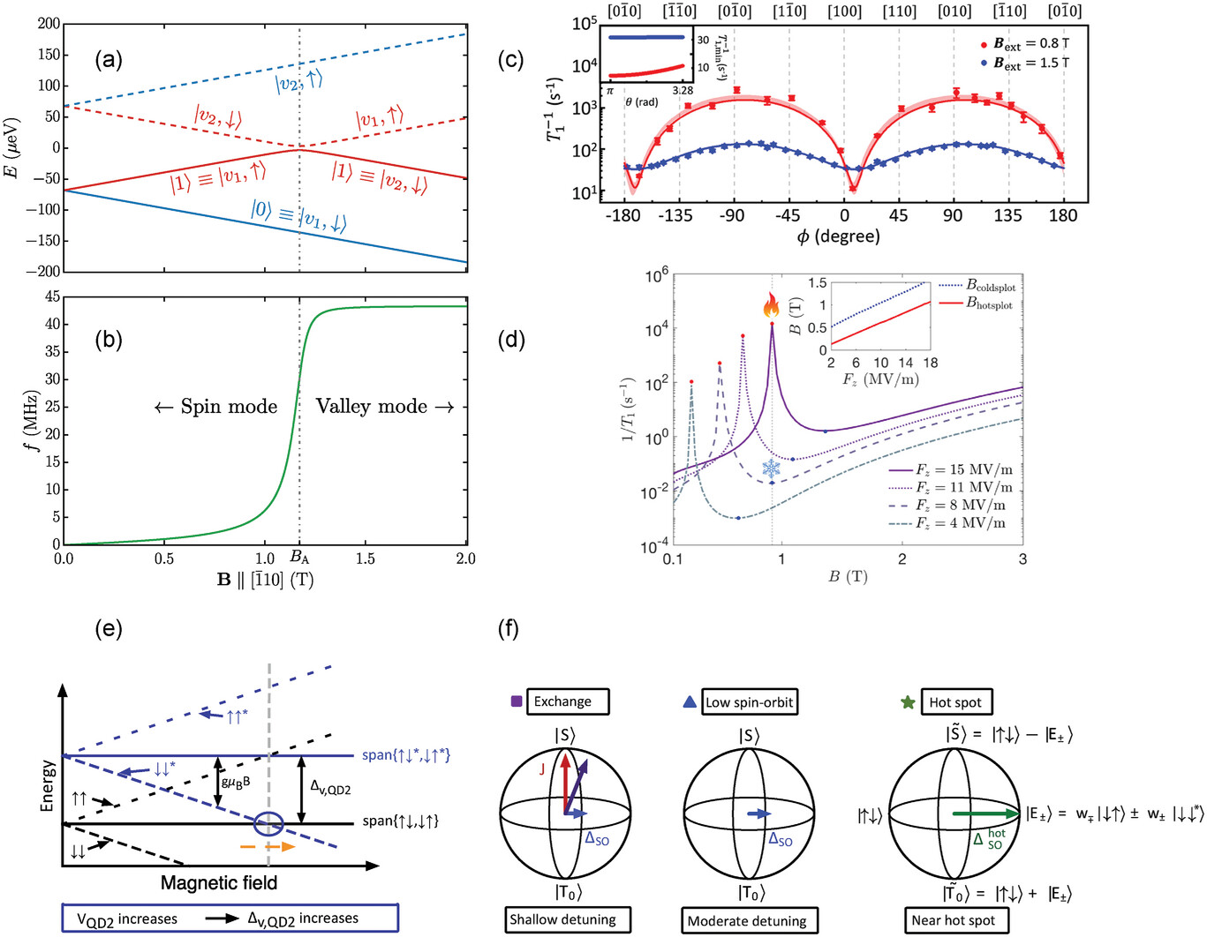





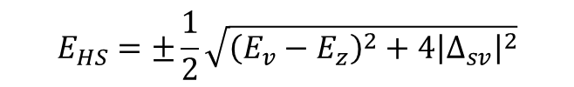




Spin-valley mixing
1 Qdot
Energy
$$|v_{2}↑⟩$$
$$E_{z}$$
Valley 2
$$|v_{2}↓⟩$$
$$E_{v}−E_{z}$$
$$E_{v}$$
B-field
$$|v_{1}↑⟩$$
“Hot spot”
Valley 1
$$E_{z}$$
$$E_{HS}=±\frac{1}{2}\sqrt{{\left(E_{v}−E_{z}\right)}^{2}+4{\left|Δ_{sv}\right|}^{2}}$$
$$|v_{1}↓⟩$$
$Δ_{sv}$ : Spin-valley coupling term
Physics recall

Slide 6

Use a 2Qdot to encode a S-T0 Qubit in the Valley ground state
→ The logical qubit state only use the valley ground state, but there is coupling with the exited valley state that changes Qubit properties.
Each Qdot has his own $E_{v}$ and $E_{z}$

Slide 7
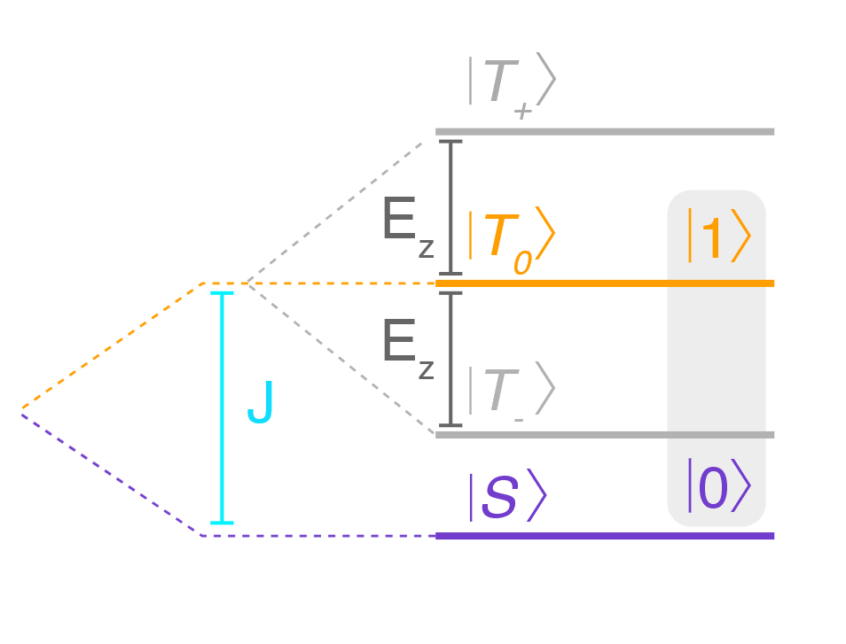
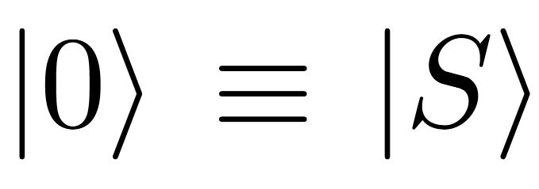
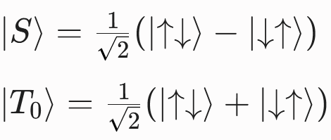
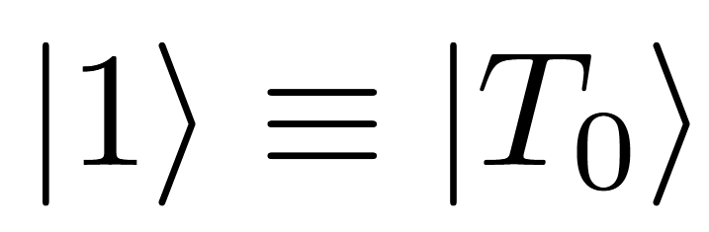
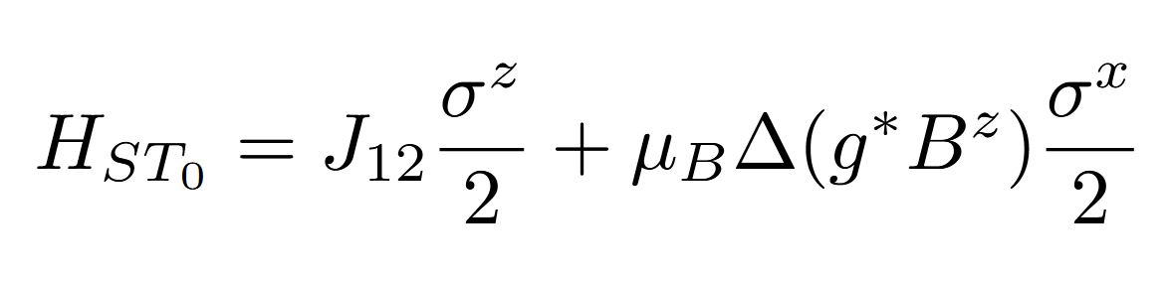




The Singlet-Triplet Qubit (2 QD)
Encoded in the subspace with zero total magnetic projection:
$$m_{s}=+1$$
$$m_{s}=0$$
$$m_{s}=−1$$
The system dynamics are described by the effective Hamiltonian
in the {|S⟩ , |T0⟩} basis:
Driven with a magnetic field gradient (Z rotations and electric field (X Rotations)
$$ΔE_{z}=$$
Semiconductor Spin Qubits Rev. Mod. Phys. 95, 025003 (2023)
Physics recall

Slide 8
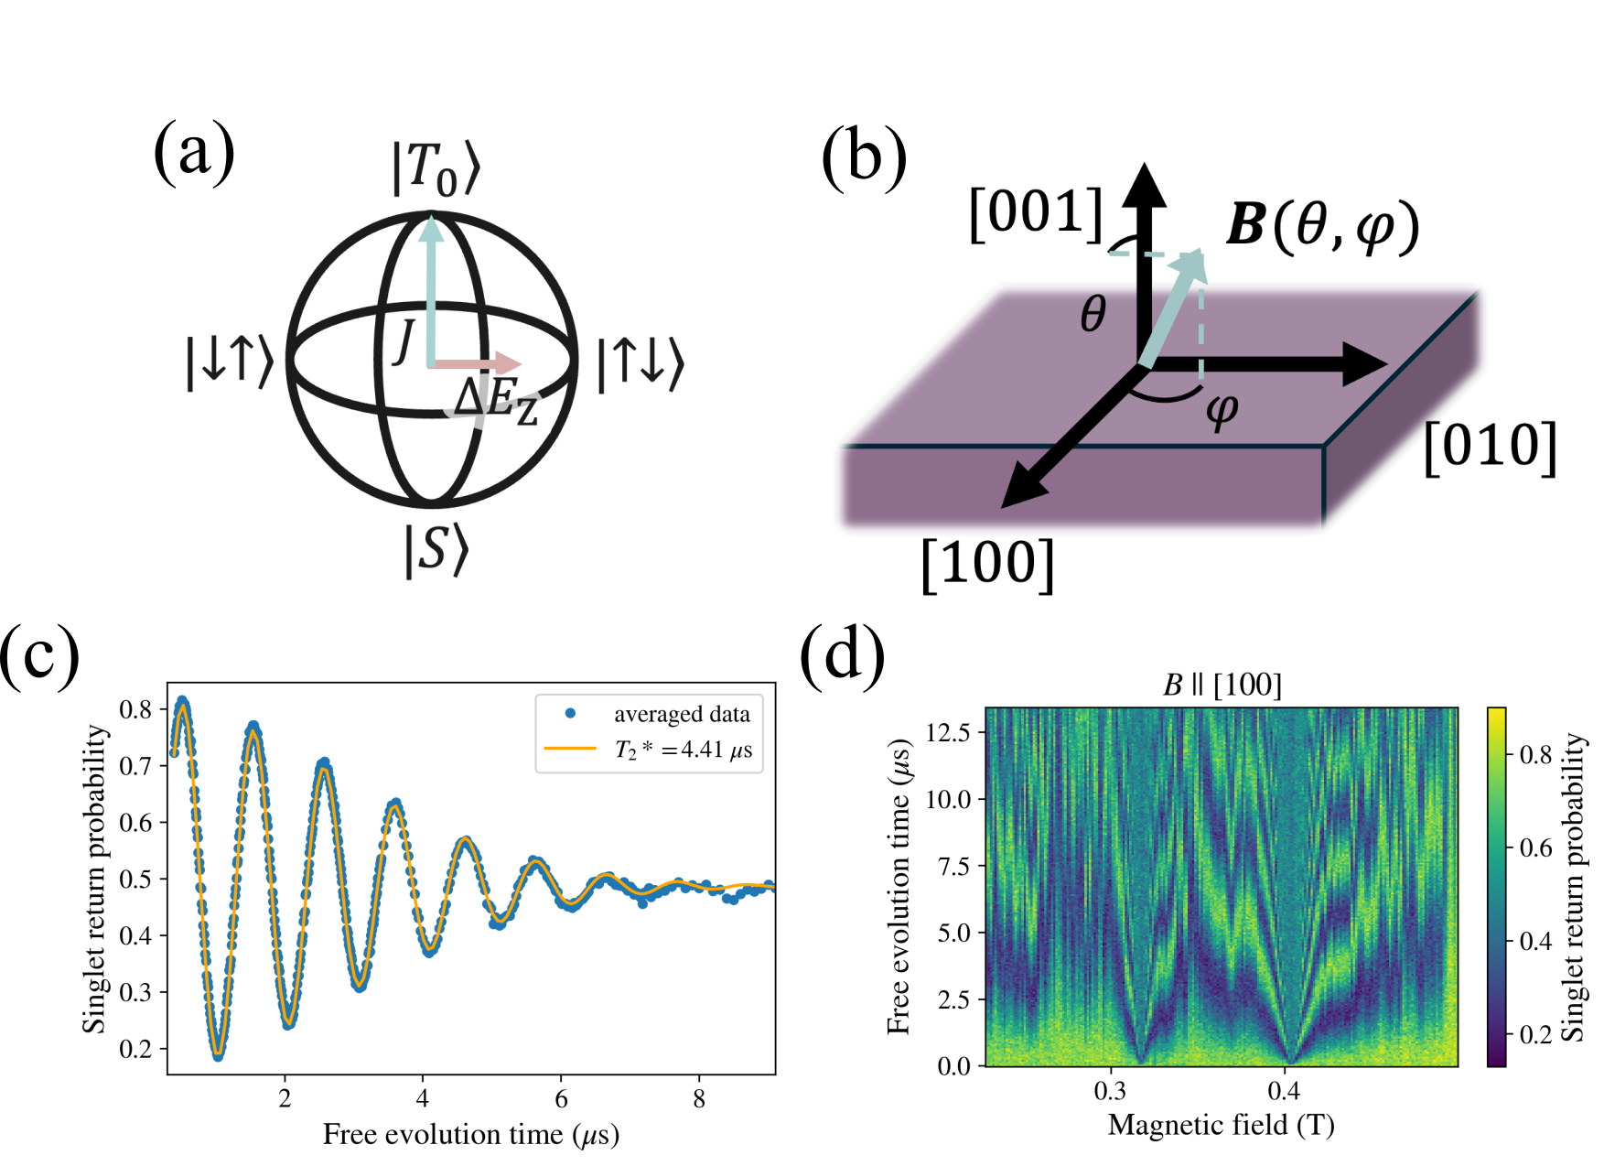
The Singlet-Triplet Qubit (2 QD)
Experiment - Devices & Setup

Slide 9
Free induction decay measurements
Initialize the system in the (4,0) singlet ground state S(4,0).
Pulse rapidly to the separated (3,1) charge state where exchange coupling J = 0.
Allow the state to freely evolve.
Return to (4,0) and perform single-shot readout via Pauli spin blockade.
Measurements

Slide 10
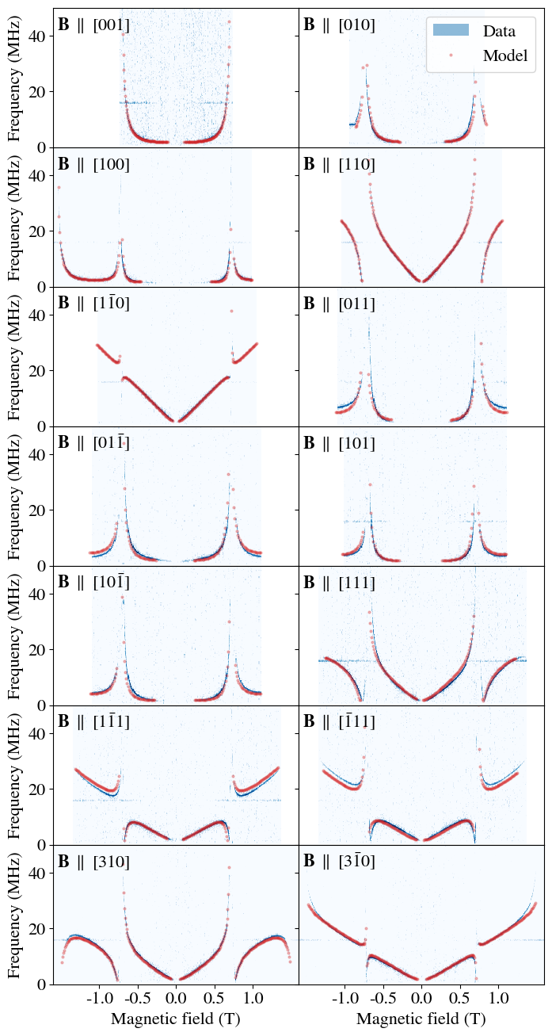
SiMOS ST rotation frequency
Rotation frequency depends on B-field magnitude and orientation
Measurements

Slide 11
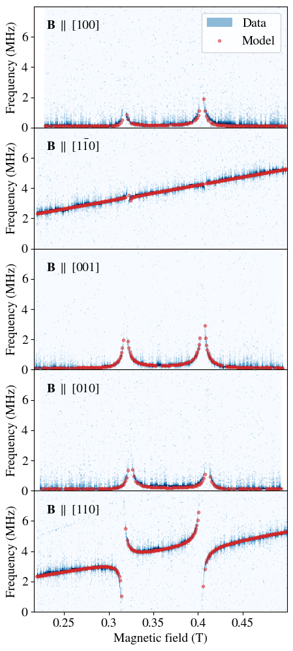
Si/SiGe ST rotation frequency
A model FIT allows the computation of the spin-valley splitting for each direction
Measurements

Slide 12
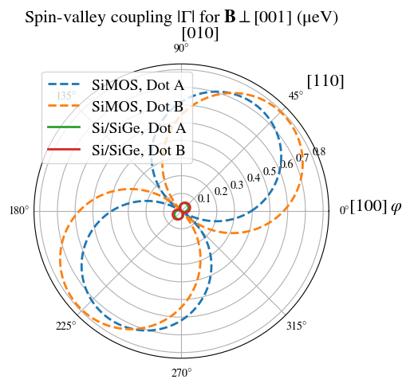
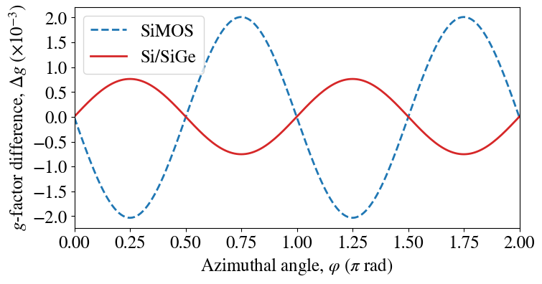

Angular dependence of Delta-g and S-V coupling
In this case B is perpendicular to [001]
$Δ\text{g}\text{(}θ,φ)=μ_{B}(Δα−Δβsin\left(2φ\right)\sin^{2}\left(θ\right))$
$$\left|Γ\left(θ, φ\right)\right|=\frac{γ}{2}\sqrt{3+\cos\left(2θ\right)−2\cos\left(2\left(φ+η\right)\right)\sin^{2}{θ}}$$
Measurements

Slide 13
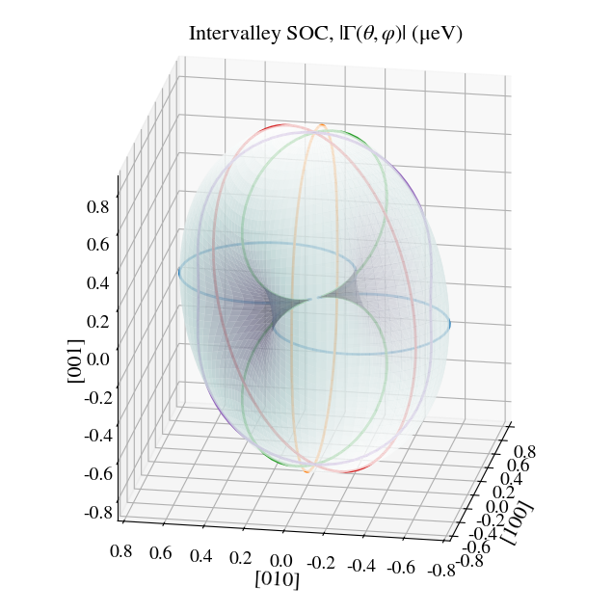
Angular dependence of Delta-g and S-V coupling
In this case B is perpendicular to [001]
Measurements

Slide 14
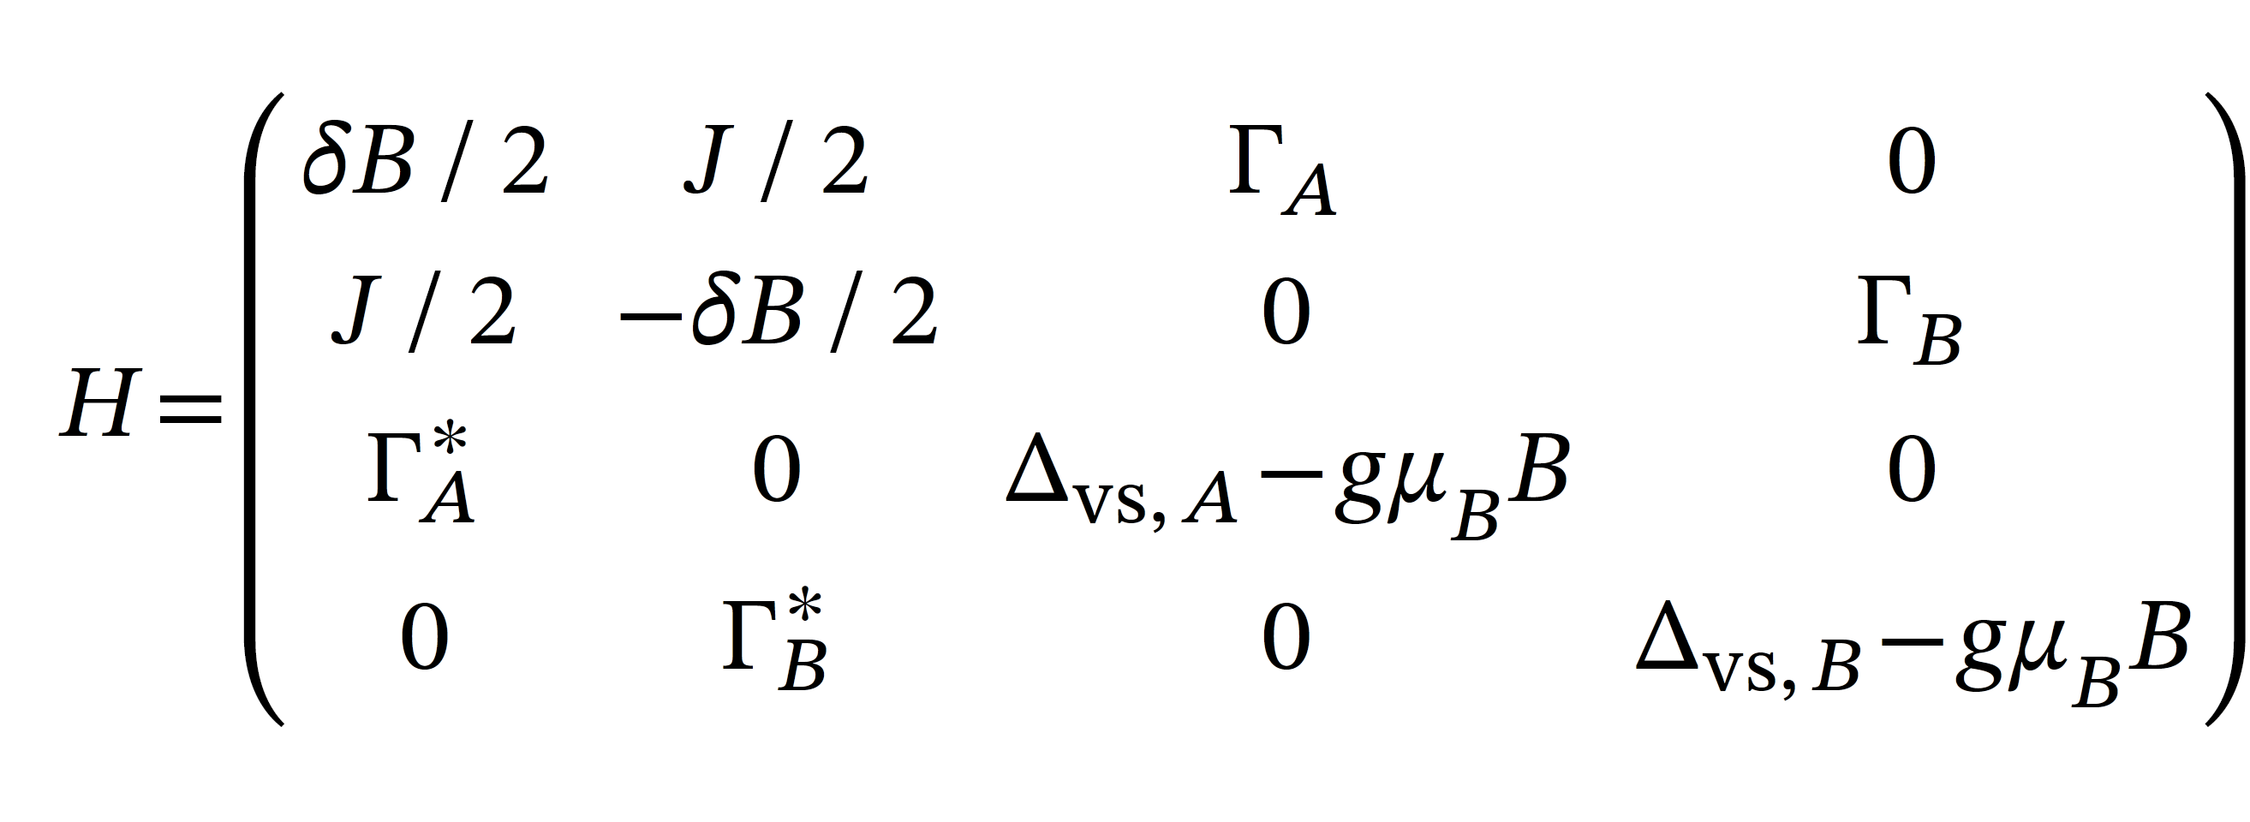
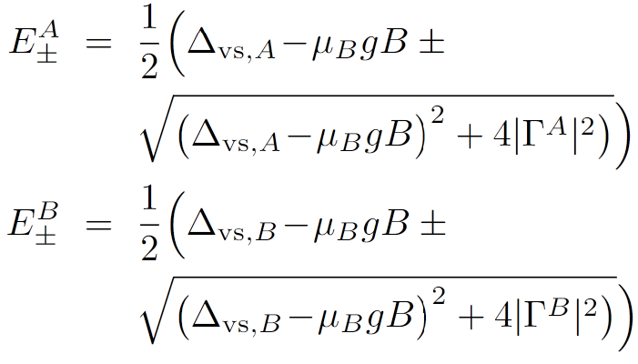
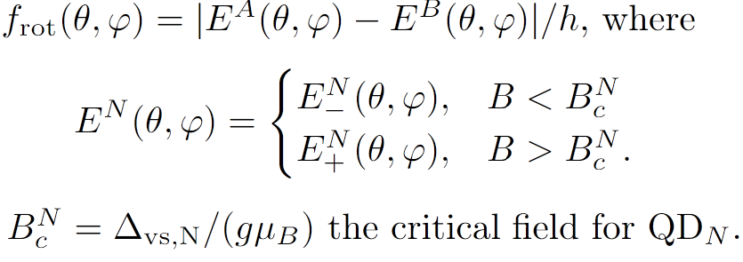




Peaks and anticrossing shapes in $B→f_{rot}\left(B\left(θ, φ\right)\right)$ plots
$$|{\tilde{↑_{0}}}^{A}{\tilde{↓_{0}}}^{B}⟩$$
$$|{\tilde{↓_{0}}}^{A}{\tilde{↑_{0}}}^{B}⟩$$
$$|{\tilde{↓_{1}}}^{A}{\tilde{↓_{0}}}^{B}⟩$$
$$|{\tilde{↓_{0}}}^{A}{\tilde{↓_{1}}}^{B}⟩$$
Compute eigenvalues
Compute frequency
$$\left|Γ\left(θ, φ\right)\right|=\frac{γ}{2}\sqrt{3+\cos\left(2θ\right)−2\cos\left(2\left(φ+η\right)\right)\sin^{2}{θ}}$$
$Δ\text{g}\text{(}θ,φ)=μ_{B}(Δα−Δβsin\left(2φ\right)\sin^{2}\left(θ\right))$

Slide 15
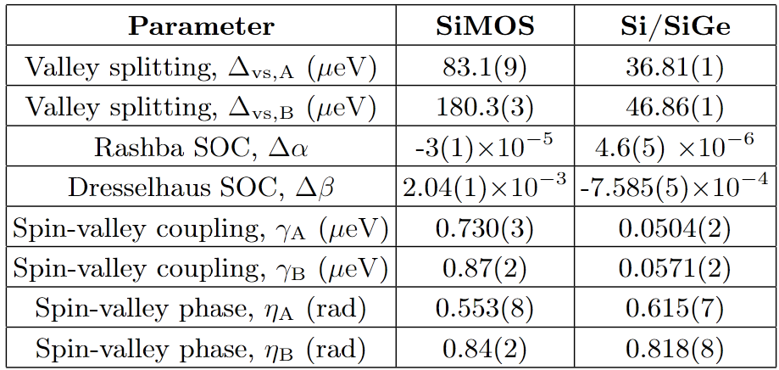
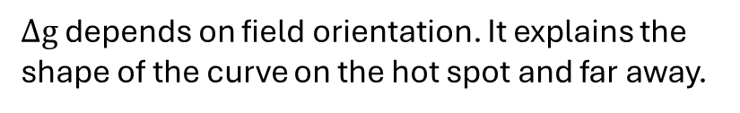
Peaks and anticrossing shapes in $B→f_{rot}\left(B\left(θ, φ\right)\right)$ plots
$$\left|Γ\left(θ, φ\right)\right|=\frac{γ}{2}\sqrt{3+\cos\left(2θ\right)−2\cos\left(2\left(φ+η\right)\right)\sin^{2}{θ}}$$
$Δ\text{g}\text{(}θ,φ)=μ_{B}(Δα−Δβsin\left(2φ\right)\sin^{2}\left(θ\right))$
$Δ\text{g}$ depends on field orientation. It explains the shape of the curve on the hot spot and far away.

Slide 16
CONCLUSION
- SiMOS has10x larger spin-valley coupling & significantly higher valley splitting
Both systems show similar g-factor variations (Delta-g)
- Spin-valley coupling peaks along [110] crystallographic axes for both platforms
B parallel to [001]: Minimizes Delta-g, but maximizes hot-spot dephasing (> 5 MHz)

Slide 17
Adv Funct Materials, Volume: 34, Issue: 19, First published: 10 January 2024, DOI: (10.1002/adfm.202304725)

Slide 18
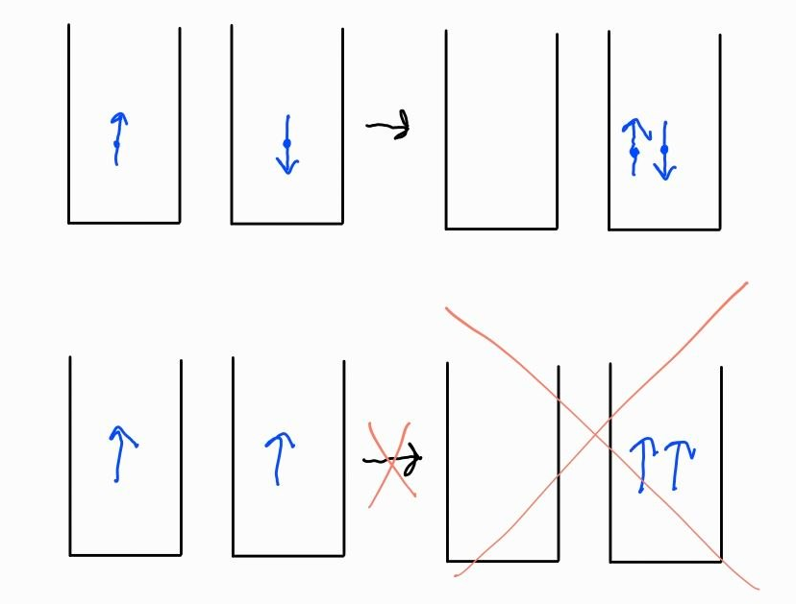
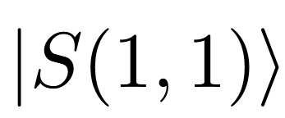
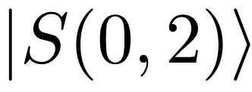
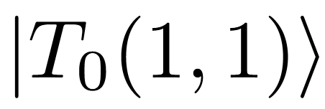
4.2 Pauli Spin Blockade (PSB)
T
detuning
4. Readout Methodologies

Slide 19
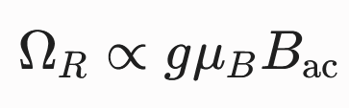
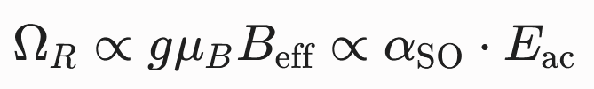
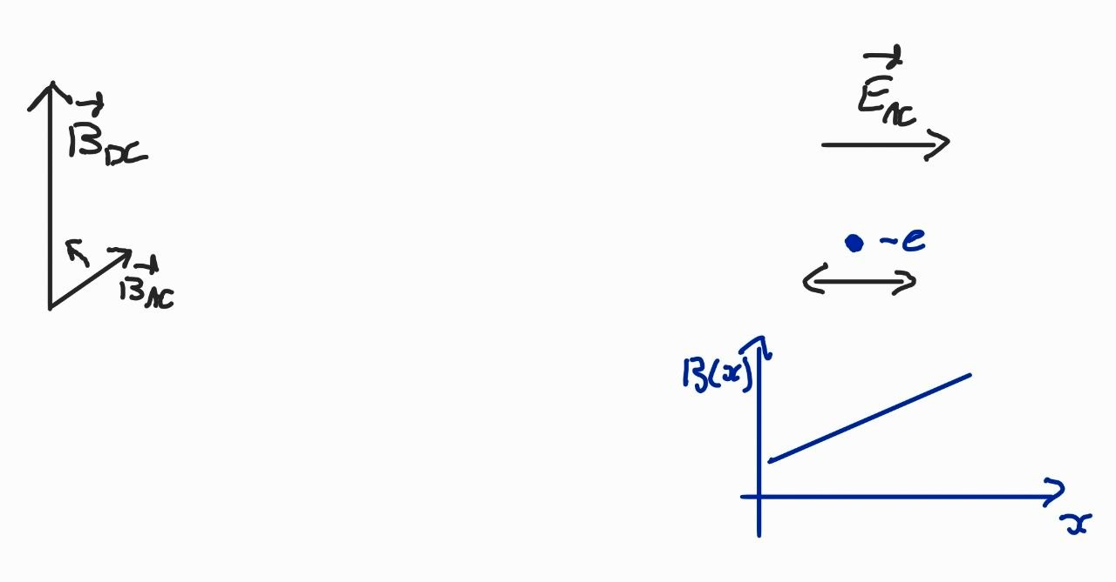

3.2 Spin Coherent Control Mechanisms
Electron Spin Resonance (ESR)
Electric Dipole Spin Resonance (EDSR)
Apply a B field at Larmor frequency
Apply a E field (AC) and a B field gradient
Make the spin flip
3. Focus on Loss-DiVincenzo Qubits

Slide 20
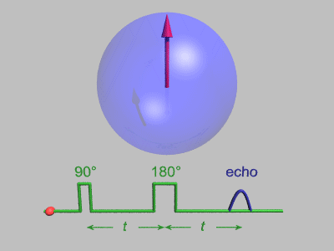
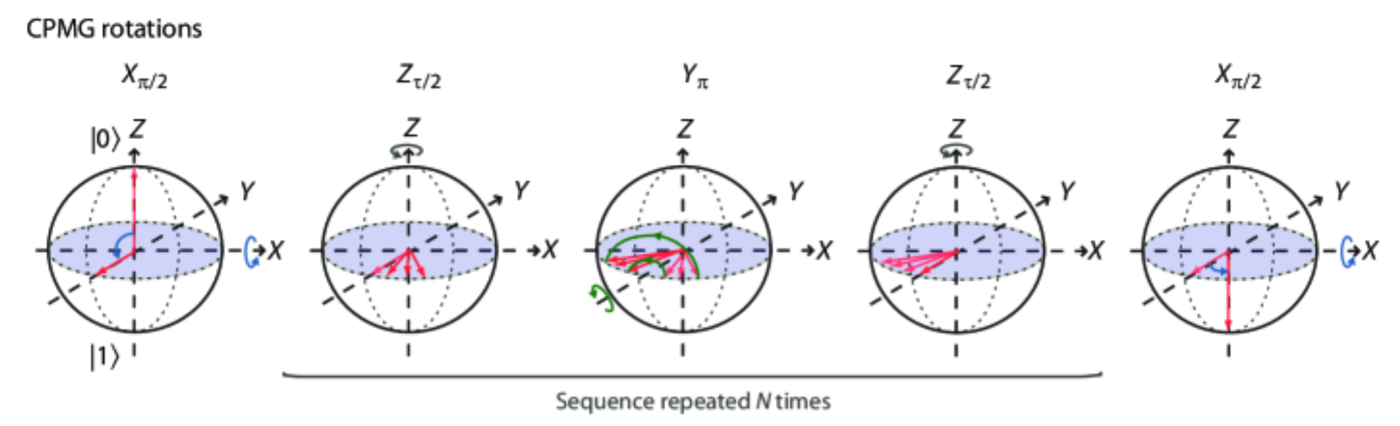










3.1 Coherence and Quality Factors
Hahn echo sequence
CPMG sequence
$$\frac{π_{x}}{2}$$
$$π_{x}$$
e$cho$
$$\frac{π_{x}}{2}$$
$$π_{y}$$
$$π_{y}$$
$$…$$
$$π_{y}$$
e$cho$
$$n times$$
3. Focus on Loss-DiVincenzo Qubits

Slide 21
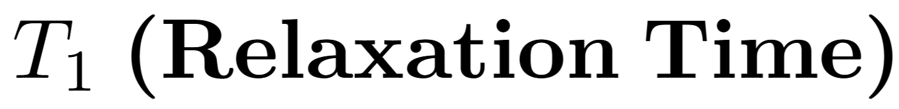
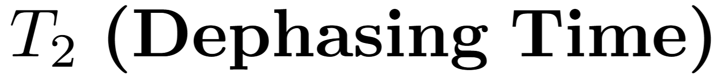
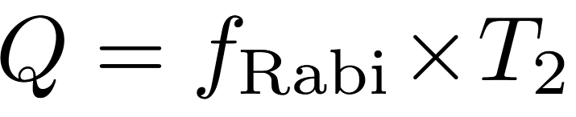
3.1 Coherence and Quality Factors
Typical timescales for assessing performance :
Flip from 1 to 0
Dispersion around Z axis (phase)
How to Increase T2 ?
3. Focus on Loss-DiVincenzo Qubits

