Slide 1
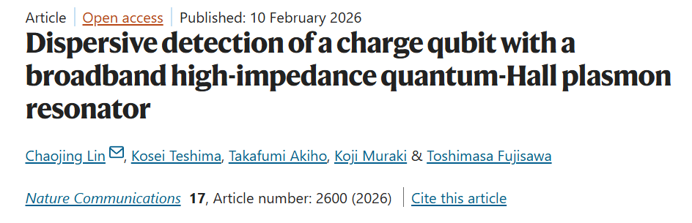
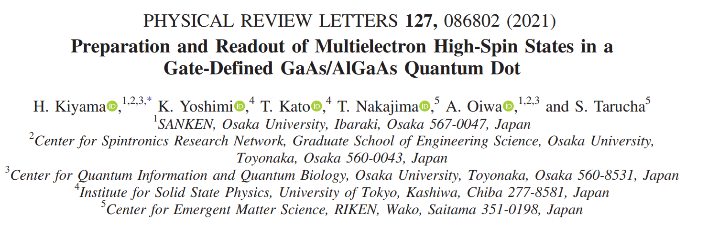
Spin Qubits in high magnetic fields,
what have we gained, what have we lost?
Aldo Tarascio - Spin Journal Club 27.07.2026

Slide 2
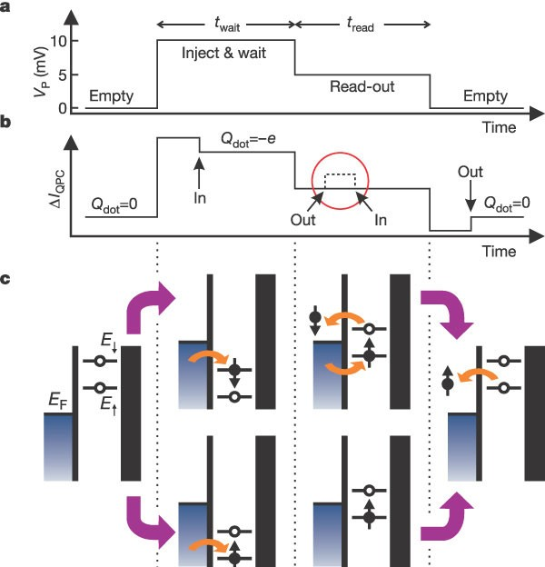
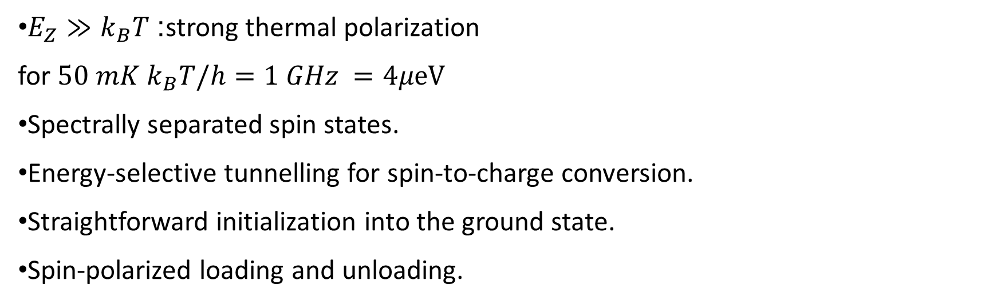
In the beginning high fields were attractive
$E_{Z}≫k_{B}T$: strong thermal polarization
for ${50 mK k}_{B}T/h=1 GHz =4μeV$
Spectrally separated spin states.
Energy-selective tunnelling for spin-to-charge conversion.
Straightforward initialization into the ground state.
Spin-polarized loading and unloading.
Elzerman, J., Hanson, R., Willems van Beveren, L. et al. Single-shot read-out of an individual electron spin in a quantum dot. Nature 430, 431–435 (2004)
Notes:
Measure phase and amplitude with RF lock in amplifyer

Slide 3
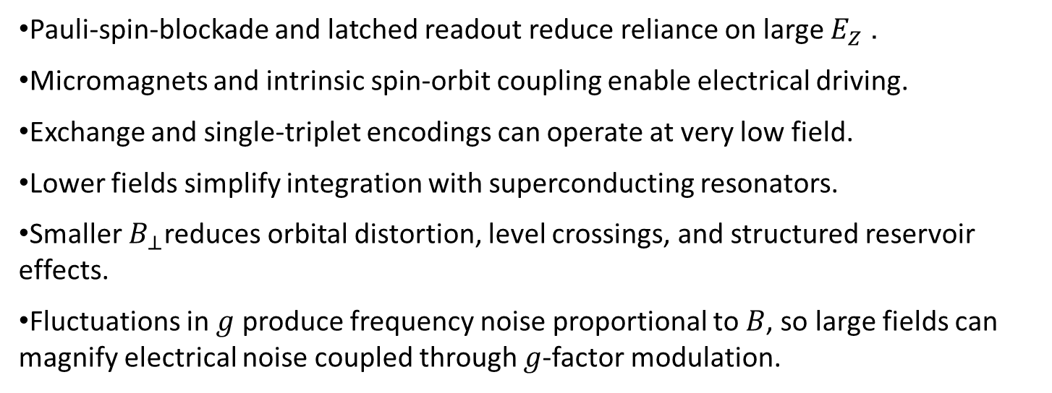
Low-Field Measurements
We learned to do the same jobs in a different way
Pauli-spin-blockade and latched readout reduce reliance on large $E_{Z}$.
Micromagnets and intrinsic spin-orbit coupling enable electrical driving.
Exchange and single-triplet encodings can operate at very low field.
Lower fields simplify integration with superconducting resonators.
Smaller $B_{⊥}$reduces orbital distortion, level crossings, and structured reservoir effects.
Fluctuations in $g$ produce frequency noise proportional to $B$, so large fields can magnify electrical noise coupled through $g$-factor modulation.
More than everything: A setup is easier to build below 1 GHz!

Slide 4
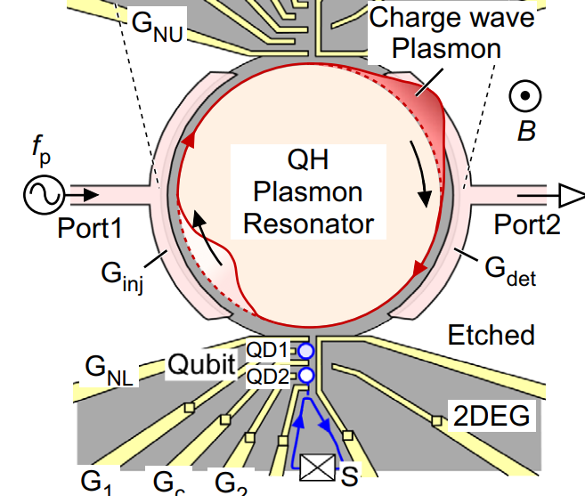
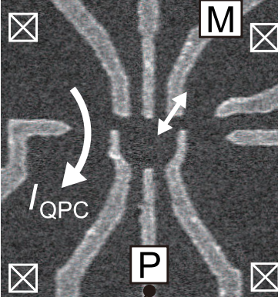
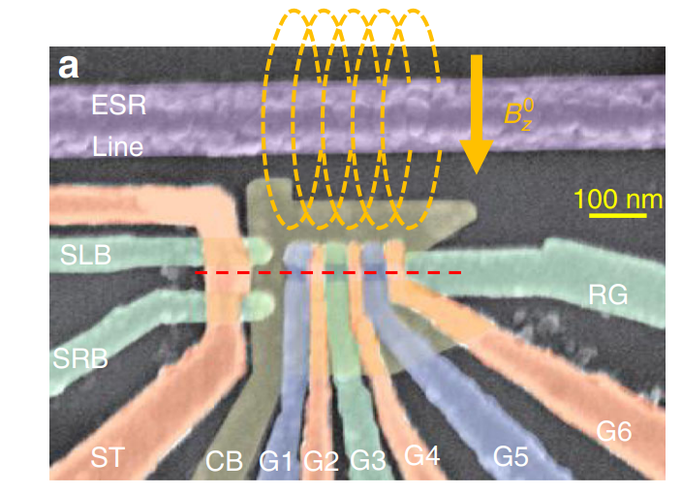
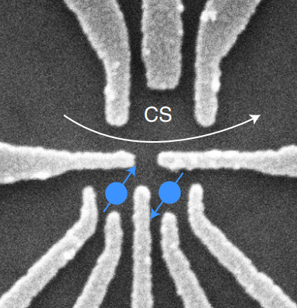
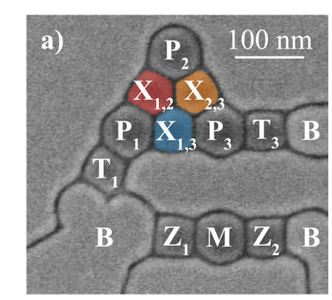
Magnetic fields for spin qubits
-Single-Triplet
-Exchange
-Electron or Hole single-spin qubits
-High-spin experiments
Plasmonic resonator
<0.01 T
0.15 T
1.7 T
>3 T
Kiyama, H. et al.
Preparation and Readout of
Multielectron High-Spin
States in a Gate-Defined
GaAs/AlGaAs Quantum Dot.
Phys. Rev. Lett. 127, (2021).
Lin, C., et al.
Dispersive detection of
a charge qubit with a
broadband high-impedance
quantum-Hall plasmon resonator.
Nat Commun 17, (2026).
Jirovec, D., Hofmann, A., Ballabio, A. et al.
A singlet-triplet hole spin qubit in planar Ge
Nat. Mater. 20 (2021)
Zhao, R., Tanttu, T., Tan, K.Y. et al.
Single-spin qubits in isotopically
enriched silicon at low magnetic field.
Nat Commun 10, (2019)
Broz, J.D., Hoke, J.C., Acuna, E. et al.
Demonstration of an always-on
exchange-only spin qubit.
Nat Commun 17 (2026)
4

Slide 5
One field, Three systems
The Son
The Father
The Holy Ghost
The dot
Zeeman splitting
Fock–Darwin spectrum
Orbital compression and crossings
The fermionic environment
Landau-quantized bulk density of states
Spatially and energetically selective tunnelling
Spin-resolved reservoirs
The bosonic environment
Edge magnetoplasmons.
Chiral microwave propagation
Quantized high impedance
Kiyama, H. et al.
Preparation and Readout of
Multielectron High-Spin
States in a Gate-Defined
GaAs/AlGaAs Quantum Dot.
Phys. Rev. Lett. 127, (2021).
Lin, C., et al.
Dispersive detection of
a charge qubit with a
broadband high-impedance
quantum-Hall plasmon resonator.
Nat Commun 17, (2026).
Notes:
When eta goes up, does that mean that the SAW gets faster or slower?

Slide 6
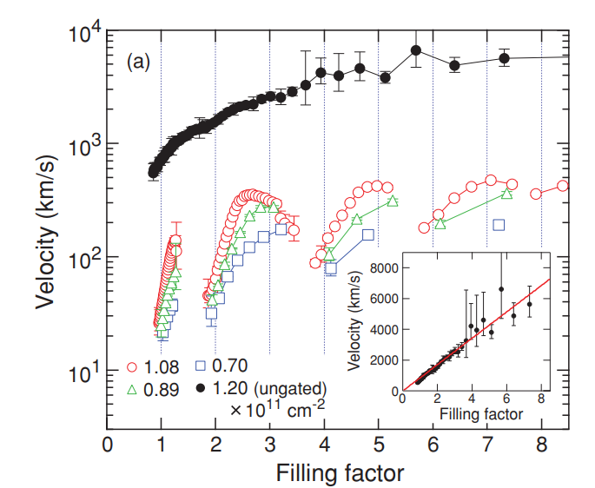

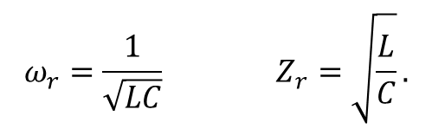
A high impedance resonator
High impedance resonators have large vacuum fluctuation and can couple strongly to DQD
They can be used to readout, perform operation and couple distant qubits
A native solution: using the high impedance edge states of the QHE with the slow EMP modes
$$ω_{r}=\frac{1}{\sqrt{LC}} Z_{r}=\sqrt{\frac{L}{C}}.$$
$Z_{EMP}=h/νe^{2}$At $ν=2$: $Z≃12.9 kΩ$
$$f_{n}=\frac{nv_{EMP}}{D} ⇒D= 20µm⇒f=2 GHz$$
Kumada et al.PRB 84, 045314 (2011)

Slide 7
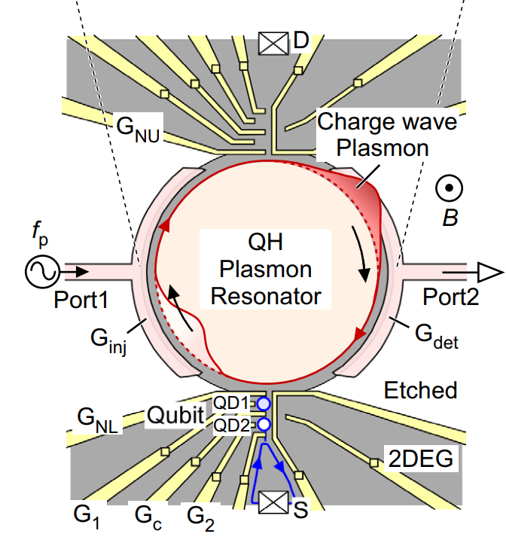
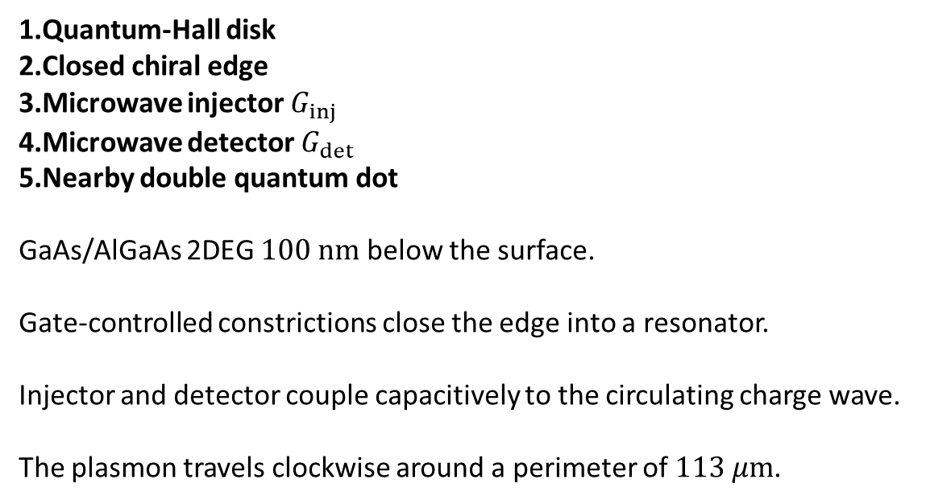
Device layout
Not used in this experiment: future experiment showing coupling?
Quantum-Hall disk
Closed chiral edge
Microwave injector $G_{inj}$
Microwave detector $G_{det}$
Nearby double quantum dot
GaAs/AlGaAs 2DEG $100 nm$ below the surface.
Gate-controlled constrictions close the edge into a resonator.
Injector and detector couple capacitively to the circulating charge wave.
The plasmon travels clockwise around a perimeter of $113 μm$.

Slide 8
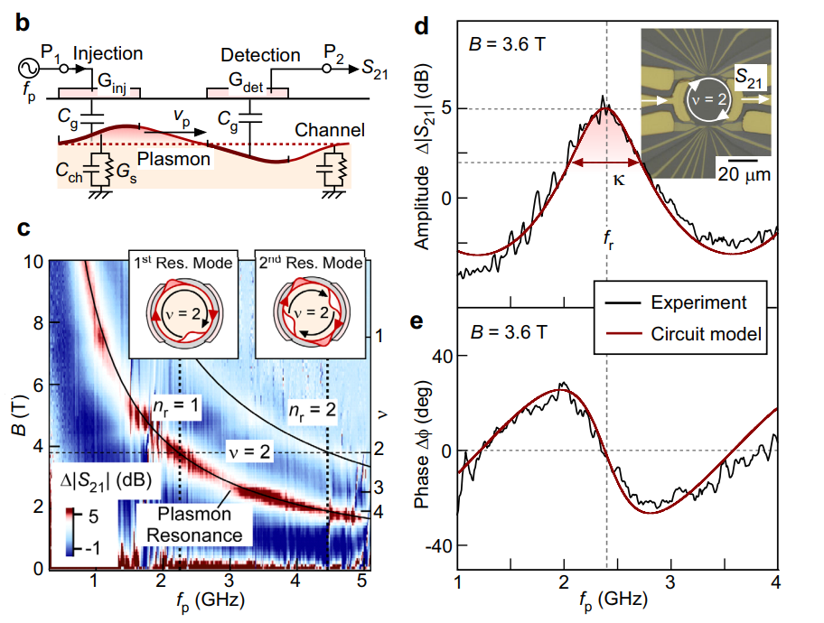
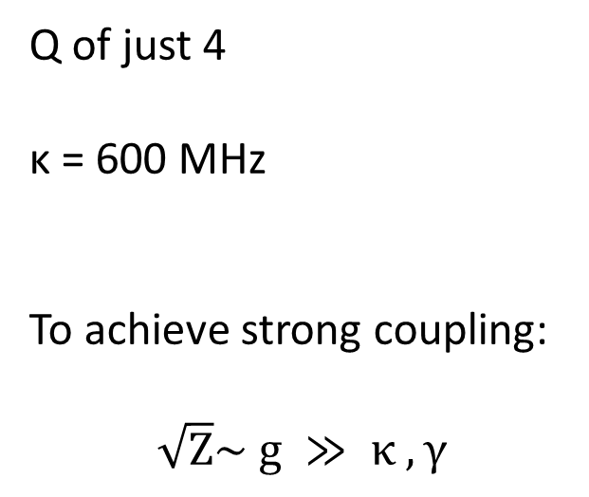
Characterizing the resonator
Q of just 4
κ = 600 MHz
To achieve strong coupling:
$$\sqrt{Z}\sim g ≫ κ , γ$$

Slide 9
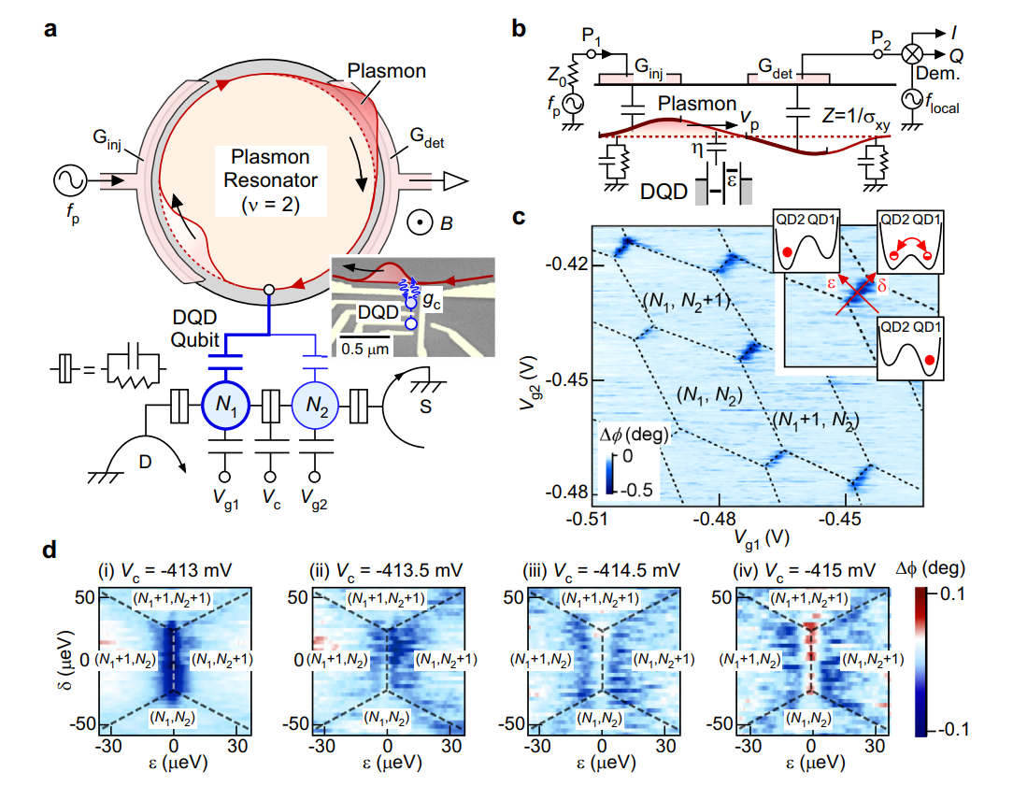
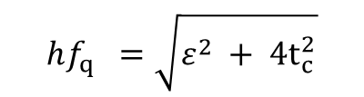
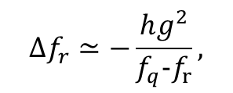
Coupling to the dot
the plasmon’s local electric potential
modulates the DQD detuning
δε = ηeV_{ch}, η ≃ 0.032.
$$hf_{q} =\sqrt{ε^{2} + 4t_{c}^{2}}$$
The electric-dipole coupling is strongest near ε = 0
Where the electron is delocalized
Dispersive
$$Δf_{r}≃−\frac{hg^{2}}{f_{q}-f_{r}},$$
Resonant
(coupling?)

Slide 10
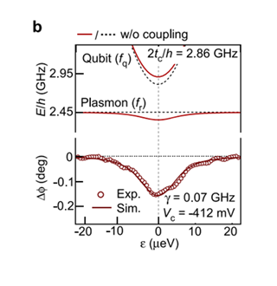
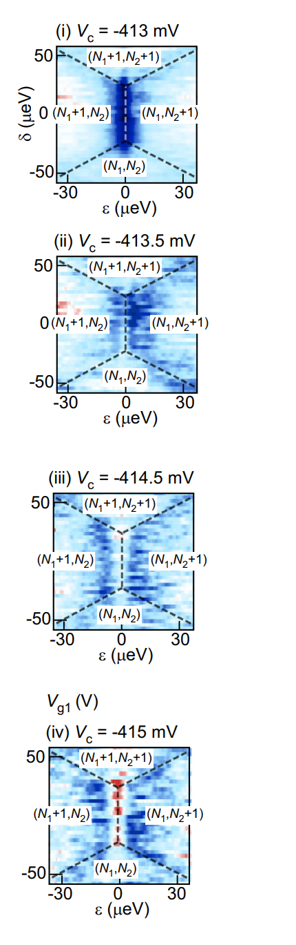
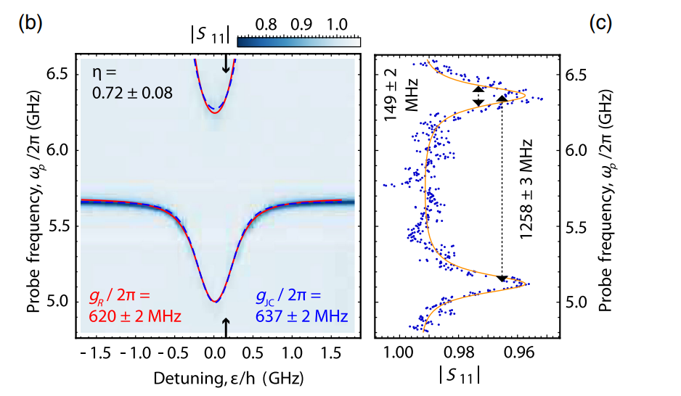
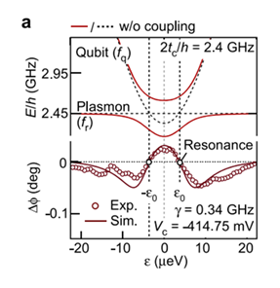
Spectroscopy
NOTE: not a plasmon resonator
JJ array resonator Scarlino PRX 12 2022

Slide 11
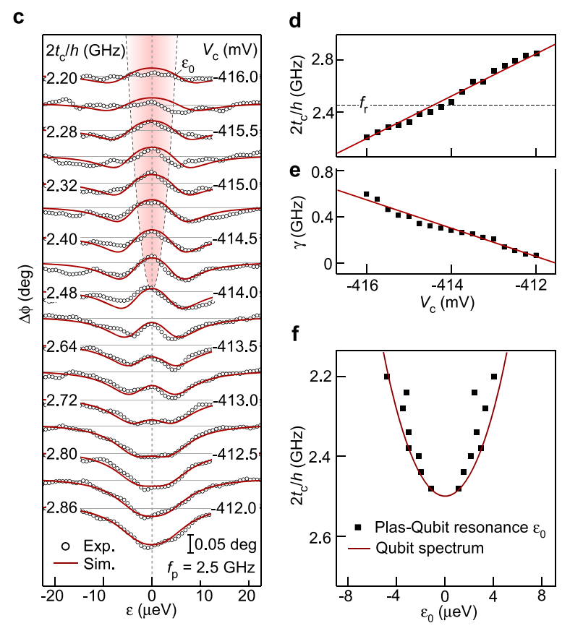
Spectroscopy
Notes:
steady-state phase line shape using a driven-dissipative Jaynes–Cummings master-equation model.
Also, panel 3e is the total decoherence rate
$$γ=\frac{γ_{1}}{2}+γ_{φ},$$
not a clean, independently measured relaxation rate $γ_{1}$. The authors explicitly say that $γ_{1}$and $γ_{φ}$cannot be separated accurately with this measurement.

Slide 12
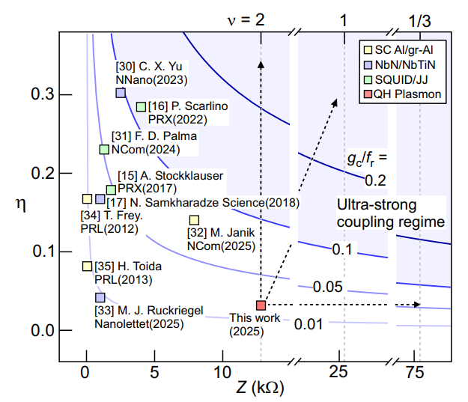
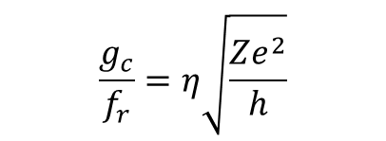
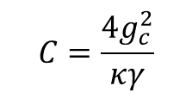
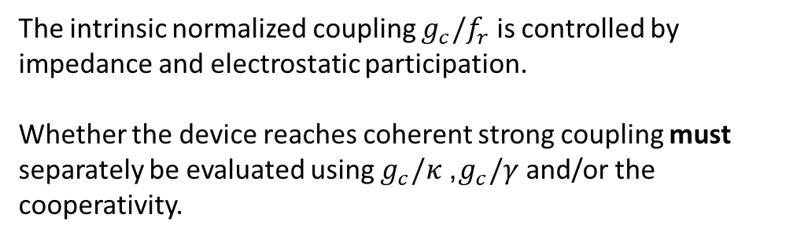
An unfair comparison
$$\frac{g_{c}}{f_{r}}=η\sqrt{\frac{Ze^{2}}{h}}$$
The intrinsic normalized coupling $g_{c}/f_{r}$ is controlled by impedance and electrostatic participation.
Whether the device reaches coherent strong coupling must separately be evaluated using $g_{c}/κ$, $g_{c}/γ$ and/or the cooperativity.
$$C=\frac{4g_{c}^{2}}{κγ}$$

Slide 13
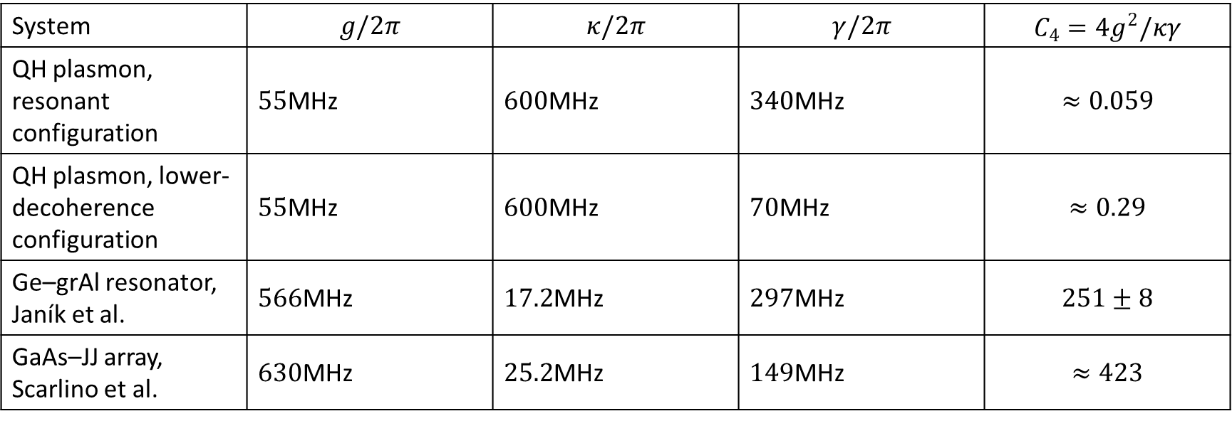
An unfair comparison
System | $$g/2π$$ | $$κ/2π$$ | $$γ/2π$$ | $$C_{4}=4g^{2}/κγ$$
QH plasmon, resonant configuration | $55$MHz | $600$MHz | $340$MHz | $$≈0.059$$
QH plasmon, lower-decoherence configuration | $55$MHz | $600$MHz | $70$MHz | $$≈0.29$$
Ge–grAl resonator, Janík et al. | $566$MHz | $17.2$MHz | $297$MHz | $$251±8$$
GaAs–JJ array, Scarlino et al. | $630$MHz | $25.2$MHz | $149$MHz | $$≈423$$

Slide 14
Conclusion and outlook (for this paper)
An EMP resonator is questionable for the future of cQED based quantum computing, but it could be interesting for:
Broadband dispersive spectroscopy of quantum dots at high magnetic field.
Chiral coupling between distant quantum dots, enabling directional transmission and reduced back-propagation.
Nonreciprocal quantum networks, where the propagation direction is set intrinsically by the magnetic field.
Quantum-Hall and fractional-quantum-Hall experiments, where the dot acts as a probe for anyons and quasiparticles.

Slide 15
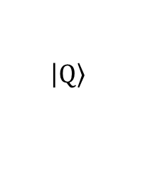
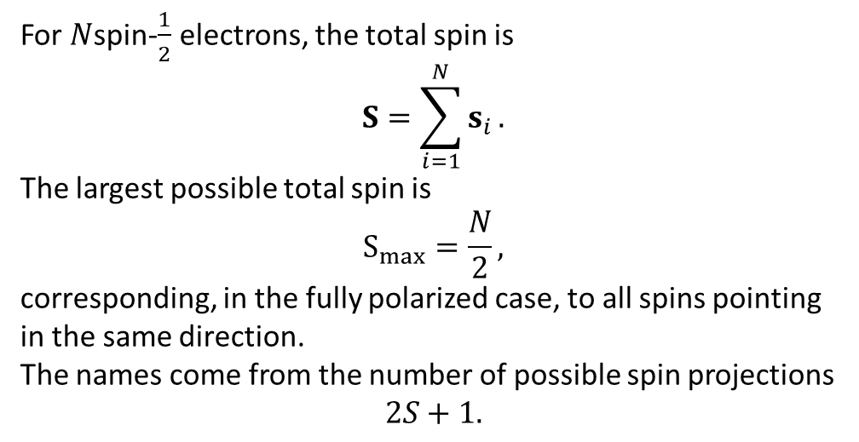
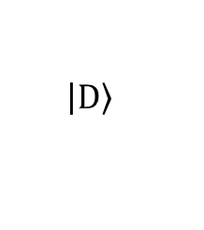
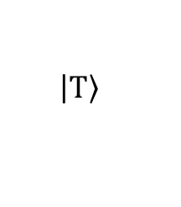
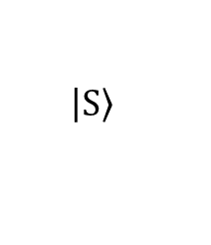
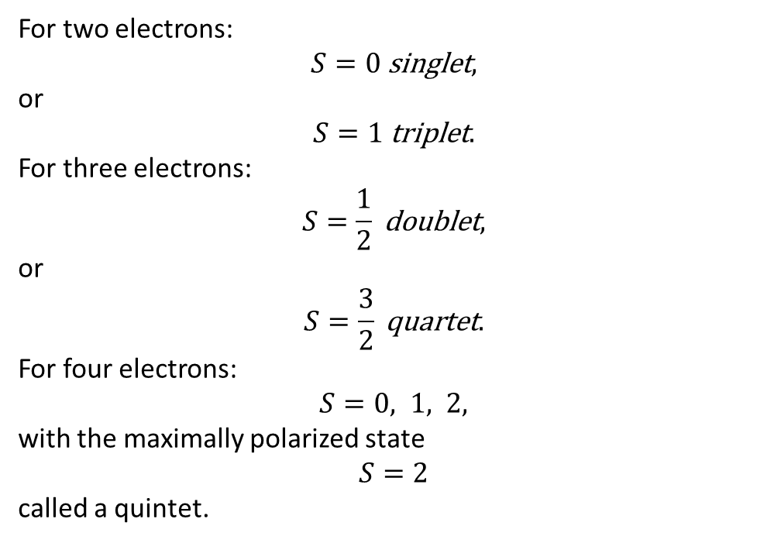
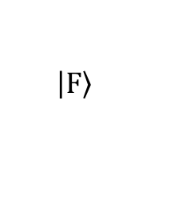
High spin states
For two electrons:
$$S=0 \text{singlet},$$
or
$$S=1 \text{triplet}.$$
For three electrons:
$$S=\frac{1}{2} \text{doublet},$$
or
$$S=\frac{3}{2} \text{quartet}.$$
For four electrons:
$$S=0, 1, 2,$$
with the maximally polarized state
$$S=2$$
called a quintet.
$$\left|\left.S\right\rangle \right.$$
For $N$spin-$\frac{1}{2}$ electrons, the total spin is
$$S=\sum_{i=1}^{N}{s_{i}}.$$
The largest possible total spin is
$$S_{max}=\frac{N}{2},$$
corresponding, in the fully polarized case, to all spins pointing in the same direction.
The names come from the number of possible spin projections
$$2S+1.$$
$$\left|\left.T\right\rangle \right.$$
$$\left|\left.D\right\rangle \right.$$
$$\left|\left.Q\right\rangle \right.$$
$$\left|\left.F\right\rangle \right.$$
Notes:
At larger perpendicular field:
the Fock–Darwin orbital spectrum changes;
orbital gaps can shrink;
exchange becomes more important;
Zeeman energy favours aligned spins.

Slide 16
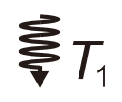
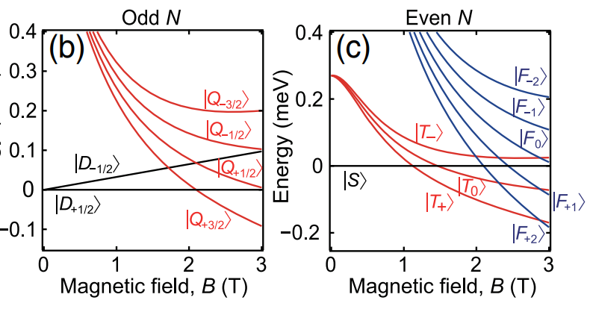
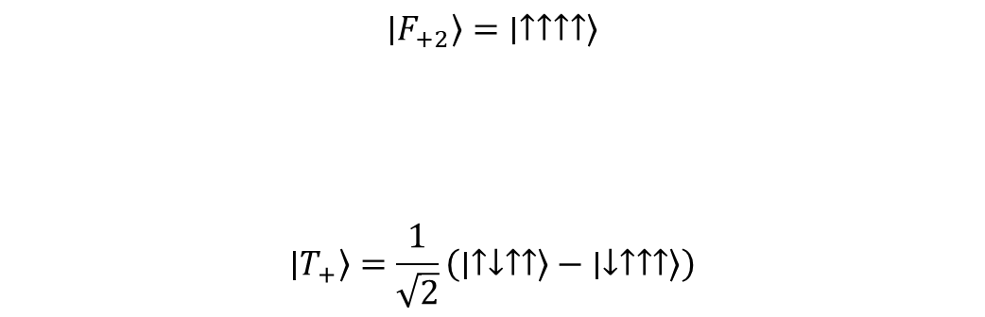
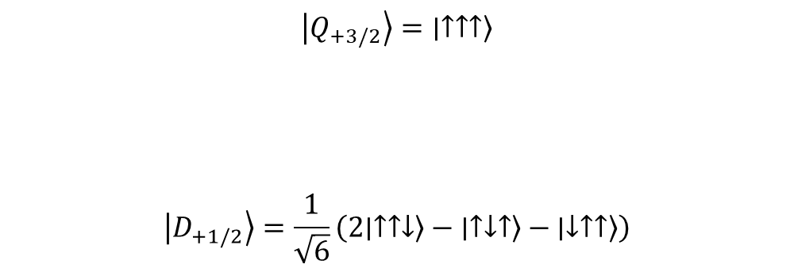
Fock Darwin spectrum
$$∣Q_{+3/2}⟩=∣↑↑↑⟩$$
$$∣D_{+1/2}⟩=\frac{1}{\sqrt{6}}\left(2∣↑↑↓⟩−∣↑↓↑⟩−∣↓↑↑⟩\right)$$
$$∣F_{+2}⟩=∣↑↑↑↑⟩$$
$$∣T_{+}⟩=\frac{1}{\sqrt{2}}\left(∣↑↓↑↑⟩−∣↓↑↑↑⟩\right)$$
Notes:
At larger perpendicular field:
the Fock–Darwin orbital spectrum changes;
orbital gaps can shrink;
exchange becomes more important;
Zeeman energy favours aligned spins.

Slide 17
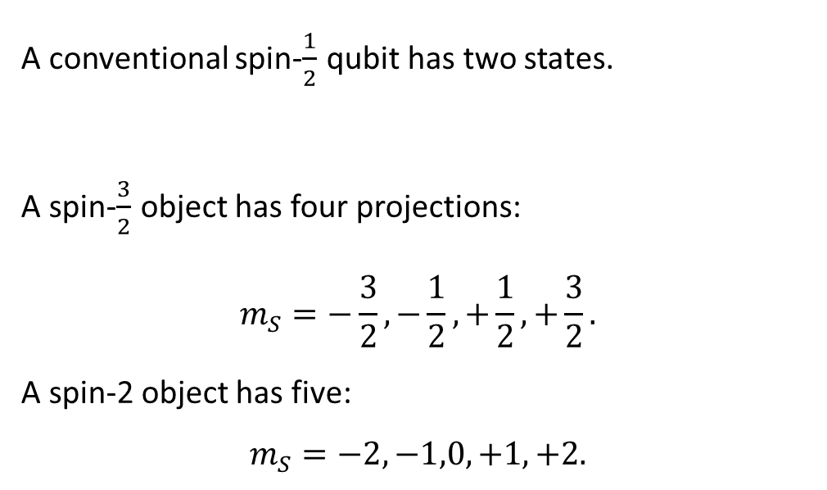
A Larger Hilbert space
A conventional spin-$\frac{1}{2}$ qubit has two states.
A spin-$\frac{3}{2}$ object has four projections:
$$m_{S}=−\frac{3}{2},−\frac{1}{2},+\frac{1}{2},+\frac{3}{2}.$$
A spin-2 object has five:
$$m_{S}=−2,−1,0,+1,+2.$$
This could be used as:
a multilevel qudit.
an encoded qubit.
an ancilla.
a larger local quantum register.

Slide 18
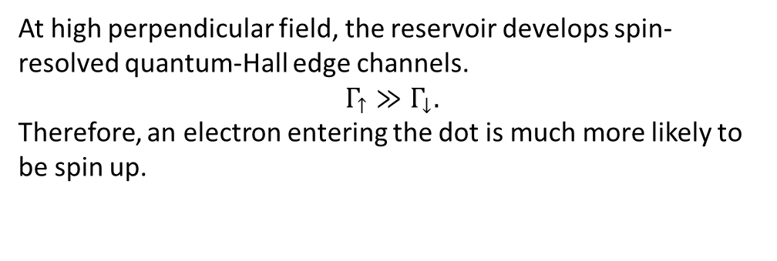
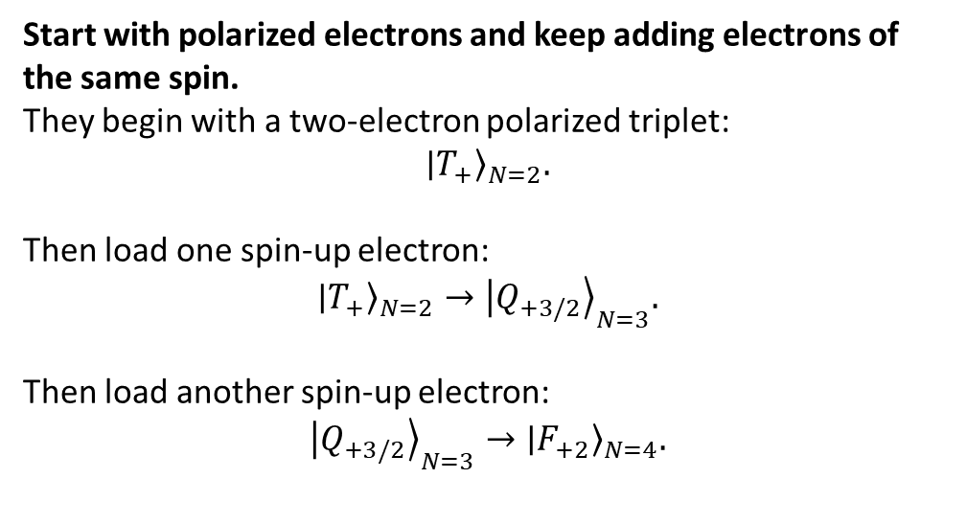
How to prepare a high spin state
Start with polarized electrons and keep adding electrons of the same spin.
They begin with a two-electron polarized triplet:
$${∣T_{+}⟩}_{N=2}.$$
Then load one spin-up electron:
$${∣T_{+}⟩}_{N=2}→{∣Q_{+3/2}⟩}_{N=3}.$$
Then load another spin-up electron:
$${∣Q_{+3/2}⟩}_{N=3}→{∣F_{+2}⟩}_{N=4}.$$
At high perpendicular field, the reservoir develops spin-resolved quantum-Hall edge channels.
$$Γ_{↑}≫Γ_{↓}.$$
Therefore, an electron entering the dot is much more likely to be spin up.
Problem: How do we add only spin up electrons?
Quantum-Hall edge spin filtering

Slide 19
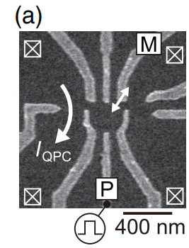
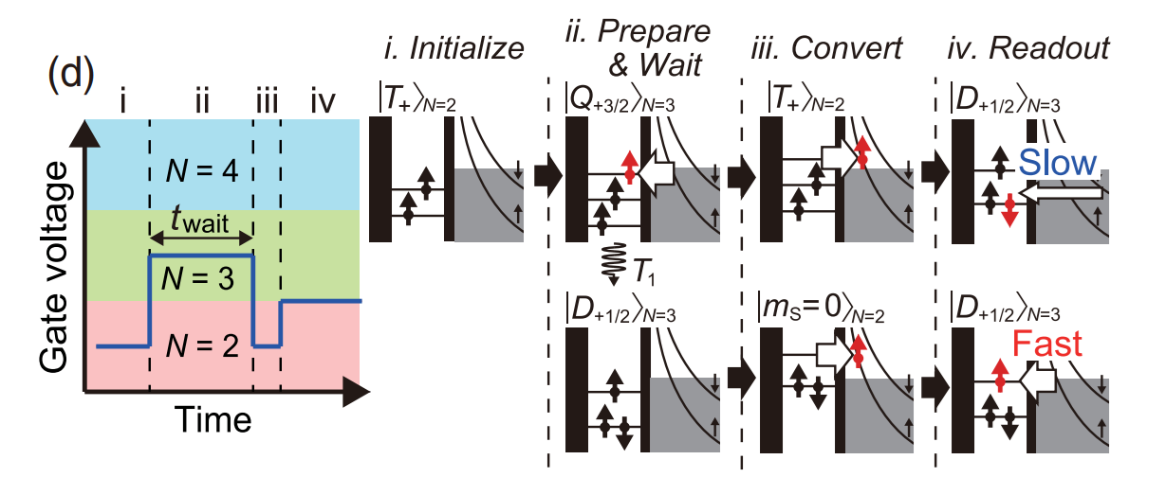
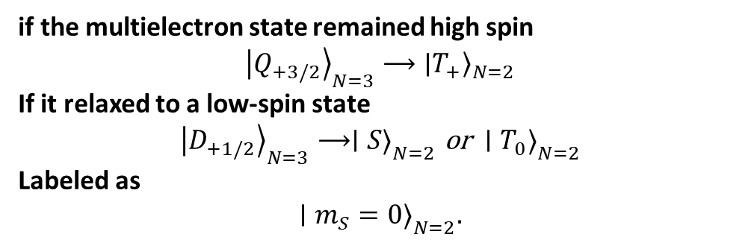
Odd states
if the multielectron state remained high spin
$${∣Q_{+3/2}⟩}_{N=3}⟶{∣T_{+}⟩}_{N=2}$$
If it relaxed to a low-spin state
$${∣D_{+1/2}⟩}_{N=3}⟶∣S{\left.⟩\right.}_{N=2} \text{or} ∣T_{0}{\left.⟩\right.}_{N=2}$$
Labeled as
$$∣m_{S}=0{\left.⟩\right.}_{N=2}.$$

Slide 20
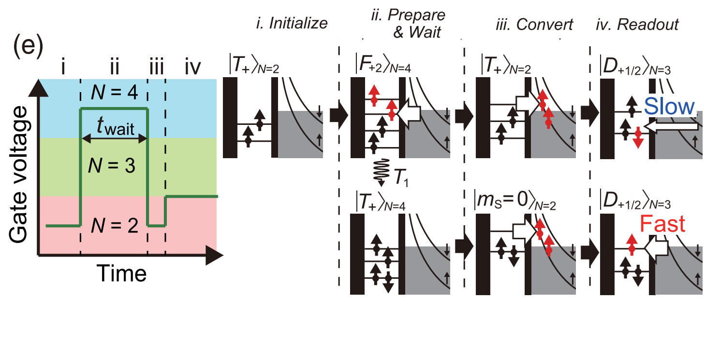
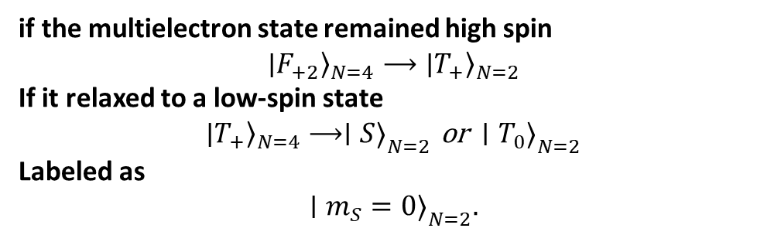
Even electrons
if the multielectron state remained high spin
$${∣F_{+2}⟩}_{N=4}⟶{∣T_{+}⟩}_{N=2}$$
If it relaxed to a low-spin state
$${∣T_{+}⟩}_{N=4}⟶∣S{\left.⟩\right.}_{N=2} \text{or} ∣T_{0}{\left.⟩\right.}_{N=2}$$
Labeled as
$$∣m_{S}=0{\left.⟩\right.}_{N=2}.$$

Slide 21
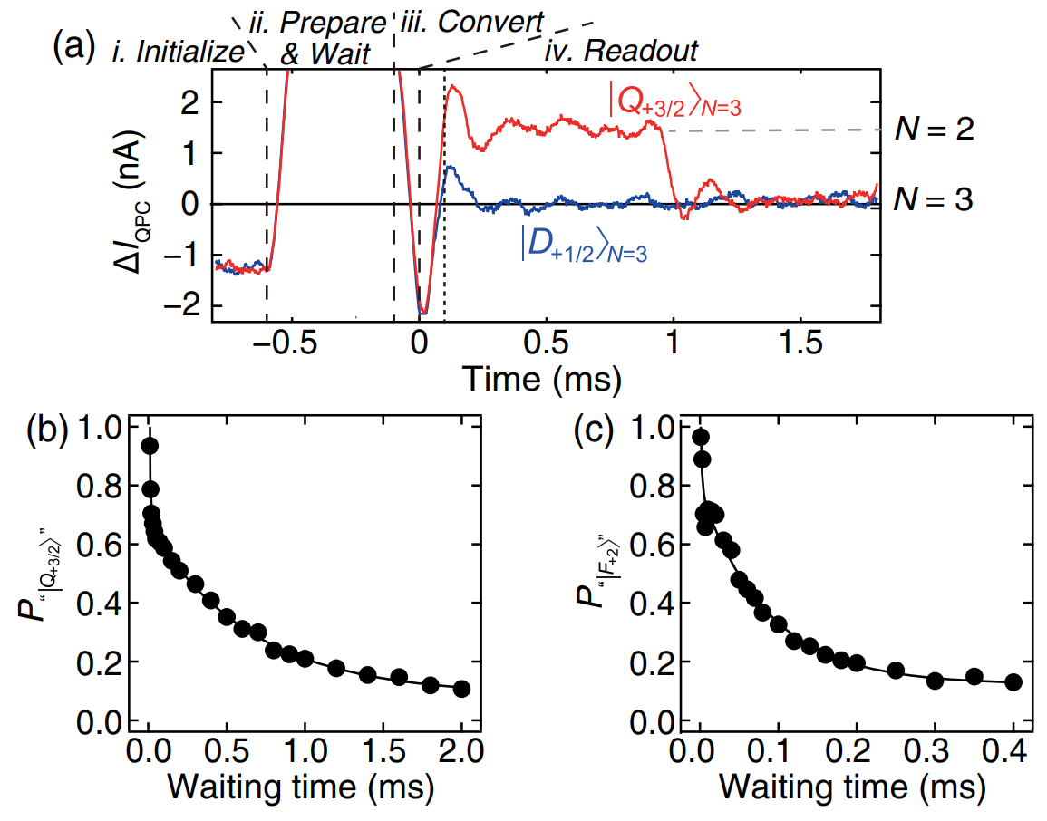
Single-shot and relaxation
Notes:
Measured tunnel rates are approximately:
$Γ_{slow}≃500 Hz, Γ_{fast}≃30 kHz.$
The four-electron quintet relaxes almost eight times faster than the three-electron quartet.

Slide 22
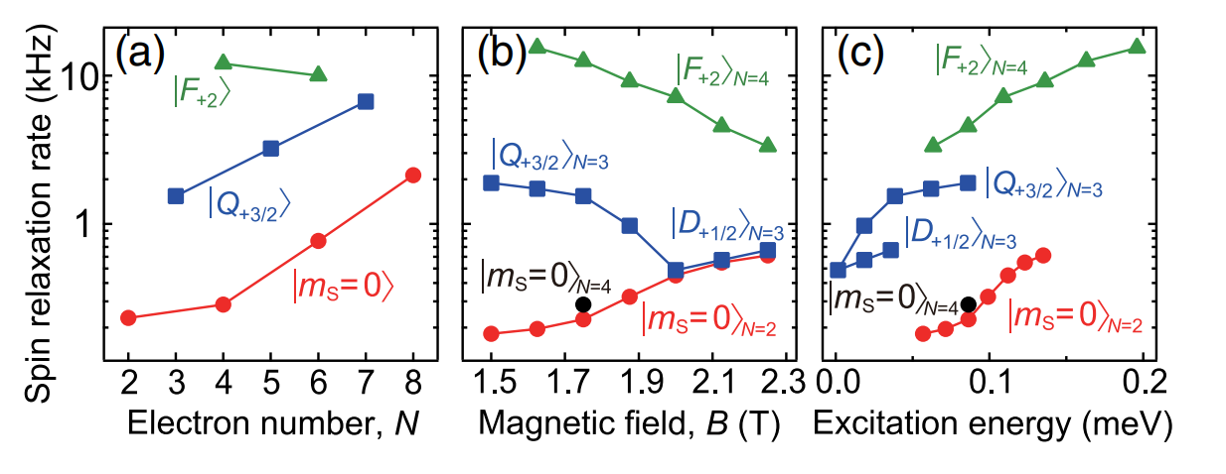
Study of relaxation rate
Magnetic field controls the spectrum, but excitation energy and many-body spin structure control the relaxation.

Slide 23

Electron correlations
Exact diagonalization numerically with phonon-assisted spin-relaxation rates reproduce the experimental trend
high-spin states relax faster than low-spin states even at equal excitation energy and equal electron number. Strong effects of electron correlation and spin–orbit mixing.
Notes:
Spin relaxation rates calculated using the exact diagonalization method.

Slide 24


Conclusion and outlook (for this paper)
High spin states offer interesting insight in many body physics and with spin polarized reservoirs we can perform easy readout
Polarized reservoirs are fun.
Spin-resolved edge channels produce strongly spin-dependent tunnel rates,
$$Γ_{↑}≫Γ_{↓},$$
A ferromagnetic contact could polarize the reservoir as well
How to read high spin states
$$\text{complex} \text{high}\text{−}\text{spin} \text{state}→$$
$$\text{simple} \text{two}\text{−}\text{electron} \text{state}→\text{charge} \text{readout}.$$
High spin is not protected.
At equal excitation energy and even equal electron number, the high-spin states relax faster.
What changes in Si/SiGe?
Potential advantages: isotopic purification and weaker spin orbit coupling may reduce some spin-relaxation channels; high-mobility Si/SiGe wells can support quantum-Hall edge states.
Main complication: valleys.
Valley-resolved states and edge channels add another quantum number, so the relevant hierarchy becomes
$$Δ_{orb}, Δ_{v}, E_{Z}, J.$$
Valley mixing could reduce spin-filtering fidelity or create additional leakage paths during the mapping sequence.

Slide 25

Summary
High magnetic fields change the qubit environment, not only the Zeeman splitting: quantum-Hall edges provide both a chiral bosonic mode and a spin-selective fermionic reservoir.
EMP resonator: its quantized high impedance enables broadband dispersive detection of a nearby charge qubit, but the present low $Q$and large $κ$ keep the device in the weak-coupling regime.
High-spin states: spin-resolved edge channels enable polarized loading of $S=3/2$ and $S=2$ states, while mapping them back to $N=2$ avoids direct readout of a complex spectrum.
Main trade-off: high field provides new control resources, but also introduces complex orbital spectra, stronger correlations and faster relaxation

Slide 27


Several mechanisms
27

Slide 28



Population and back action
$$Microwave Power⟶V_{d}⟶n_{pl}⟶\text{qubit} \text{excitation}.$$
At low power, the probe mainly measures the qubit.
At high power, it also changes the qubit population.
polarized qubit: strong phase and amplitude response;
partially saturated qubit: smaller response;
fully saturated qubit, $P_{z}=0$: dispersive signal disappears.
Notes:
Fig B> model with the master equation model
he resonator contains a thermal contribution and a driven contribution:
$$n_{pl}=n_{pl,th}+n_{pl,drv}.$$
They estimate
$$n_{pl,th}≃0.45,$$
and, near the resonator frequency in the weak-coupling limit,
$$n_{pl,drv}≃{\left(\frac{2eV_{d}}{hκ}\right)}^{2}.$$
K uncertain scaling factor

