Slide 1

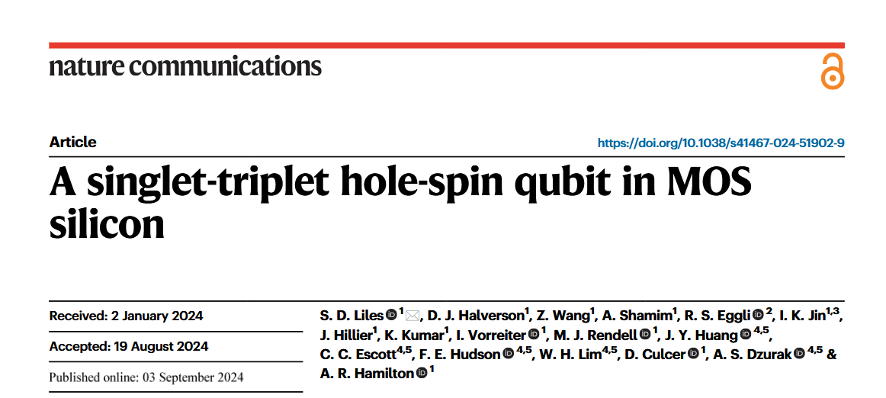

Slide 2
Why Singlet-Triplet? Why holes? Why MOS?
Singlet-Triplet
+ Low B (<5 mT)
+ No GHz (baseband)
- Footprint
- Complex eigenstates
Holes
+ Large intrinsic SO
+ Tunable g-factor & SO
+ Suppressed hyperfine
+ Potential sweet spot
- Large intrinsic SO
Silicon MOS
+ Scalable
+ CMOS compatible
- Bad interface
- Charge Noise
Anisotropic exchange coupling!
Theory predicts leakage error prevention?
ST hole qubit in Silicon MOS not yet shown!

Slide 3
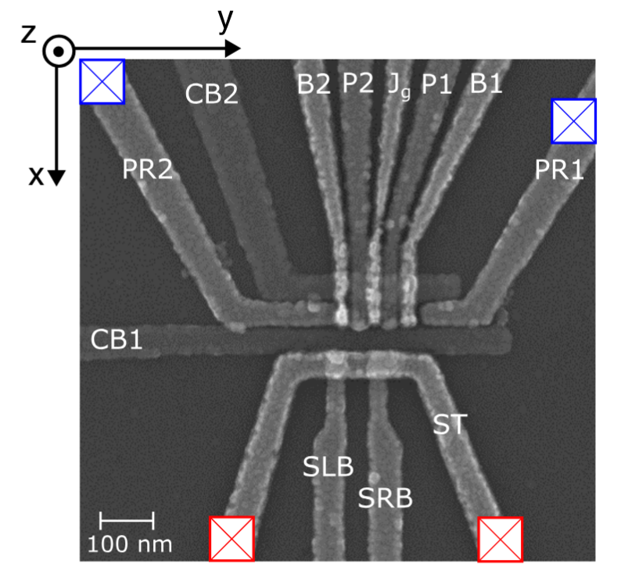
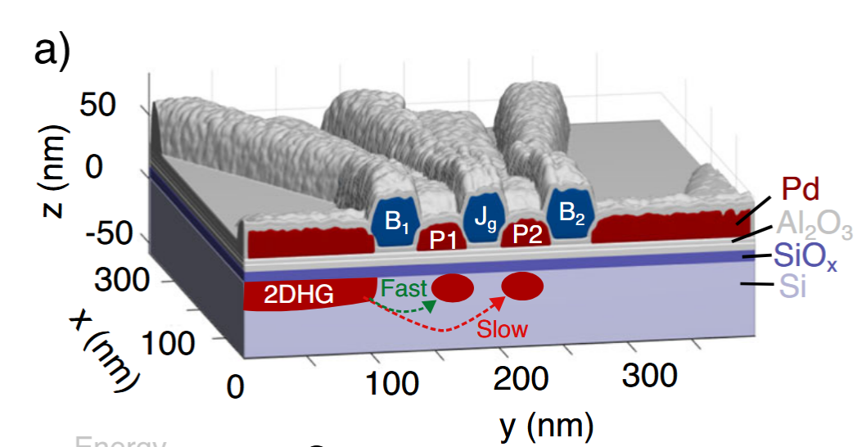
Device & Fabrication
Γ_{L} > 10 MHz, Γ_{R} < 30 kHz, t_{c} > 1 GHz

Slide 4
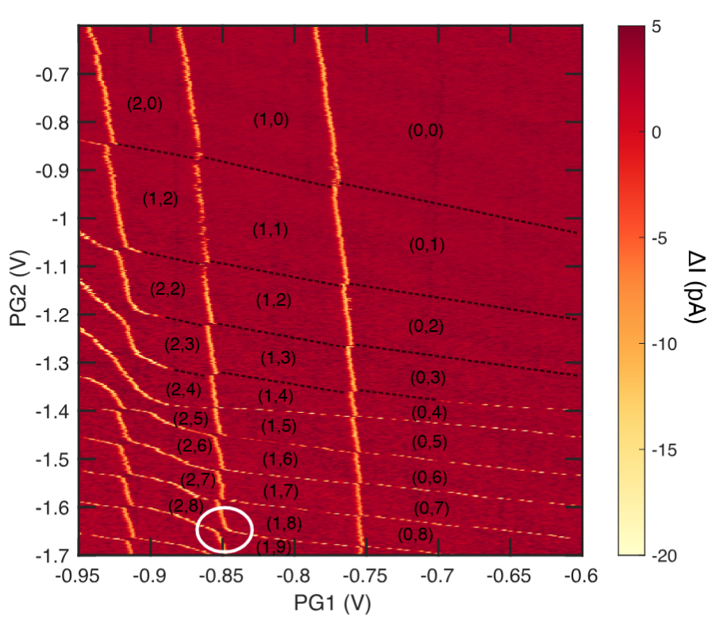
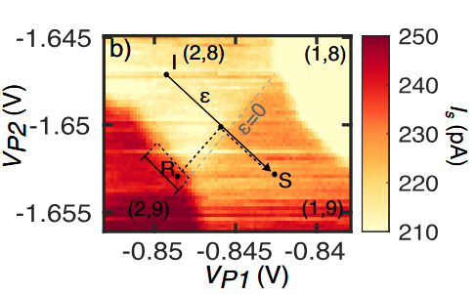
Charge Stability Diagram

Slide 5
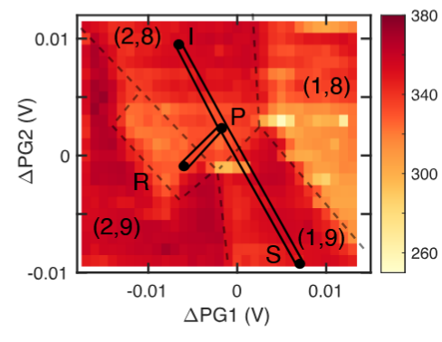
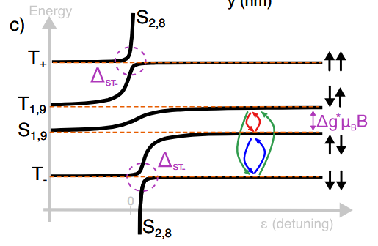
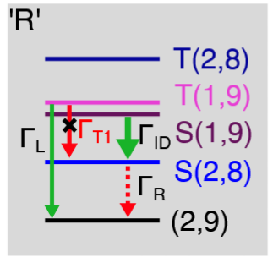
Singlet-Triplet & Readout

Slide 6
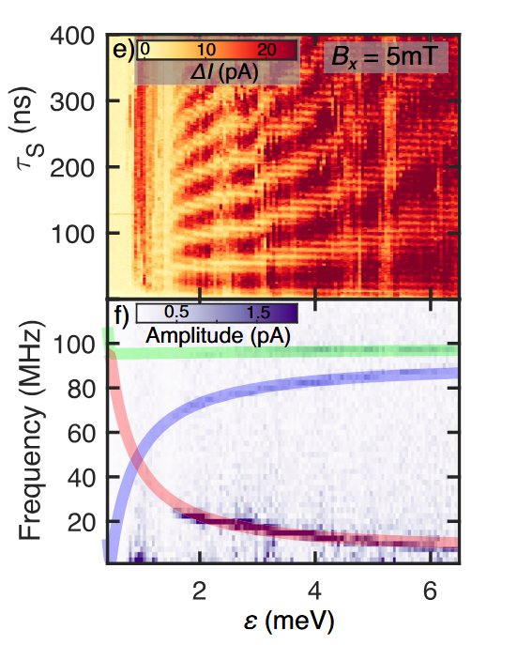
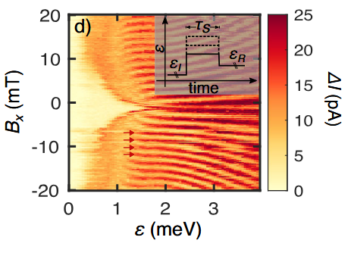
Magnetospectroscopy
t_{c} = 9 ± 1 μeV
Eff. g-factors:
0.8 ± 0.1
1.2 ± 0.1

Slide 7
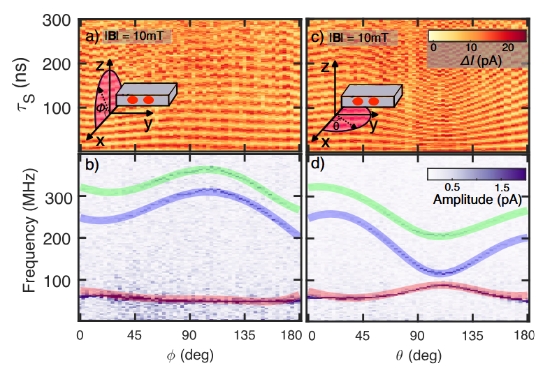
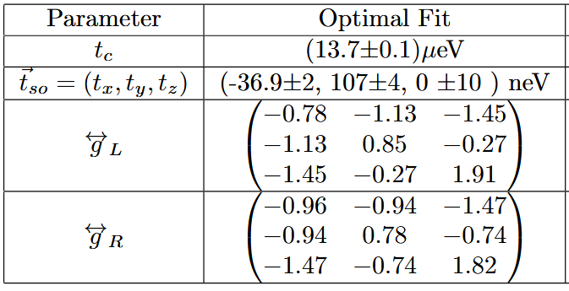
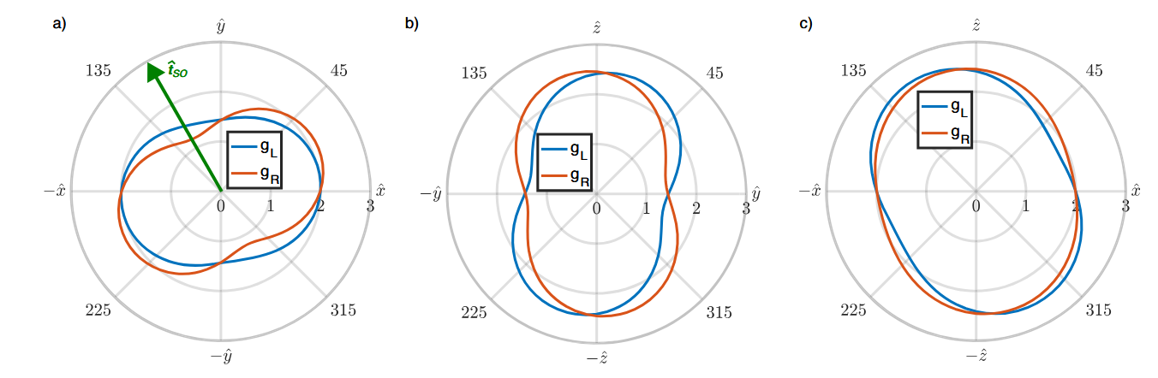
Anisotropic g-tensors

Slide 8
Anisotropic g-tensors

Slide 9
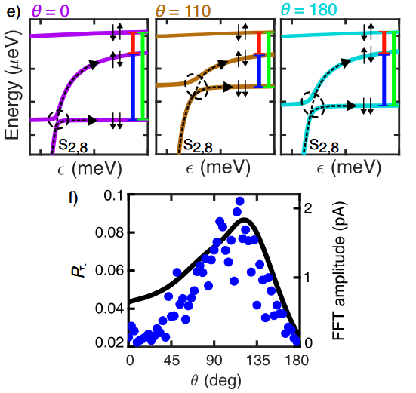
Anisotropic of the FFT amplitudes

Slide 10

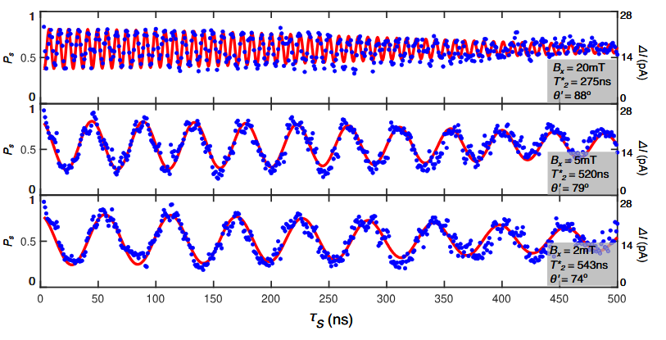
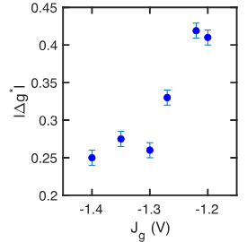
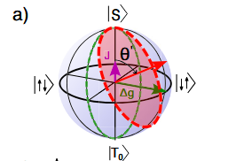
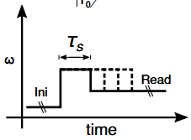
Coherent Δg-driven oscillations
J = 6 MHz @ ϵ = 1.9 meV
∣Δg∣ = 0.41

Slide 11
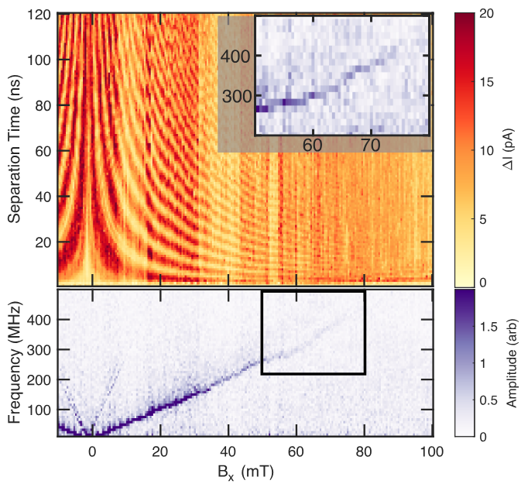
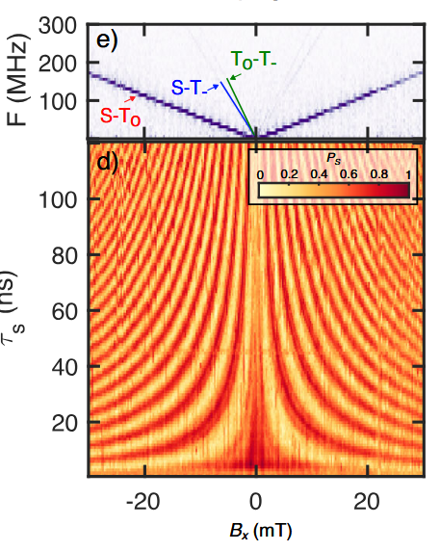
Coherent Δg-driven oscillations

Slide 12
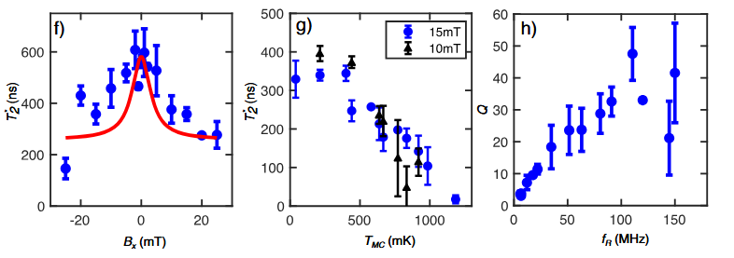
Dephasing
δϵ = 30 μeV and δΔE_{Z} = 4 neV

Slide 13
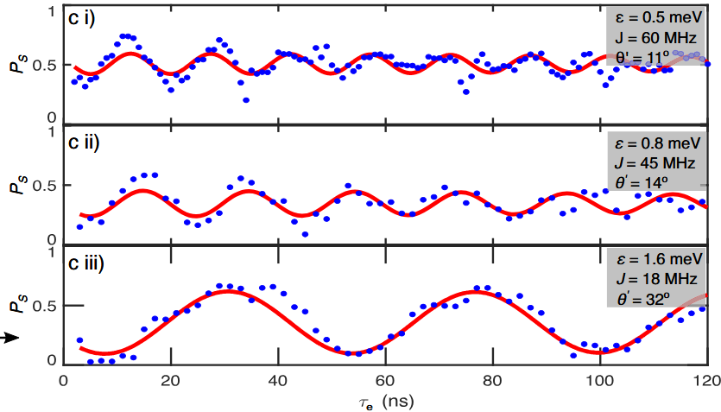
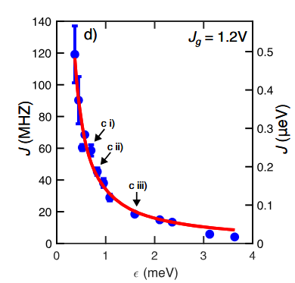
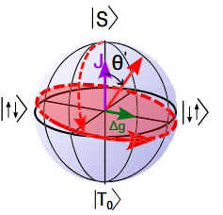
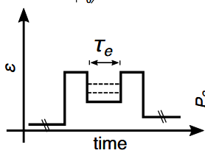
Coherent exchange-driven oscillations

Slide 14
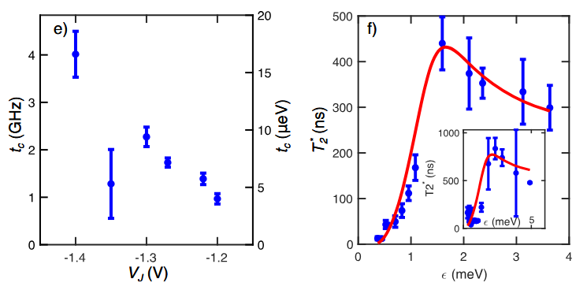
Coherent exchange-driven oscillations

Slide 15
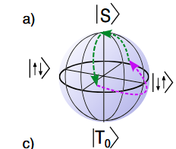
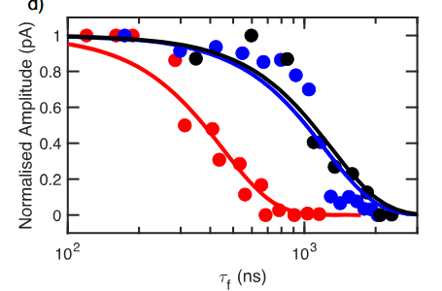
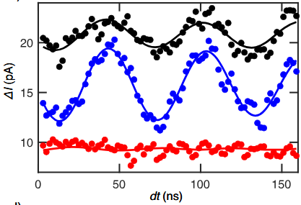
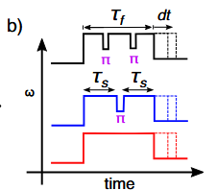
Spin-echo measurement
T₂^{Echo} = 550 ± 50 ns @ 0 echo
T₂^{Echo} = 1220 ± 150 ns @ 1 echo
T₂^{Echo} = 1300 ± 200 ns @ 2 echos

Slide 16
Conclusion
Characterized Anisotropic g-tensors and t_{SO}
Shown coherent Δg-driven oscillations
Shown coherent exchange-driven oscillations
Demonstrated spin echo pulse

