Slide 1

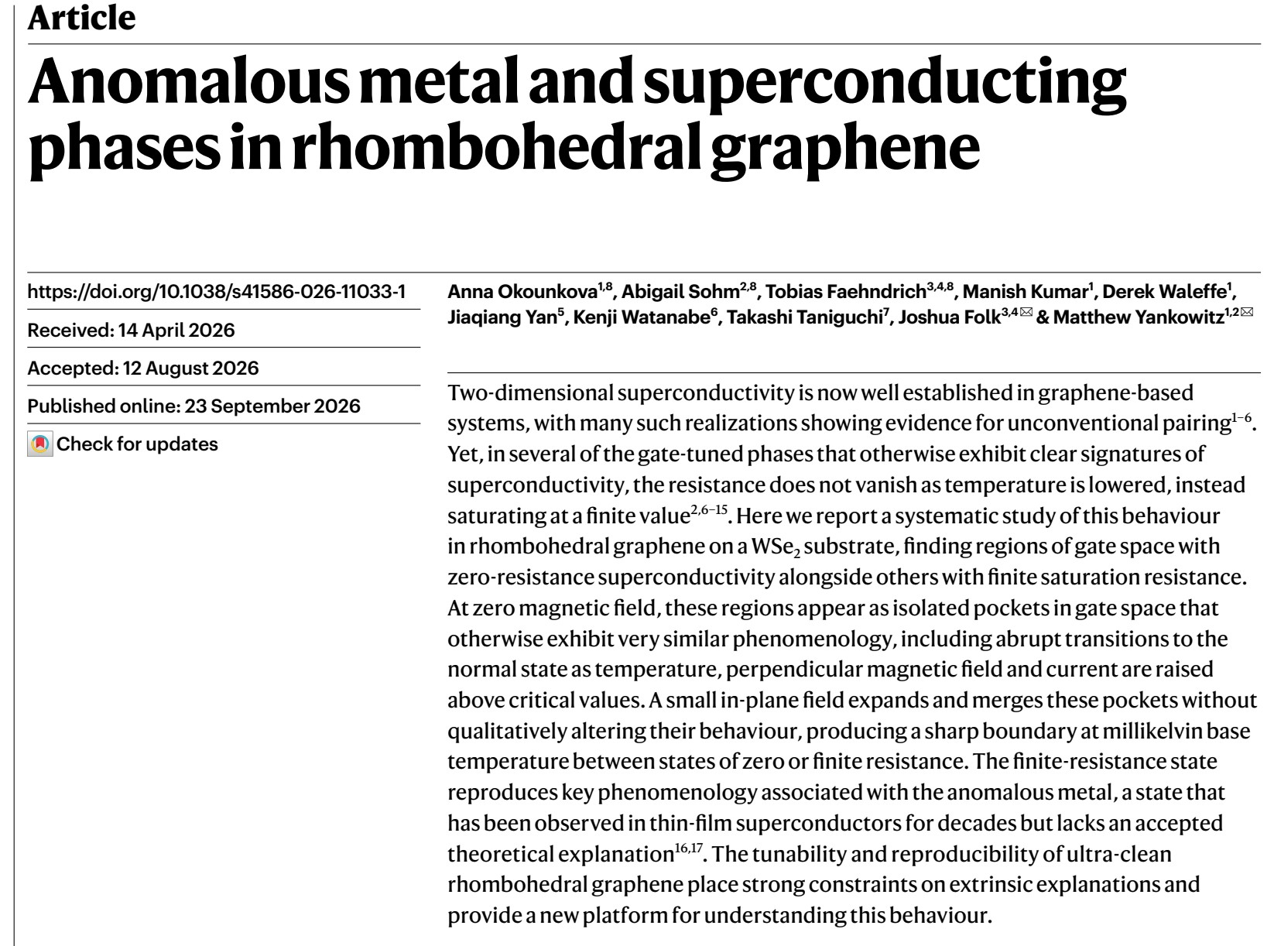
Anomalous metal and superconducting phases in rhombohedral graphene
Journal Club, Fall 2026
A. Okounkova, A. Sohm, T. Faehndrich, …, J. Folk & M. Yankowitz
UW Seattle and UBC Vancouver
Nature 658, 65–70 (2026)
Kristupas Razas, 08.10.2026
Notes:
Today: a Nature paper from the Yankowitz (UW) and Folk (UBC) groups on regions in rhombohedral graphene that look superconducting but never reach zero resistance. I will connect it to our own MIT–Basel papers, where the same question came up.

Slide 2
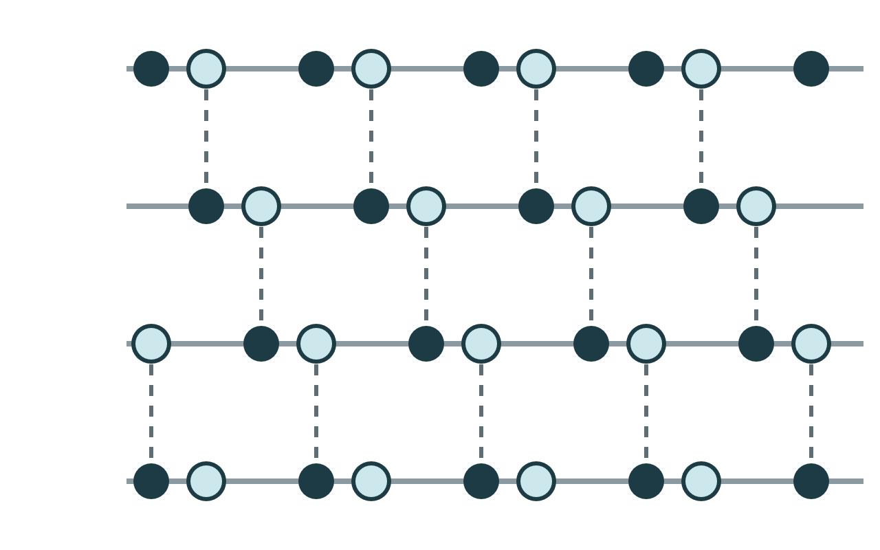
Rhombohedral graphene
Flat bands
A
Low-energy band E ∝ kᴺ: kinetic energy is quenched, interactions dominate.
Gate-tunable
B
Top and bottom gates set density n and displacement field D independently.
Isospin order
Spin and valley polarize into half / quarter / unpolarized metals.
C
Superconductivity
More than ten superconducting states, across bilayers to more than ten layers.
A
Ultra-clean
ABC stacking: each layer shifted by one carbon bond. Dashed lines are interlayer dimers.
No twist angle, no moiré, clean limit ξ/ℓ ≪ 1.
n = (CₜVₜ + C_bV_b)/e, D = (CₜVₜ − C_bV_b)/2ε₀
2
Notes:
Short reminder from previous journal clubs. Rhombohedral = ABC stacking. The band becomes flatter with layer number, so interactions win. Two gates give two independent knobs, n and D. Interactions polarize spin and valley; superconductors appear next to these isospin transitions. Key advantage over twisted graphene: no twist-angle disorder, very clean.

Slide 3
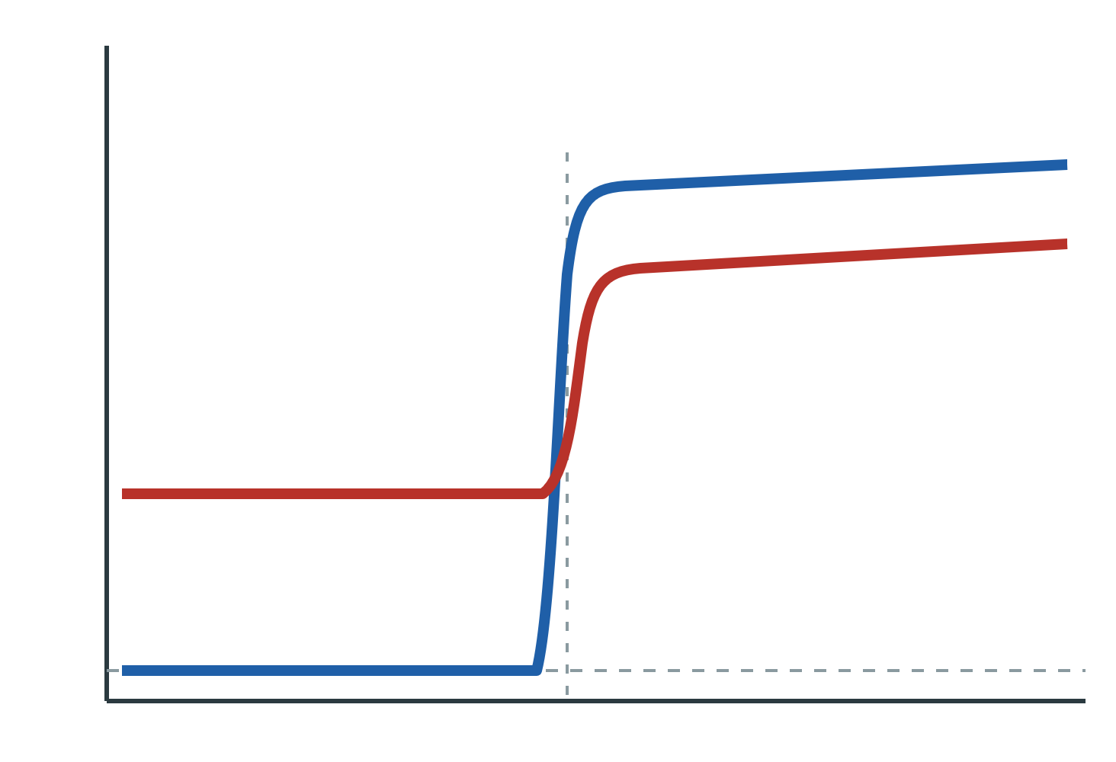
The puzzle: resistance that never reaches zero
R
normal state
Intrinsic new state or caused externally (noise, inhomogeneity, contacts)?
AM: R saturates
SC: R → 0
Tc
T
3
Notes:
Many superconducting pockets in graphene show everything you expect from a 2D superconductor, except the resistance does not go to zero. It levels off. Nobody knows why. This is one of the most discussed open questions right now, and we ran into it ourselves.

Slide 4
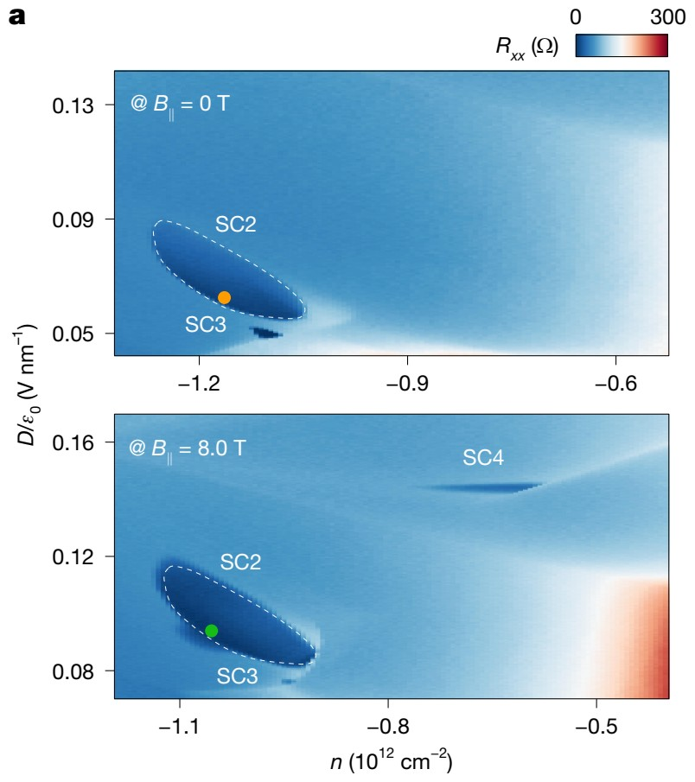
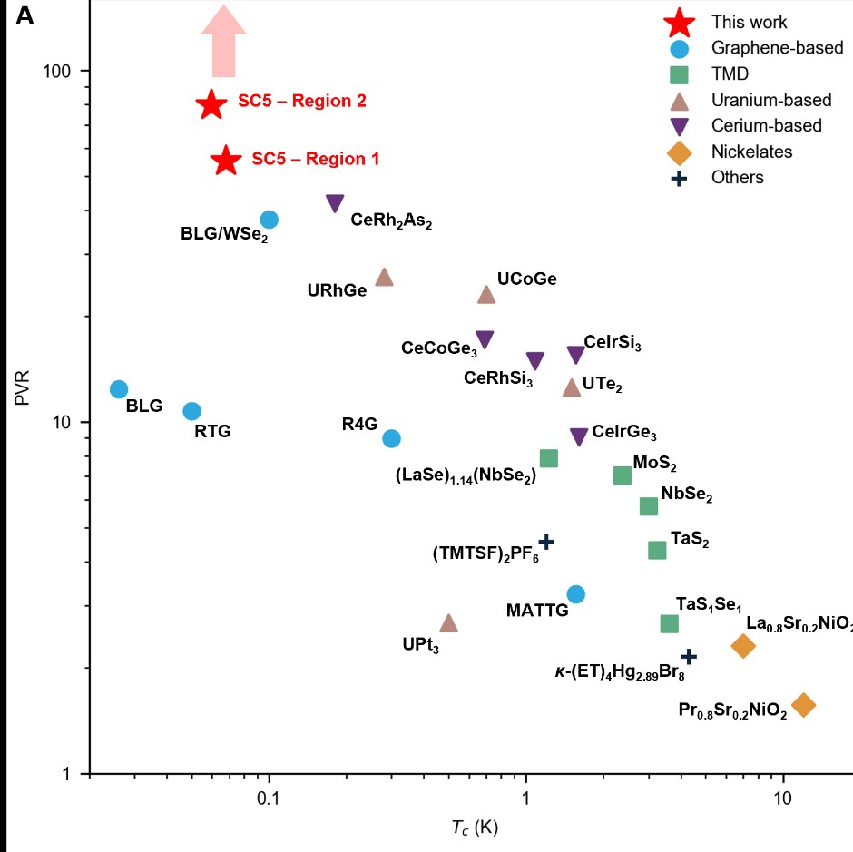
MIT–Basel collaboration
Family of magnetic field-boosted superconductors
Seo, Cotten, Ye et al. — Nature 656, 60 (2026)
R4G and R5G: SC1–SC4 without WSe₂, further superconductors with WSe₂
Superconductors enhanced, or even induced, by in-plane and out-of-plane field
Robust to B∥ = 8.5 T (tens of times the Pauli limit)
Reproduced in 7 devices and 2 fridges (MIT and Basel)
Record Pauli-limit violation in graphene
Yang, Sharifi Sedeh, Yoon, Ye et al. — arXiv:2510.10873
SC5 in WSe₂-encapsulated rhombohedral trilayer: Tc ≈ 68 mK, B⊥c ≈ 12 mT
Enhanced by in-plane field and still superconducting at 8.835 T
Pauli-limit violation ratio ≥ 80, the highest reported
Improved filtering and noise suppression revealed this zero-resistance state
4
Notes:
Two collaboration papers. First: a whole family of superconductors in four- and five-layer graphene that get stronger in magnetic field; Basel did the high in-plane field measurements. Second: SC5 in trilayer on WSe2 with a record Pauli-limit violation. Note the last line: the new state only appeared after improving filtering. That is important for today.

Slide 5
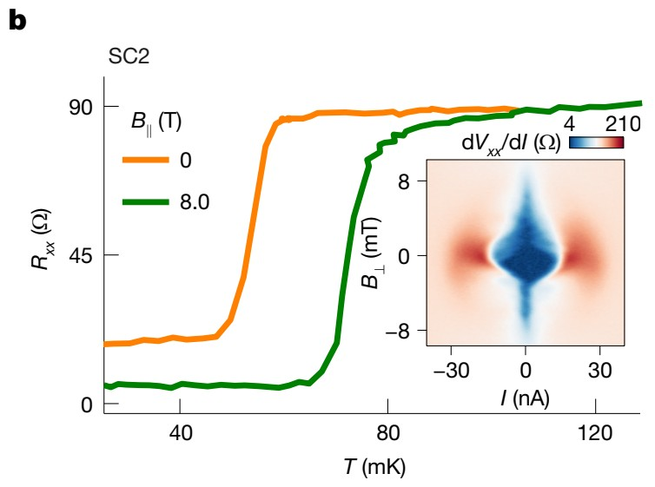
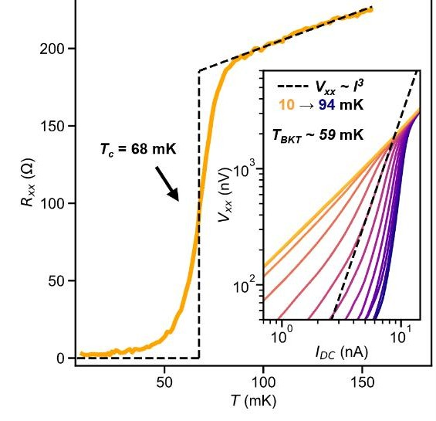
Residual resistance
Seo et al.: residual R noted for SC2 and SC4; possible non-superconducting islands; Fraunhofer-like patterns used as evidence for SC.
Filtering (extrinsic) matters: improved setup revealed a zero-resistance state that was hidden before.
Seo et al., SC2: resistance levels off well above zero at 0 T (orange); lower, but still finite, at 8 T (green).
Yang et al., SC5: with improved filtering, a clean drop to zero.
Seo et al., Nature 656, 60 (2026), Fig. 2b; Yang et al., arXiv:2510.10873, Fig. 1E
5
Notes:
In Seo et al., some states such as SC2 and SC4 had a large residual resistance; we listed the ratios in Supplementary Table 1 and argued with inhomogeneity and Fraunhofer-like patterns. In the SC5 paper, improved filtering revealed a zero-resistance state. Referees asked repeatedly: is the finite resistance real physics or an artefact?

Slide 6
This paper
Okounkova, Sohm, Faehndrich et al. (Folk, UBC; Yankowitz, UW) — Nature 658, 65–70 (2026)
Graphite — top gate (Vₜ)
Samples
hBN
Two eight-layer rhombohedral graphene devices on a WSe₂ monolayer, with graphite gates. The second device is less homogeneous but reproduces the same features.
WSe₂ monolayer
8-layer rhombohedral graphene
Main result
hBN
Zero-resistance (SC) and finite-resistance (AM) pockets side by side in the same device. Both show superconducting signatures, but they are separated by a sharp boundary and have very different field scales.
Graphite — bottom gate (V_b)
SiO₂ / Si (Si gate dopes the contacts)
Cr/Au contacts
6
Notes:
Eight-layer rhombohedral graphene on monolayer WSe2, dual gated; two devices, the second messier but with the same phase boundaries. Main result: a zero-resistance and a finite-resistance pocket side by side in the same sample, with a sharp boundary and very different field scales. Here the finite-resistance state is the subject, and the neighbouring superconductor is a built-in control.

Slide 7
Measurement setup
Lock-in
0.5–1 nA, below 50 Hz
Phosphor-bronze dc wiring to the sample stage
Ribbon cables in the FSE module
RC filter on sample Kapton PCB + Silver Epoxy
10 kΩ, 1 nF (≈ 16 kHz)
Sample on a copper backplate
→
→
→
→
Fridge
Electron temperature
Excitation
Bluefors dilution refrigerator with FSE. Base T 11–14 mK (RuOx), 3-axis vector magnet.
≈ 20 mK by CB thermometry in quantum dots, down to 14 mK from metallic nanowires. Measured earlier with same setup.
The saturation resistance does not change with AC excitation down to 500 pA.
Okounkova et al., Nature 658, 65 (2026), Methods
7
Notes:
Because filtering and electron temperature are central to the extrinsic explanations, here is their setup. Bluefors fridge with fast sample exchange, 11 to 14 mK base, vector magnet. Phosphor-bronze wiring, ribbon cables, RC filters on the sample board with a cutoff near 16 kHz. Electron temperature about 20 mK, from earlier measurements with the same wiring. Our comment: no microwave filtering is described, and pair-breaking photons are near 7 GHz.

Slide 8
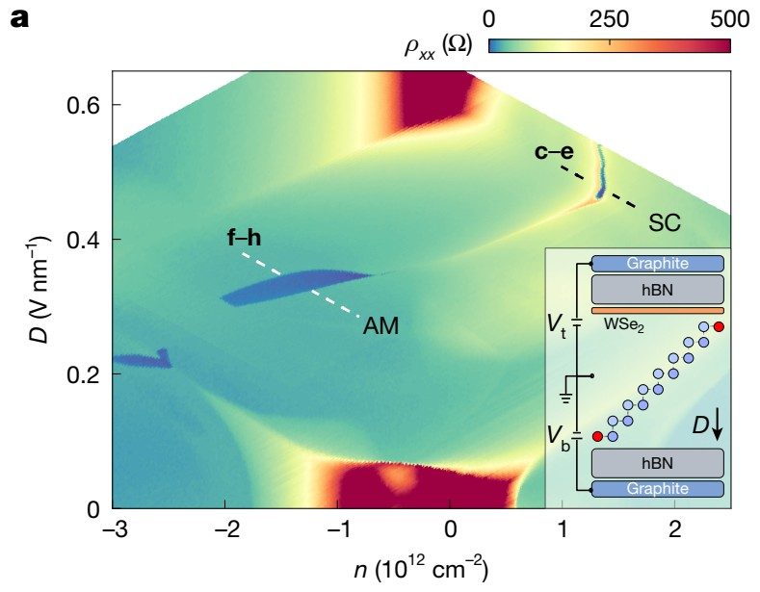
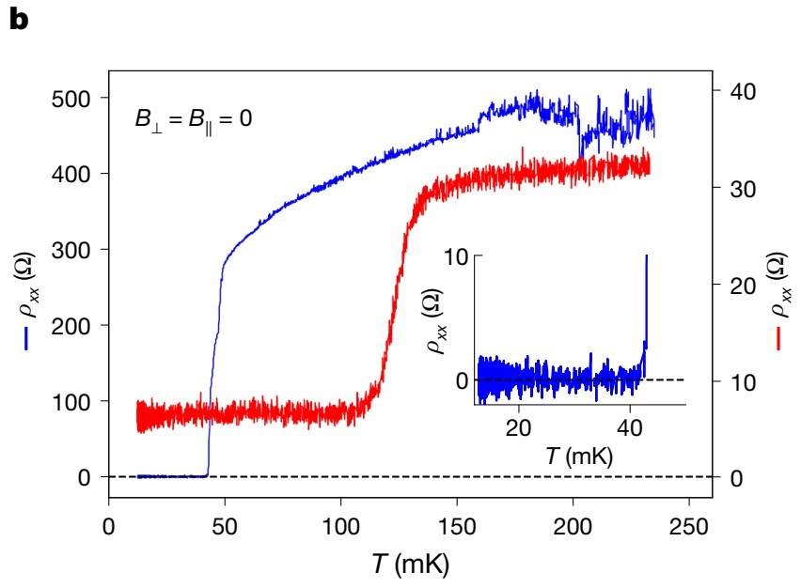
Two phases at zero field
SC (blue): ρ drops below resolution: true zero resistance.
AM (red): sharp drop at Tc, then saturates at a finite value.
Okounkova et al., Nature 658, 65 (2026), Fig. 1a,b
8
Notes:
Panel a: resistivity map in density and displacement field at base temperature. Two isolated pockets. Panel b: in the SC pocket (blue) the resistance goes to zero; in the AM pocket (red) it drops just as sharply but stays finite. Inset shows the blue curve really is zero within resolution.

Slide 9
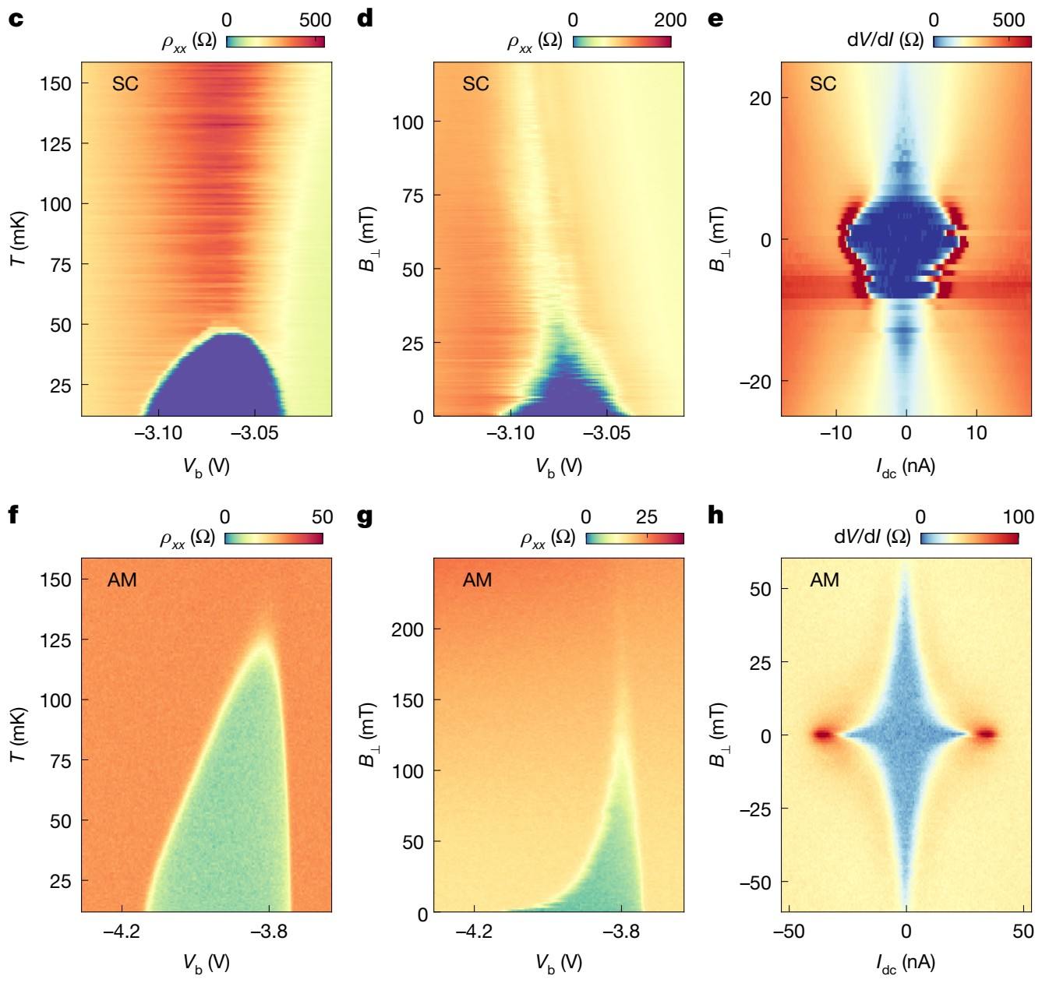

Both pockets show typical superconducting signatures
Critical temperature
Critical perpendicular field
Critical current
SC
AM
SC = zero R, AM = finite R. Similar signatures, different scales.
Okounkova et al., Nature 658, 65 (2026), Fig. 1c–h
9
Notes:
Columns: temperature, perpendicular field, dc current; top row SC, bottom row AM. Both show a critical temperature, field and current, the signatures of a 2D superconductor, but the AM survives larger perpendicular fields and currents. The noise in the SC row is an instability with hysteresis at zero field; it disappears with about 30 mT in-plane field, so the main analysis is done at finite in-plane field.

Slide 10
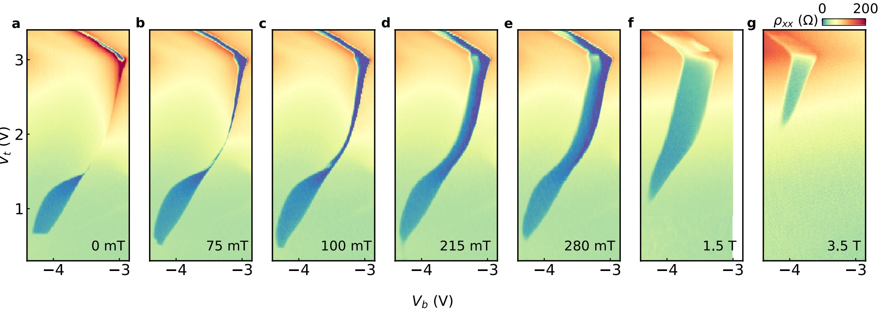
In plane field evolution
0 mT
AM pocket and a tiny SC, separate
75–100 mT
both grow and connect
215–280 mT
one broad band, SC along its edge
1.5 T
SC gone, the whole band is AM
3.5 T
only a small AM remains
Okounkova et al., Nature 658, 65 (2026), Extended Data Fig. 7
10
Notes:
Same gate map at increasing in-plane field. At zero field: the AM pocket at the bottom left and a tiny SC at the top right. At 75 to 100 mT both grow and connect; at 200 to 300 mT they form one broad band with the zero-resistance SC along one edge. At 1.5 T the SC is gone and the band is AM; at 3.5 T only a small AM piece survives. So in Figs. 2 to 4, measured at 350 mT, AM means this expanded pocket next to the SC.

Slide 11
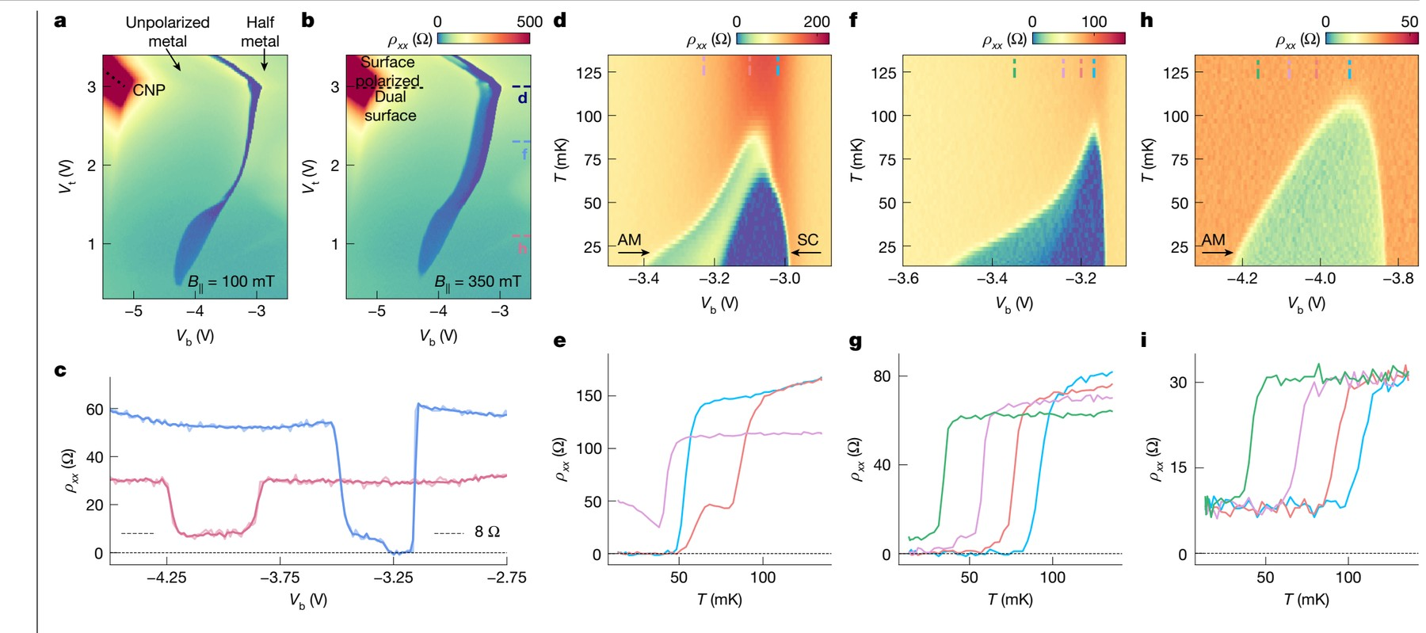
In-plane field: a sharp SC/AM boundary
Merging: B field (in plane) expands both pockets until they touch (≈ 100 mT).
Phases: SC next to the half-metal, AM next to the unpolarized metal.
Okounkova et al., Nature 658, 65 (2026), Fig. 2
10
Notes:
Small in-plane fields enhance both pockets until they merge. The boundary between SC and AM is abrupt, so it looks like two distinct states rather than a smooth crossover. SC sits next to the spin-polarized half-metal, AM next to the unpolarized metal. Both exceed the Pauli limit by about 14 to 16 times, so likely spin-triplet. Cooling through the middle of the pocket: first the AM plateau, then a jump to zero.

Slide 12
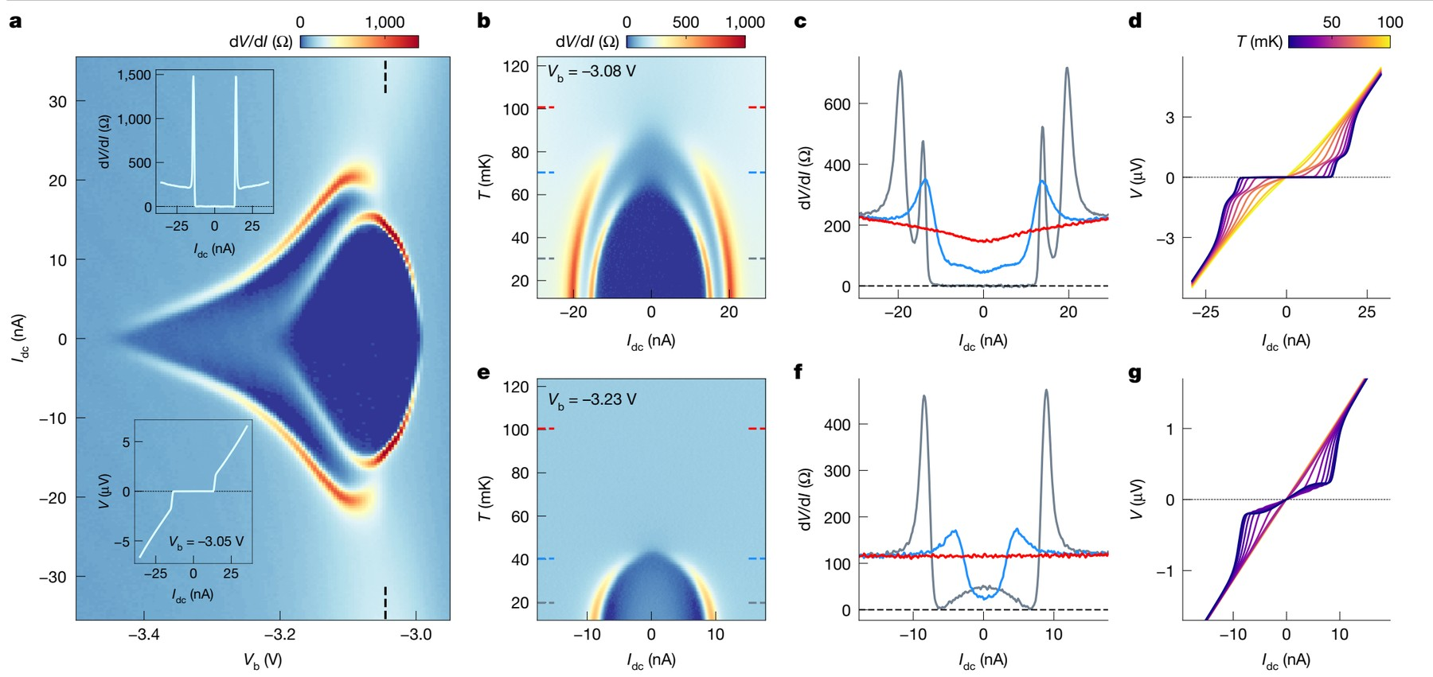
Double dome
AM: ~8nA current can lower dV/dI
SC: BKT transition 61 mK
Okounkova et al., Nature 658, 65 (2026), Fig. 3
11
Notes:
With dc current, close to the boundary we see two critical currents: first the zero-resistance state breaks, then the AM, then the normal state. In temperature this gives an inner dome inside an outer dome. Further into the AM, only the outer dome is left. Strange detail: in the AM a moderate current can reduce the differential resistance.

Slide 13
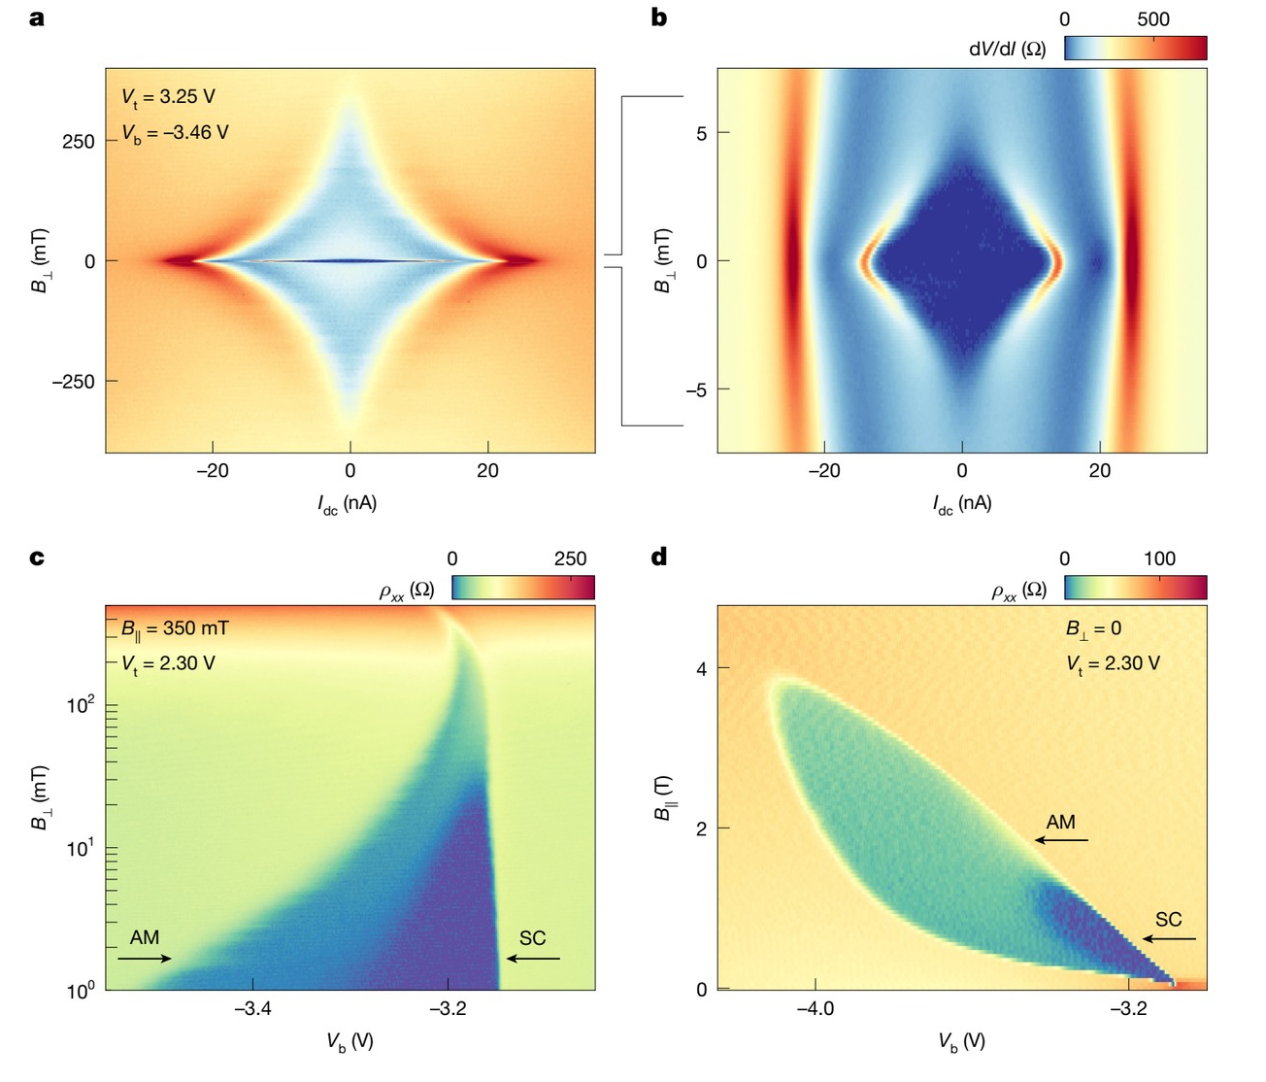
Very different field scales for SC and AM
≈ 4 mT
SC critical B⊥ → ξ ≈ 300 nm
≈ 300 mT
AM critical B⊥ → ξ ≈ 30 nm
≈ 4×
higher critical in-plane field by the AM
The AM is unlikely to be just a phase-disordered version of the neighbouring SC.
Okounkova et al., Nature 658, 65 (2026), Fig. 4
12
Notes:
Inner diamond: SC, critical perpendicular field about 4 mT, coherence length about 300 nm. Outer diamond: AM, about 300 mT, about 30 nm. In-plane, the AM survives about four times higher fields. Inhomogeneity would need a reproducible 30 nm texture, which the crystal does not have. The authors conclude the paired states differ in orbital and/or spin structure.

Slide 14
SC vs AM
Property | SC | AM
Low-T resistance | zero | finite: R_sat/R_N ≈ 0.1 - 0.4
Critical B⊥ (→ ξ) | ≈ 4 mT (≈ 300 nm) | ≈ 300 mT (≈ 30 nm)
Critical B∥ | ≈ 1.4 T | ≈ 3.9 T
Pauli-limit violation ratio | ≈ 14x | ≈ 16x
BKT transition | yes, ≈ 61 mK | no
Hysteresis near B = 0 | yes | not seen
Neighbouring normal state | half-metal (spin-polarized) | unpolarized metal
Current response | dV/dI = 0 up to one critical current, then normal | outer dome, non-monotonic dV/dI, drops/rises
Okounkova et al., Nature 658, 65 (2026), main text and Methods
13
Notes:
Summary of the paper. Same onset temperature and the same kind of critical behaviour, but very different field scales, no BKT transition in the AM, and different neighbouring normal states. The authors read this as two competing paired states rather than one superconductor with and without phase coherence.

Slide 15
Comparison with thin-film anomalous metals
Aspect | Thin films | Rhombohedral graphene
Systems | Amorphous films (e.g. a-MoGe), cuprate films, gated vdW materials, Josephson arrays | 8-layer rhombohedral graphene on WSe₂
Disorder | Disordered or granular | Ultra-clean, ξ/ℓ ≪ 1
Sheet resistance | R□ ~ R_Q = h/4e² ≈ 6.45 kΩ | R□ ≪ R_Q
Phase space | Intermediate regime when tuning through a superconductor–insulator/metal transition | Pocket beside true SC, sharp boundary
R_sat / R_N | Typically smaller | ≈ 0.1–0.4, relatively large
Theory | Likely quantum phase fluctuations | unexpected
Common properties: sharp drop at Tc, then saturation. Well-defined critical fields and currents.
Kapitulnik, Kivelson & Spivak, Rev. Mod. Phys. 91, 011002 (2019); Sacépé et al., Nat. Phys. 16, 734 (2020)
14
Notes:
Anomalous metals have been reported for 40 years in disordered films and Josephson arrays. There they appear near a superconductor–insulator or superconductor–metal transition, with sheet resistance close to the pair quantum h/4e². Graphene is the opposite limit: very clean and very conductive. Standard dissipative theories say quantum phase fluctuations should be negligible here, so the AM is a real puzzle.

Slide 16
Bullet proof experiments
Superfluid stiffness
Pairing gap
Local imaging
Kinetic inductance or microwave resonators: phase stiffness measurements -> long range coherence.
Tunnelling spectroscopy: superconducting gap of SC and AM.
Scanning SQUID / SQUID-on-tip: mobile vortices / hidden ~30 nm structure.
Setup improvement
Beyond dc resistance
Geometry
Lower electron temperature, better filtering, controlled radiation: does saturated resistance change?
Nernst effect and voltage noise for vortex motion, shot noise for 2e vs e.
Vary probe spacing and width, Corbino disks: does R_sat scale like a sheet or like junctions?
16
Notes:
The authors themselves say dc transport is not enough and suggest superfluid stiffness and gap measurements. I would add: local imaging, noise and Nernst for vortex motion, and simply going colder and quieter with independent electron thermometry. Geometry tests distinguish a sheet property from junction-like weak links. The D < 0 side, where carriers sit next to the WSe2, shows only SC and could serve as an internal control.

Slide 17
Conclusions
Rhombohedral graphene hosts adjacent zero-R (SC) and finite-R (AM) pockets with the same superconducting properties.
Sharp SC/AM boundary and signatures of a likely different paired state.
The AM appears where standard theory says it should not.
Intrinsic or extrinsic origin is still unclear.
17
Notes:
Take-home: two neighbouring states with the same superconducting fingerprints, one with zero and one with finite resistance, cleanly separated in gate space, in a system where the anomalous metal should not exist. Whether it is intrinsic is open. Open the floor with the question about our own residual-resistance states.

Slide 18
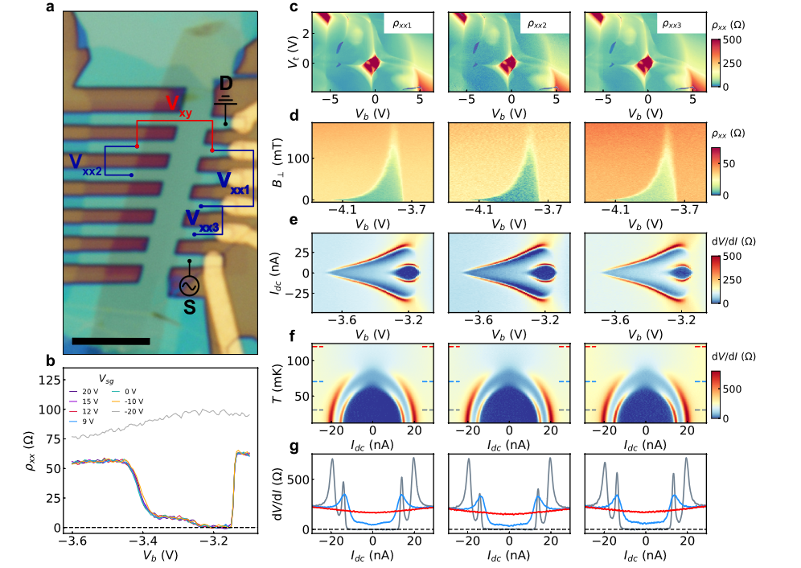
Appendix
17
Notes:
Take-home: two neighbouring states with the same superconducting fingerprints, one with zero and one with finite resistance, cleanly separated in gate space, in a system where the anomalous metal should not exist. Whether it is intrinsic is open. Open the floor with the question about our own residual-resistance states.

Slide 19
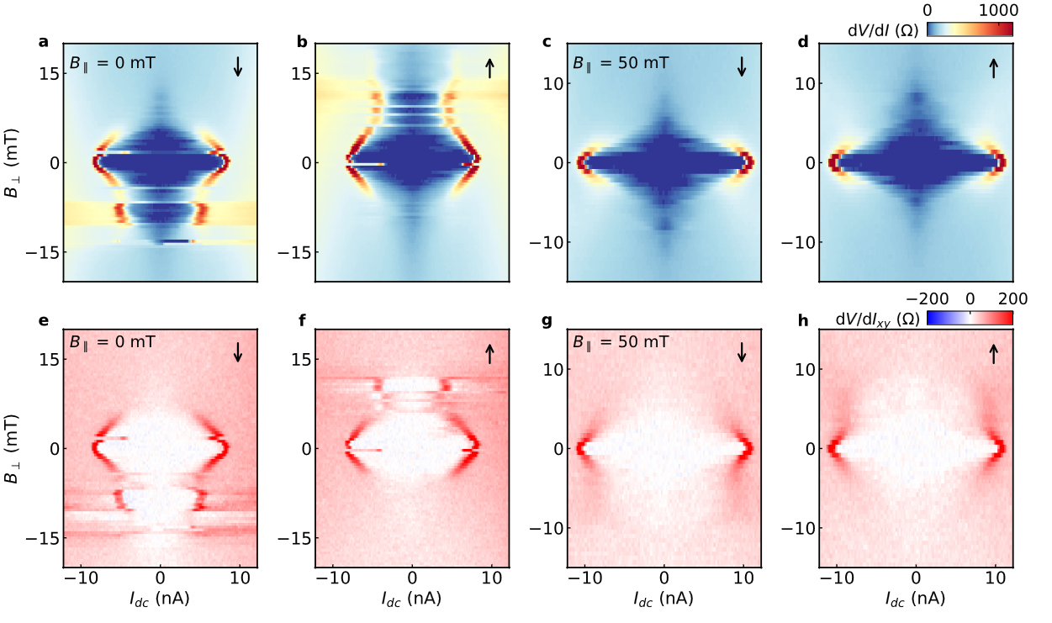
Appendix
17
Notes:
Take-home: two neighbouring states with the same superconducting fingerprints, one with zero and one with finite resistance, cleanly separated in gate space, in a system where the anomalous metal should not exist. Whether it is intrinsic is open. Open the floor with the question about our own residual-resistance states.

