Slide 1
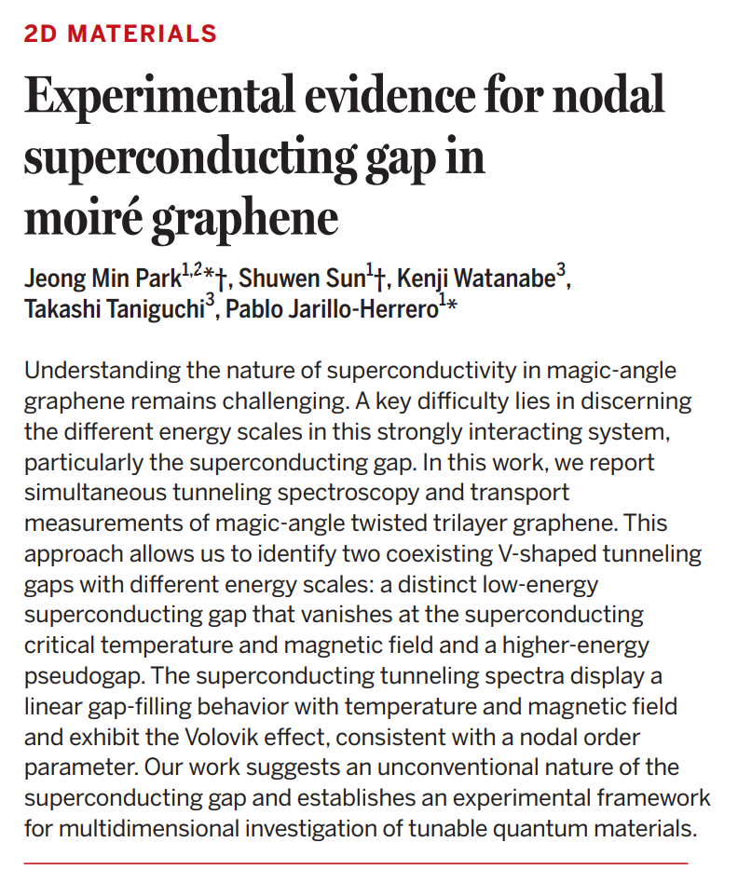
Presenter: Omid Sharifi Sedeh
Journal Club 13.02.2026

Slide 2
Introduction to Graphene multilayer devices

Slide 3
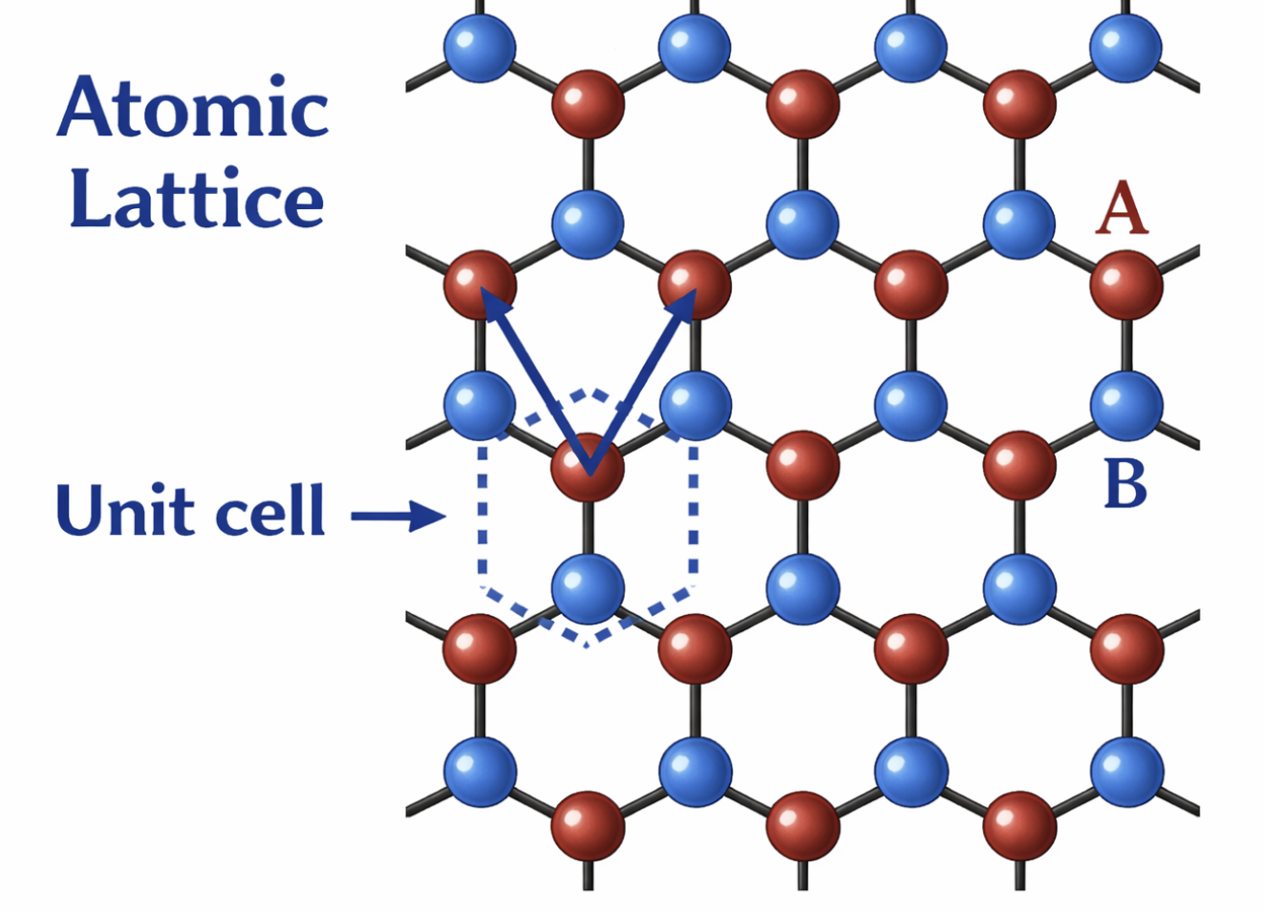
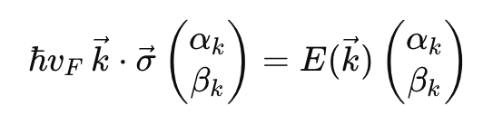
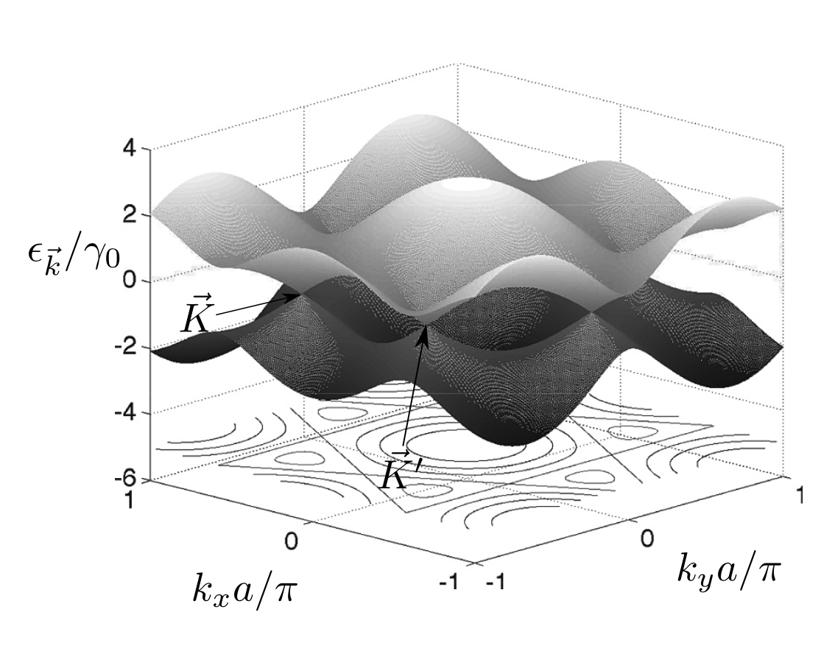
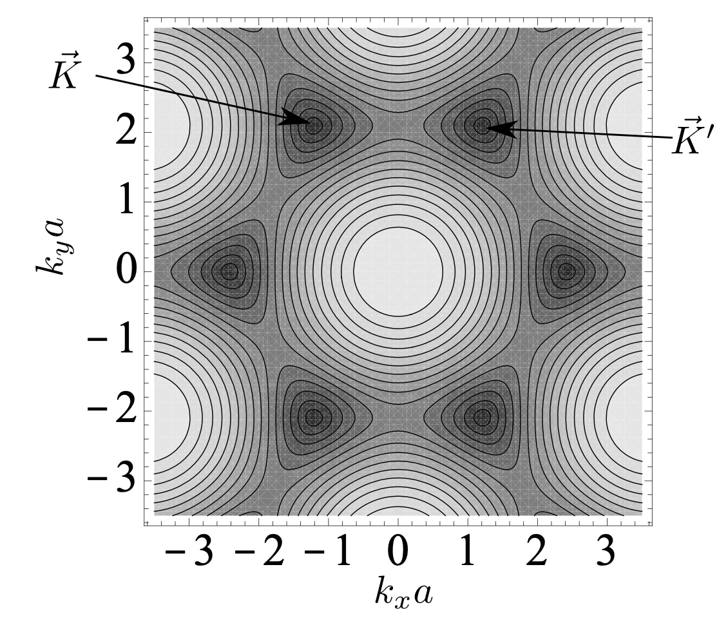
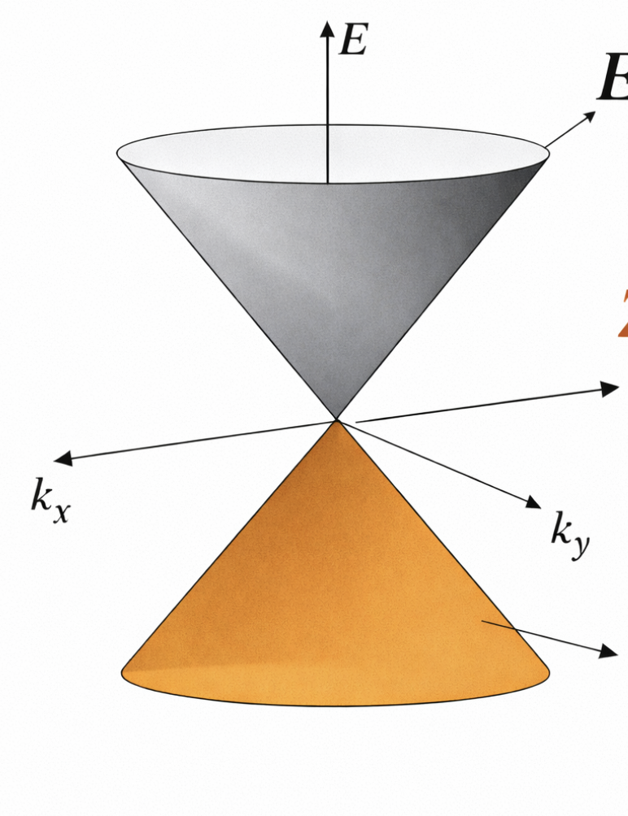
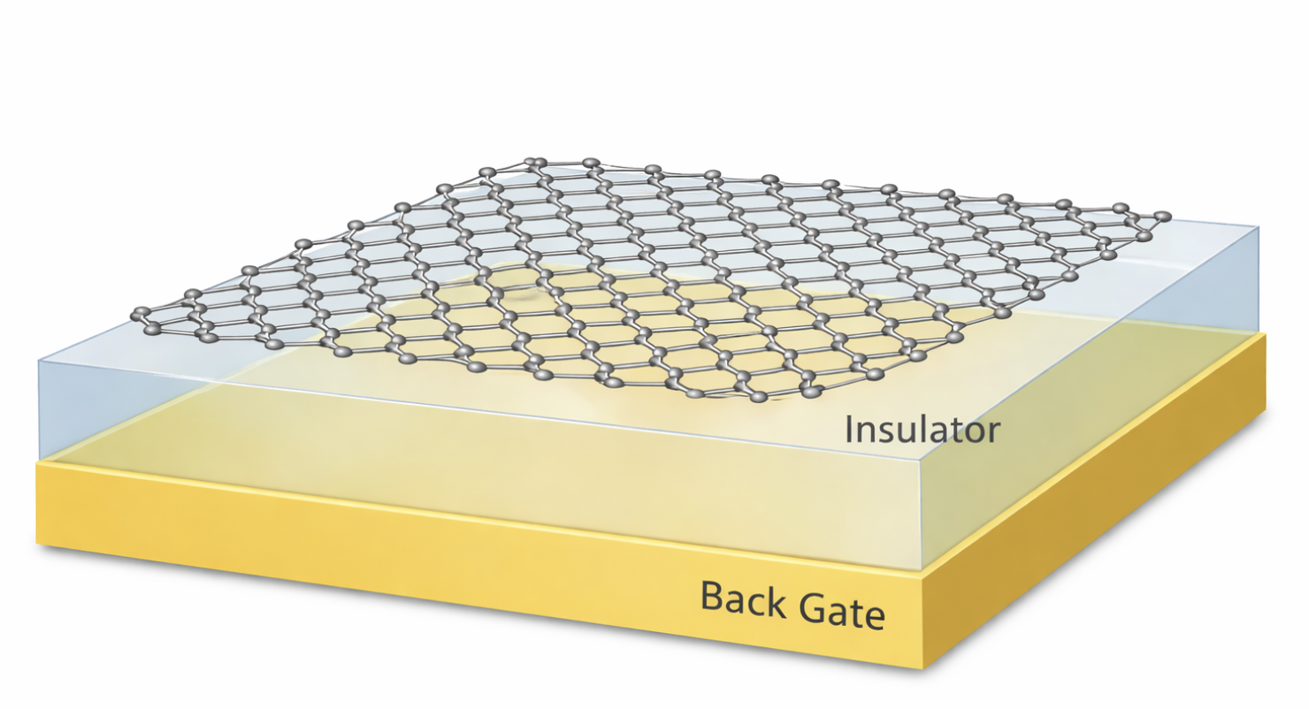
Single Layer Graphene
Dirac equation for massless particles (2D)
Pseudospins:
Probability amplitude on A or B
Band diagram
Dirac Cone
4-fold degeneracy: Valley*Spin Flavors (Iso-spins)
conduction band
zero gap
valance
Physics of Nanoelectronics by Tero T. Heikkila

Slide 4
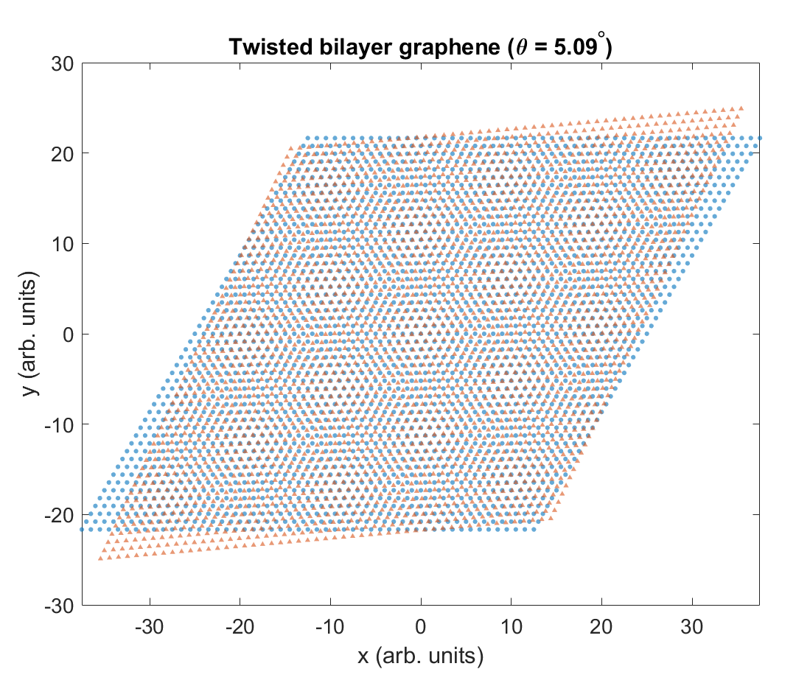
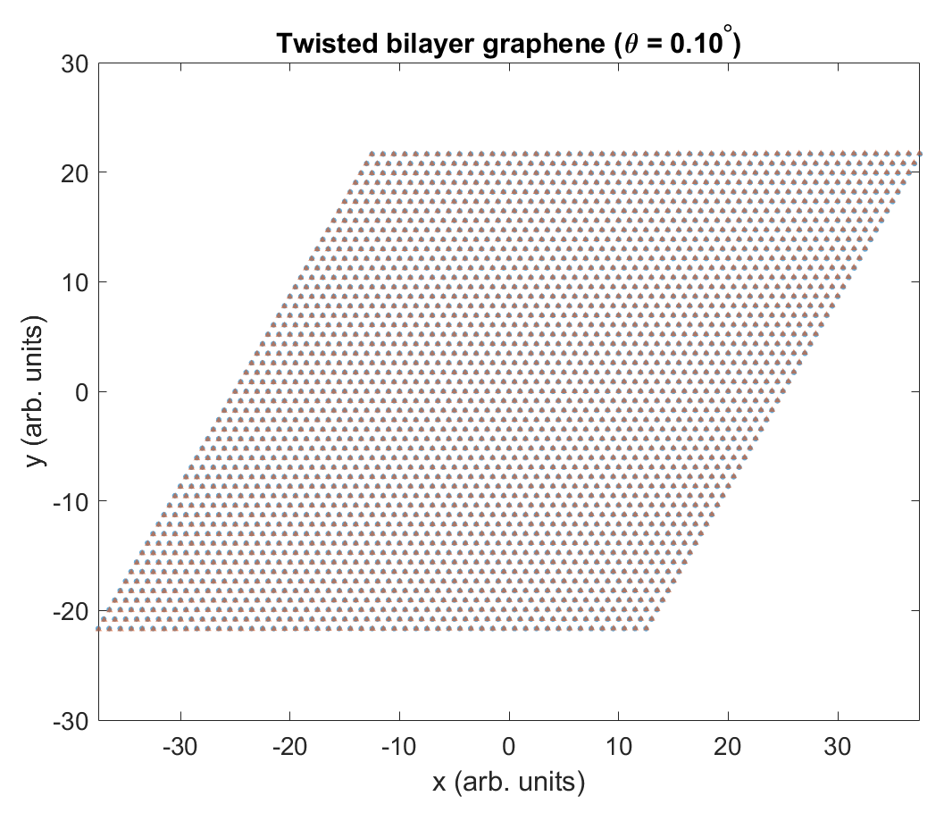
Moiré pattern in twisted bilayer graphene
Moiré wavelength

Slide 5
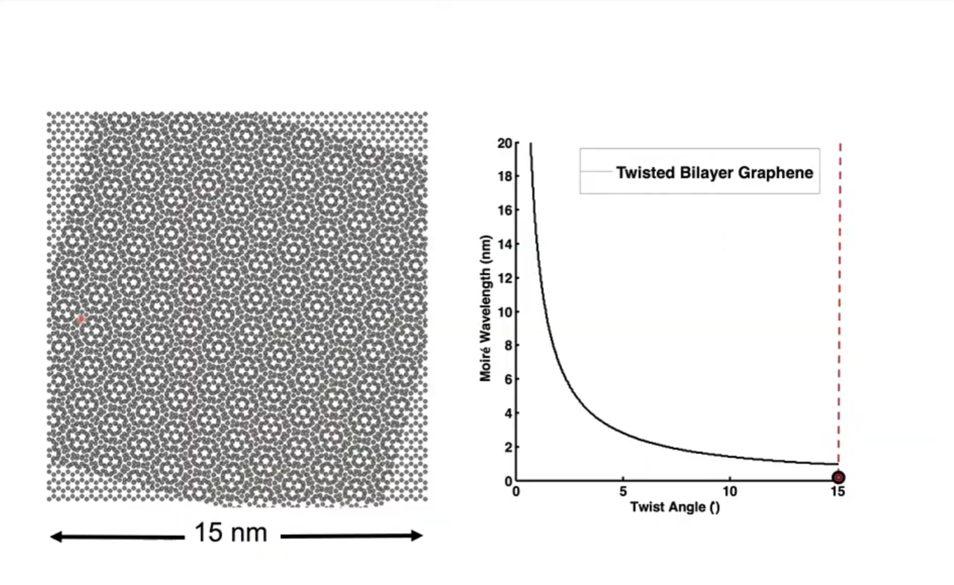
Moiré wavelength dependence on twist angle
Source: Pablo Jarillo-Herrero

Slide 6
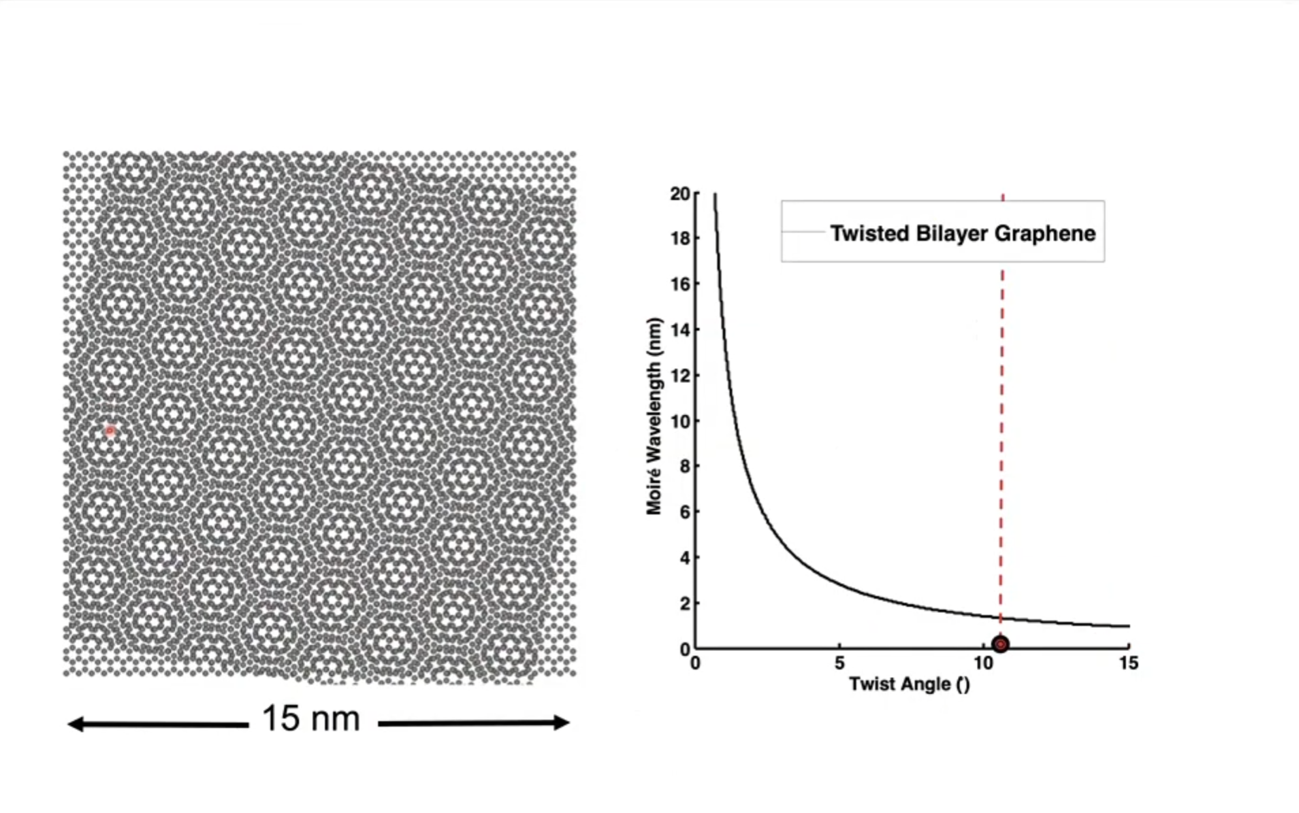
Moiré wavelength dependence on twist angle
Source: Pablo Jarillo-Herrero

Slide 7
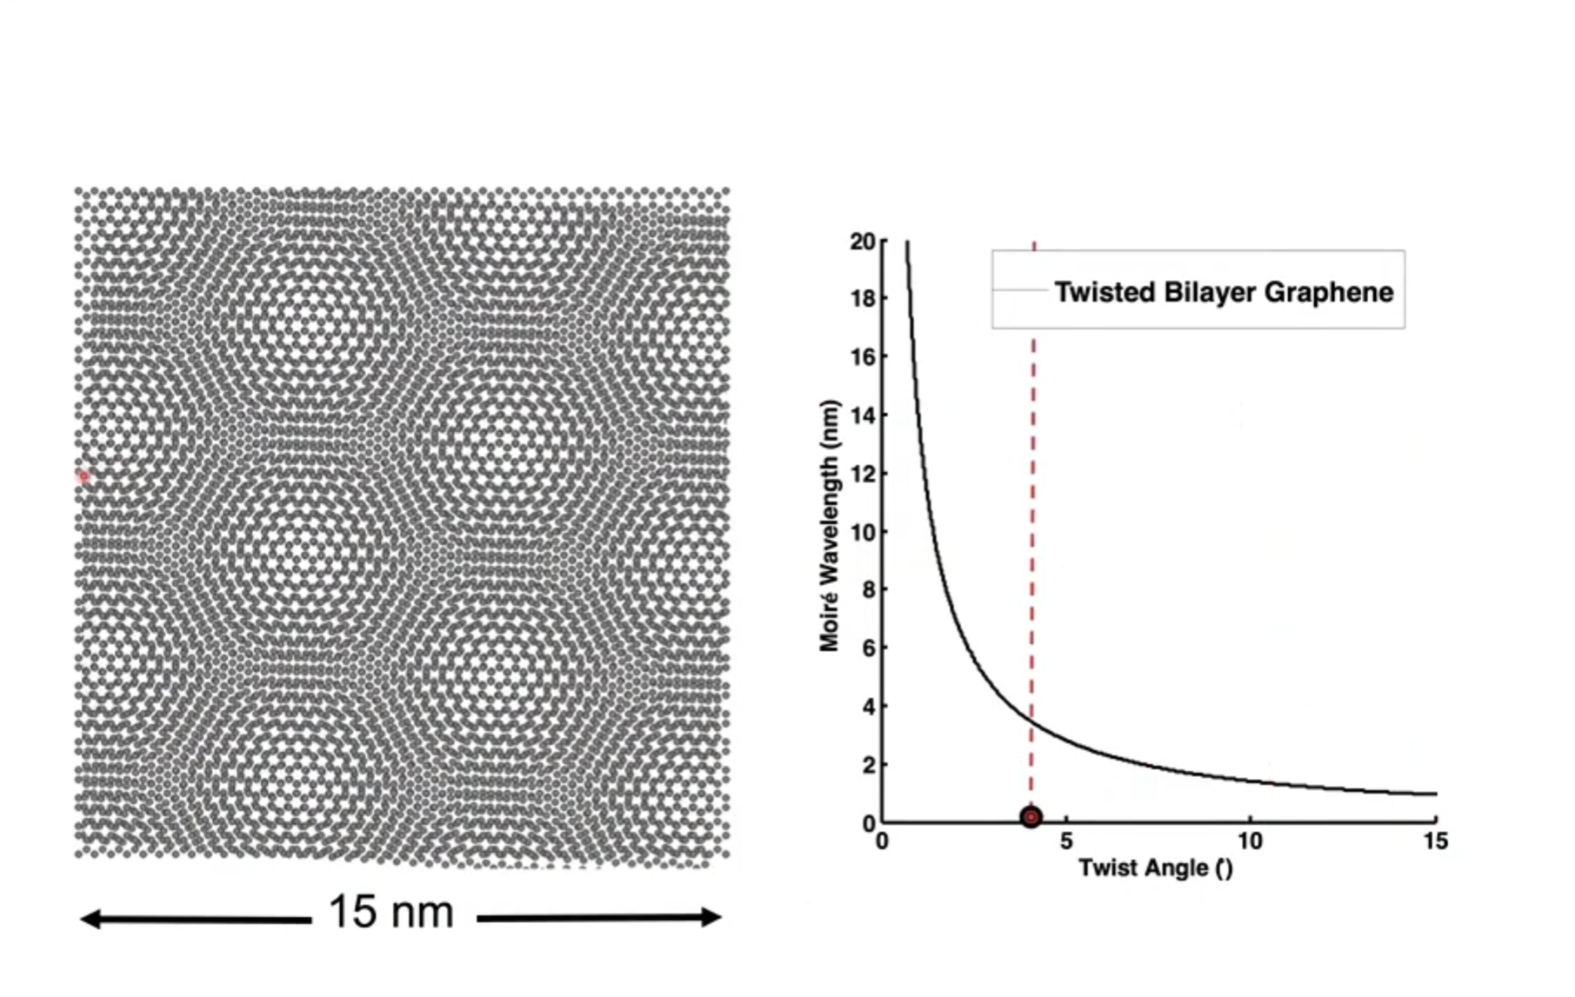
Moiré wavelength dependence on twist angle
Source: Pablo Jarillo-Herrero

Slide 8
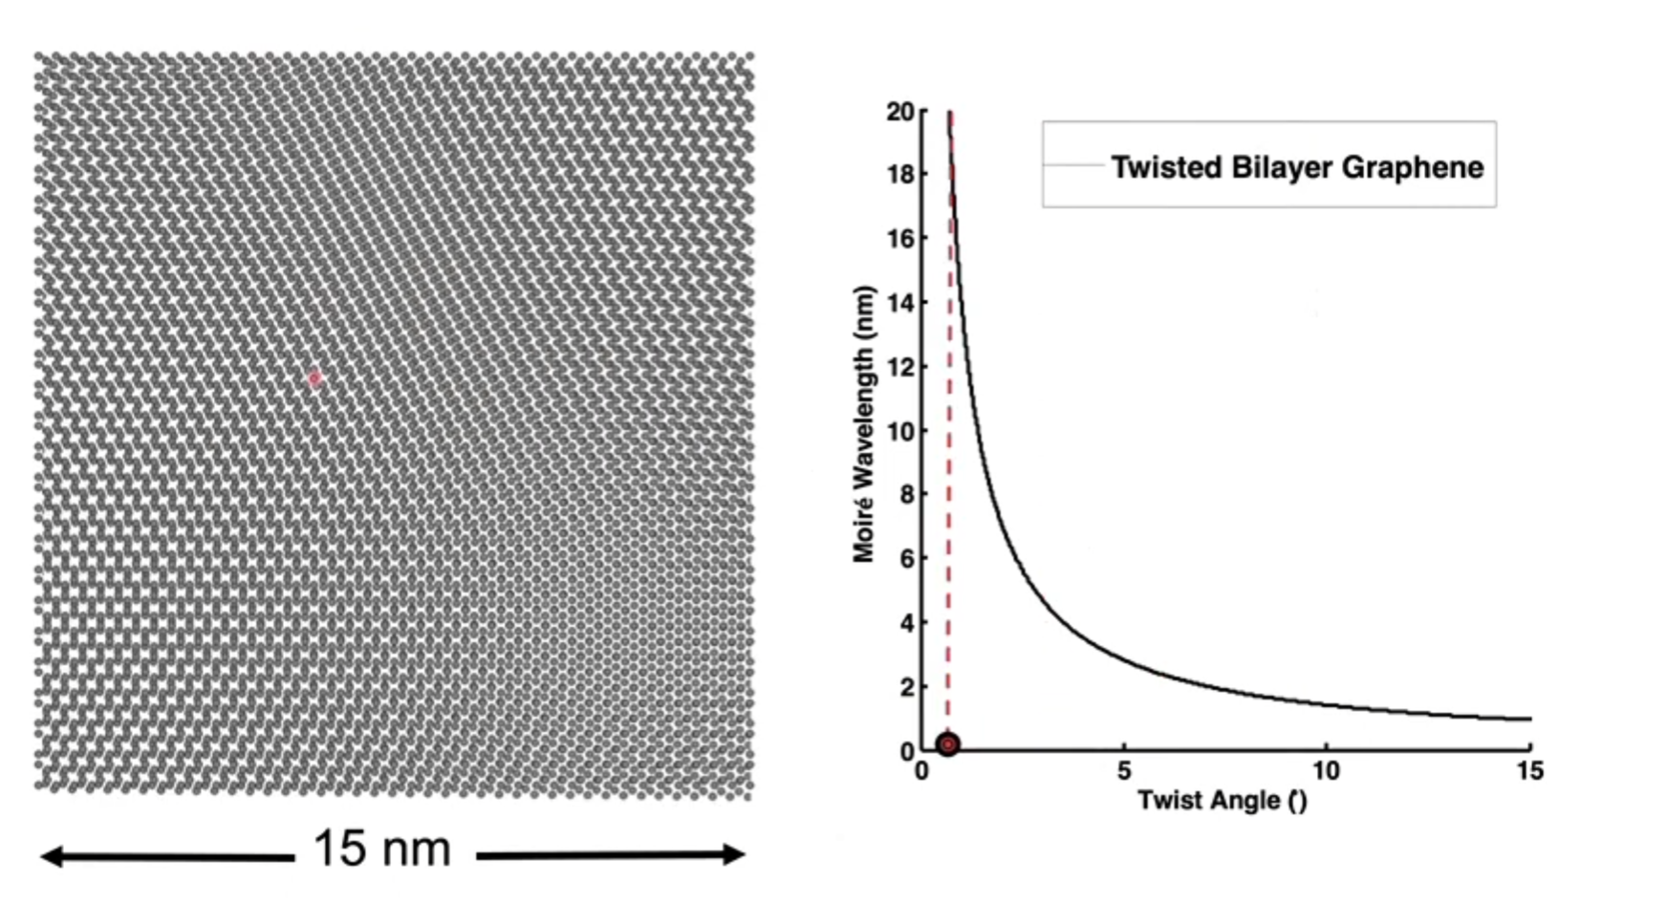
Moiré wavelength dependence on twist angle
Source: Pablo Jarillo-Herrero

Slide 9
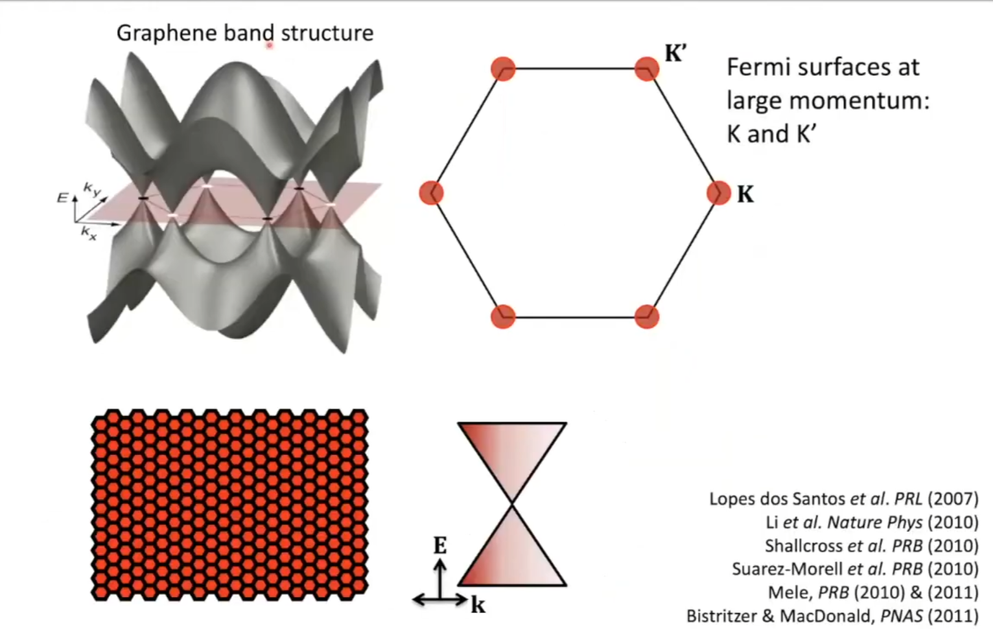
Lopes dos Santos et al. PRL (2007) Li et al. Nature Phys (2010) Shallcross et al. PRB (2010) Suarez-Morell et al. PRB (2010) Mele, PRB (2010) & (2011) Bistritzer & MacDonald, PNAS (2011)
Source: Pablo Jarillo-Herrero

Slide 10
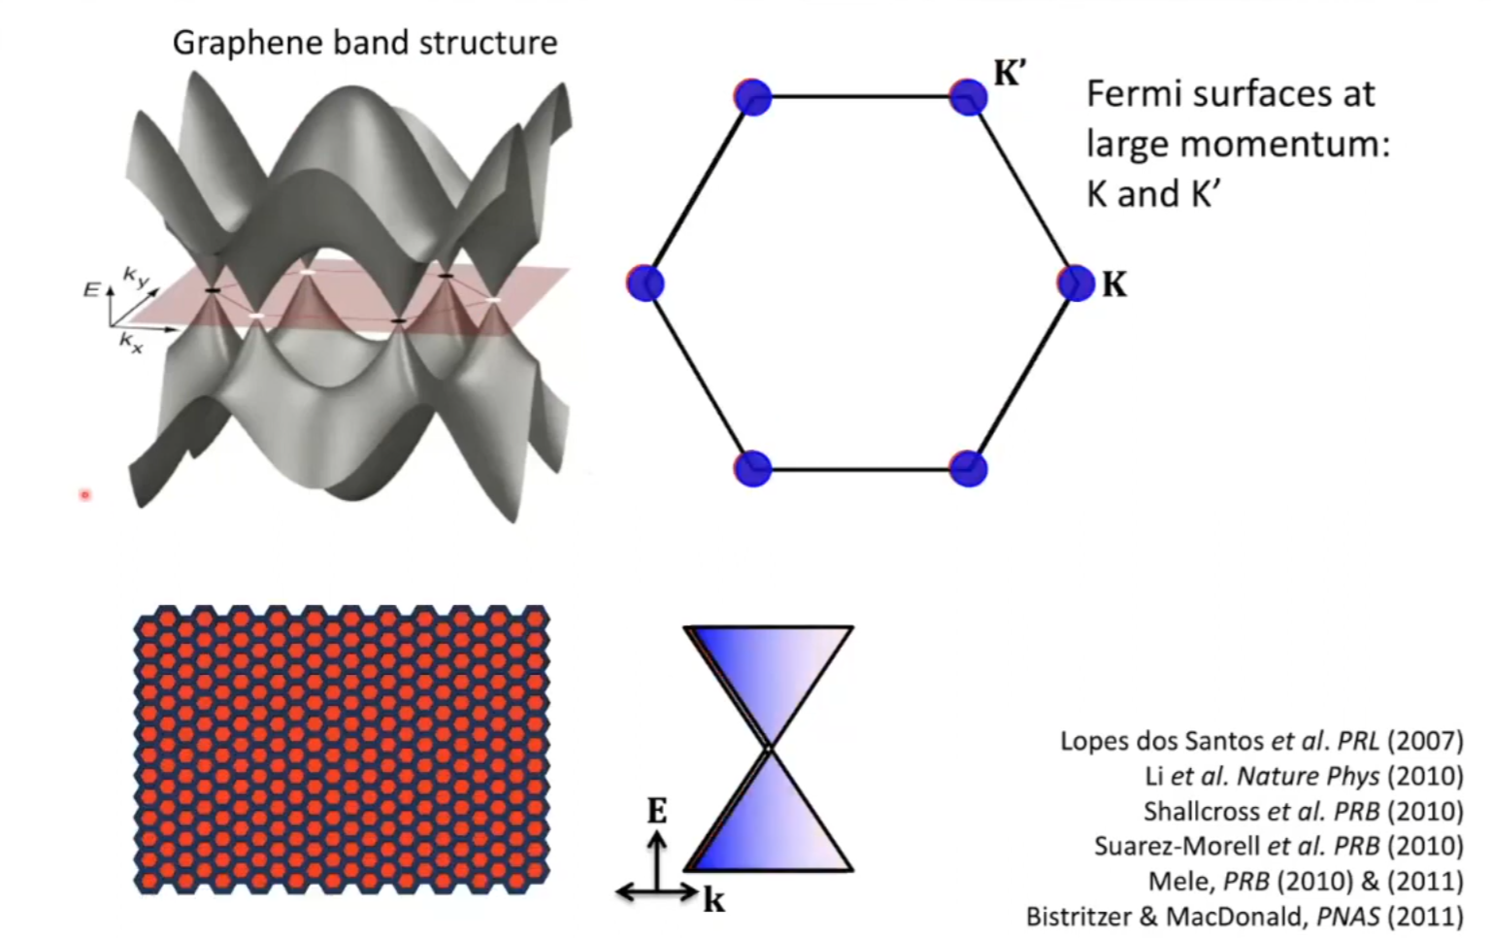
Lopes dos Santos et al. PRL (2007) Li et al. Nature Phys (2010) Shallcross et al. PRB (2010) Suarez-Morell et al. PRB (2010) Mele, PRB (2010) & (2011) Bistritzer & MacDonald, PNAS (2011)
Source: Pablo Jarillo-Herrero

Slide 11
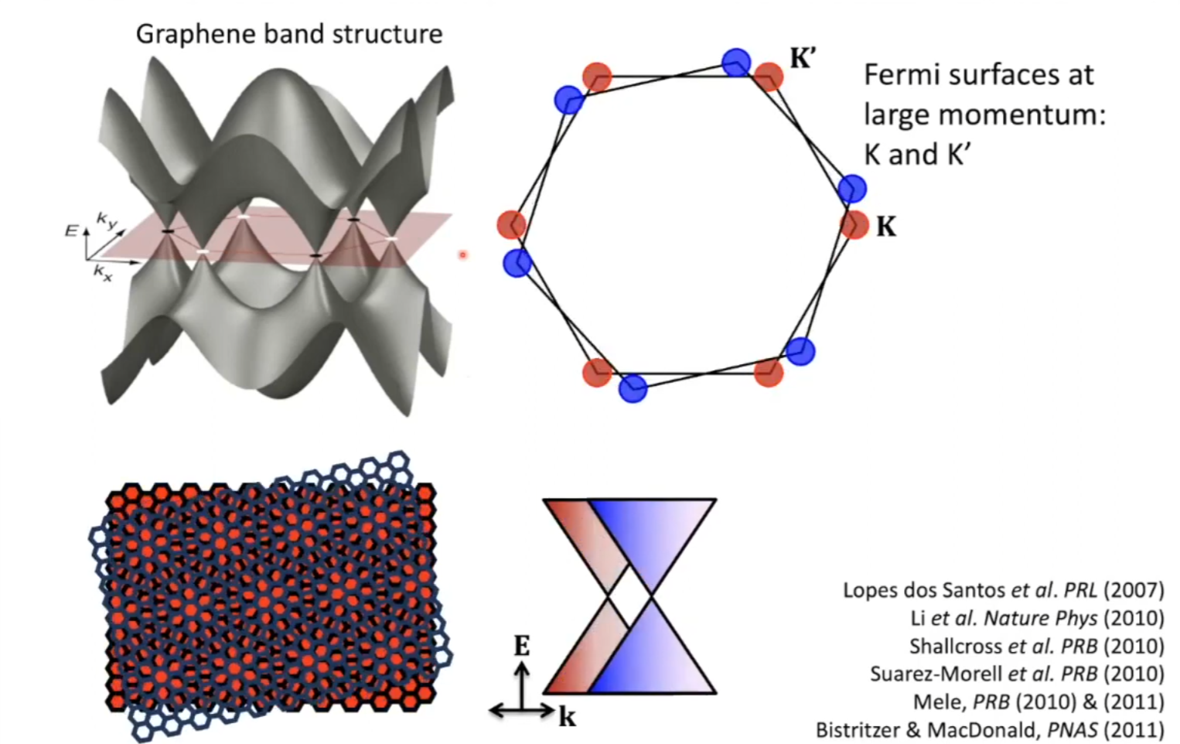
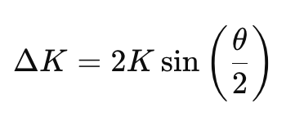
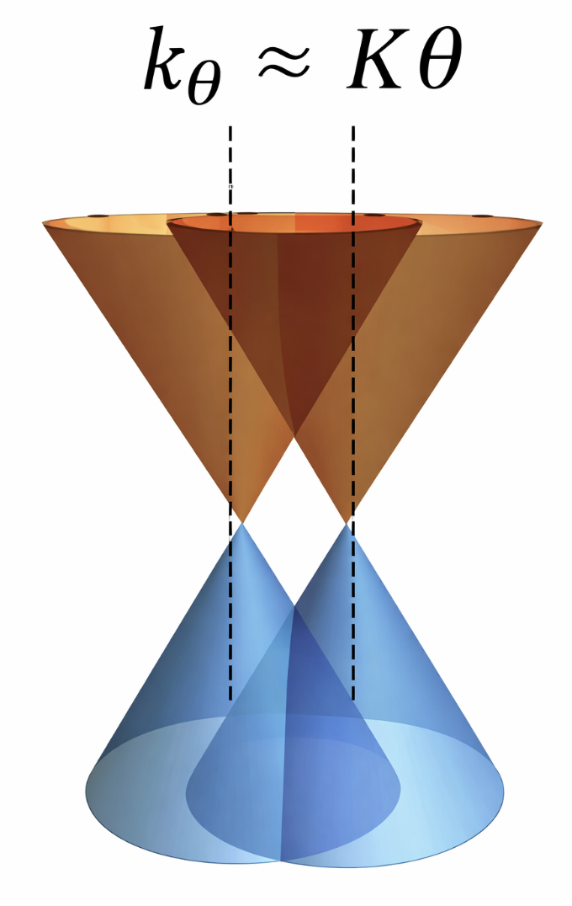
Momentum shift:
Lopes dos Santos et al. PRL (2007) Li et al. Nature Phys (2010) Shallcross et al. PRB (2010) Suarez-Morell et al. PRB (2010) Mele, PRB (2010) & (2011) Bistritzer & MacDonald, PNAS (2011)
Source: Pablo Jarillo-Herrero

Slide 12
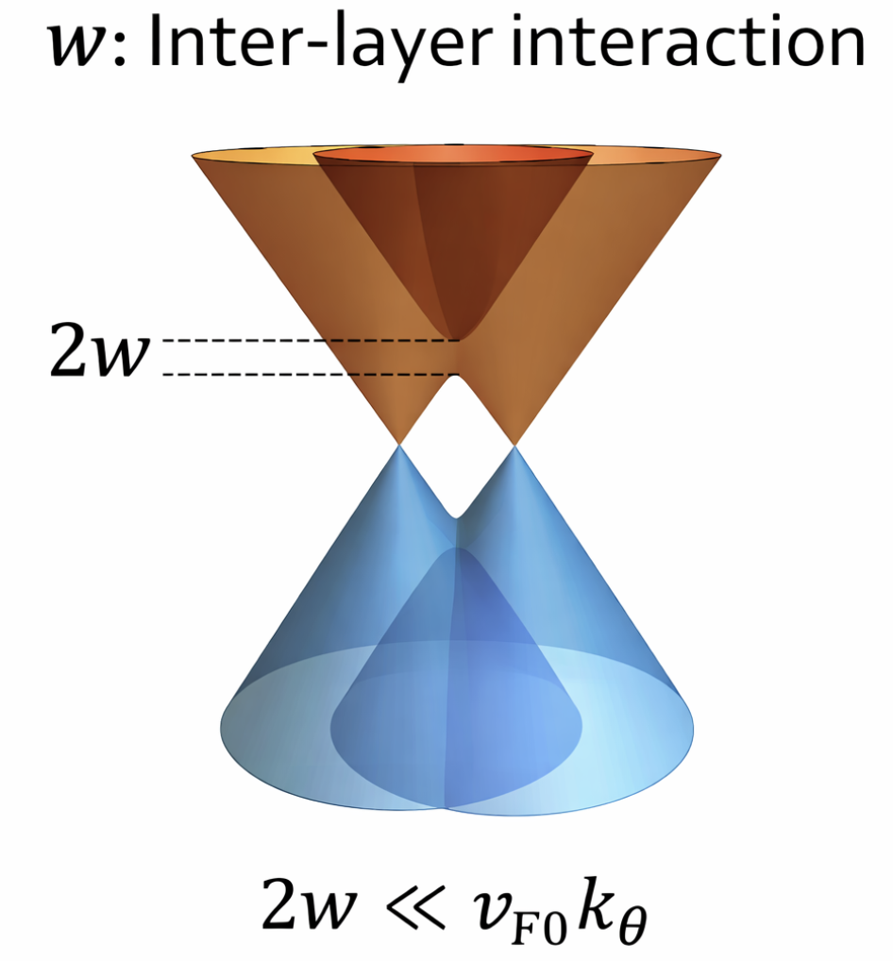
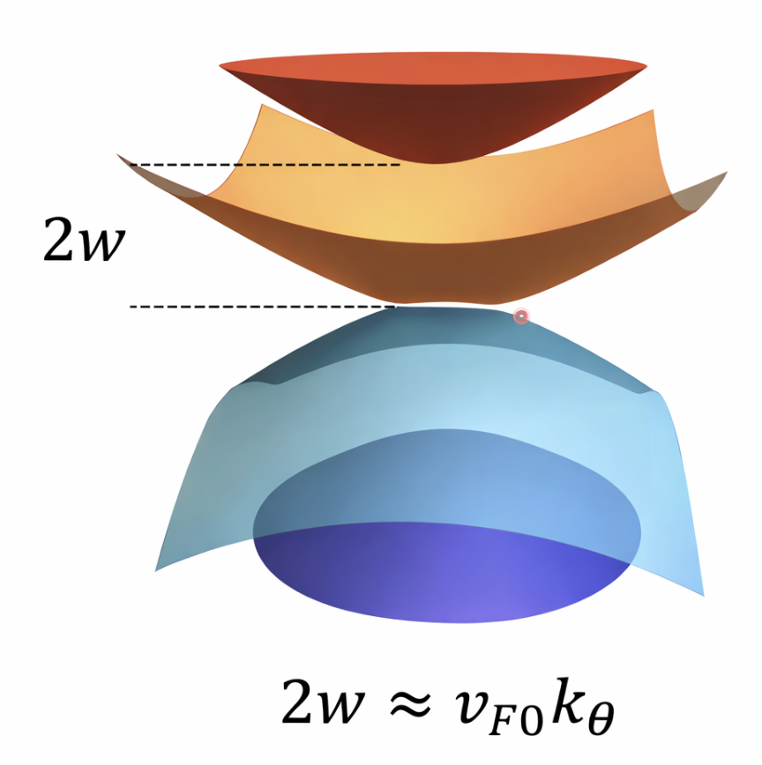
Flat band condition reaches at “magic angle” 1.1 degree
Bistritzer & MacDonald, PNAS (2011) Also: Li et al. Nature Phys. (2010) Suarez-Morell et al. PRB (2010

Slide 13

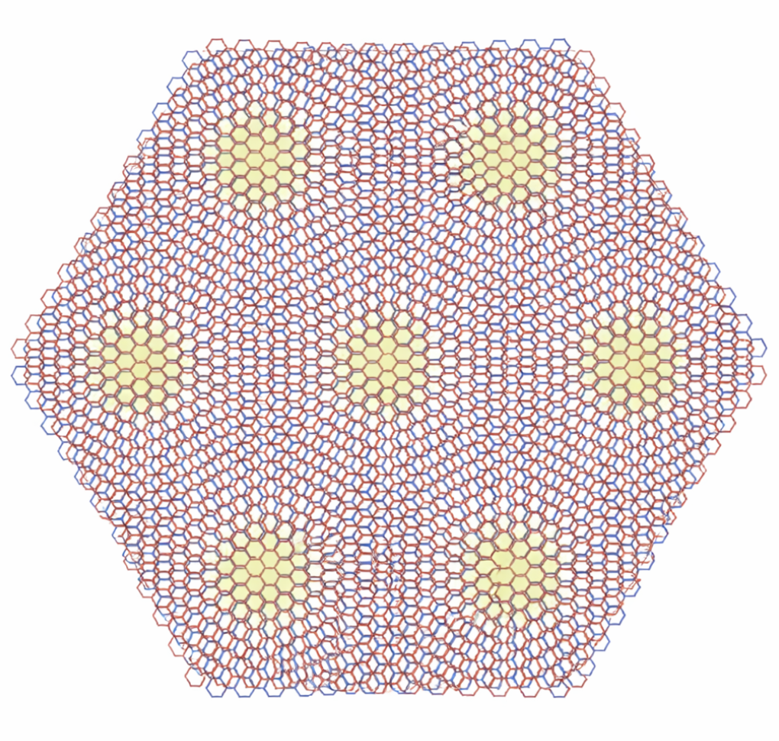
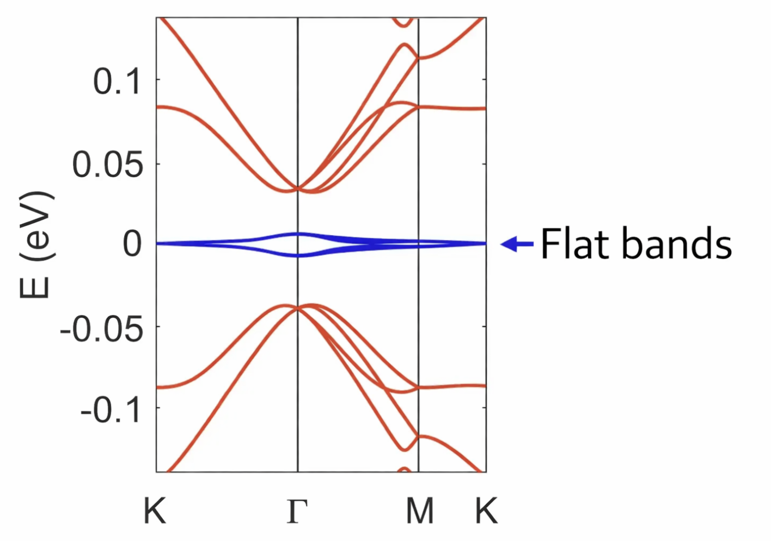
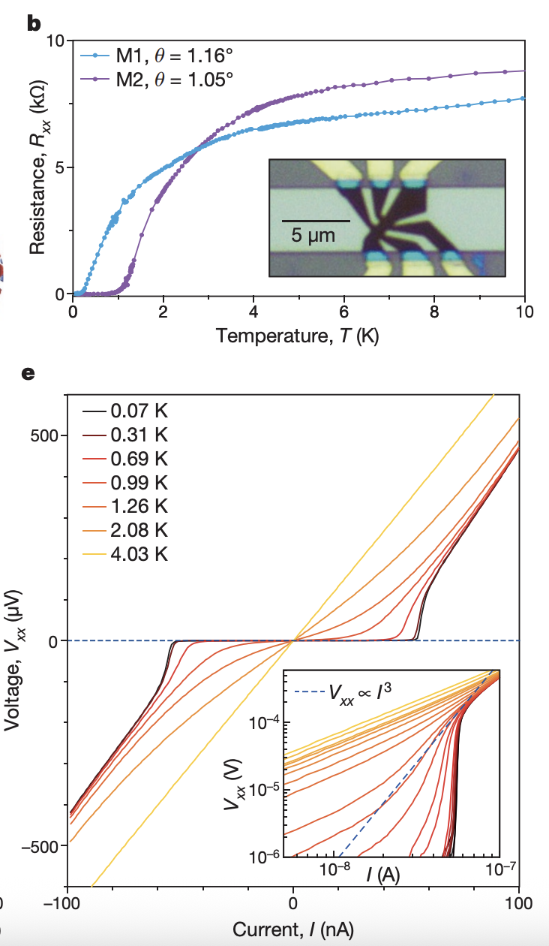
BA
AA
AB
Max 4 hole/electron per moiré unit cell
due to Spin-valley degeneracy
Nature 556, 43–50 (2018).

Slide 14
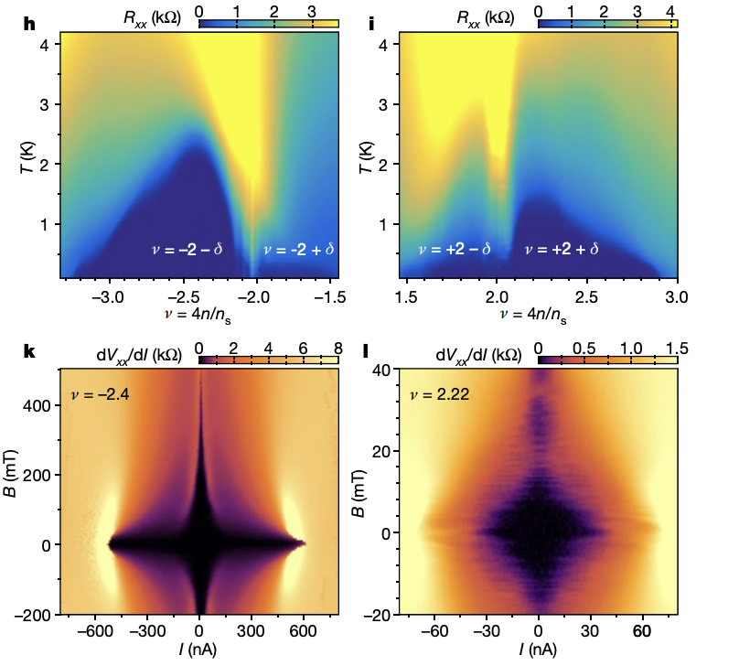
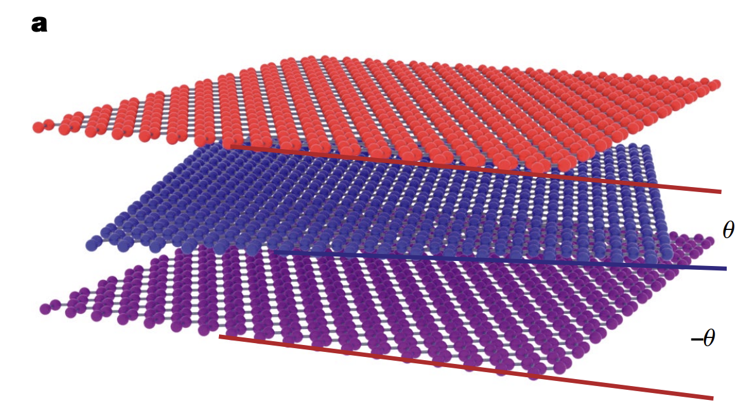
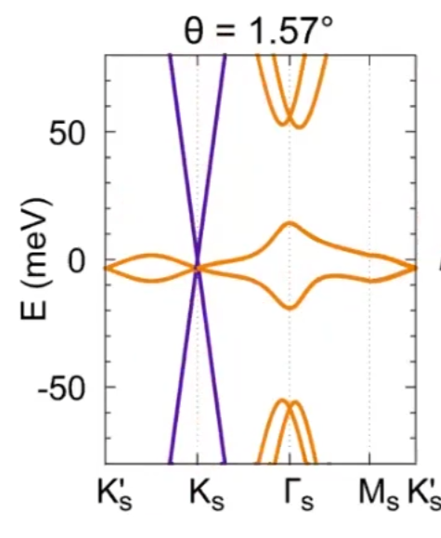
Magic angle twisted 3 layer graphene
Suppression with B and Josephson phase coherence
Nature 590, 249–255 (2021).

Slide 15
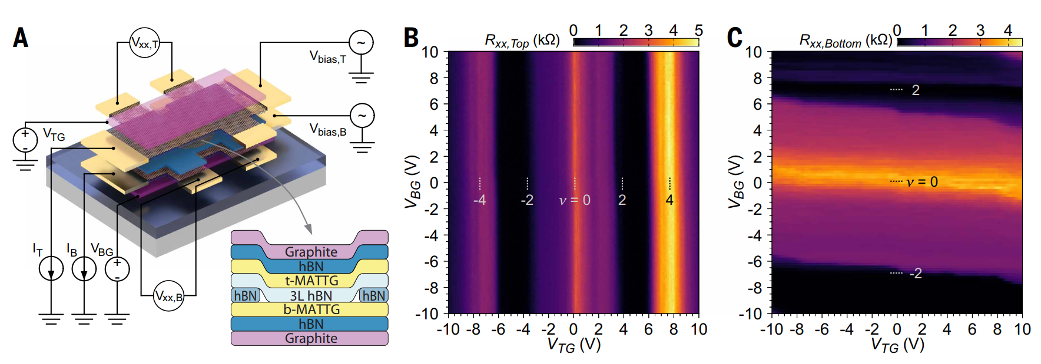
Device of the Study
3Layer hBN barrier
Radius of the junction = 1 um

Slide 16
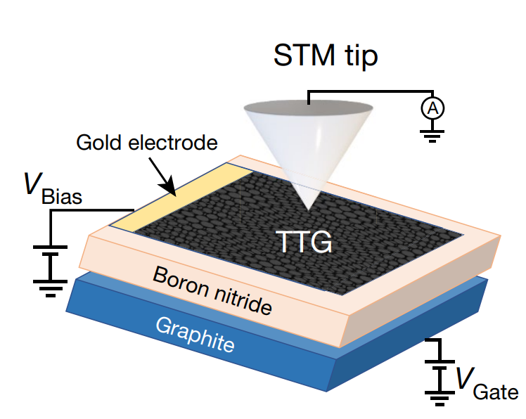
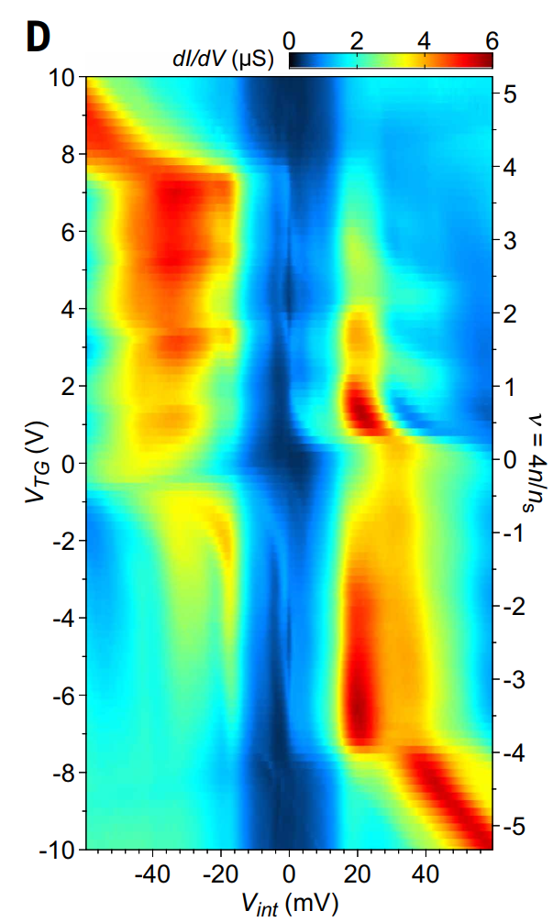
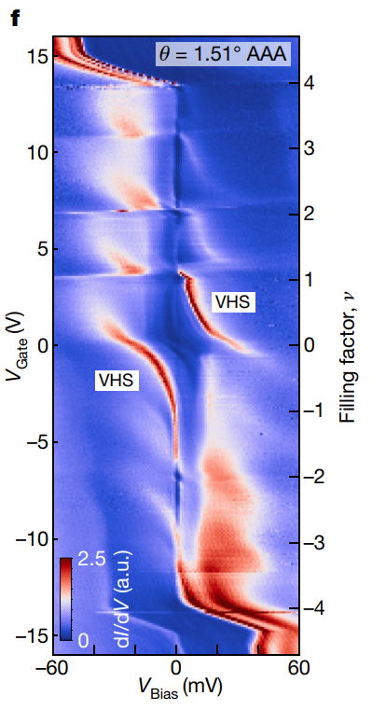
Nature 606, 494–500 (2022)

Slide 17
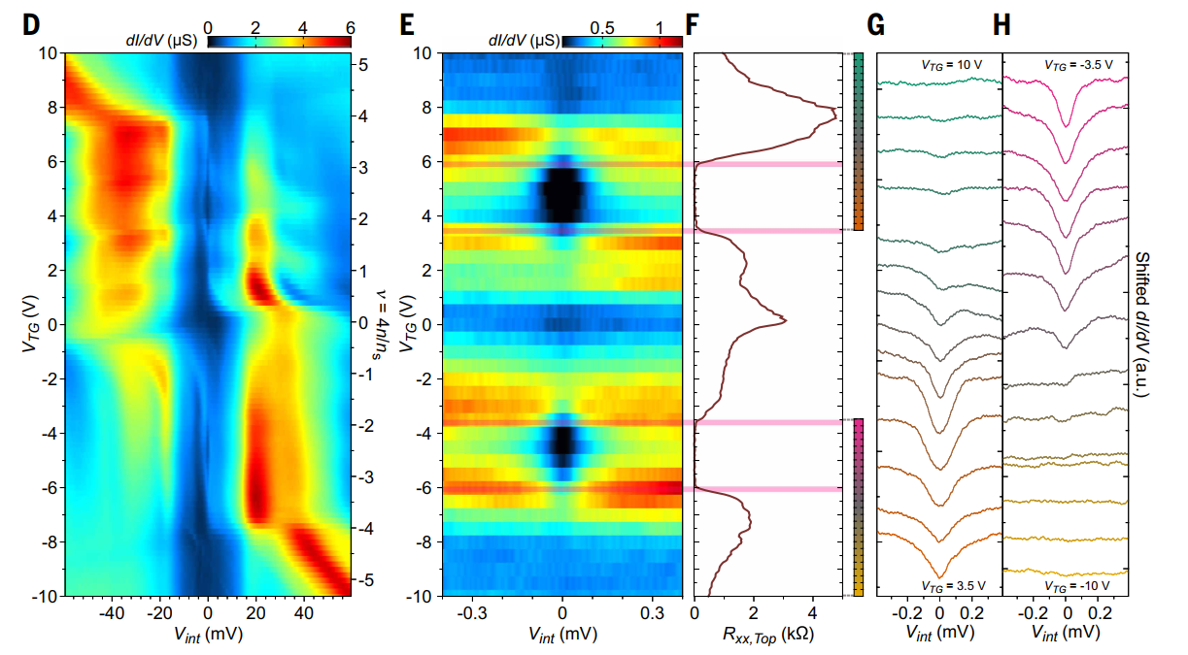

Slide 18
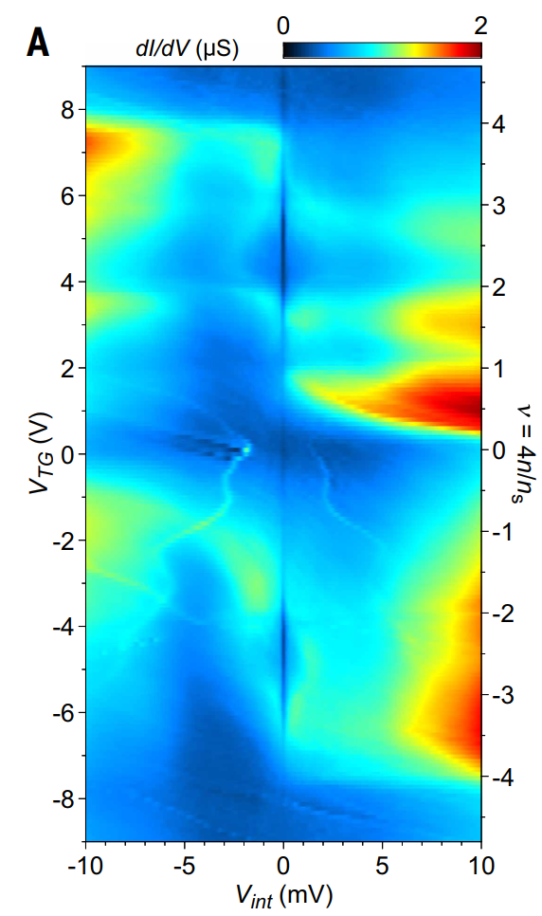
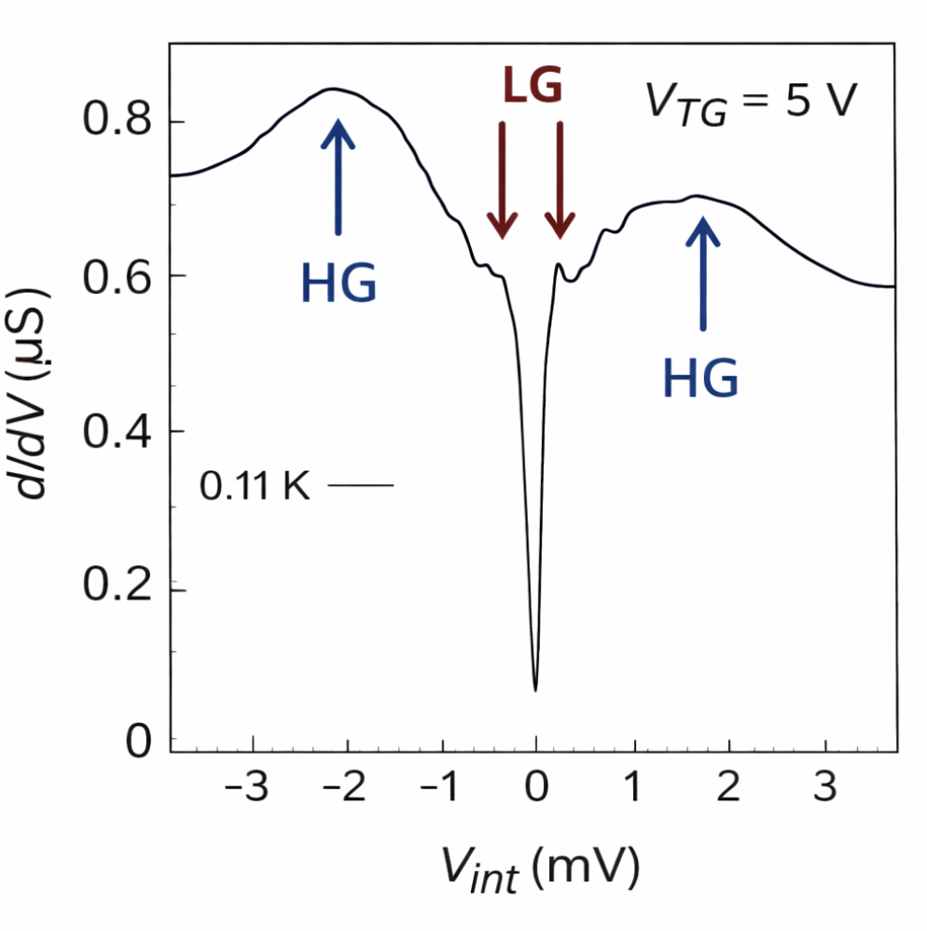
Coexistence of two gaps

Slide 19
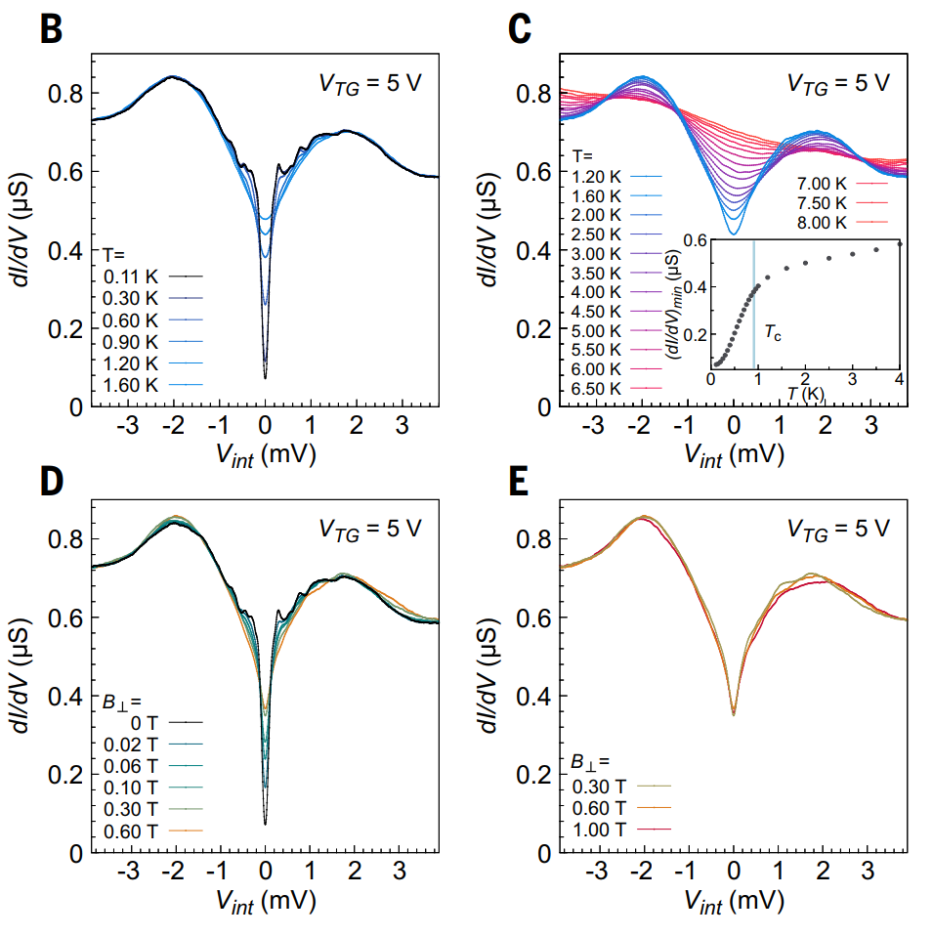
Temperature dependence
LG fills up rapidly
HG is less T sensitive

Slide 20
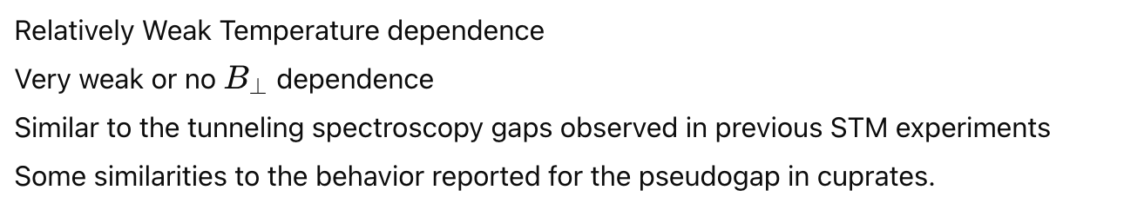
Perpendicular field dependence
LG fills up rapidly
Barely changes

Slide 21
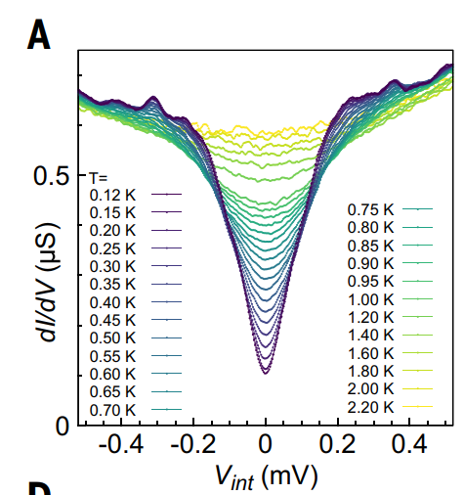
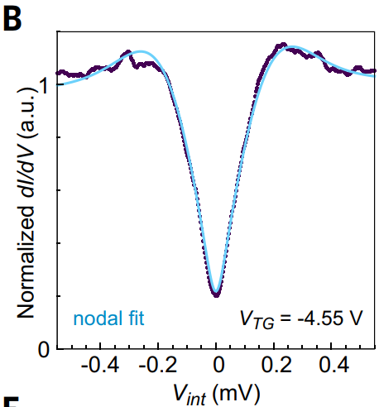
Focusing on lower energy gap
Normalize to the HG figures
dI/dV versus Vint at VTG = -4.55 V

Slide 22
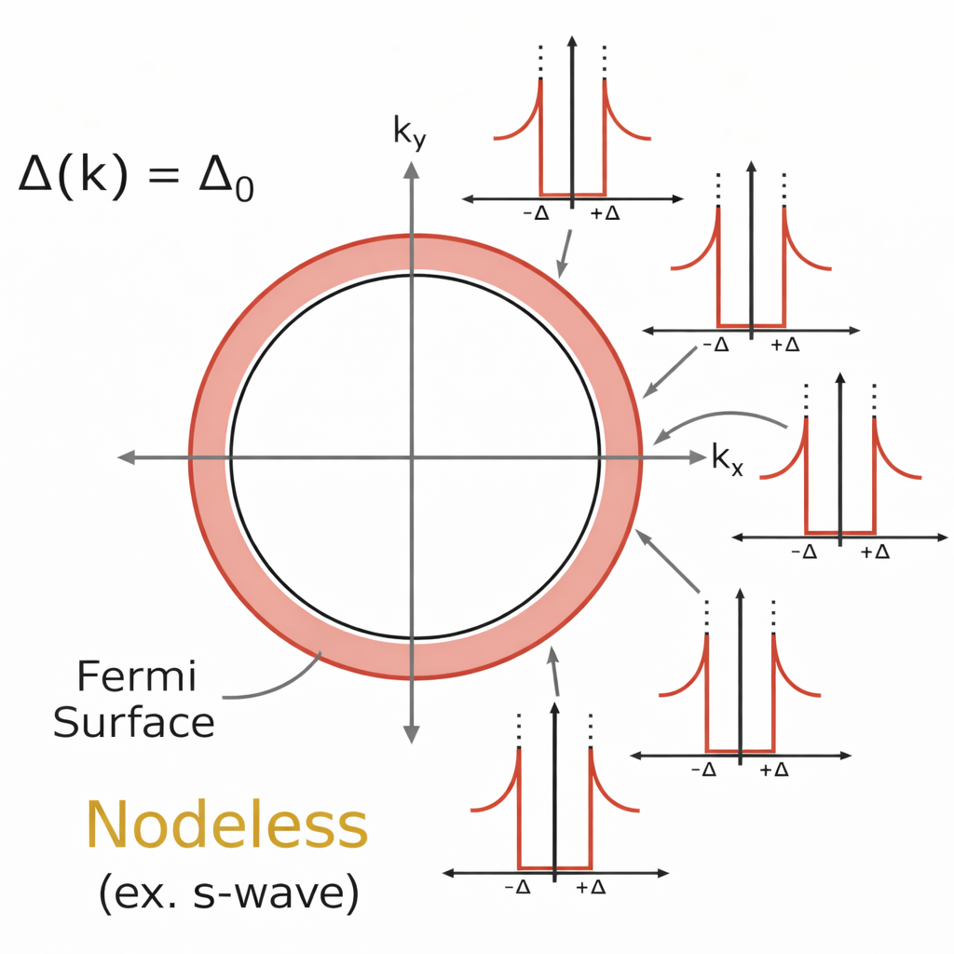
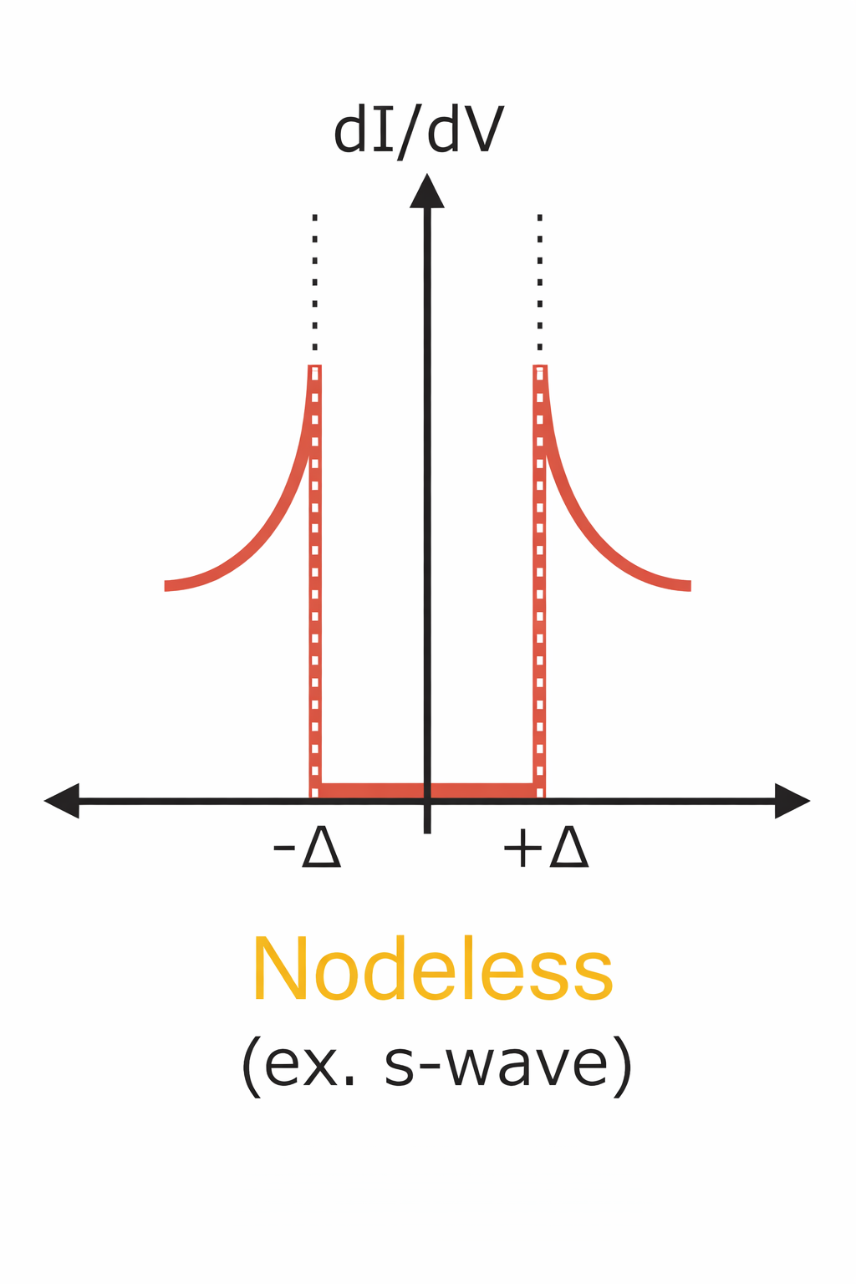
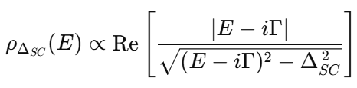
Nodeless SC
Ref: Talk from Kevin Nuckolls (Yazdani group) YouTube

Slide 23
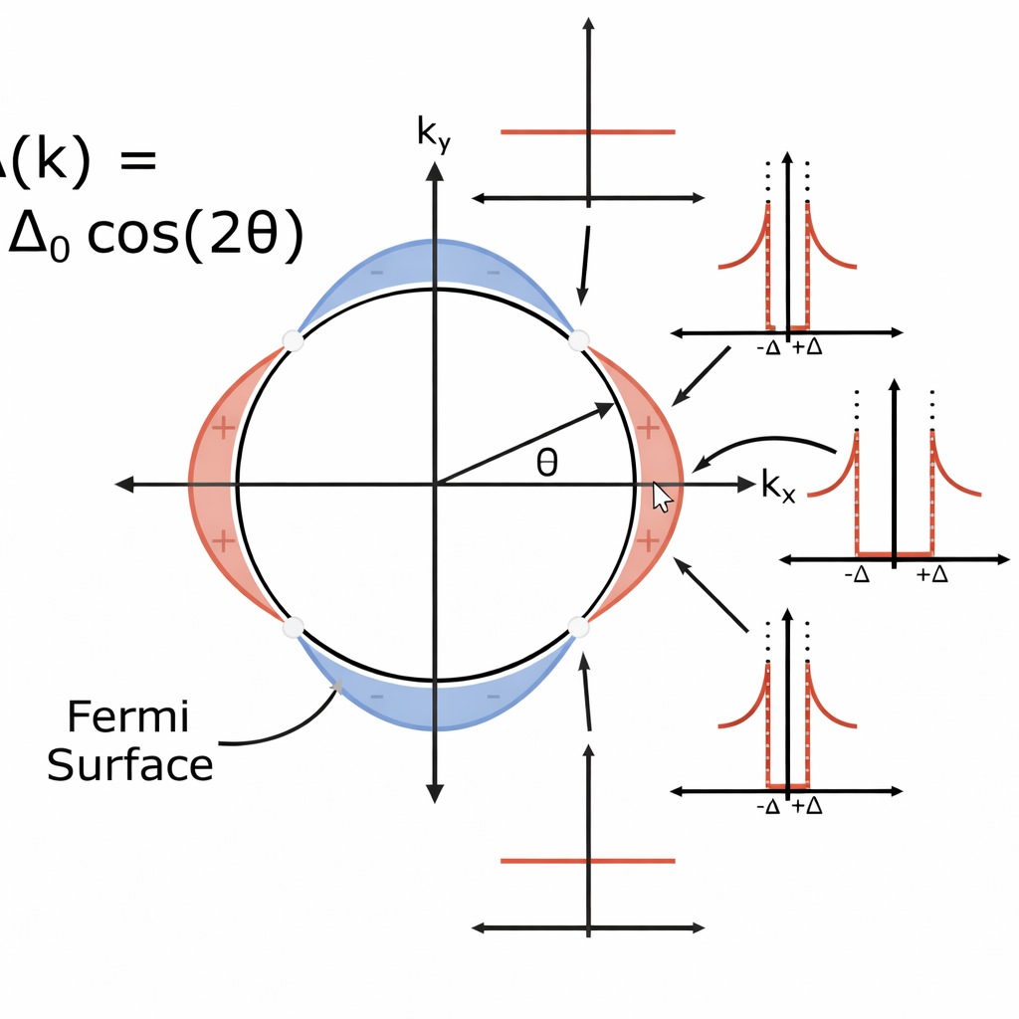
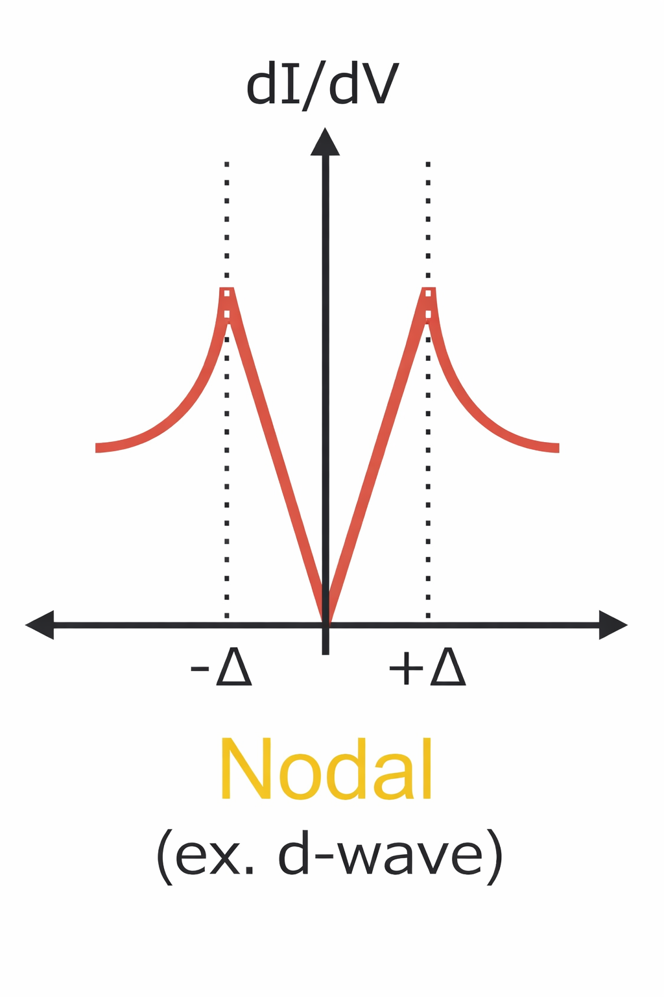
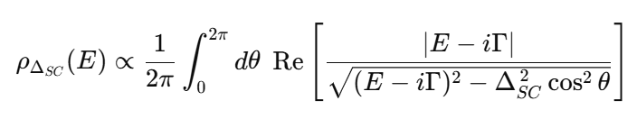
Nodal SC

Slide 24
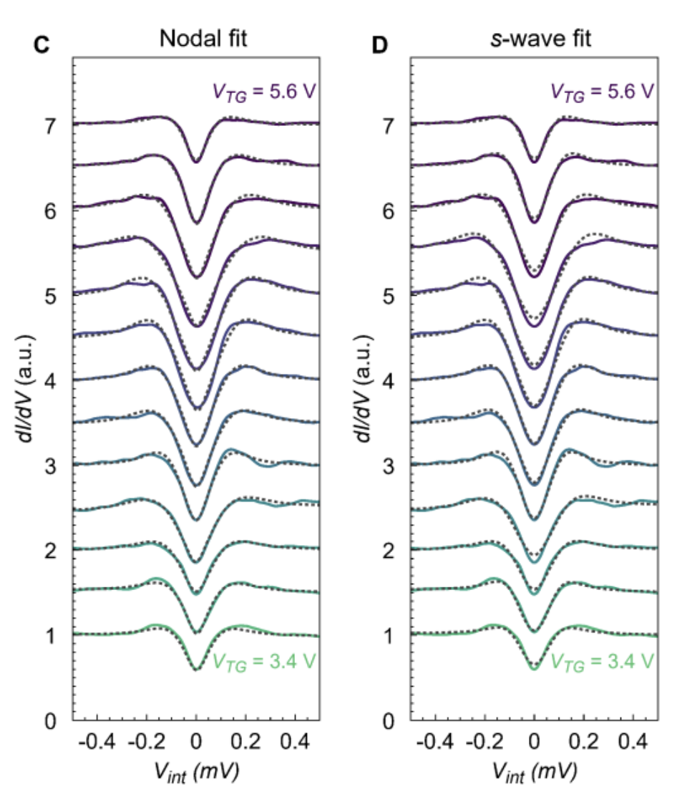
Nodal fit looks slightly better(?!)

Slide 25
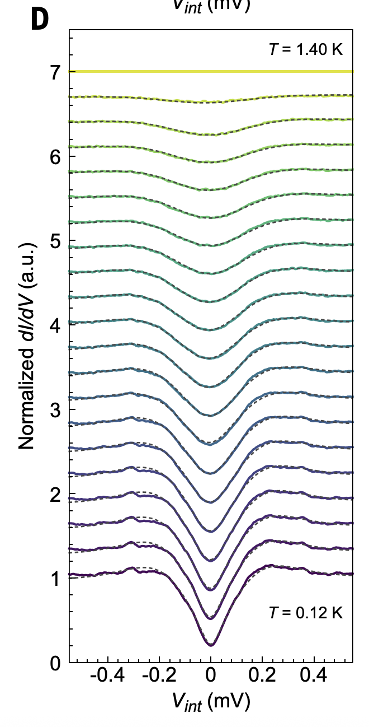
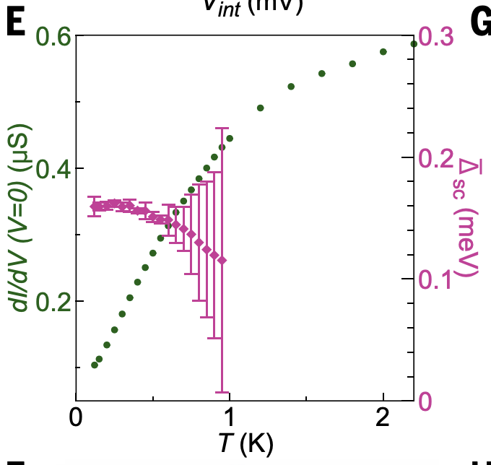
Other evidences of nodal SC
Linear gap filling of zero bias conductance below Tc
reminiscent of the behavior of high-­temperature superconductors with a nodal order parameter

Slide 26
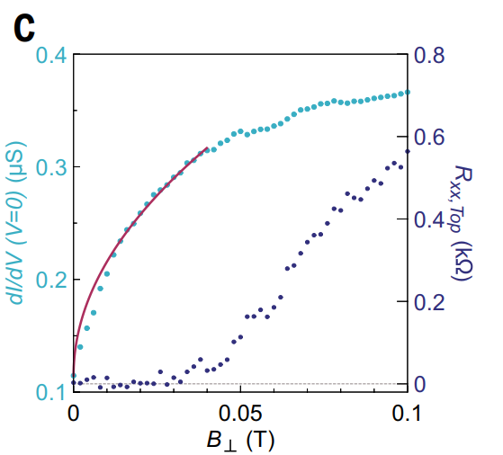
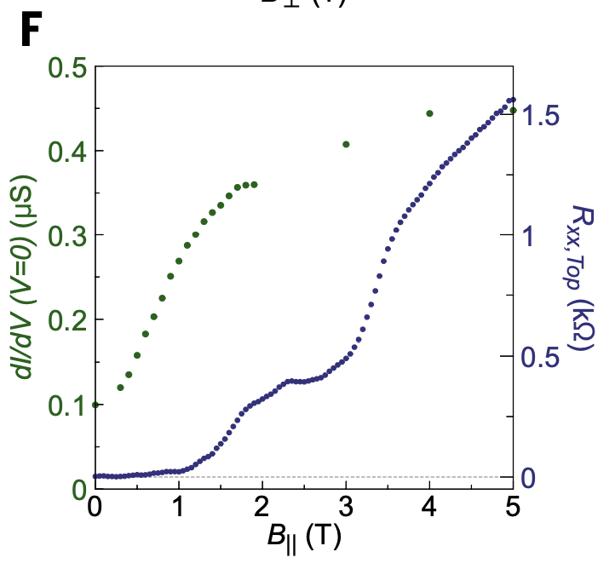
Volovik effect
Doppler shift of quasiparticle energies in the presence of a magnetic field.
√B⊥ dependence of the zero-­energy DOS in a superconductor with a nodal order parameter
Small parallel fields Gap nodes widen to normal, spin-polarized states

Slide 27
Conclusion
4 pieces of evidence for nodal superconductivity
Outlook: josephson junction, study other moire devices, esp. air sensitive devices
Thank you for your attention!

Slide 28
