Slide 1
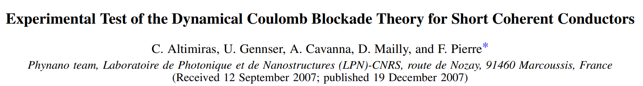
James Mingchi Xu 27.06.2025
Journal Club - Zumbühl Group

Slide 2
Outline
Simple intuition of Dynamic Coulomb Blockade (DCB)
P(E) model of DCB
Suppressing DCB by short circuiting
Temperature dependent of DCB down to 40mK
Scaling of DCB at different Fano factor
Discussion: Thermometry device based on DCB

Slide 3

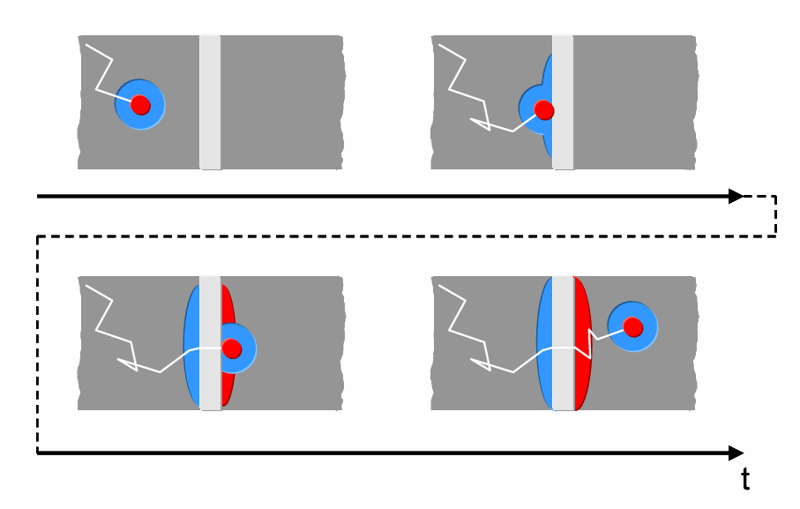
intuition of Dynamic Coulomb Blockade (DCB)
Electron
Screening cloud
The environment matters

Slide 4

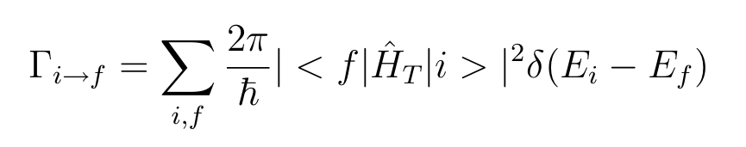
P(E) model of DCB
The current is,
By Fermi’s golden rule:

Slide 5
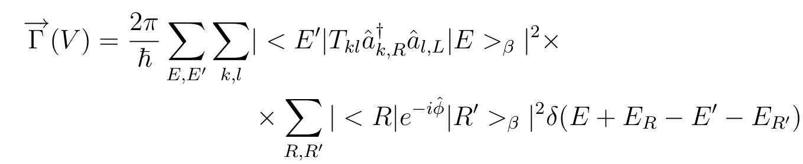
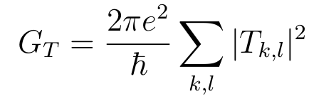
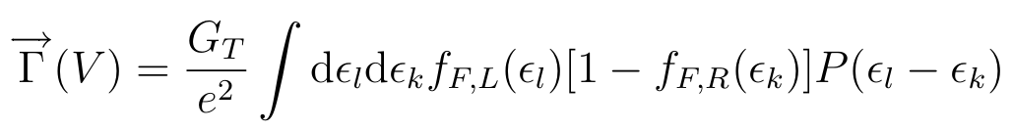
P(E) model of DCB
Particle space
Environment space
Math…

Slide 6
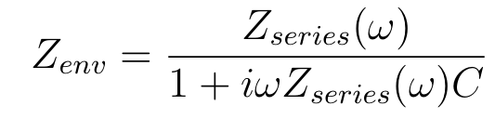

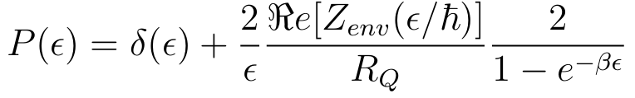
The Characteristic of P(E)
P(E) model of DCB
When

Slide 7
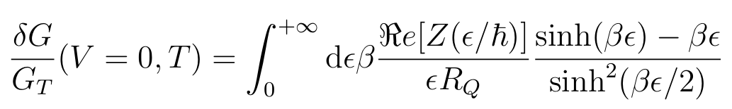
G/Gt at 0 Bias
P(E) model of DCB

Slide 8
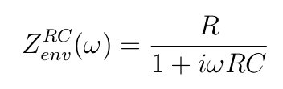
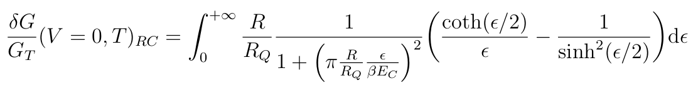


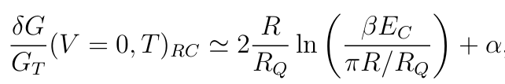
In this experiment, assuming
P(E) model of DCB
Approximating

Slide 9
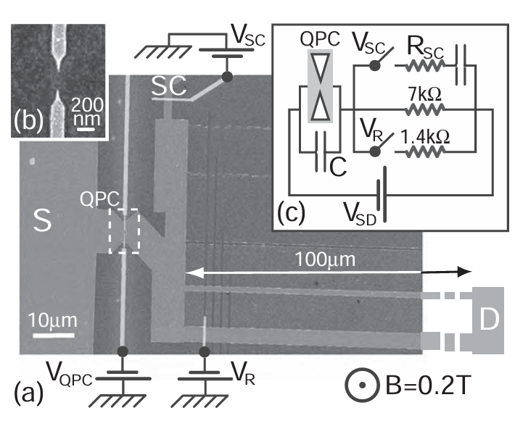
The device
C = 30fF ~ 30mK*kb

Slide 10
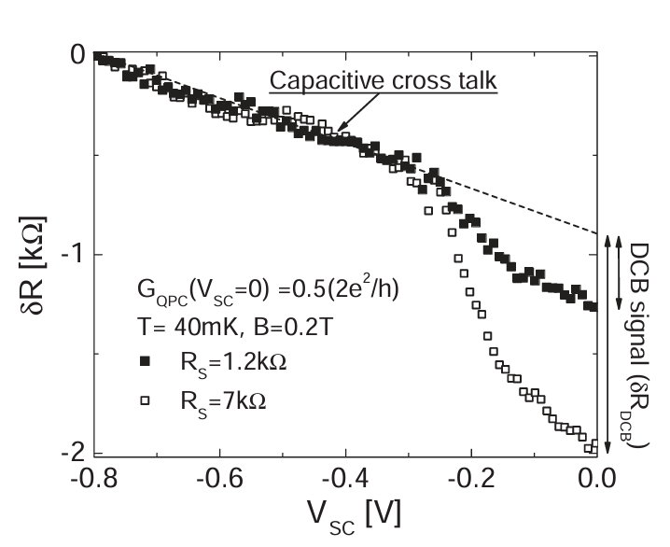
Suppressing DCB by short circuiting
DCB at Vsc = 0

Slide 11
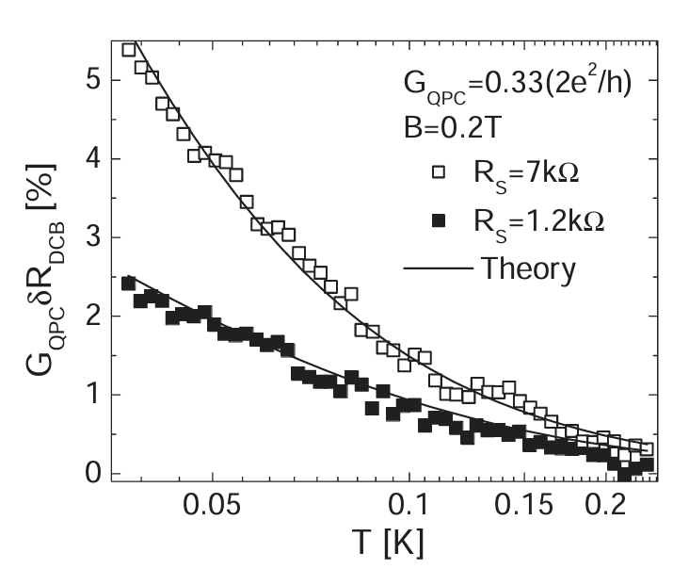
Temperature dependent of DCB
Hope for thermometry !
Fit Ec and R at a high temperature
(Te = Tmc)
Read temperature with Ec/R

Slide 12
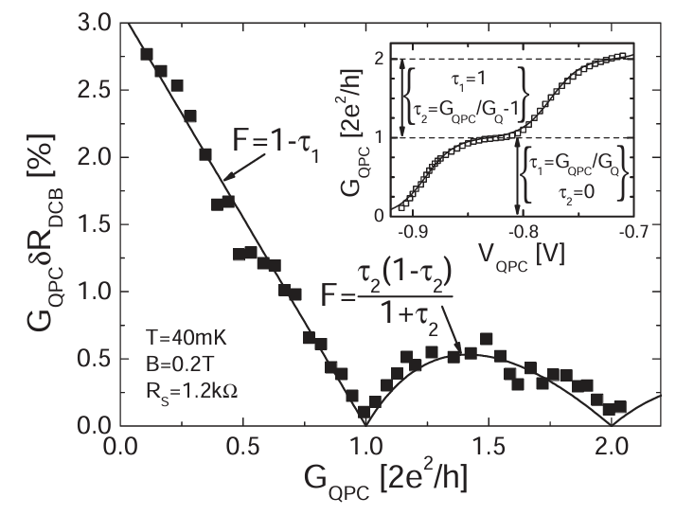
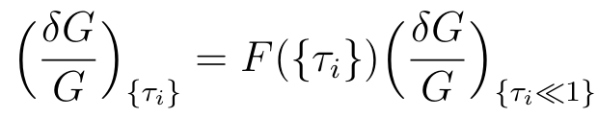

Scaling of DCB at different Fano factor
Park here
against fluctuation?

Slide 13
Conclusion
P(E) model can be solved when the circuit environment is made
P(E) model agrees with the measurement result
DCB can be used as a secondary thermometer

Slide 14
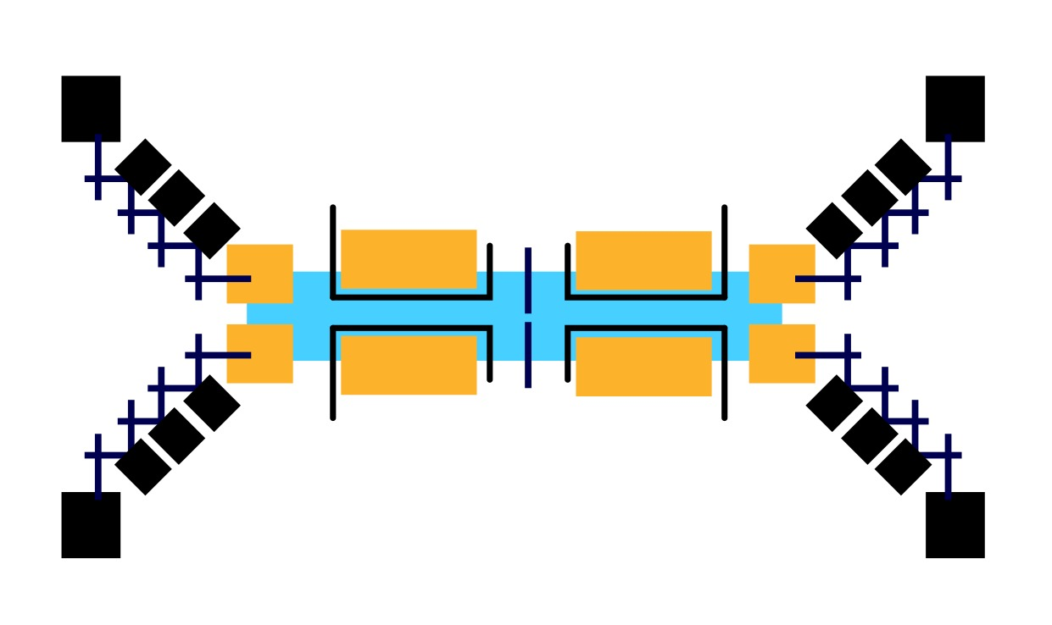
Discussion: Thermometry device based on DCB

Slide 15
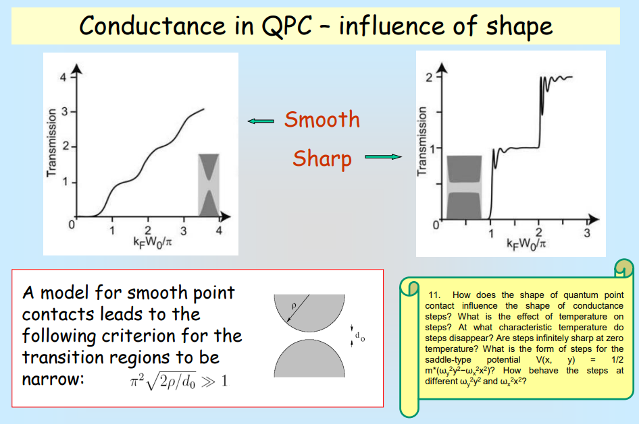
Shape of the QPCs

Slide 16
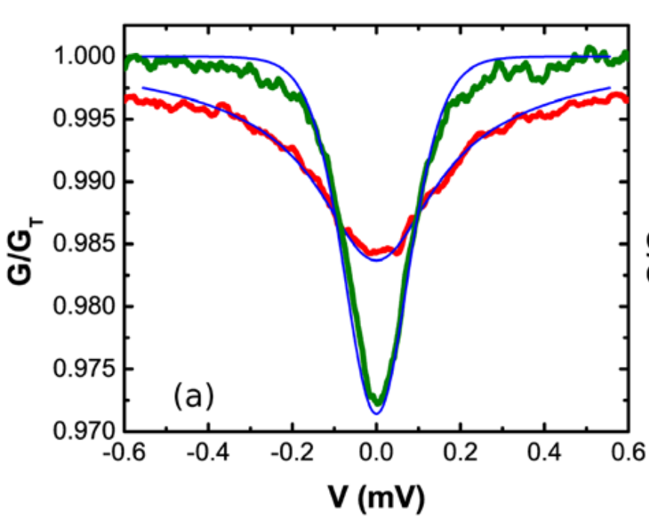
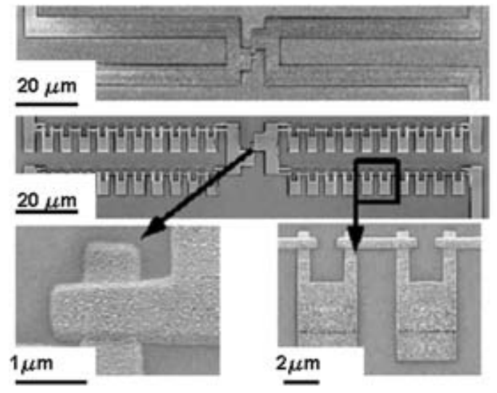
Discussion: Thermometry device based on DCB
300mK
Rj = 6.1 kOhm
J Low Temp Phys (2009) 154: 172–178
DOI 10.1007/s10909-009-9859-1

Slide 17
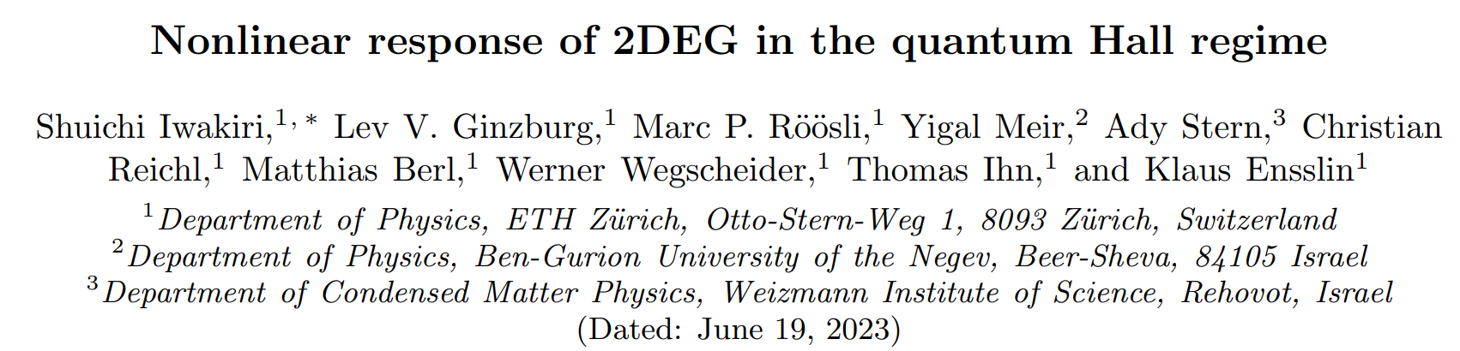
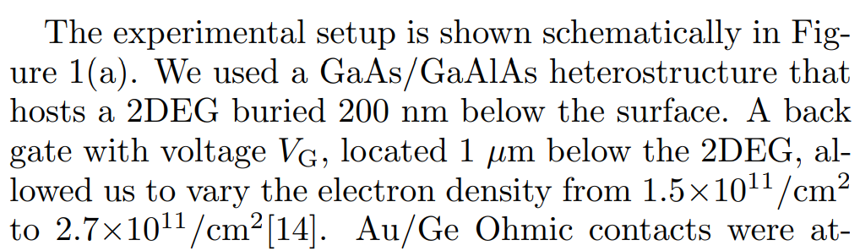
Universal gate for Density

