Slide 1
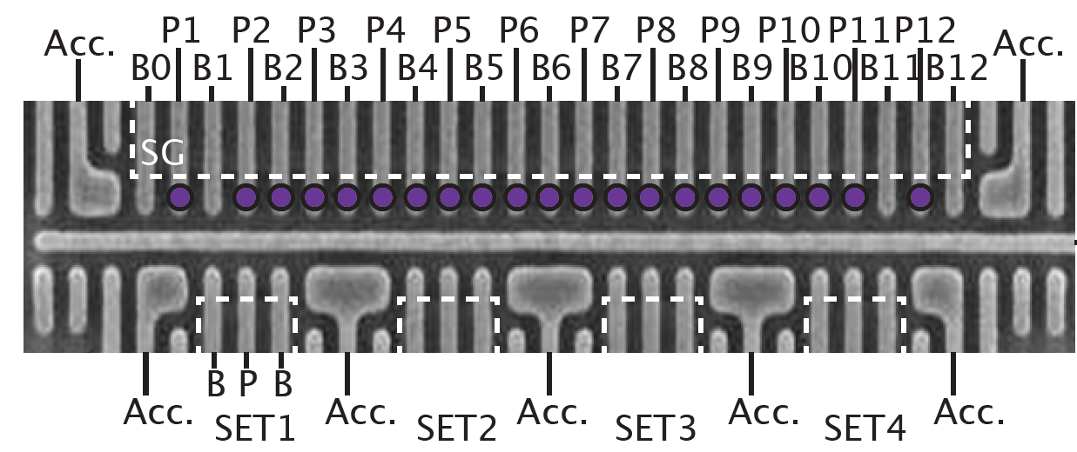
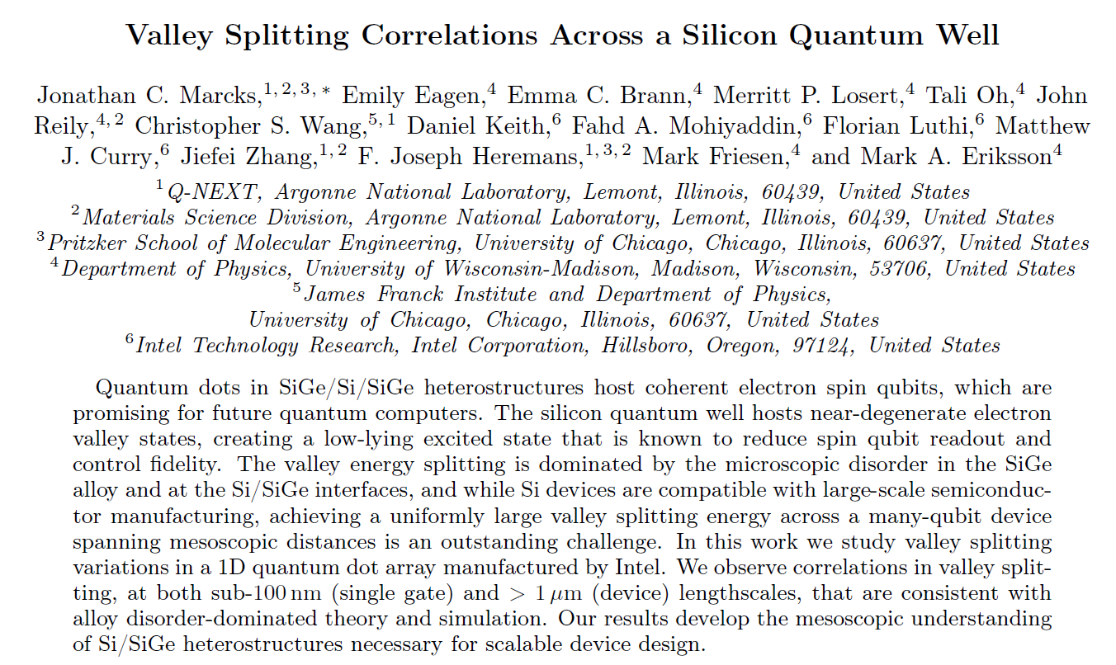

Journal Club
Speaker: Artemii Efimov
19 Sep 2025

Slide 2
Valleys: INTRO
Tensile strain and spatial quantization:
Lattice mismatch of Si with SiGe
Vertical electric field + mass anisotropy in Si/SiO2
sharp disruptions of the periodic crystal potential at the QW interfaces:
Random distribution of Ge atoms in SiGe
Interface sharpness&disorder of Si/SiO2 interface
4x
Energy
6-fold degenerate
CB minimum
Bulk
2x
Valley splitting

Slide 3
Valleys: INTRO
High valleys-low valleys: ∼20–200 meV (Si/SiGe), 20-40meV (Si-MOS)
Orbital level spacings in a quantum dot
(∼1–10 meV, but depends on dot size)
Valley splitting ΔEv (∼0.01–1 meV)
Zeeman splittings (∼0.01–0.1 meV at Tesla-scale fields)
Energy
6-fold degenerate
CB minimum
Bulk
Valley splitting
P. Weitz, R. J. Haug, K. von Klitzing, and F. Sch¨affler, Surf. Sci. 361/362, 542 (1996).
Valley splitting theory of SiGe/Si/SiGe quantum wells
Mark Friesen1,*, Sucismita Chutia1, Charles Tahan2, and S. N. Coppersmith1 (PRB, 2007)

Slide 4
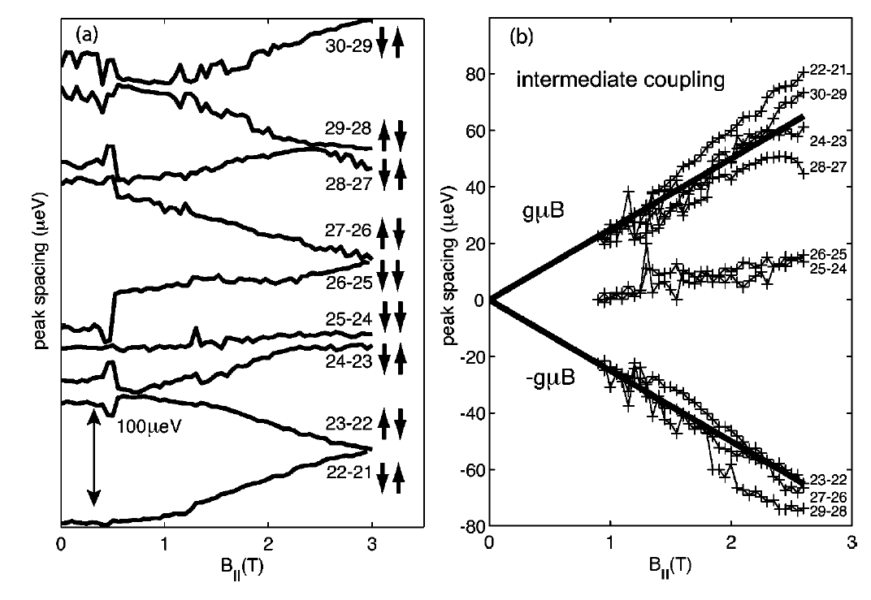
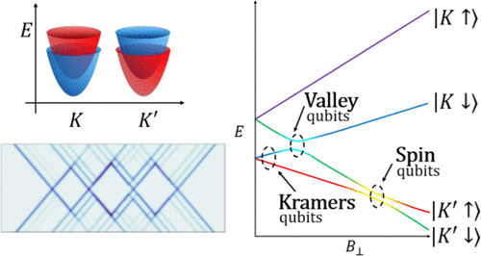
Traditional approach
Magnetospectroscopy of different spin states
Stability of spin states in quantum dots S. Lindemann, T. Ihn, T. Heinzel*, W. Zwerger†, and K. Ensslin K. Maranowski and A. C. Gossard, PRB 2002
Aakash Shandilya, Sundeep Kapila, Radha Krishnan, Bent Weber, and Bhaskaran Muralidharan
ACS Applied Nano Materials 2025 8 (30), 14949-14959
DOI: 10.1021/acsanm.5c01655

Slide 5
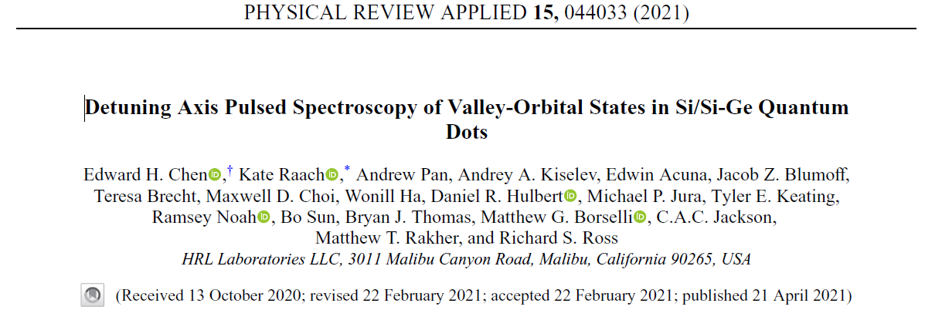
Novel Method: HRL Labs 2021

Slide 6
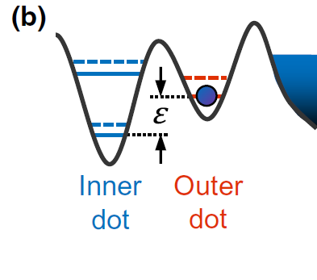
Reservoir
Orbital excitation
Preparing here!
(associated) Valley excitation
Detuning!

Slide 7
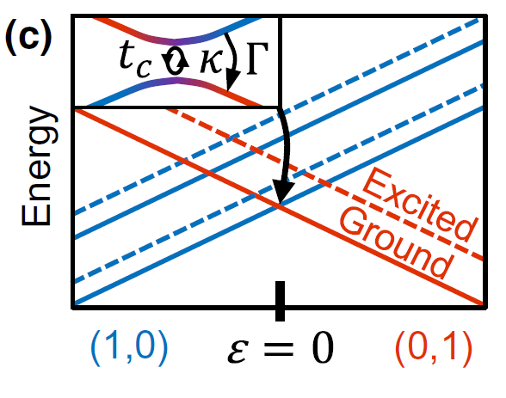
Ground state = reference
Reservoir
Probing these levels!
Working only on one side of detuning

Slide 8
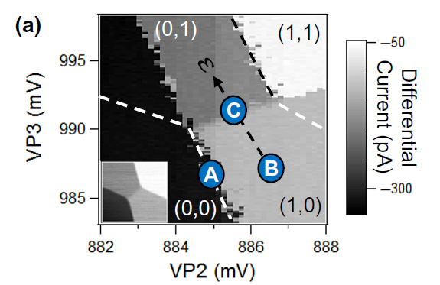
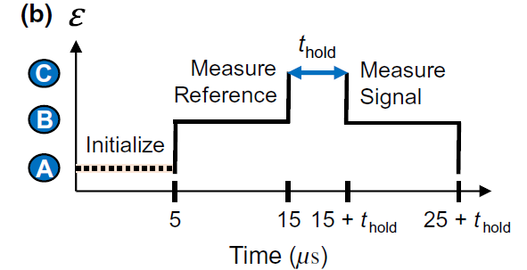
A (Re-)loading from the reservoir to the source DOT to Ground State
B Pulse to the bulk of (1,0) region
Charge Sensor: Signal_(1,0)
  Diabatically going to to some ε = …
  Hold …
  Diabatically going back to some ε = …
B Pulse back
Charge Sensor: Signal(1,0) or Signal_(0,1)
Result ≠0 if matched with an excited state
Result = 0 if not matched with an excited state
Repeat
Matched with the excited state of the target dot: tunnels -> (0,1)
No level matching -> still (1,0)
C
HRL data 2021
8

Slide 9
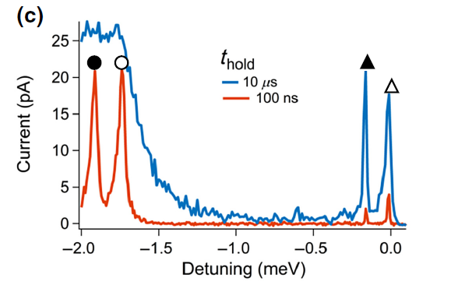

$$κt_{c}^{−2}<t_{hold}<Γ_{decay}^{−1}$$
HRL data 2021

Slide 10
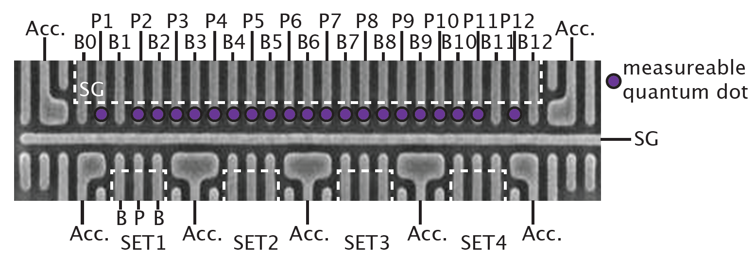
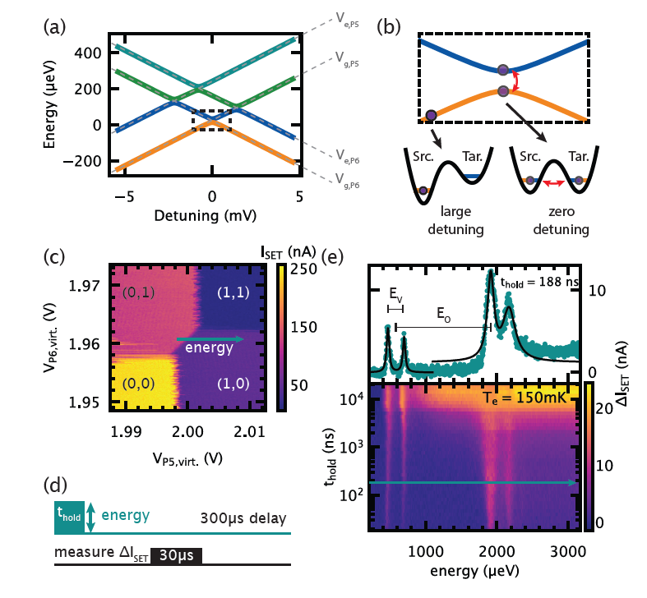
The tool is working, let’s go deeper into material physics
M. Eriksson lab data 2025

Slide 11
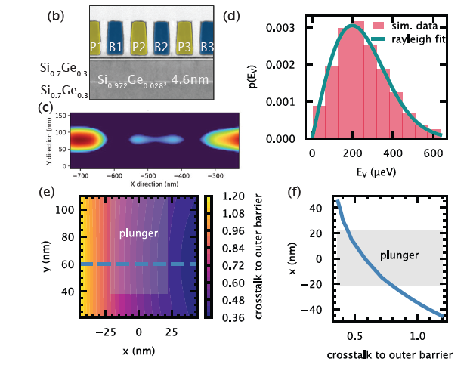
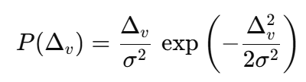
Simulated Electron Density in the elongated QD
ADD theory = Alloy disorder-dominated valley splitting
Key point of the paper: To verify the ADD model
=> conclusion about the valley splitting’ variations
Hint: 2.8 % Ge doping
Simulated Valley splitting according to E-field distortion
Dot Center position as a function from the Crosstalk
M. Eriksson lab data 2025

Slide 12
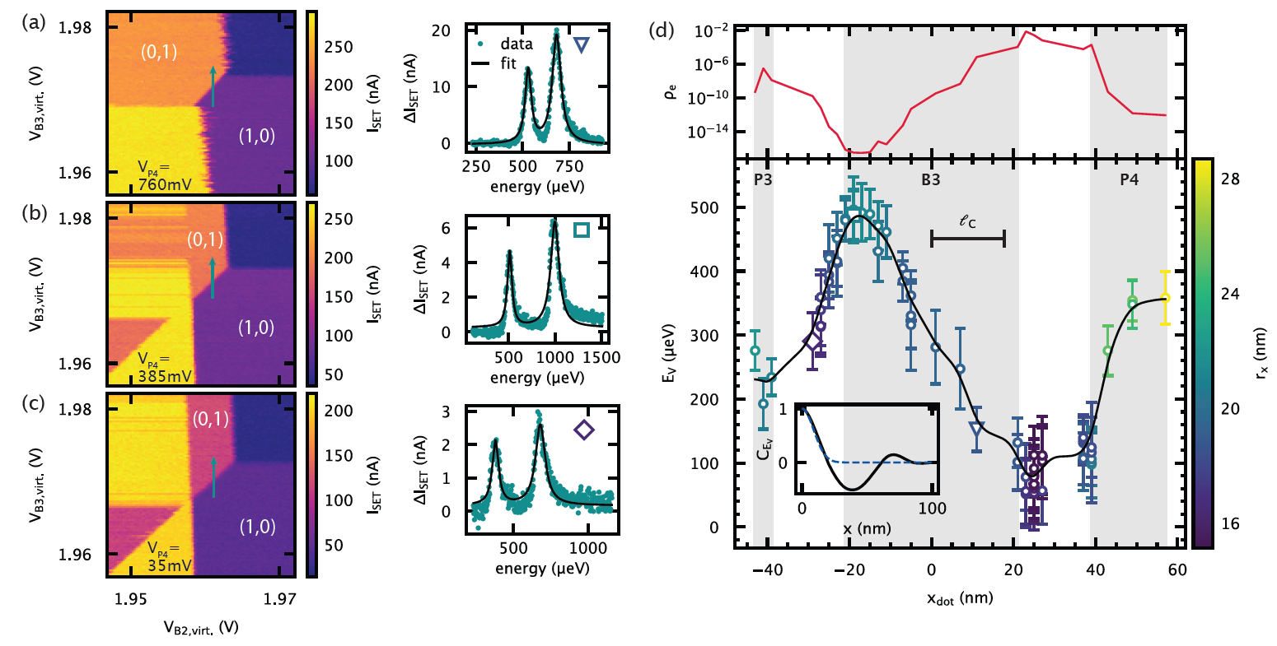
Continuous electron valley probe
M. Eriksson lab data 2025

Slide 13
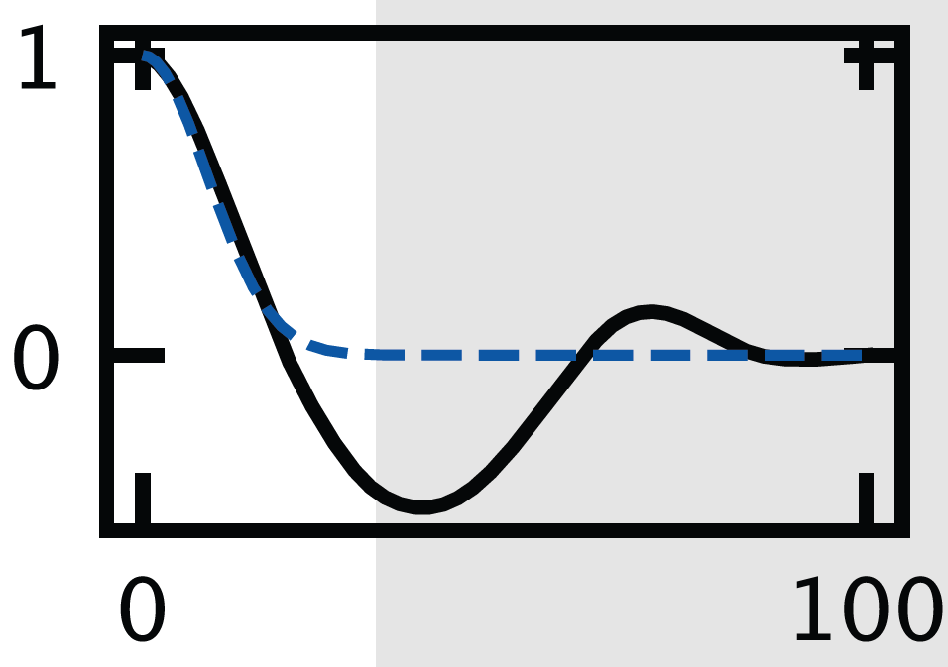
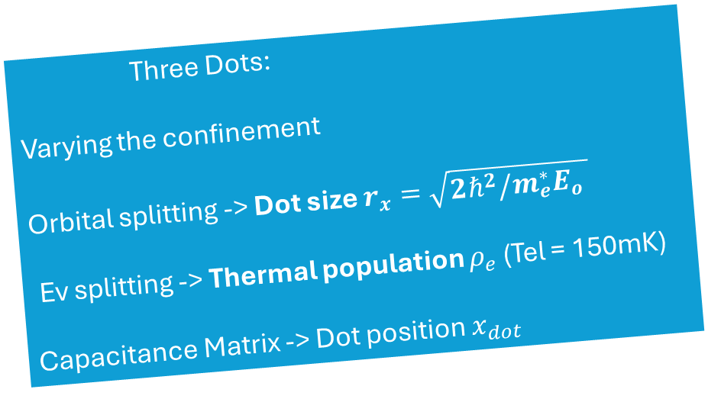
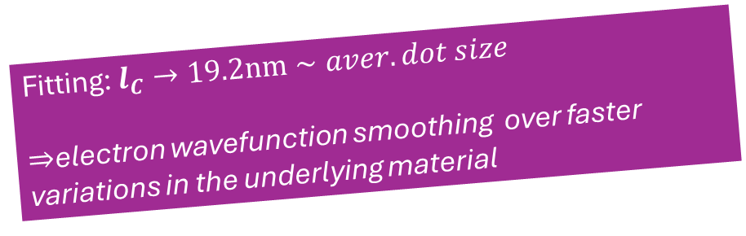
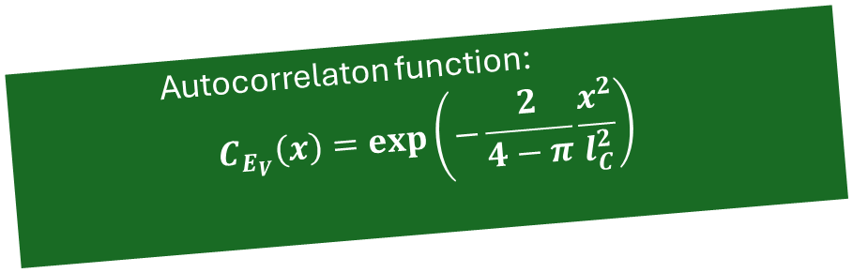
Continuous electron valley probe
Three Dots:
Varying the confinement
Orbital splitting -> Dot size $r_{x}=\sqrt{2ℏ^{2}/m_{e}^{∗}E_{o} }$
Ev splitting -> Thermal population $ρ_{e}$ (Tel = 150mK)
Capacitance Matrix -> Dot position $x_{dot}$
Fitting: $l_{C}→19.2nm∼aver. dot size$
$⇒$electron wavefunction smoothing over faster variations in the underlying material
Autocorrelaton function:
$$C_{E_{V}}\left(x\right)=\exp\left(−\frac{2}{4−π}\frac{x^{2}}{l_{C}^{2}}\right)$$
M. Eriksson lab data 2025

Slide 14
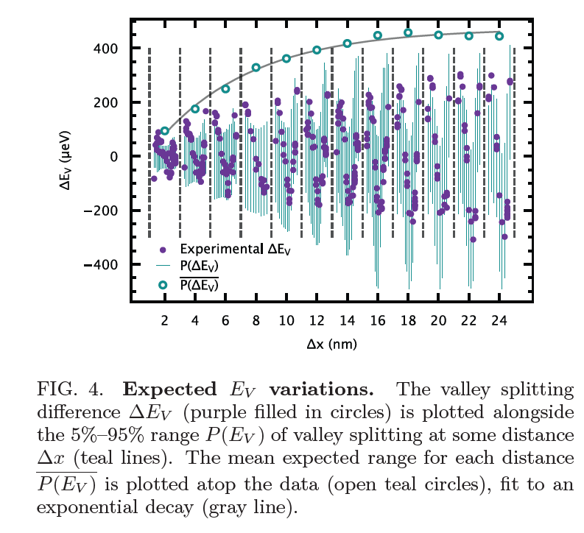
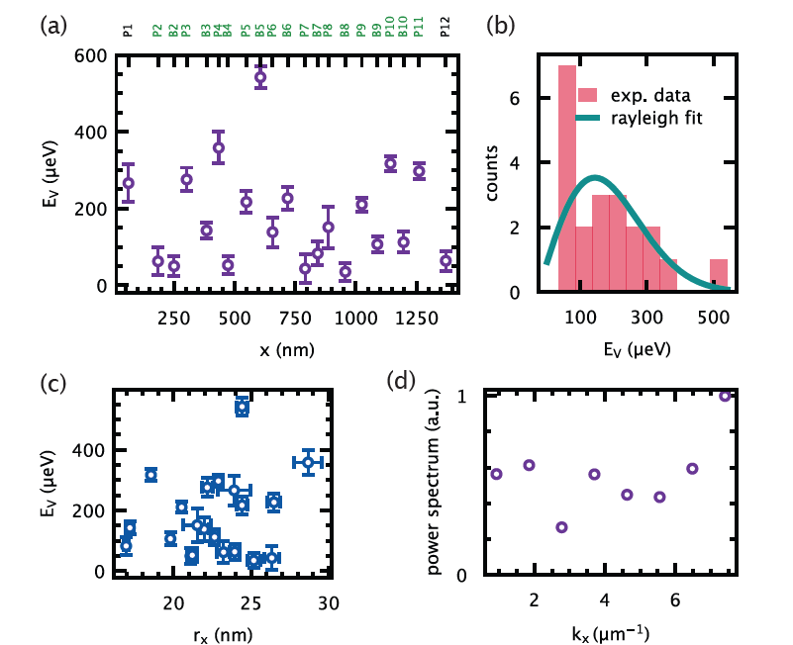
across the gate
across the device
“Alloy disorder-dominated bahaviour”
(not Rayleigh)
“Local correlations die out on/below
electron wavefunction size”
No (significant) dependence Ev from the dot size ->
“Domination of underlying material disorder”

Slide 15
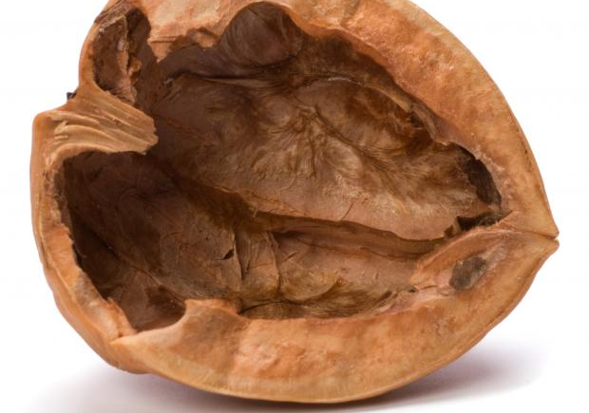

1. Valley states – parasitic states for (traditional) spin qubits
2. Si/SiGe (+a few % of Ge) quantum dots : large valley splitting ($∼$200μeV) + spatial correlations (>100% for large QD arrays!)
3. Detuned Axis Pulsed spectroscopy: convenient approach to probe valley states (not only) for the qubit dots
Baseband operation, no Magnetic Field needed.

