Slide 1
James Mingchi Xu 30.08.2024
Journal Club - Zumbühl Group

Slide 2
Outline
The device Architecture
Characterization of QPCs
Coulomb Diamond in Different Tuning Regime
Measurement with the Charger Sensor
The connection to the Microkelvin project.

Slide 3
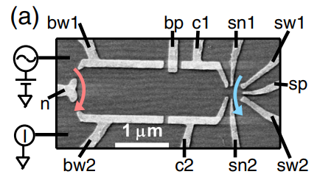
Device architecture
Electron Density: 2×${10}^{11}$ cm²
Mobility: 2×10⁶ cm²/V*s
Area: 2.6 µm²
Level spacing: Δ = 2.7 µeV (31.11mK)
To calculate the self capacitance and the charging energy (naively):
C₀=8ϵ₀ ϵ_{r} R = 8.351e-16F
where ϵ_{r} = 13.1, and R = 0.9 µm (A disc charge with same area in infinite GaAs)
E_{c} = e²/C₀ = 2.22K * k_{b}

Slide 4
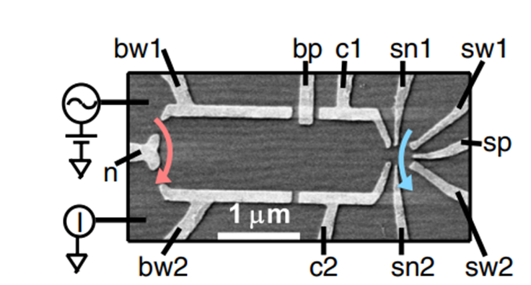
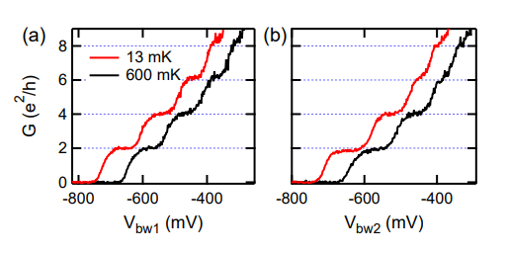
Characterization of QPCs
The exact voltage of Vn is not specified :(
The sub-band spacing of is around 50µeV (0.58K)

Slide 5
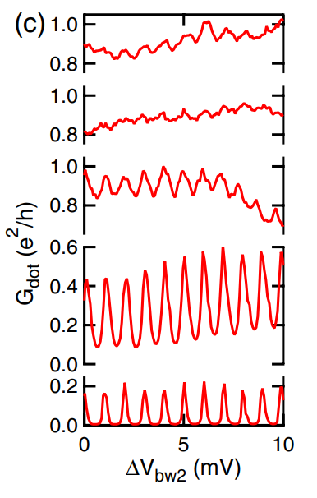
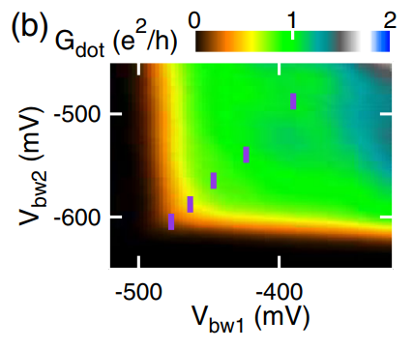
Characterization of QPCs
T = 13 mK ; B = 25 mT ; 1mV period
1st plateau
1st plateau
1st plateau
T = 540 mK
B = 25 mT
Tunnelling regime
Tunnelling regime

Slide 6
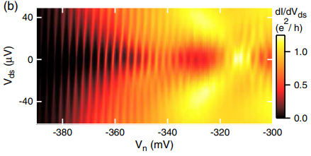
Coulomb Diamond in Different Regime
For Vn = -315mV
Ec = 16µeV (180mK)
T = 13 mK ; B = 0 mT
For Vn < -370mV
Ec = 115µeV (1.33K)

Slide 7
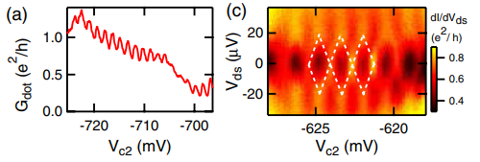
Coulomb Diamond in Different Regime
When both QPC’s are kept on the first plateau…
T = 13 mK ; B = 0 mT

Slide 8
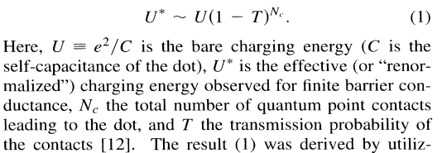
Charging Energy Renormalization (Ref[6,7])

Slide 9
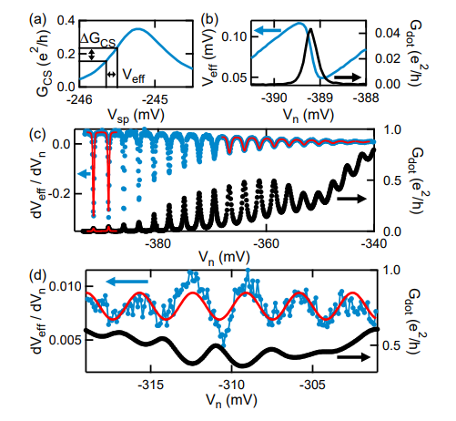
Measurement with the Charger Sensor
Model from ref[10]
Mesoscopic charge quantization
I. L. Aleiner and L. I. Glazman
Phys. Rev. B 57, 9608 – Published 15 April 1998

Slide 10
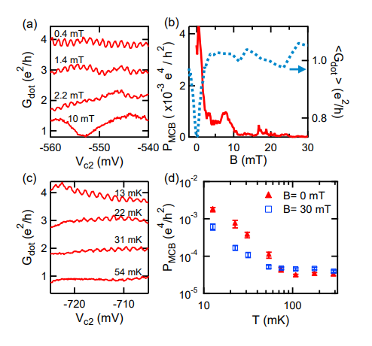
Measurement with the Charger Sensor

Slide 11
Conclusion
Coulomb blockade caused by weak localization is observed.
The charging energy of a QPC defined quantum dot changes significantly with the tuning.

Slide 12
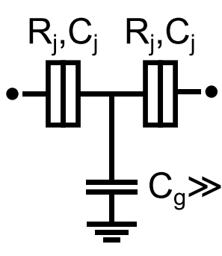
The A 2DEG CBT
Ohmic
Ohmic
To park the QPCs on the plateau?
The dimension of the charging island?
The charging energy renormalization?
To use the WL as the charging effect?
Shape of the island?
Quantum hall regime?
QPC
QPC

