Slide 1
Introduction to Physics I
For Biologists, Geoscientists, & Pharmaceutical Scientists

Slide 2
Newton’s First Law
An object at rest remains at rest unless acted on by and external force.
An object in motion continues to travel with constant velocity unless acted on by an external force.
This is also known as the ‘Law of Inertia’.
Notes:
LKB

Slide 3
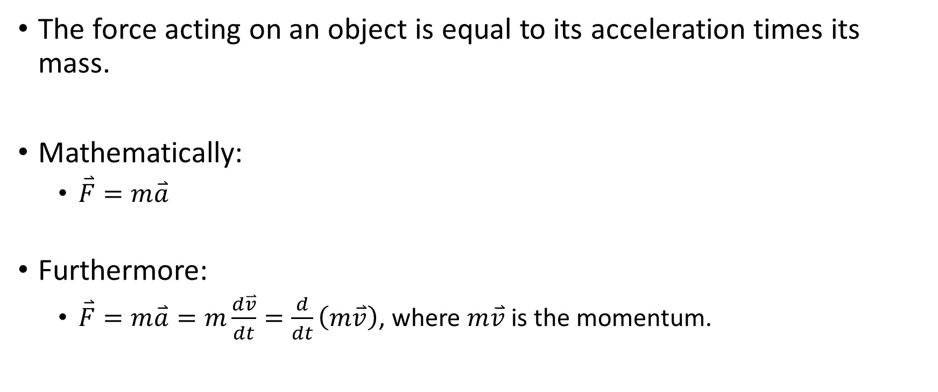
Newton’s Second Law
The force acting on an object is equal to its acceleration times its mass.
Mathematically:
$\overset{⃑}{F}=m\overset{⃑}{a}$
Furthermore:
$\overset{⃑}{F}=m\overset{⃑}{a}=m\frac{d\overset{⃑}{v}}{dt}=\frac{d}{dt}\left(m\overset{⃑}{v}\right)$, where $m\overset{⃑}{v}$ is the momentum.
Notes:
Bottle, strings and masses

Slide 4
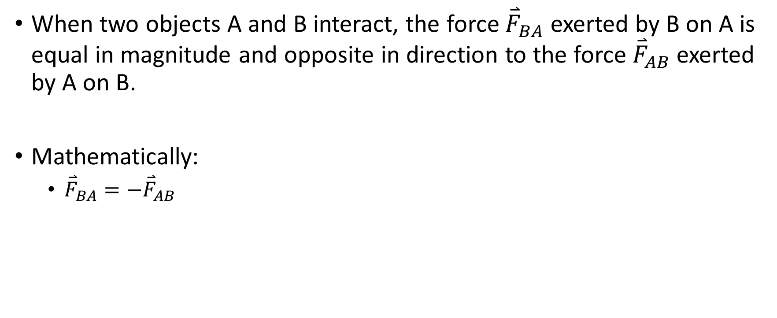
Newton’s Third Law
When two objects A and B interact, the force ${\overset{⃑}{F}}_{BA}$ exerted by B on A is equal in magnitude and opposite in direction to the force ${\overset{⃑}{F}}_{AB}$ exerted by A on B.
Mathematically:
${\overset{⃑}{F}}_{BA}={−\overset{⃑}{F}}_{AB}$
Notes:
Rope pulling

