Slide 1
Introduction to Physics I
For Biologists, Geoscientists, & Pharmaceutical Scientists

Slide 2
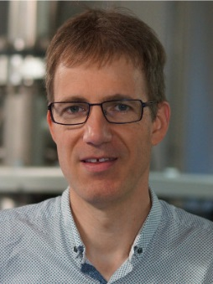
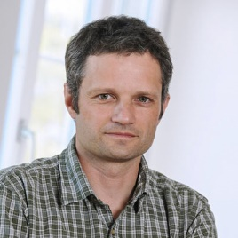


Instructors
Professors
  Dominik Zumbühl
  Michel Calame
Lectures
  Roland Steiner
Exercises/Exam
  Carl Drechsel

Slide 3
Format
Lectures: Thursdays and Fridays 10:00 – 12:00, Grosser HS Physik
Weekly Exercise Sessions: Schedule on website/ADAM
Final Exam: 31.01.2020, 9:00 – 11:00
Language: English (equivalent materials also available in German)

Slide 4
Weekly Exercise Sessions
Exercise Sessions are optional, but strongly recommended
Exercises sheets and solutions will be in English and German
Exercise sheets and solutions will be published on website/ADAM
Sessions start Tuesday 24.9. & Wednesday 25.09.2019
Students are distributed in an alphabetical order among their study program (Bio, Pharma, Geo).

Slide 5
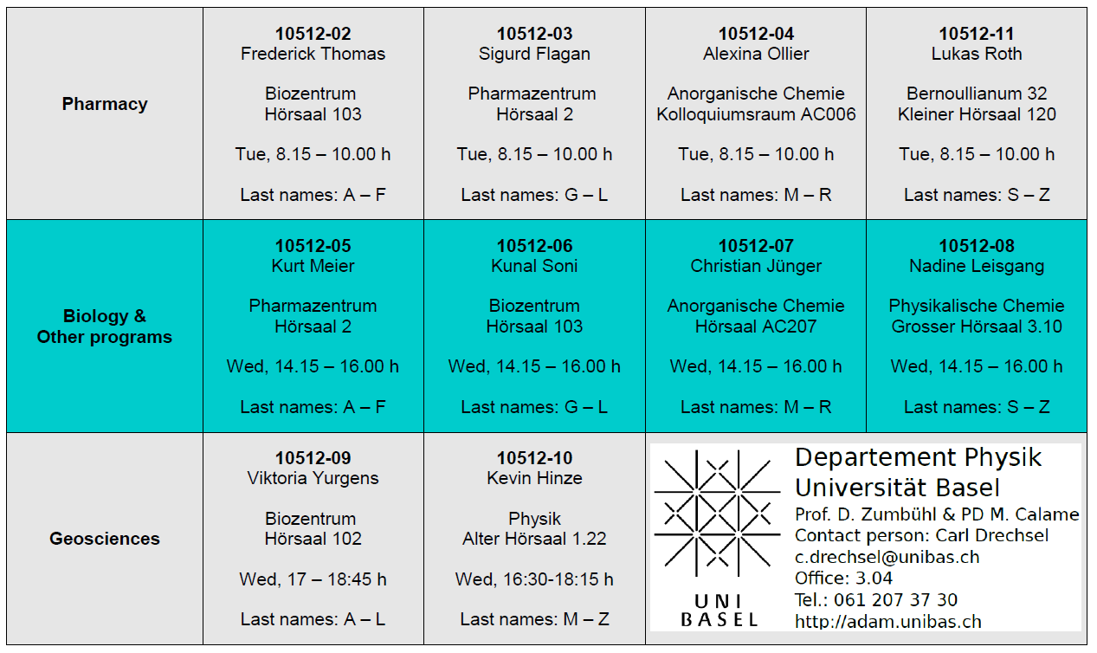
Weekly Exercise Sessions

Slide 6
Exam
Written exam is on 31.01.2020 from 9:00 – 11:00, (rooms will be announced in December at: https://philnat.unibas.ch/examen/)
All topics from the lecture and exercise sessions
The exam will be in English and German
Allowed Items:
  Pocket calculator
  One A4 sheet with handwritten notes on both sides
  A formulary (small book with formulas)
  A dictionary
  Devices with wireless internet access are strictly forbidden
Test Exam in last exercise session (17th & 18th Dec)
The complexity of the exam is comparable to the exercises and the tutorial exam. For preparation it is recommended to solve the exercises and test exam independently

Slide 7
Literature
Physik für Mediziner, Biologen, Pharmazeuten, 8. Auflage by Trautwein, Kreibig, and Hüttermann (German)
  PDF available on course website/ADAM
Physics for Scientists and Engineers, Vol. 1, 6th Edition by Paul A. Tipler, Gene Mosca (English)
Skriptum (German)
  Hard copy available for purchase and PDF available on course website/ADAM
Lecture Notes (English)
  PDFs will be available on course website after each lecture

Slide 8
Physik für Mediziner, Biologen, Pharmazeuten, 8. Auflage by Trautwein, Kreibig, and Hüttermann

Slide 9
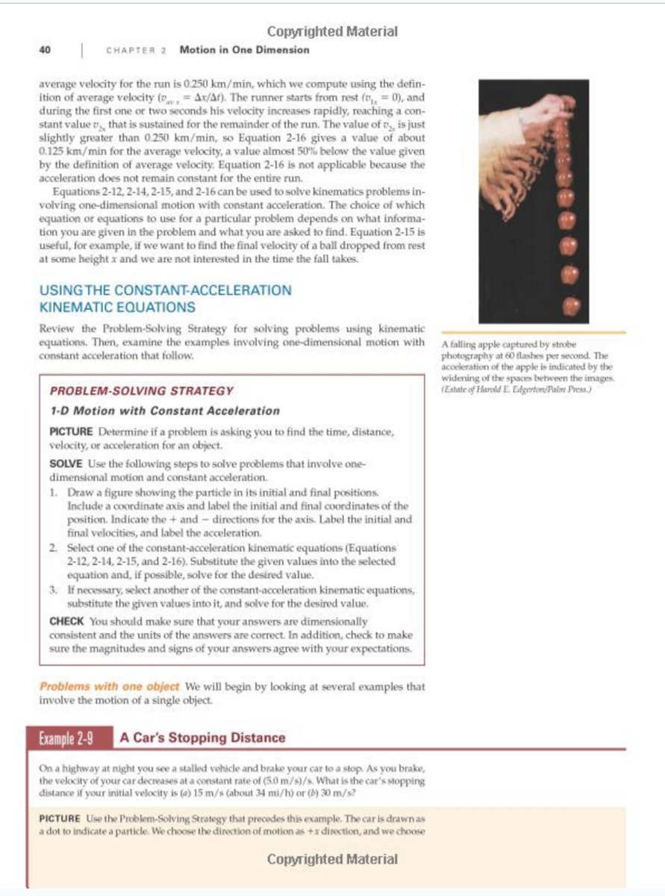
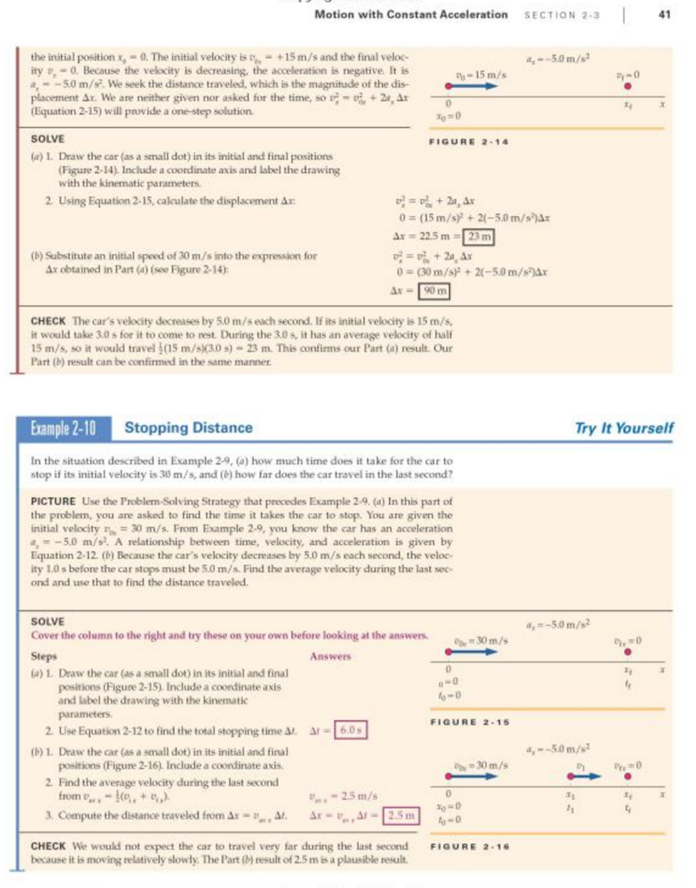
Physics for Scientists and Engineers, Vol. 1, 6th Edition by Paul A. Tipler, Gene Mosca

Slide 10
Skriptum

Slide 11
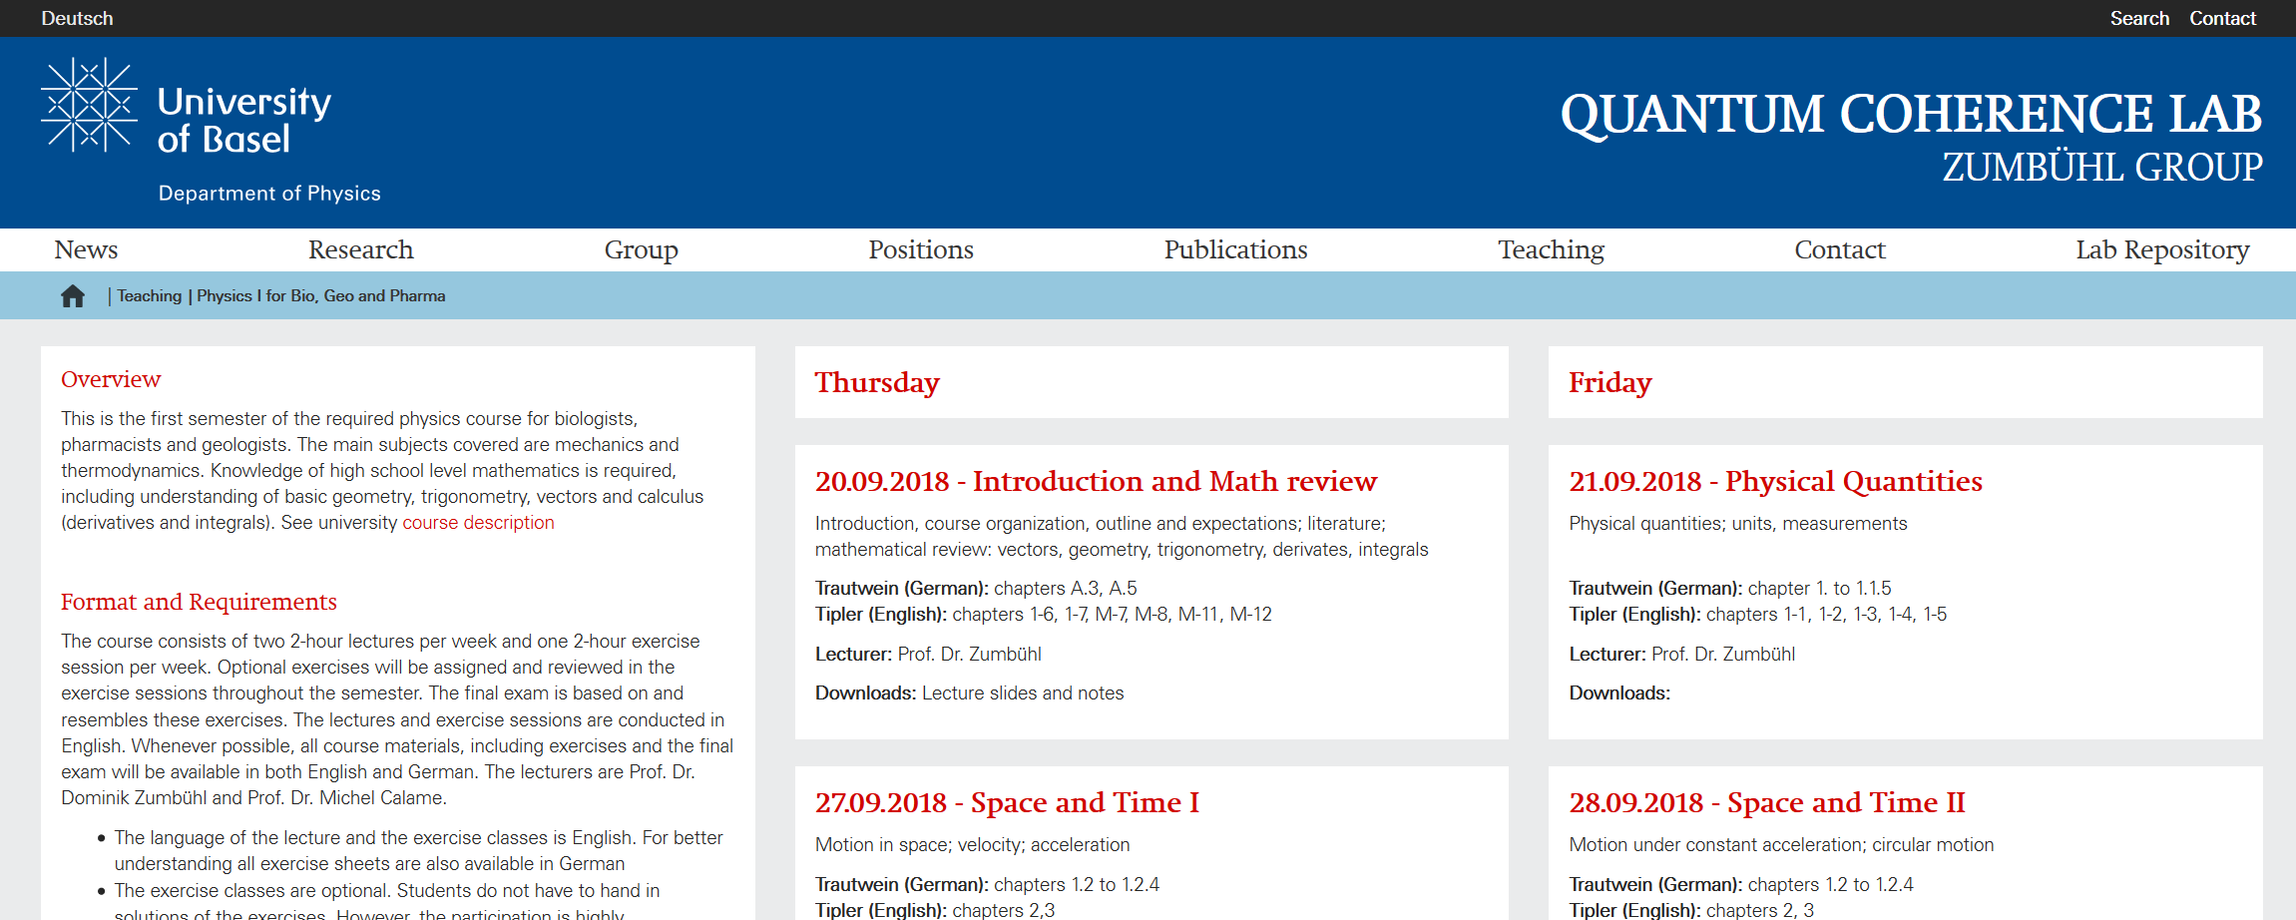
https://zumbuhllab.unibas.ch/teaching/hs19/physics1bgp.html

Slide 12
Why Physics?
“The Fundamental Science”
Understanding measurement and measurement devices
Learning to apply the “Scientific Method”

Slide 13
What is Physics?
A model that describes how the universe behaves.
  Model: fundamental principles and laws
  Universe: everything around us
  The model holds everywhere and always
Experiments are the basis for this model
The model allows us to make predictions

Slide 14
Mathematical Review
Vectors
Geometry
Trigonometry
Derivatives
Integrals

Slide 15
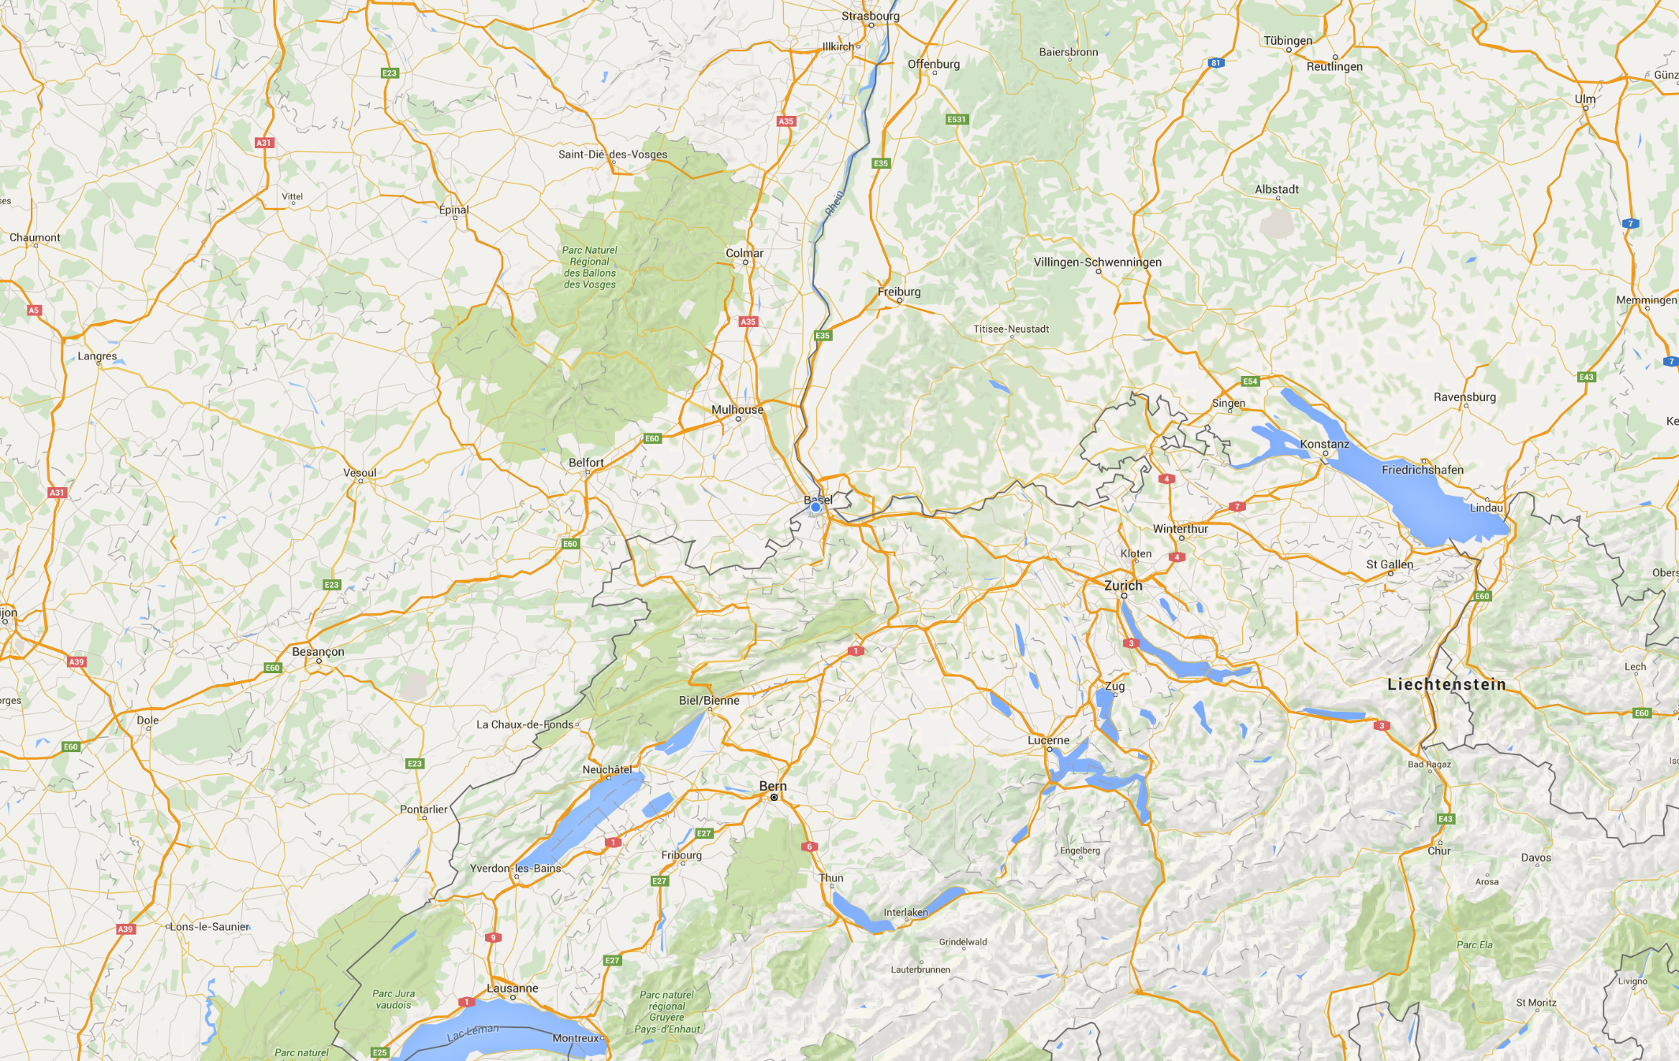
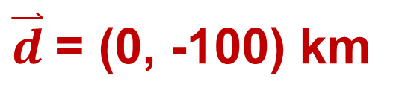
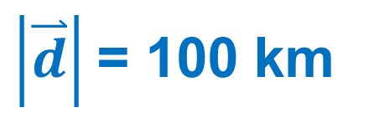
y
x
100 km
Notes:
Wenn ich sage, dass ich 100 km weit Weg von Basel bin, können sie nicht genau wissen wo ich bin. Ich kann in der Schweiz, in Frankreich, oder in Deutschland sein. Ich bin irgendwo auf diesem Kreis. Aber, wenn ich sage, dass ich bin 100 km südlich von Basel, dann wissen sie dass ich in Thun bin. Der Weg zwischen Basel und Thun ist eigentlich ein Vektor.
Wir können Achsen definieren, x und y, und dieser Vektor so schreiben. Wir haben 0 km entlang die X-Achse und -100 km entlang die y-Achse.
Der Betrag dieser Weg, die Strecke, ist 100 km und ist eine skalare Grösse.

