Slide 1
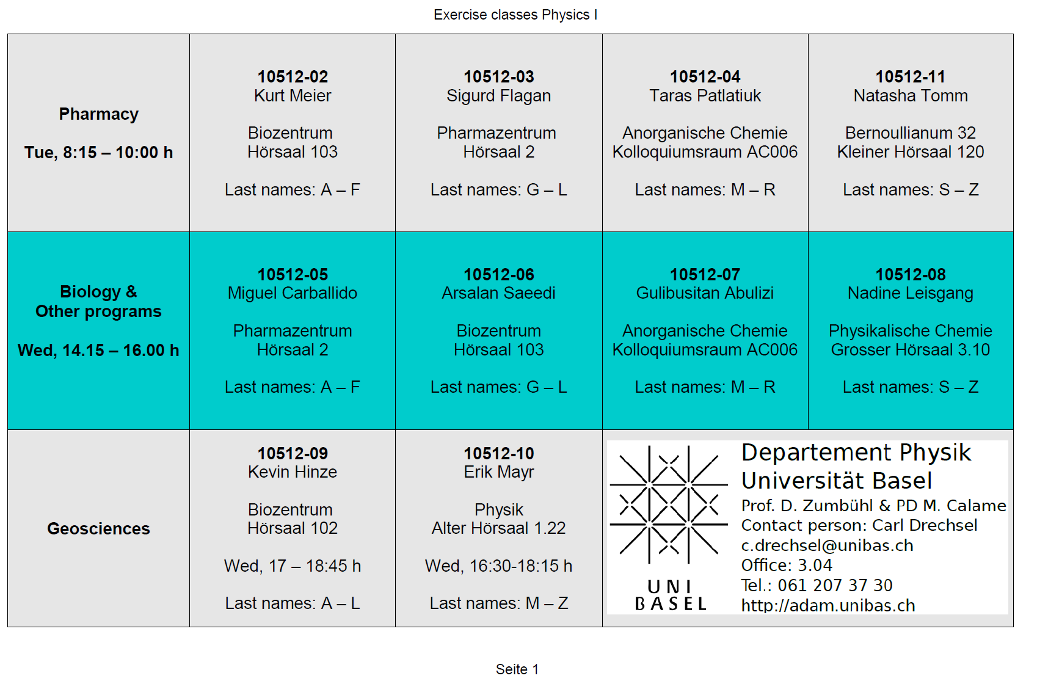
Weekly Exercise Sessions

Slide 2
Introduction to Physics I
For Biologists, Geoscientists, & Pharmaceutical Scientists

Slide 3
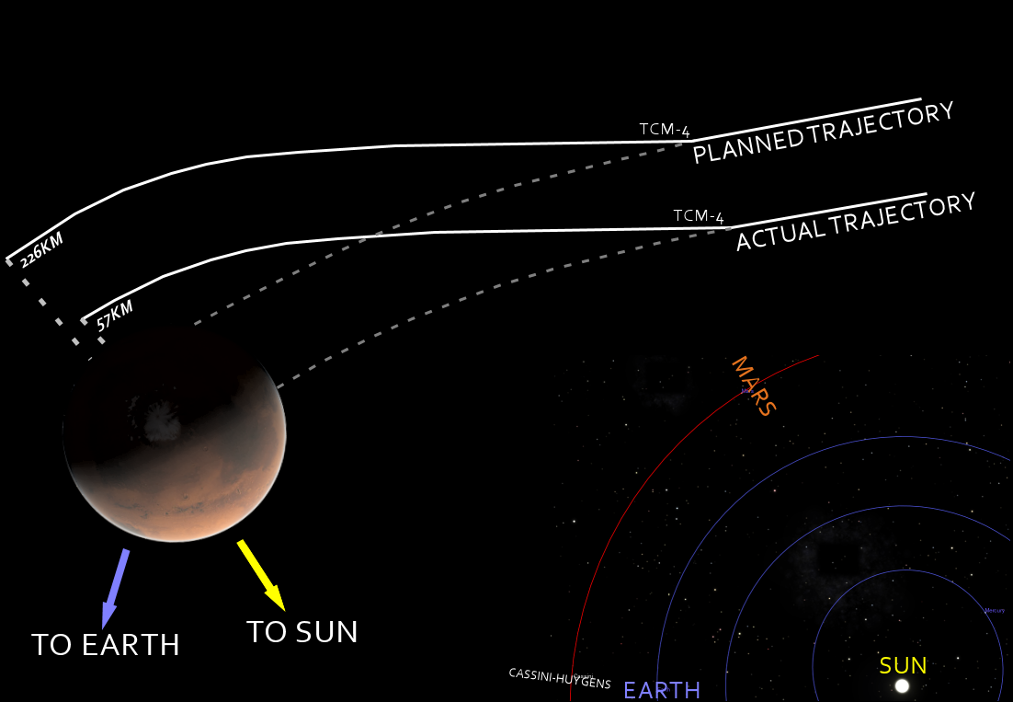
Mars Climate Orbiter (1999)

Slide 4
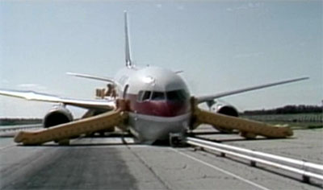
Air Canada 143 (1983)

Slide 5
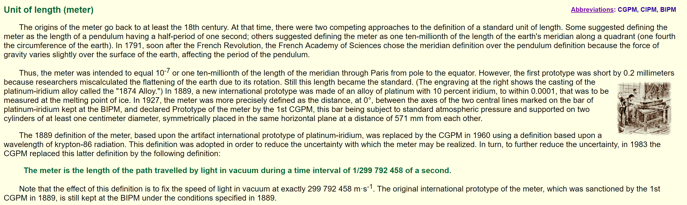
Meter
Notes:
Show length artifacts, calipers, hair measurment

Slide 6
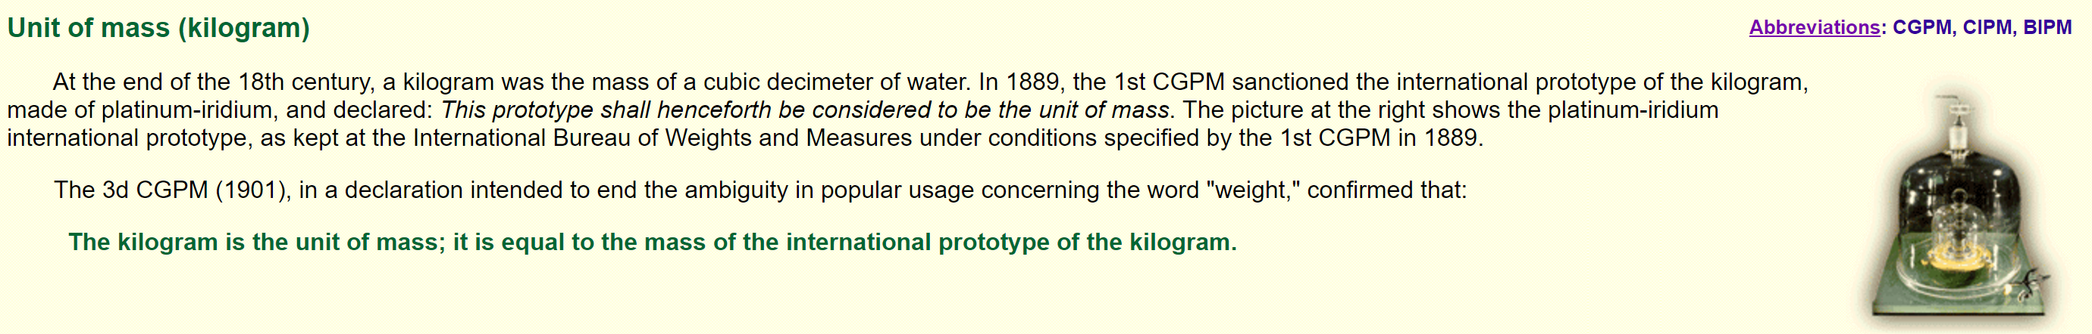
Kilogram
Notes:
Show Kilogram artifact

Slide 7
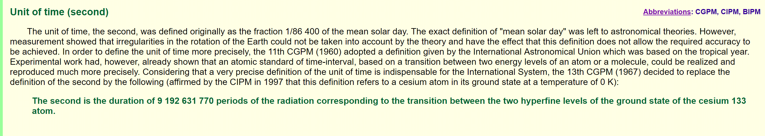
Second
Notes:
Pendulum

Slide 8
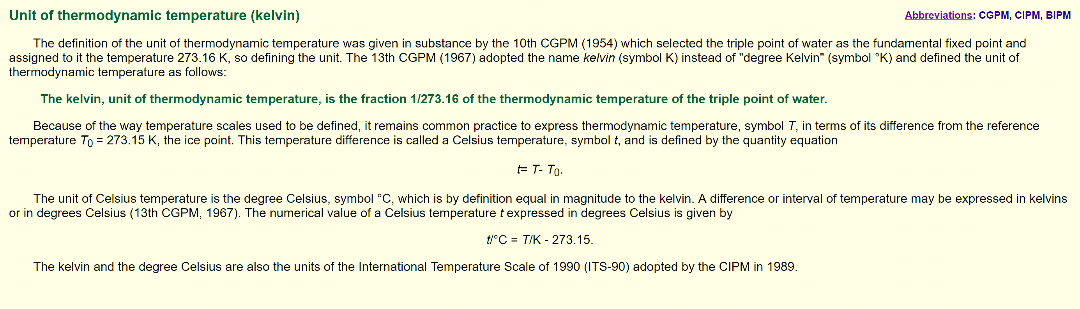
Kelvin

Slide 10
Prefixes

Slide 11
