Slide 1
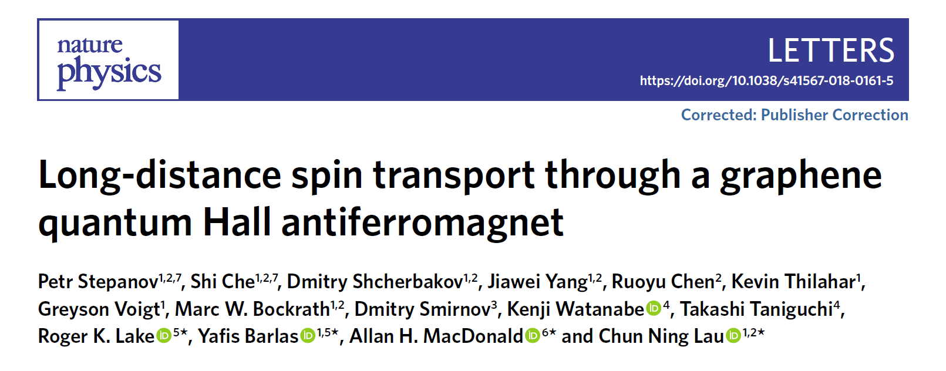
Journal Club Presentation
Mohammad Samani
March 5, 2021

Slide 2
Outline
Antiferromagnet Insulators (AFMI)
Spin Transport
Quantum Hall state ν=0 in monolayer graphene
The Device
Did we see super spin currents?
Future plans
Notes:
Left: Clean SIT transition

Slide 3
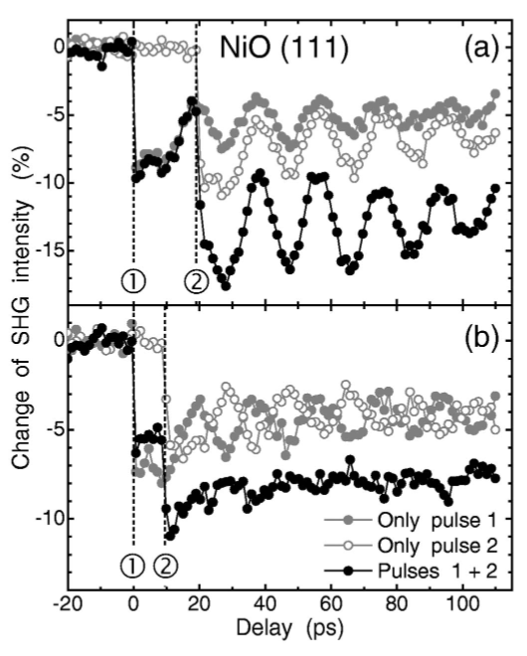
Antiferromagnets
2
4
Why are they interesting?
  Fast manipulation
  Robust against stray fields & T
  Produce little stray field
  Large magnetotransport effects
1
2
CuFeS2 (semicond.) has Néel
temperature of 825 K
1. N. T. Satoh et al. Phys. Rev. B 74, 012404 (2006)
2. (b) I. S. Jacobs J. App. Phys. 32, S61 (1961)
4. X. Marti et al. Nat Mat. 13, 367–374 (2014)
Notes:
In this Brief Report we describe ultrafast all-optical control of the AFM order parameter of NiO by sequential 100 fs laser pulses using optical second-harmonic generation(SHG) as a probe for the AFM state. Caption: Change of the intensity of the reflected SHG of a(111)-oriented NiO bulk sample at room temperature for two pump pulses incident at t=0 (1) and Δt(2). Δt=(a)19 and (b) 9.5 ps.
The scenario is significantly altered when the external field applied is parallel to the easy axis. When the anisotropy energy is small compared to the exchange energy, sublattice magnetization remains in its easy axis state, with zero net magnetization until the magnetic field compensates the anisotropy. (1 Oersted ~ 0.1 mT)
For writing, the sample is cooled in a field H_{FC} from a temperature above the AFM–ferromagnetic transition in FeRh (we used maximum field of 9 T and temperature of 400 K allowed in our transport measurement set-up) to below the transition temperature (200 K)

Slide 4
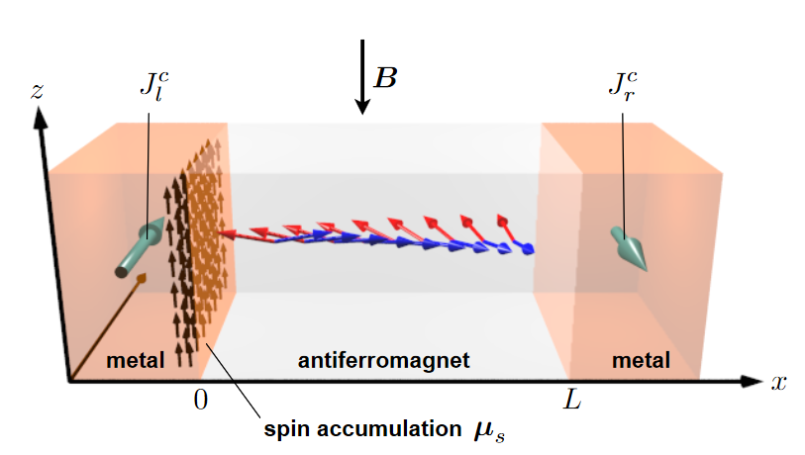
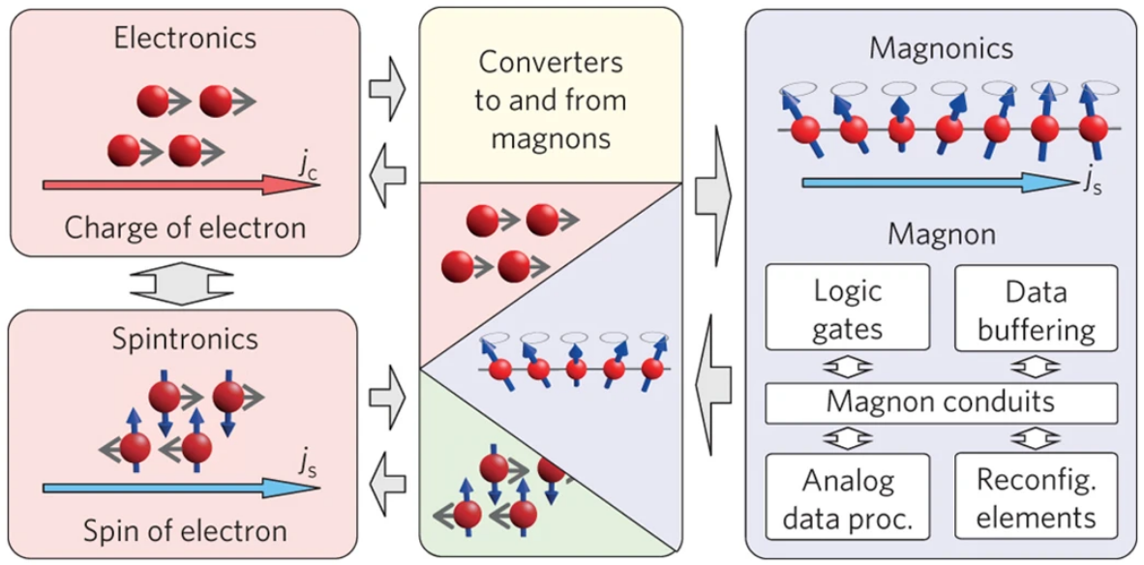
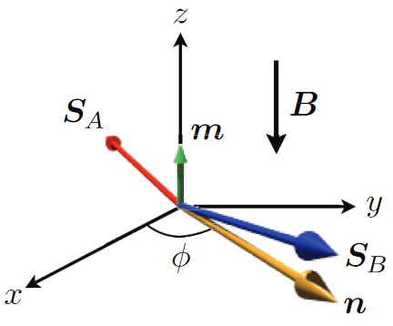
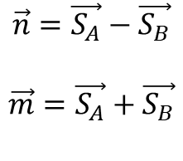
Spin Transport
Magnons
Supercurrents
$$\vec{n}=\vec{S_{A}}−\vec{S_{B}}$$
$$\vec{m}=\vec{S_{A}}+\vec{S_{B}}$$
A. V. Chumak et al. Nat. Phys. 11, 453–461 (2015)
S. Takei et al. Phys. Rev. B 90, 094408 (2014)
Notes:
A charge current Jcl in the left reservoir establishes a spin accumulation μs at the interface via the spin Hall effect, and the spin current pumped into the right reservoir generates a transverse charge current Jcr through the inverse spin Hall effect. Spin supercurrent through the antiferromagnetic bulk is carried by a dynamically precessing Néel texture. The two spin-sublattice moments are shown in the AF by approximately antiparallel arrows. Their slight canting out of the xy plane arises due to a uniform magnetic field applied in the −z direction and is further perturbed by the spin accumulation.

Slide 5
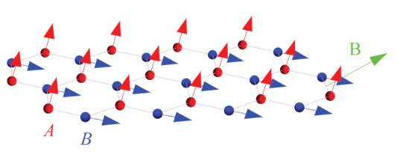
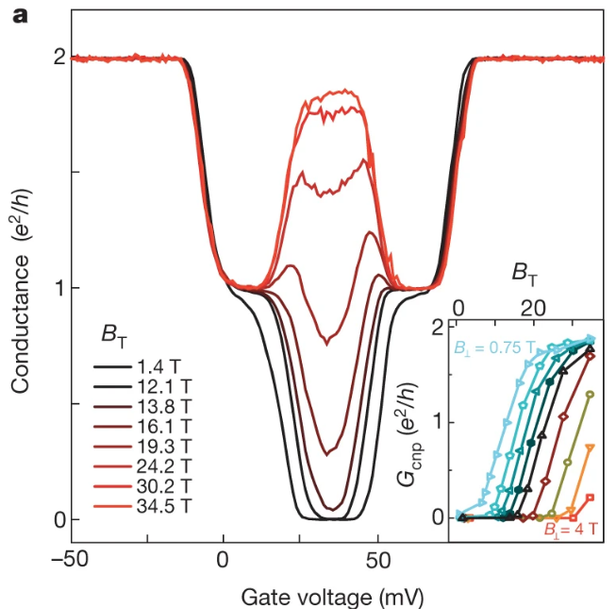
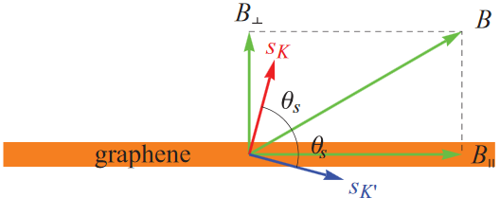
Quantum Hall Effect in graphene at ν=0
Charge neutrality point
Insulating state
Canted antiferromagnet
Can transport super current spin by Néel dynamics
M. Kharitonov Phys. Rev. B 86, 075450 (2012)
A. F. Young, et al. Nature 505, 528–532 (2014)
Notes:
Second order phase transition as B_\parallel increases from CAF to F. u is the anisotropy energy and only depends on B_perp.
Current understanding is sK + sK’ is antiparallel to B.

Slide 6

The Device
$$V_{↑}>V_{↓}, {V′}_{↑}={V′}_{↓}$$
Takei S., Yacoby A., Halperin B., Tserkovnyak Y. Phys. Rev. Lett. 116, 216801 (2016)

Slide 7
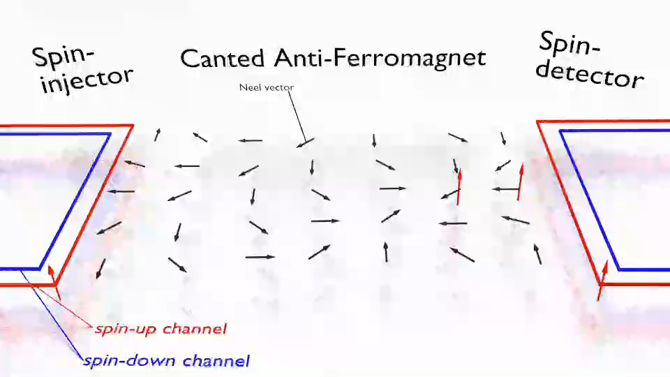
The Mechanism

Slide 8
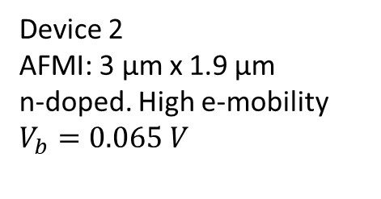

Results
Device 1
AFMI: 5 µm x 2.5 µm
$$V_{b}=0.4 V$$
Dark blue: Amplifier saturation
Fluctuations: Amplifier offset + 1/f noise
Device 2
AFMI: 3 µm x 1.9 µm
n-doped. High e-mobility
$$V_{b}=0.065 V$$

Slide 9
Charge Transport?
Tunneling, percolation, drift, diffusion?
Notes:
Also compare B=15 T vs. B=18 T in previous slide.

Slide 10

Joule Heating?
At $V_{b}$=0.01 V, $V_{nl}$ is observed.

Slide 11

Spin Seebeck Effect?
B=18 T
85 K
2.7 K
Robust QH states
T-dependence of $V_{nl}$ is opposite of spin Seebeck

Slide 12
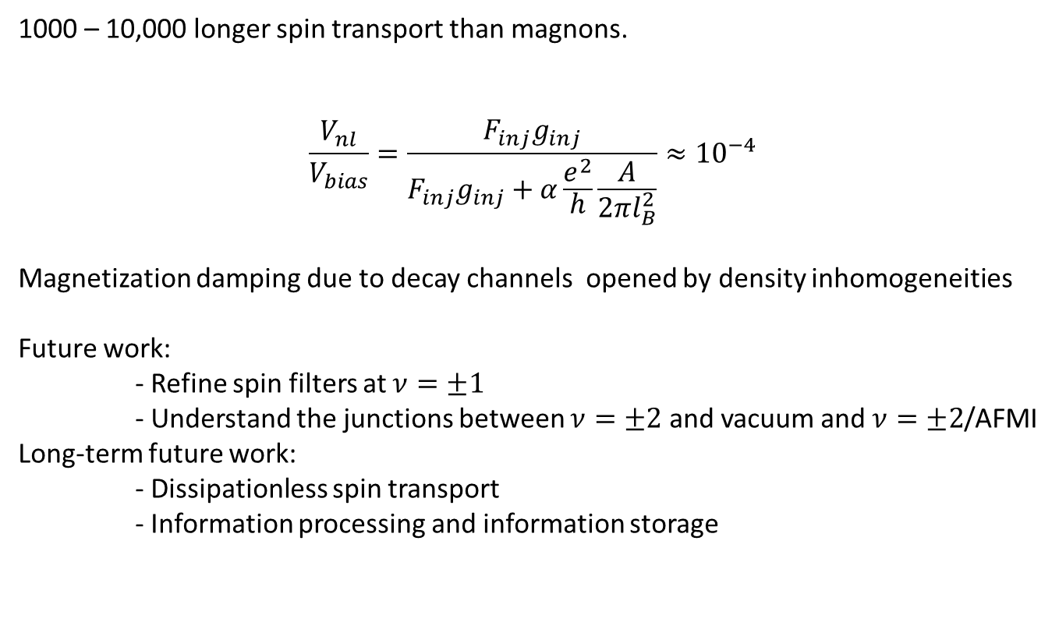
Final Remarks
1000 – 10,000 longer spin transport than magnons.
$$\frac{V_{nl}}{V_{bias}}=\frac{F_{inj}g_{inj}}{F_{inj}g_{inj}+α\frac{e^{2}}{h}\frac{A}{2πl_{B}^{2}}}≈{10}^{−4}$$
Magnetization damping due to decay channels opened by density inhomogeneities
Future work:
- Refine spin filters at $ν=±1$
- Understand the junctions between $ν=±2$ and vacuum and $ν=±2$/AFMI
Long-term future work:
- Dissipationless spin transport
- Information processing and information storage
Notes:
\alpha is magnetization damping parameter

