Slide 1

Silicon quantum processor with robust long-range qubit couplings
2017
Taras Patlatiuk
27.04.2018

Slide 2
Motivation
Universal quantum processor
Large number of qubits
Reliable two-qubit gates

Slide 3



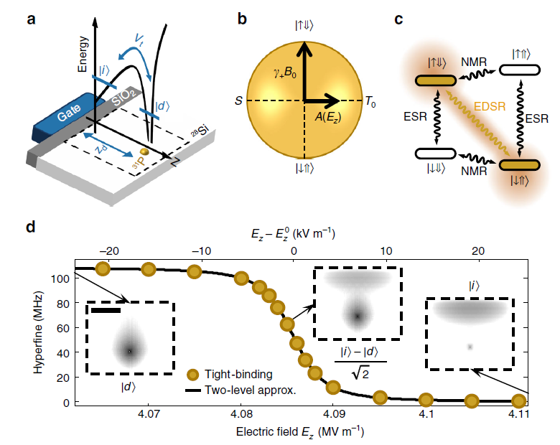











Donor spin qubit (flip-flop qubit)
$$A∝{\left|Ψ(0,0,z_{d})\right|}^{2}$$

Slide 4
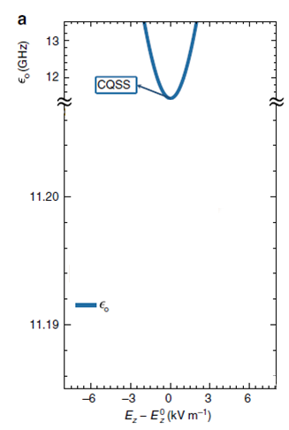
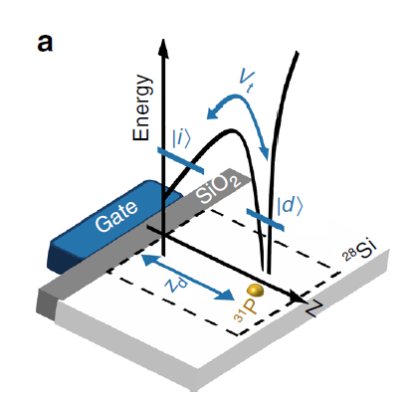
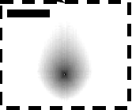






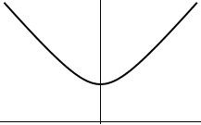


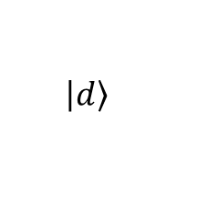
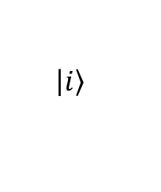
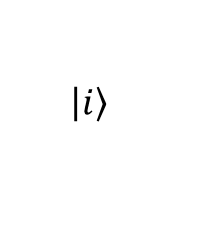
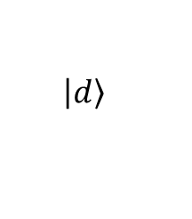
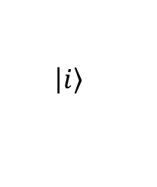
Electrical noise
CQSS - charge qubit sweet spot
Electron position – charge qubit
$$\left.\left|d\right.\right\rangle$$
$$\left.\left|i\right.\right\rangle$$
at the donor
at the interface
Ionization point
$$\left.\left|i\right.\right\rangle$$
$$\left.\left|d\right.\right\rangle$$
$$\left.\left|i\right.\right\rangle$$

Slide 5
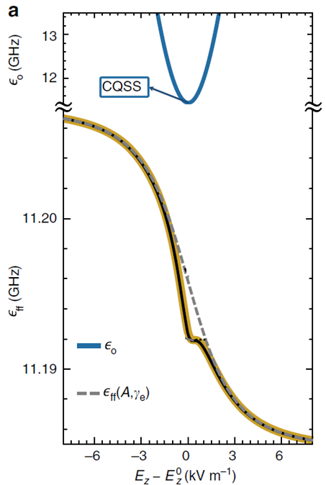

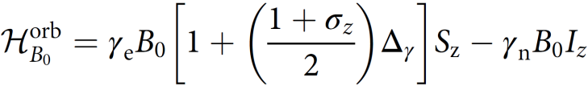




Electrical noise
Electron position – charge qubit
$$\left.\left|d\right.\right\rangle$$
$$\left.\left|i\right.\right\rangle$$
at the donor
at the interface
Qubit dephasing induced by charge and gate noise
flip-flop transition frequency

Slide 6
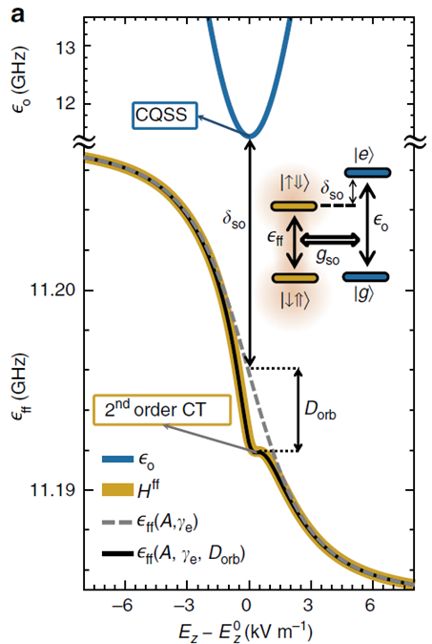

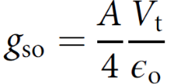

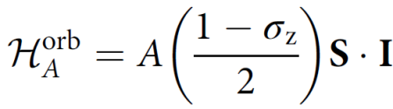
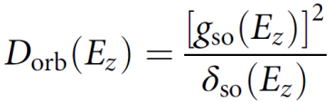
Electrical noise
flip-flop qubit qubit
charge qubit
Flip-flop precession frequency stabilization against noise
- charge qubit dependent hyperfine coupling
- charge qubit dependent
Zeeman splitting
- orbital Hamiltonian

Slide 7
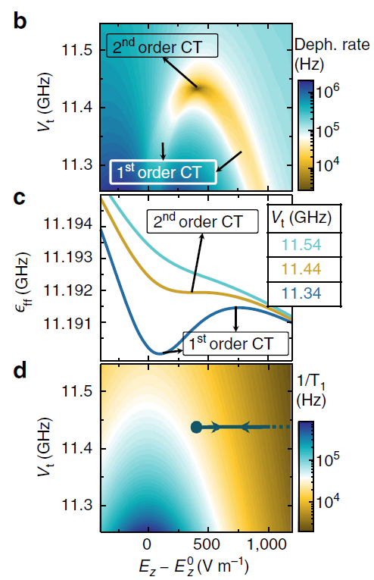


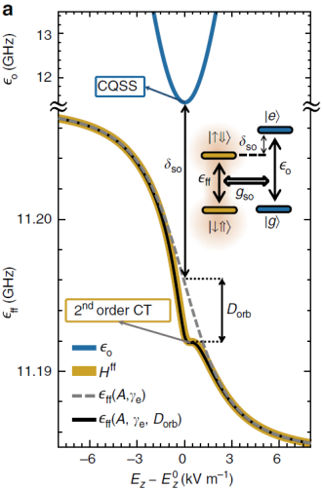

Dephasing/relaxation
Electric field noise $100 V m^{−1}$ r.m.s. amplitude
Dephasing rate:
Magnetic noise:

Slide 8



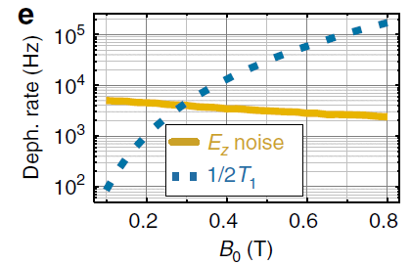
Dephasing/relaxation
Electric field noise $100 V m^{−1}$ r.m.s. amplitude
Dephasing rate:
Magnetic noise:
Relaxation via coupling to the phonons:

Slide 9
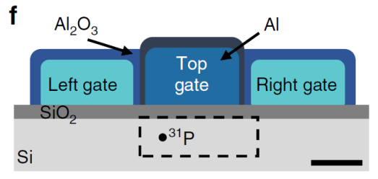
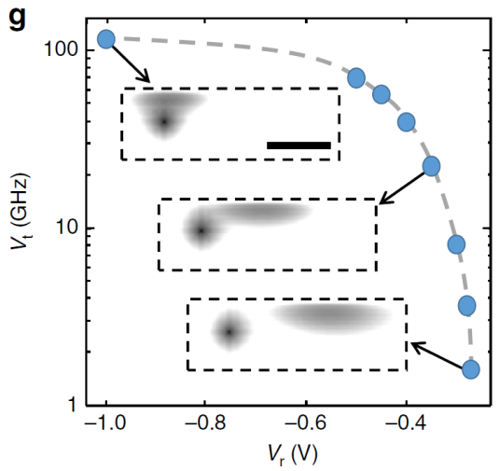


Tuning the tunnel coupling
Ion-implantation: $z_{d}≈15±10 nm$
u$ncertainty in V_{t}$

Slide 10
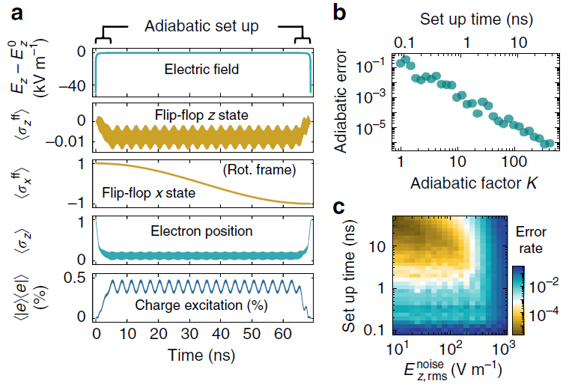
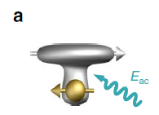
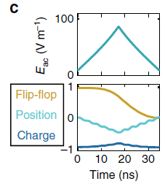
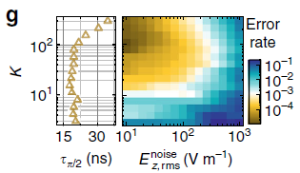

Adiabatic phase control
K – adiabatic factor (higher K, slower process)
Flip-flop qubit $π$-rotation: $69 ns$, error ${10}^{−4}$

Slide 11
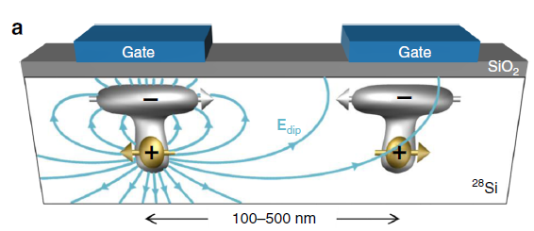
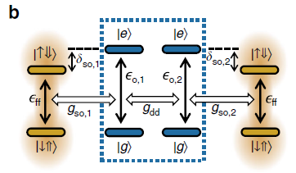
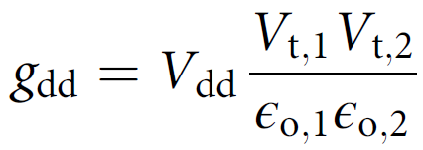
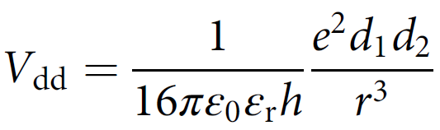
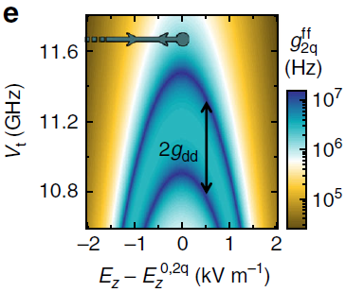
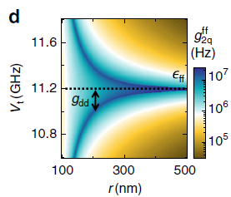
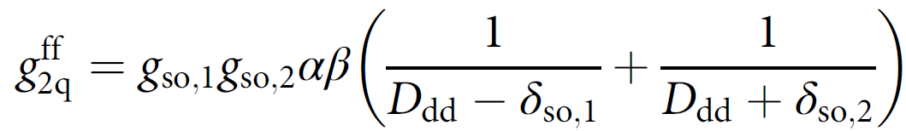
Two-qubit coupling
Both electrons at the interface (decoupled)
Simultaneously and adiabatically displaced to ionization point
Wait time
Return to the interface

Slide 12
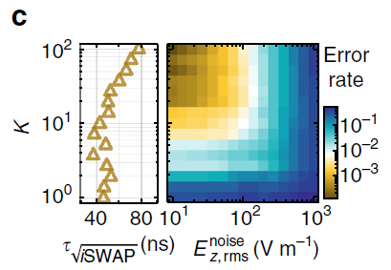


Two-qubit coupling
Both electrons at the interface (decoupled)
Simultaneously and adiabatically displaced to ionization point
Wait time
Return to the interface
Two qubit operation is insensitive to donor placement, can be adjusted using .

Slide 13
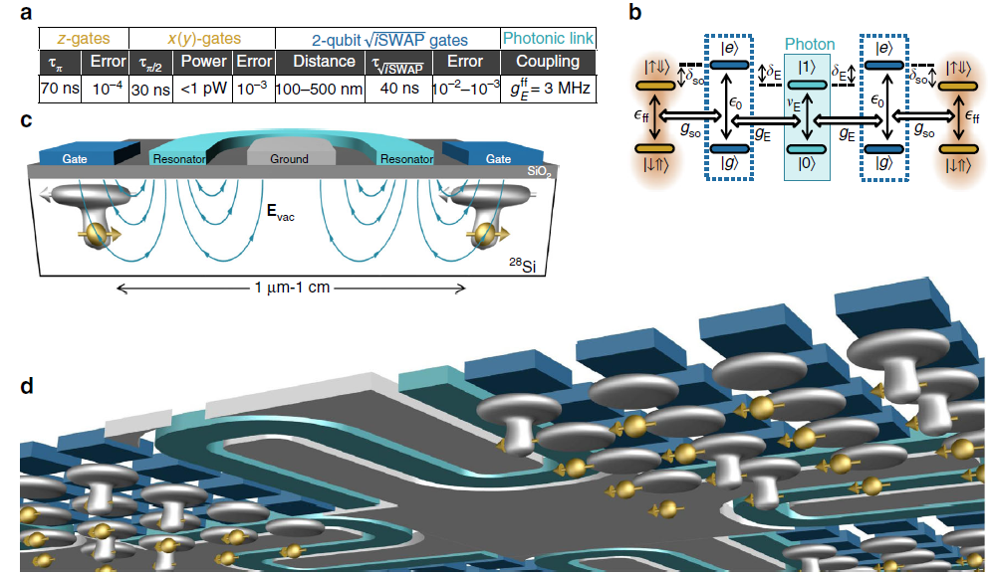



Scaling up
Coupling to the vacuum field
no need to have nanomegnets
dispersive qubit readout
time

Slide 14
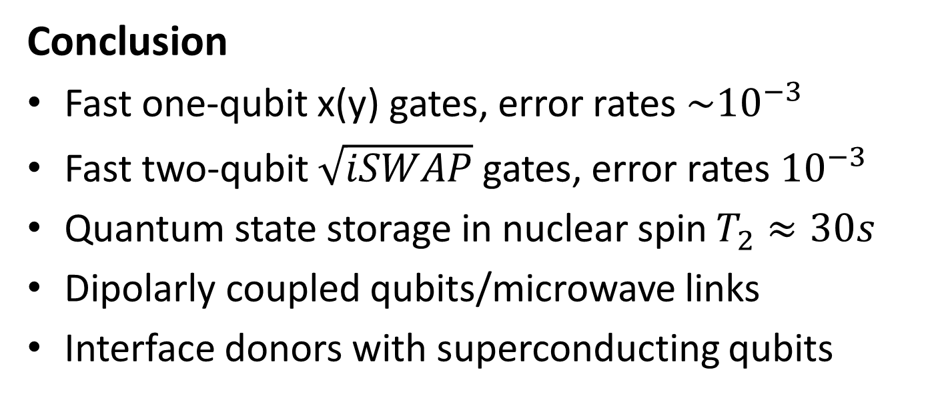
Conclusion
Fast one-qubit x(y) gates, error rates ${\sim 10}^{−3}$
Fast two-qubit $\sqrt{iSWAP}$ gates, error rates ${10}^{−3}$
Quantum state storage in nuclear spin $T_{2}≈30s$
Dipolarly coupled qubits/microwave links
Interface donors with superconducting qubits

