Slide 1
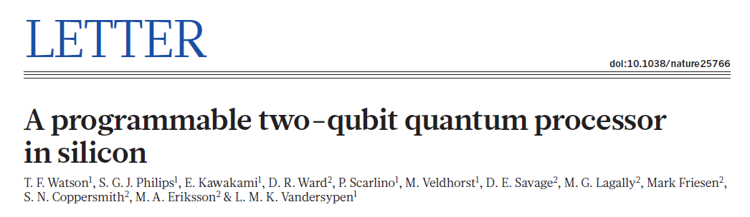
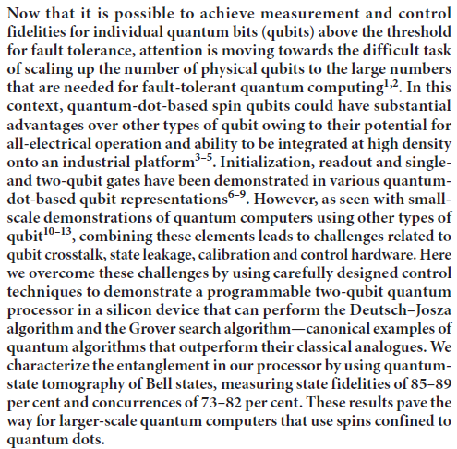
Now that it is possible to achieve measurement and control fidelities for individual quantum bits (qubits) above the threshold for fault tolerance, attention is moving towards the difficult task of scaling up the number of physical qubits to the large numbers that are needed for fault-tolerant quantum computing. In this context, quantum-dot-based spin qubits could have substantial advantages over other types of qubit owing to their potential for all-electrical operation and ability to be integrated at high density onto an industrial platform. Initialization, readout and single and two-qubit gates have been demonstrated in various quantum dot- based qubit representations. However, as seen with small-scale demonstrations of quantum computers using other types of qubit, combining these elements leads to challenges related to qubit crosstalk, state leakage, calibration and control hardware. Here we overcome these challenges by using carefully designed control techniques to demonstrate a programmable two-qubit quantum processor in a silicon device that can perform the Deutsch–Josza algorithm and the Grover search algorithm—canonical examples of quantum algorithms that outperform their classical analogues. We characterize the entanglement in our processor by using quantum state tomography of Bell states, measuring state fidelities of 85–89% and concurrences of 73–82%.
These results pave the way for larger-scale quantum computers that use spins confined to quantum dots.

Slide 2
Outline
Device & setup
Initialization and read out
Single qubit gates: Explanation, calibration and benchmarking
Two qubit gates: Control Phase (CZ) and Control rotation (CROT)
Entanglement/Bell states
Quantum algorithms:
  Deutsch-Josza algorithm
  Grover search algorithm

Slide 3
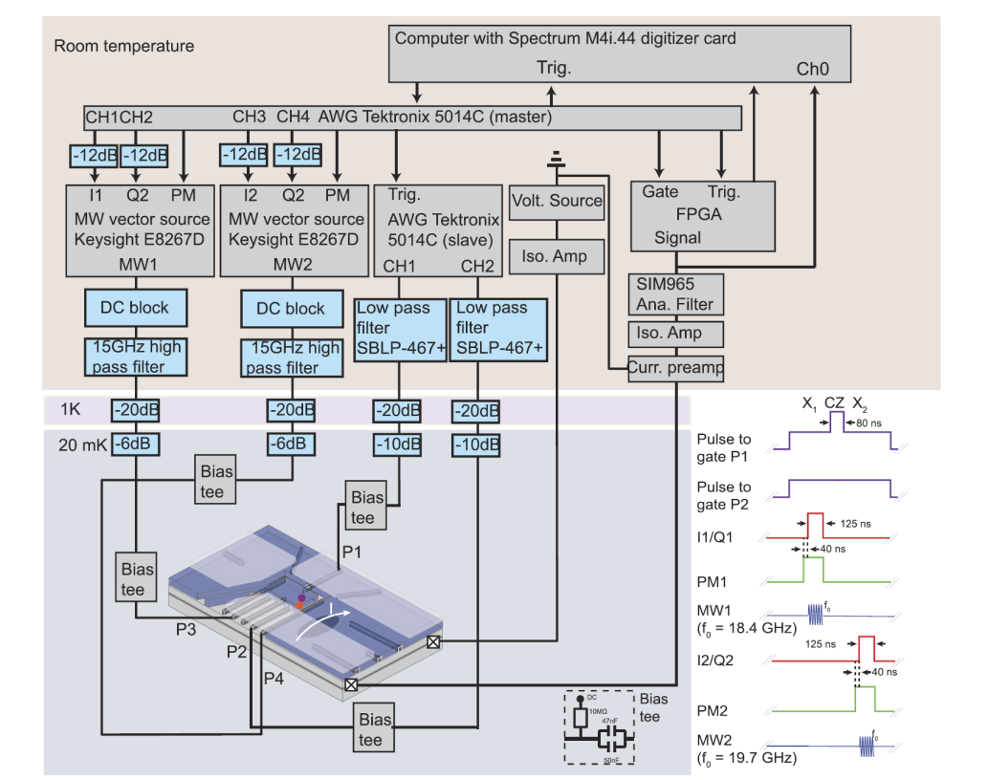
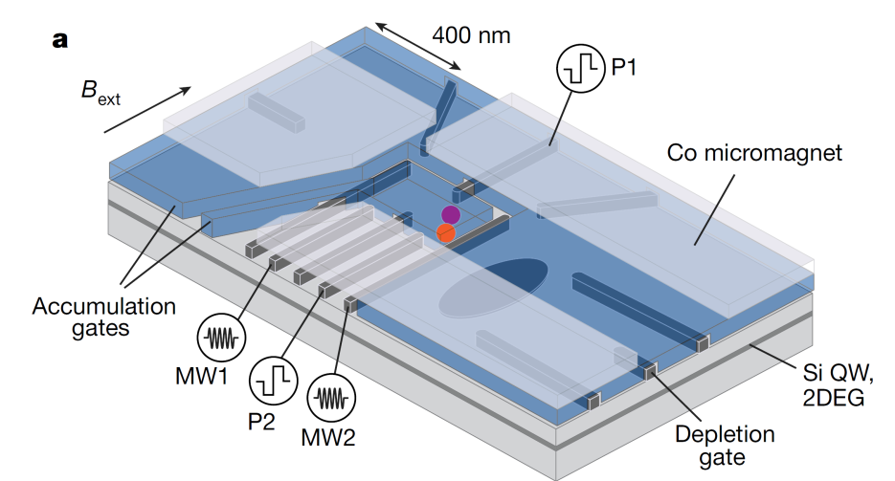
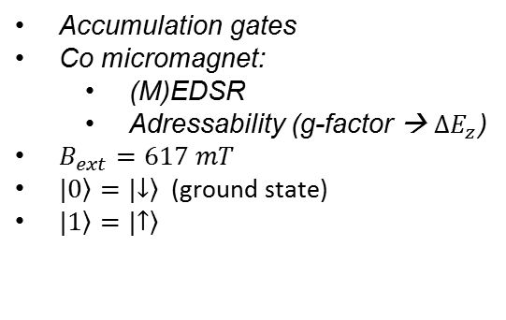
Device & Setup
Accumulation gates
Co micromagnet:
  (M)EDSR
  Adressability (g-factor → $ΔE_{z}$)
$B_{ext}=617 mT$
$|\left.0\right\rangle =|\left.↓\right\rangle$ (ground state)
$|\left.1\right\rangle =|\left.↑\right\rangle$

Slide 4
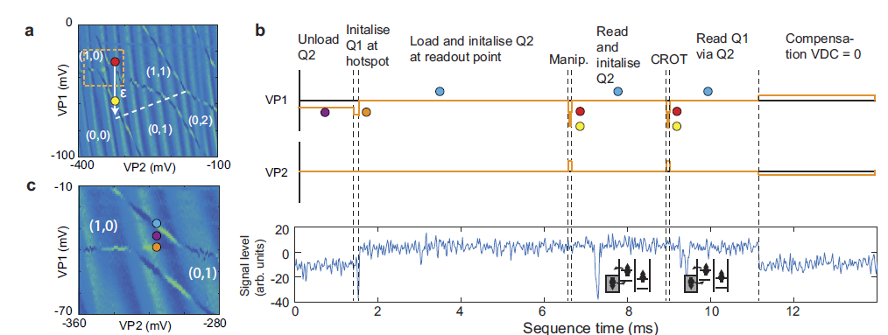
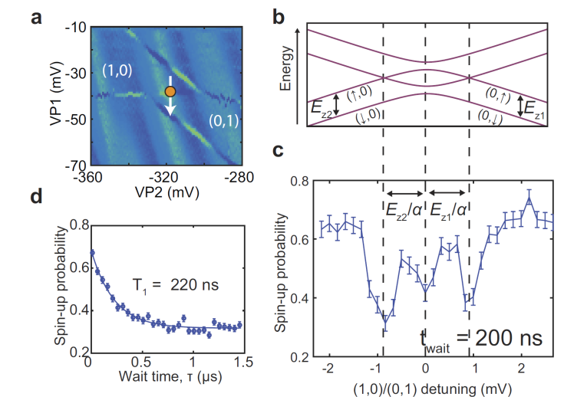
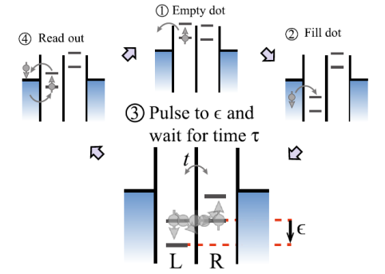
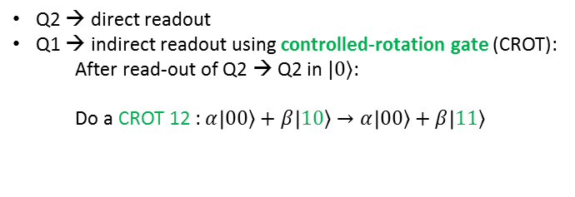

Read out and Initialization
Spin-relaxation hotspots
$$2t_{c}$$
(Bias Tee)
(1,1)
Q2 → direct readout
Q1 → indirect readout using controlled-rotation gate (CROT):
  After read-out of Q2 → Q2 in $|\left.0\right\rangle$:
  Do a CROT 12 : $α\left|\left.00\right\rangle +β\right|\left.10\right\rangle →α\left|\left.00\right\rangle +β\right|\left.11\right\rangle$
(gate will be discussed later)
Q1 is Control
Q2 is Target
 | Q1 | Q2
Initialization | >99% | >99%
Read-out | 73% | 81%
Srinivasa et al., Simultaneous Spin-Charge Relaxation in Double Quantum Dots, PRL 110, 2013

Slide 5
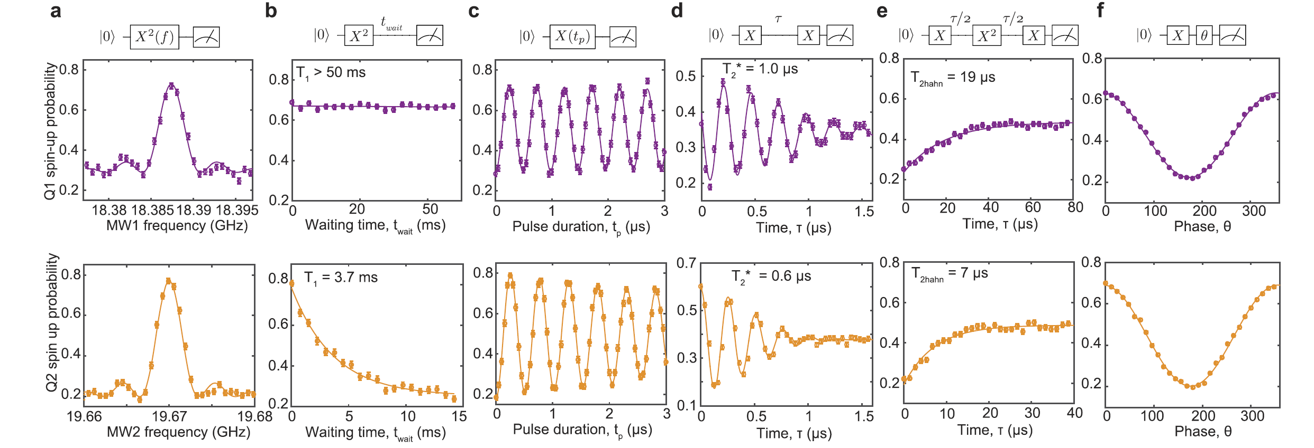


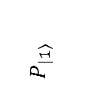
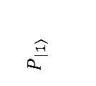


Single qubit gates: calibration and timescales
Resonance
T1
Rabi
Ramsey
Hahn-Echo
Two-Axis control
$$P_{\left.\left|1\right.\right\rangle }$$
$$P_{\left.\left|1\right.\right\rangle }$$
→> X-gate: $t_{p}= 125ns$
$X$ : $π/2$ rotation
$θ$ : $π/2$ rotation with different phase
$X^{2}$ : $π$ rotation

Slide 6
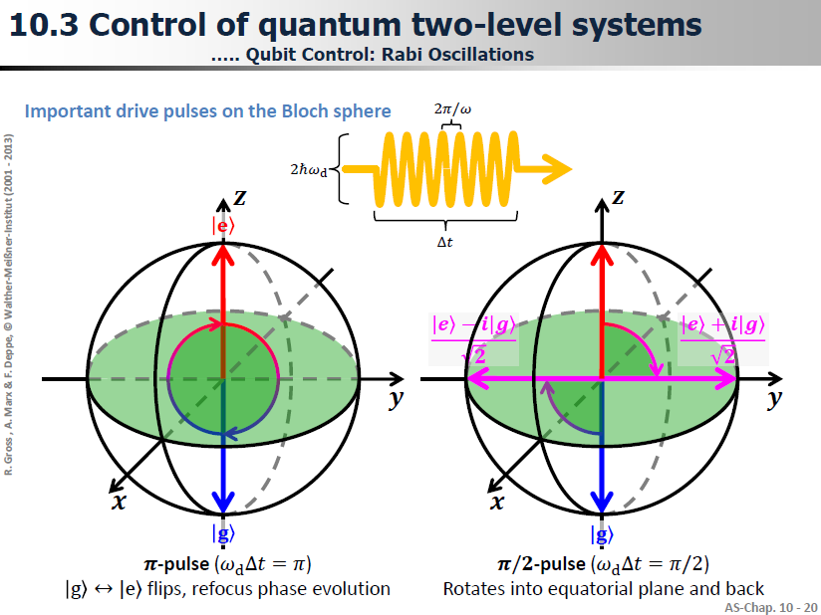
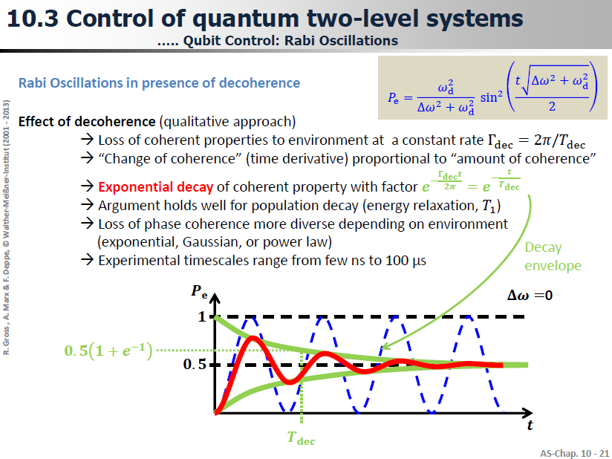
Rabi oscillations
Lecture: R. Gross , A. Marx & F. Deppe, Control of quantum two-level systems, © Walther-Meißner-Institut (2001 - 2013)

Slide 7
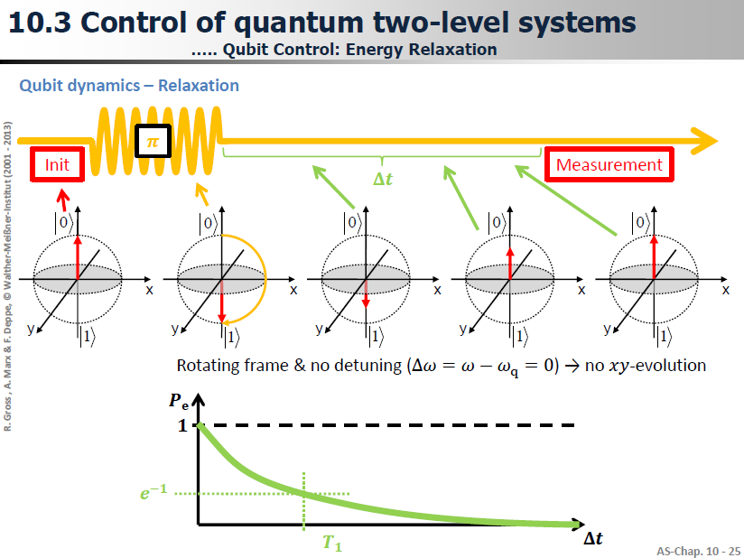
Spin Relaxation
Lecture: R. Gross , A. Marx & F. Deppe, Control of quantum two-level systems, © Walther-Meißner-Institut (2001 - 2013)

Slide 8
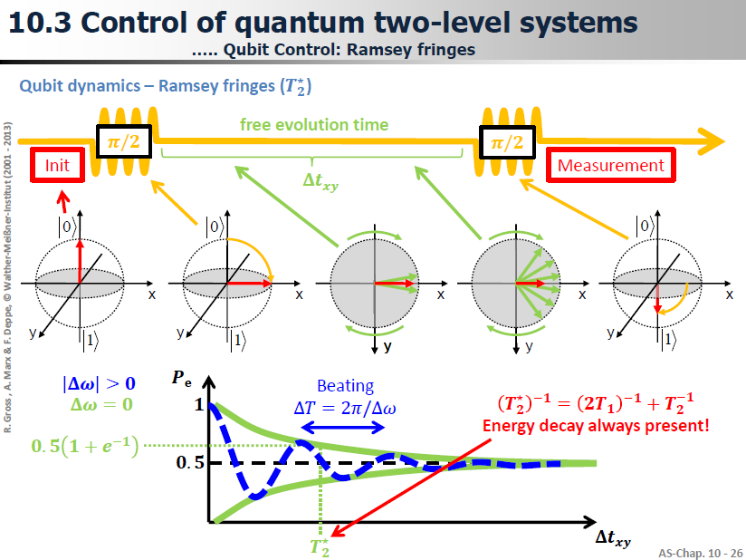
Ramsey
Lecture: R. Gross , A. Marx & F. Deppe, Control of quantum two-level systems, © Walther-Meißner-Institut (2001 - 2013)

Slide 9
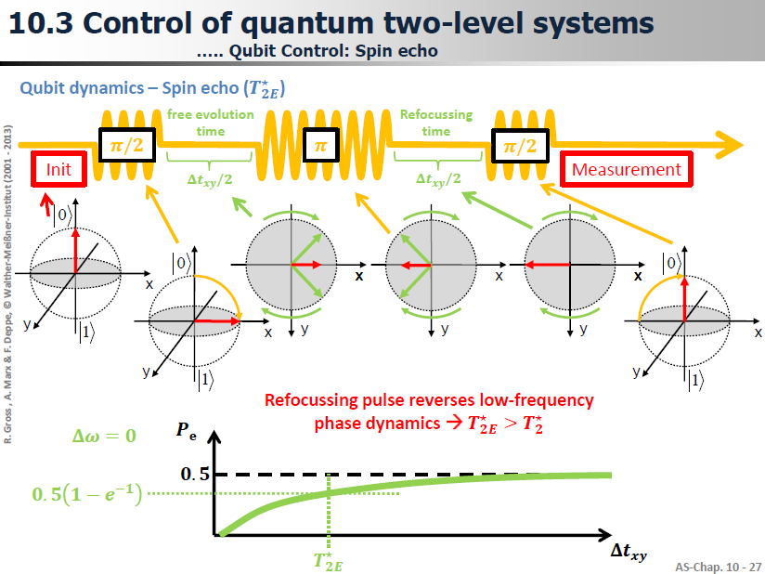
Spin-Echo
Lecture: R. Gross , A. Marx & F. Deppe, Control of quantum two-level systems, © Walther-Meißner-Institut (2001 - 2013)

Slide 10
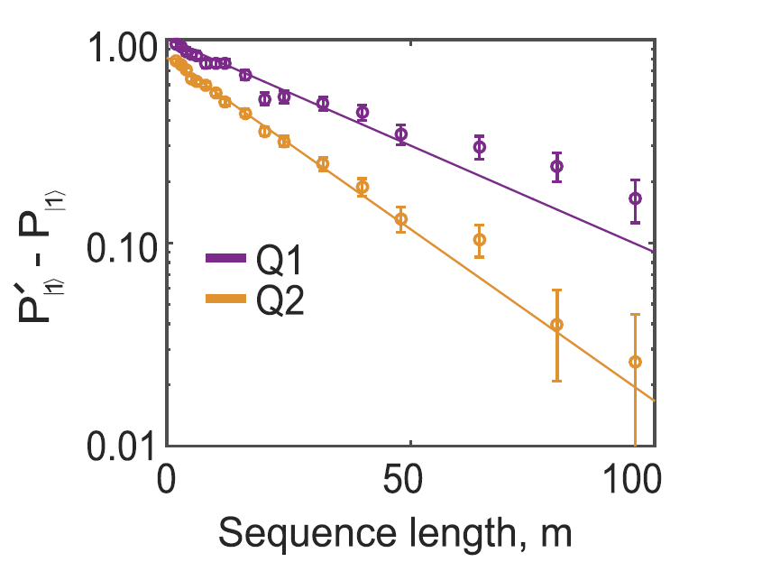
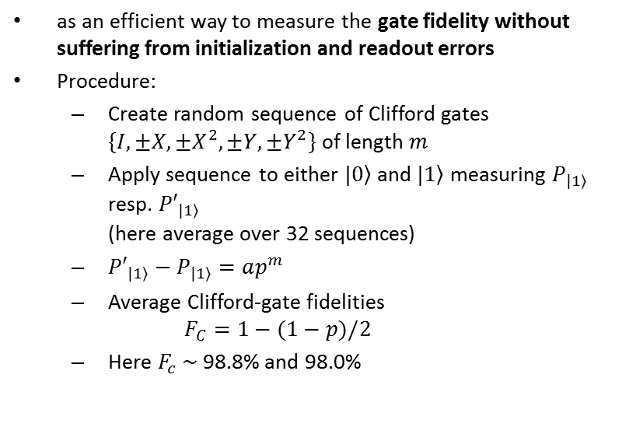
Randomized benchmarking
as an efficient way to measure the gate fidelity without suffering from initialization and readout errors
Procedure:
  Create random sequence of Clifford gates $\{I,±X,±X^{2},±Y, ±Y^{2}\}$ of length $m$
  Apply sequence to either $|\left.0\right\rangle$ and $|\left.1\right\rangle$ measuring $P_{|\left.1\right\rangle }$ resp. ${P′}_{|\left.1\right\rangle }$
  (here average over 32 sequences)
  ${P′}_{|\left.1\right\rangle }−P_{|\left.1\right\rangle }=ap^{m}$
  Average Clifford-gate fidelities
  $F_{C}=1−(1−p)/2$
  Here $F_{c} \sim$ 98.8% and 98.0%
E. Knill, Randomized Benchmarking of Quantum Gates, PRA 77 (2008)
Notes:
After initializing the electron to the spin-down state, we apply randomized sequences of m Clifford gates and a final Clifford gate Cm+1 that is chosen so that the final target state in the absence of errors is either spin-up or spin-down. Every Clifford gate is implemented by composing π and π=2 rotations around two axes, following ref. 32. Applying randomized sequences of imperfect Clifford gates acts as a depolarizing channel (30, 31). The depolarization parameter p reflects the imperfection of the average of 24 Clifford gates. Under certain assumptions, for m successive Clifford gates, the depolarization parameter is pm. We measure the spin-up probability both for the case where spin-up is the target state, Pj↑i ↑ , and for the case where spindown is the target state, Pj↓i ↑ , for 119 different randomized sequences for each choice of m, and varying m from 2 to 220. The difference of the measured spin-up probability for these two cases, Pj↑i ↑ −Pj↓i ↑ , is plotted with red circles in Fig. 4A. Theoretically, Pj↑i ↑ −Pj↓i ↑ is expressed as (3, 33) Pj↑i ↑ − Pj↓i ↑ =apm, [6] where a is a prefactor that does not depend on the gate error
As a solution, we use digital pulse modulation (PM) in series with the I/Q modulation, which gives a total on/off ratio of ∼120 dB. A drawback of PM is that the switching rate is lower. Therefore, the PM is turned on 200 ns before the I/Q modulation is turned on (Fig. 1, Inset).

Slide 11
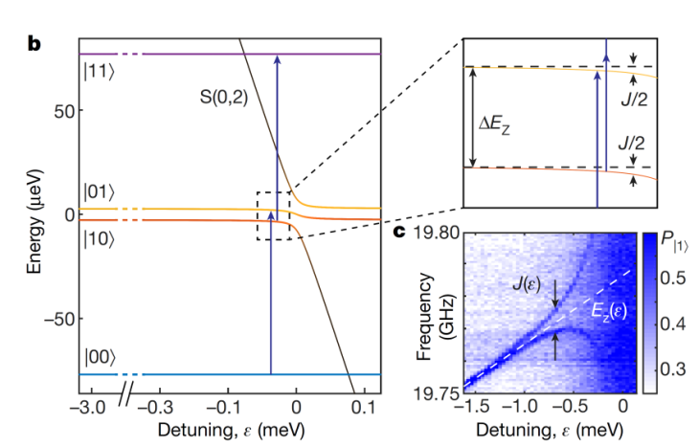
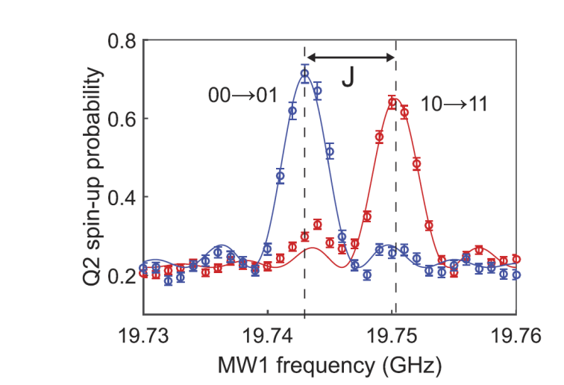
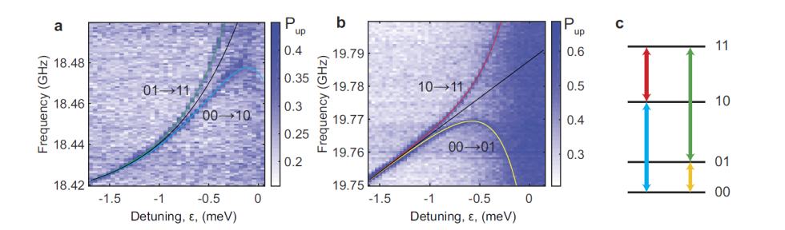
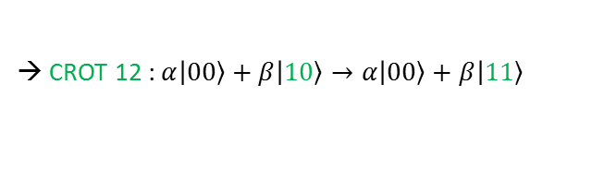
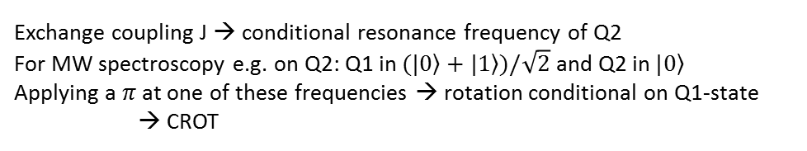
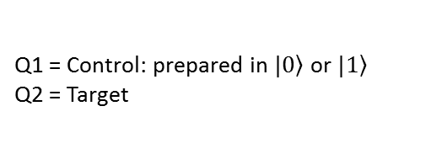
CROT gate
Q2
Q1
Q2
Q1 = Control: prepared in $\left.|0\right\rangle$ or $\left.|1\right\rangle$
Q2 = Target
Exchange coupling J → conditional resonance frequency of Q2
For MW spectroscopy e.g. on Q2: Q1 in $(\left.|0\right\rangle +\left.|1\right\rangle )/\sqrt{2}$ and Q2 in $\left.|0\right\rangle$
Applying a $π$ at one of these frequencies → rotation conditional on Q1-state
→ CROT
→ CROT 12 : $α\left|\left.00\right\rangle +β\right|\left.10\right\rangle →α\left|\left.00\right\rangle +β\right|\left.11\right\rangle$
Leakage into S(0,2)

Slide 12

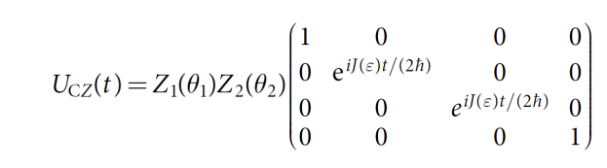
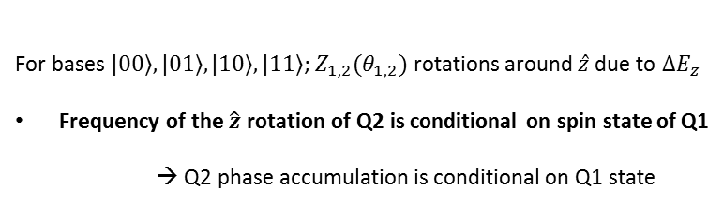
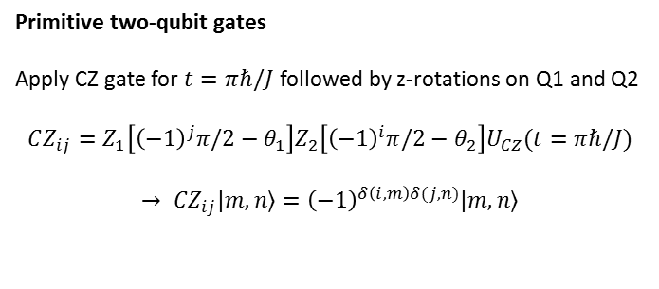

Control-phase (CZ) gate
Regime $J\left(ε\right) =10MHz≪ΔE_{z}$ (still Ising Hamiltonian)
Detuning pulse for fixed time $t$
Q2
For bases $\left.|00\right\rangle ,\left.|01\right\rangle ,\left.|10\right\rangle ,\left.|11\right\rangle$; $Z_{1,2}(θ_{1,2})$ rotations around $\hat{z}$ due to $ΔE_{z}$
Frequency of the $\hat{z}$ rotation of Q2 is conditional on spin state of Q1
→ Q2 phase accumulation is conditional on Q1 state
Primitive two-qubit gates
Apply CZ gate for $t=πℏ/J$ followed by z-rotations on Q1 and Q2
$$CZ_{ij}=Z_{1}\left[{\left(−1\right)}^{j}π/2−θ_{1}\right]Z_{2}\left[{\left(−1\right)}^{i}π/2−θ_{2}\right]U_{CZ}(t=πℏ/J)$$
$$→ CZ_{ij}\left.|m,n\right\rangle ={\left(−1\right)}^{δ\left(i,m\right)δ(j,n)}\left.|m,n\right\rangle$$
See also: M. Veldhorst et al. A two-qubit logic gate in silicon. Nature 526, 410 (2015).

Slide 13

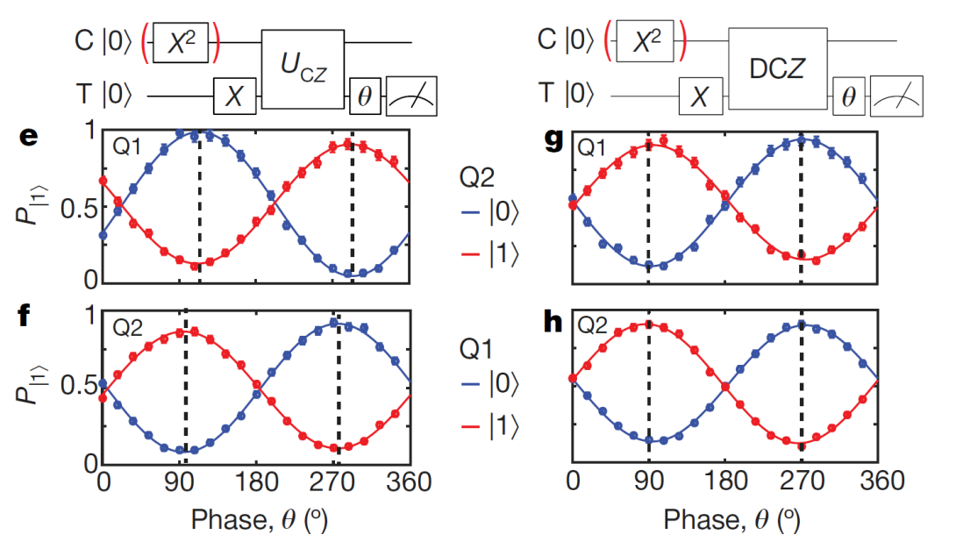


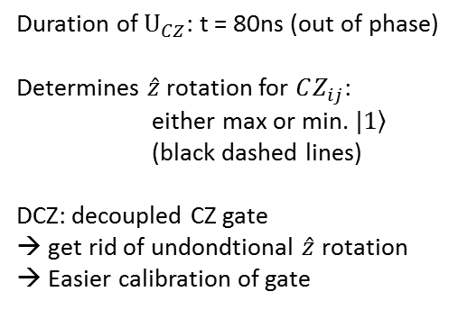
Control-phase (CZ) gate
Duration of $U_{CZ}$: t = 80ns (out of phase)
Determines $\hat{z}$ rotation for $CZ_{ij}$:
either max or min. $\left.|1\right\rangle$
(black dashed lines)
DCZ: decoupled CZ gate
→ get rid of undondtional $\hat{z}$ rotation
→ Easier calibration of gate
Not exactly 90° because of $\hat{z}$ rotations ($ΔE_{z})$
Exactly 90° because no $\hat{z}$ rotations ($ΔE_{z})$

Slide 14
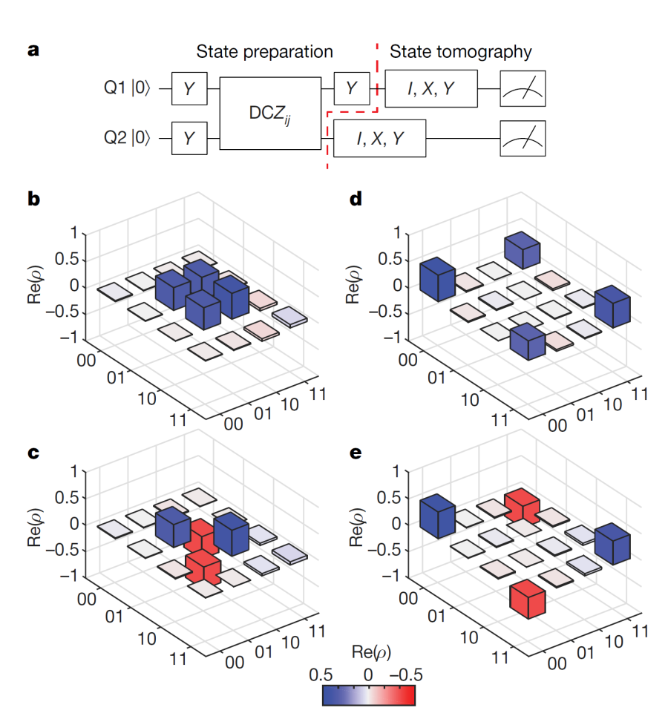

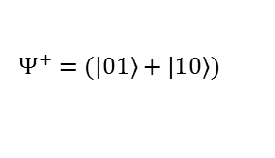
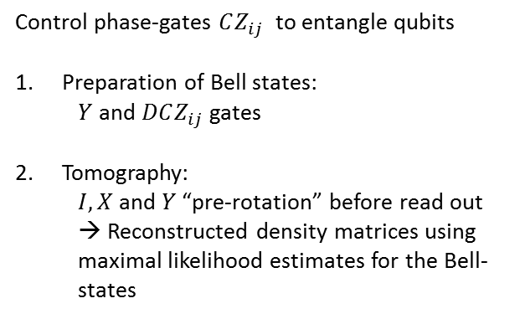
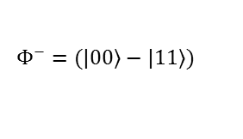
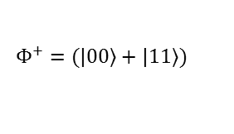
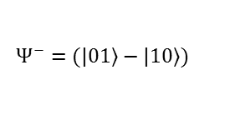
Bell states and two-qubit entanglement
Control phase-gates $CZ_{ij}$ to entangle qubits
Preparation of Bell states:
  $Y$ and $DCZ_{ij}$ gates
Tomography:
  $I, X$ and $Y$ “pre-rotation” before read out
  → Reconstructed density matrices using maximal likelihood estimates for the Bell-states
$$Ψ^{+}=(\left.|01\right\rangle +\left.|10\right\rangle )$$
$$Φ^{+}=(\left.|00\right\rangle +\left.|11\right\rangle )$$
$$Ψ^{−}=(\left.|01\right\rangle −\left.|10\right\rangle )$$
$$Φ^{−}=(\left.|00\right\rangle −\left.|11\right\rangle )$$
State fidelities $\sim 85−89\%$
Concurrences $\sim 73−82\%$ (100% = maximal entangled)*
Superconducting qubits: e.g. F=93-95% C=87-90%
Chao Song et al., 10-Qubit Entanglement and Parallel Logic Operations with a Superconducting Circuit, PRL 119 (2017)

Slide 15
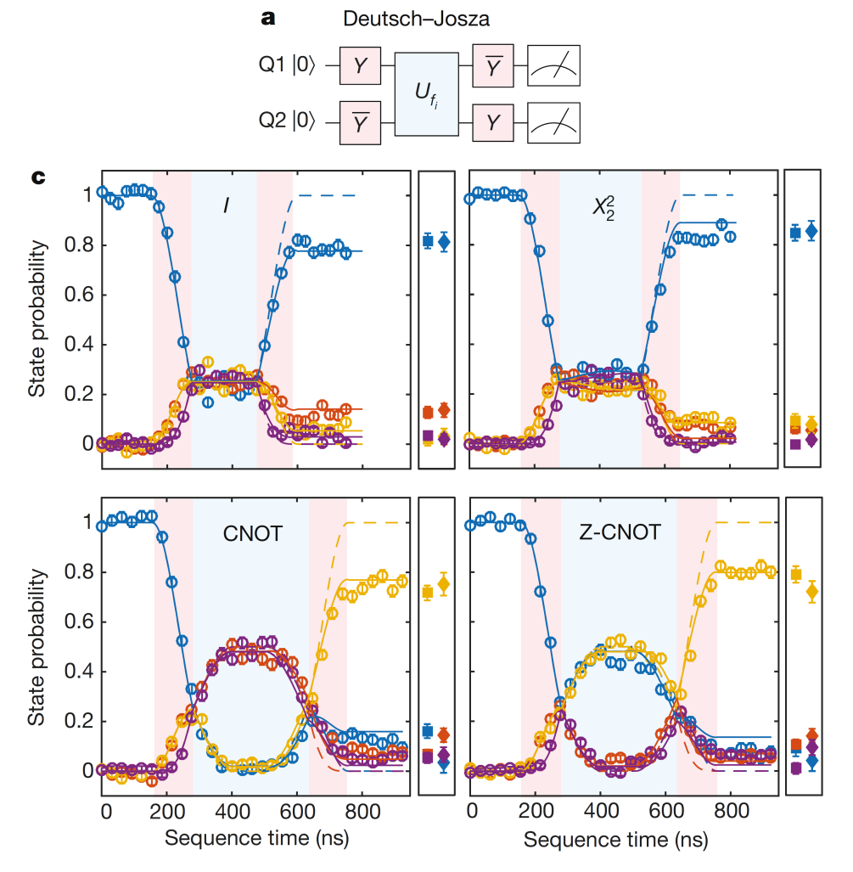
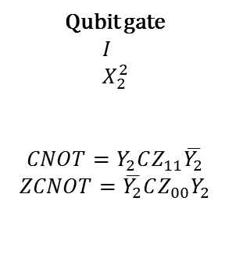
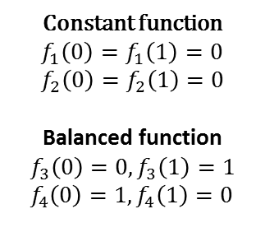
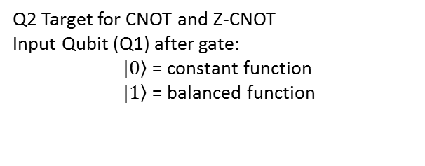
Deutsch-Josza
Two sides of a coin: same or different?
Classical: look at both sides → 2 measurements
Quantum: create superposition → 1 measurement
Mathematically: function constant or balanced?
Constant function
$$f_{1}\left(0\right)=f_{1}\left(1\right)=0 \\ f_{2}\left(0\right)=f_{2}\left(1\right)=0$$
Balanced function
$$f_{3}\left(0\right)=0,f_{3}\left(1\right)=1 \\ f_{4}\left(0\right)=1, f_{4}\left(1\right)=0$$
Qubit gate
$$I \\ X_{2}^{2}$$
$$CNOT=Y_{2}CZ_{11}\overline{Y_{2}}$$
$$ZCNOT=\overline{Y_{2}}CZ_{00}Y_{2}$$
Q2 Target for CNOT and Z-CNOT
Input Qubit (Q1) after gate:
$\left.|0\right\rangle$ = constant function
$\left.|1\right\rangle$ = balanced function

Slide 16
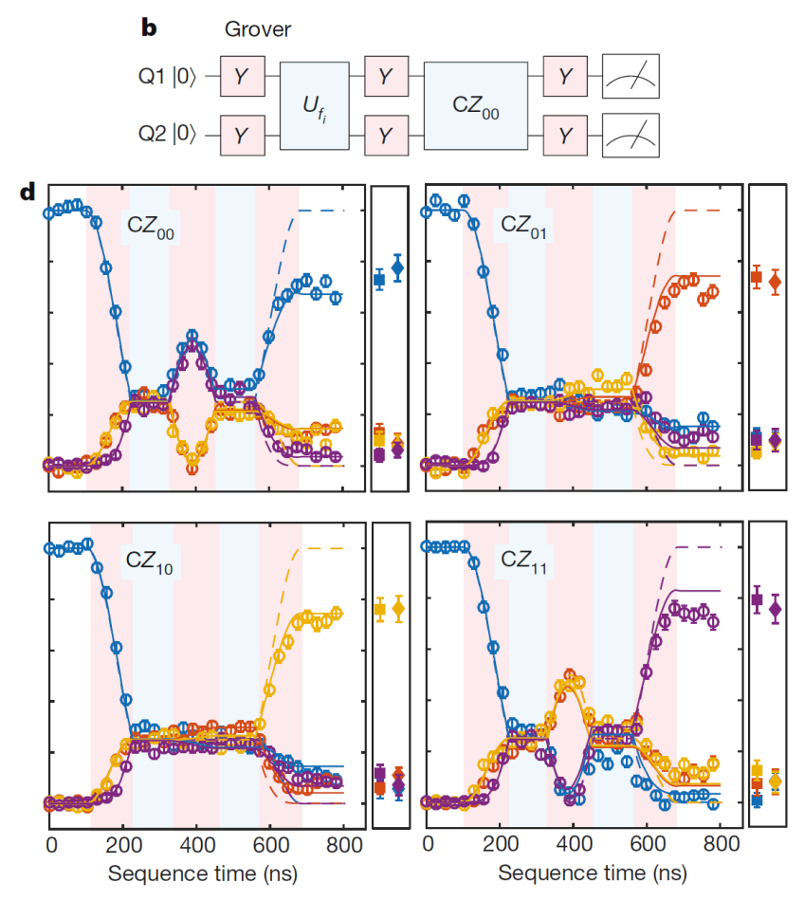
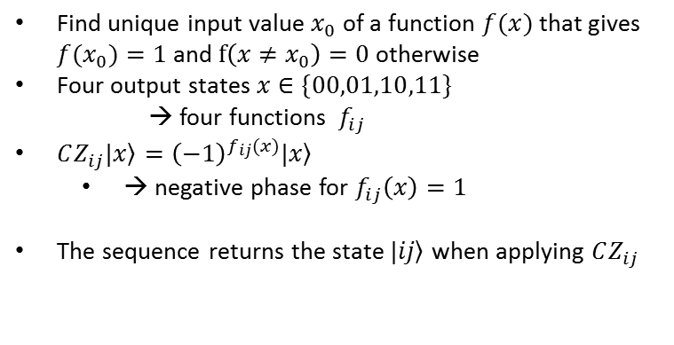
Grover’s search algorithm
Find unique input value $x_{0}$ of a function $f(x)$that gives ${f(x}_{0})=1$ and $f\left(x≠x_{0}\right)=0$ otherwise
Four output states $x∈\{00,01,10,11\}$
→ four functions $f_{ij}$
$CZ_{ij}\left.|x\right\rangle ={\left(−1\right)}^{f_{ij}(x)}\left.|x\right\rangle$
  → negative phase for $f_{ij}\left(x\right)=1$
The sequence returns the state $\left.|ij\right\rangle$ when applying $CZ_{ij}$

Slide 17
Summary
Interesting transition from «hardware» to quantum information processing/processor
First proof of quantum algorithm in a spin qubits device
Outlook:
  Read-out fidelity limits experiment!
  Isotopically purified Si-28 → Coherence times
  Symmetrically operating exchange gates* → gate fidelities (less charge noise)
*M. D. Reed et al., PRL 116 (2016) and F. Martins PRL 116 (2016)

Slide 18
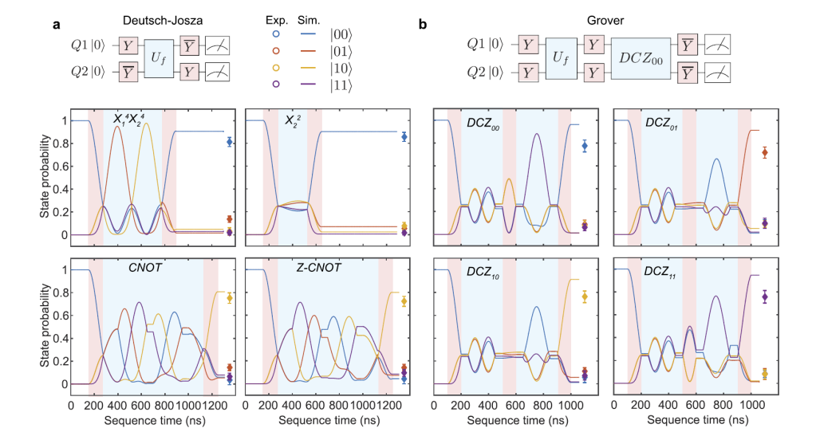
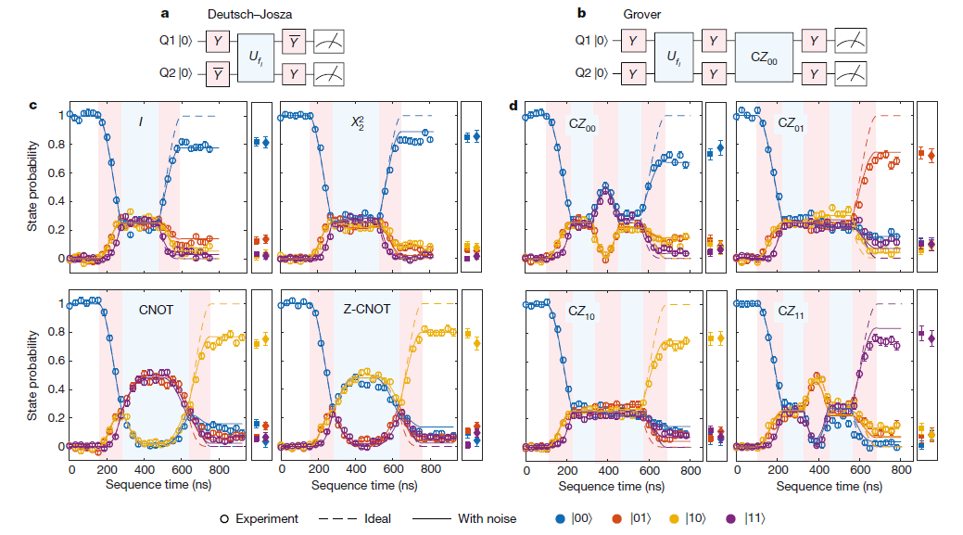
Quantum Algorithms: Predictions

