Slide 1
FAM
Mirko Rehmann
March 16 2018

Slide 2
Outline
Introduction & Motivation
Sample architecture
Charge sensing and the last hole regime
Spin filling and orbital structure
Excited state spectroscopy
Summary and conclusions

Slide 3
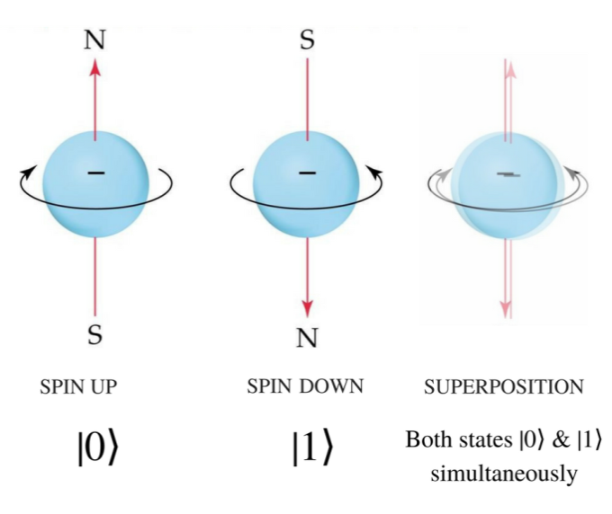
Introduction & Motivation
Promising platform for quantum computation
Manipulation:
Large oscillatory B-fields
Difficult to adress individual spins and to scale up
Solution
Spin-orbit coupling:
Weak for electrons
Strong for holes
Further advantages of h over e:
Rather insensitive to dephasing induced by hyperfine coupling to the nuc. spins
No valley degeneracy
Current challenge:
Reach the last hole regime and determine spin properties of the last few holes!

Slide 4
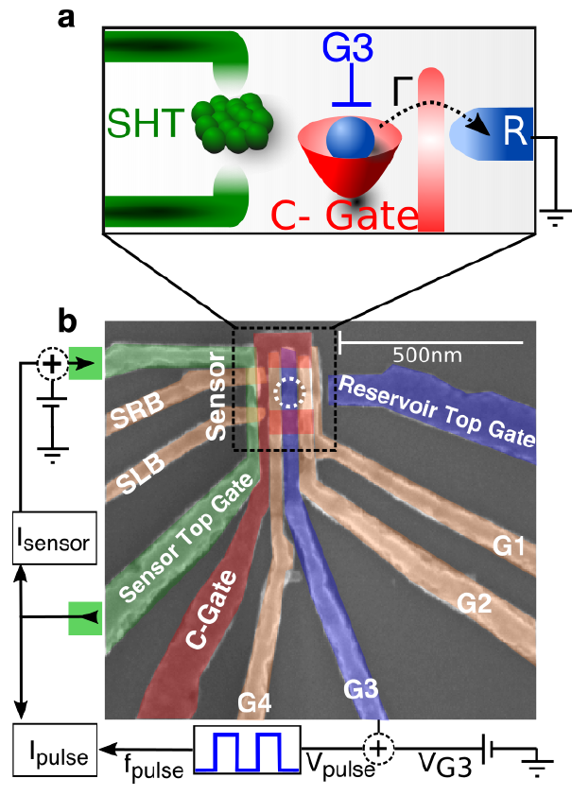
Sample architecture
Layout suitable for high frequency spin manipulation experiments
Scalability up to many qubits
Previous studies: transport measurements -> not possible to reach the single hole regime
Speciality: charge sensor (single hole transistor SHT)
R: reservoir of two-dimensional holes
C-gate: tuning of the dot-reservoir tunnel rate
G3: tuning of the dot potential
SHT: charge sensing
Pulse-bias technique:
1 mV DC to source of SHT
Square wave to G3
I_{pulse} sensitive to dQ_{dot}/dV_{G3}

Slide 5
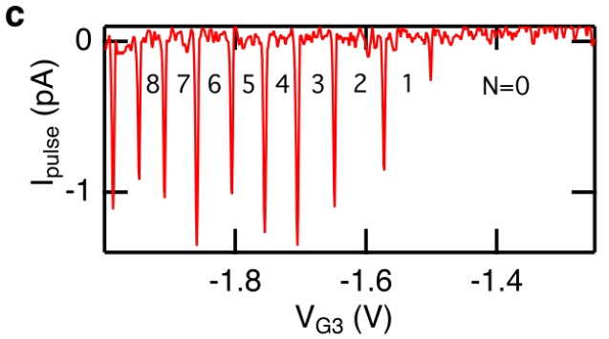
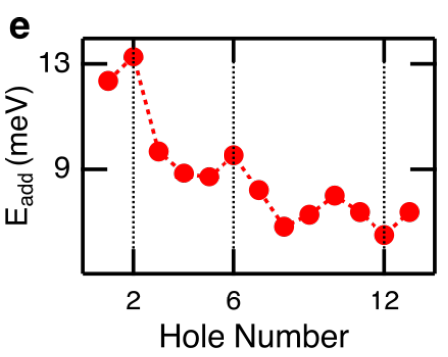
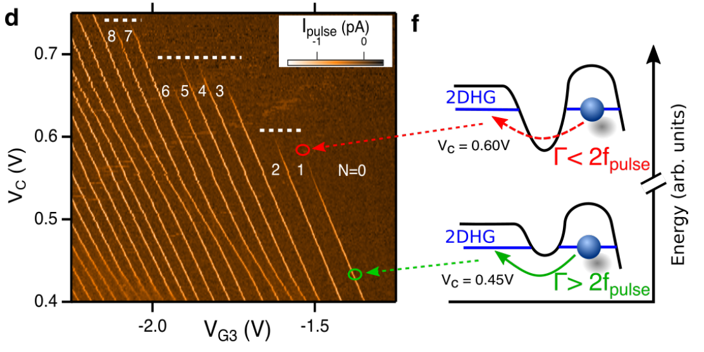
The last hole regime
c: depletion of the last 10 holes
d: charge stability diagram
e: hole addition energies
Peaks at N = 2 and N = 6
f: disappearance of the sensor signal for Γ < 2f_{pulse}
Further evidence for shell-filling:
Staircase-like disappearence of sensor signal
Higher energy orbital shell -> wavefunction span increses -> invrease of Γ
Magic numbers (2, 6) Fock-Darwin spectrum of 2d parab. confinement
Beyond N = 6: loss of circular symmetry or many-body effects

Slide 6
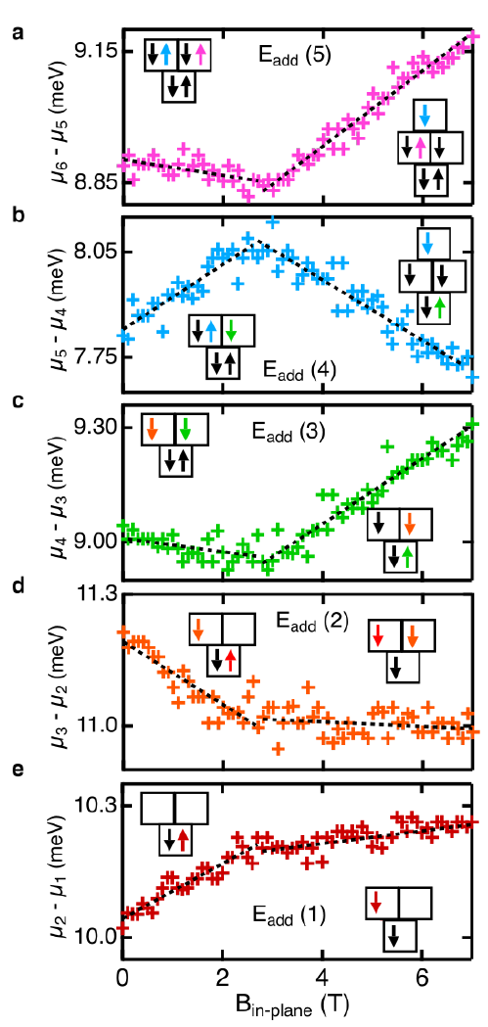
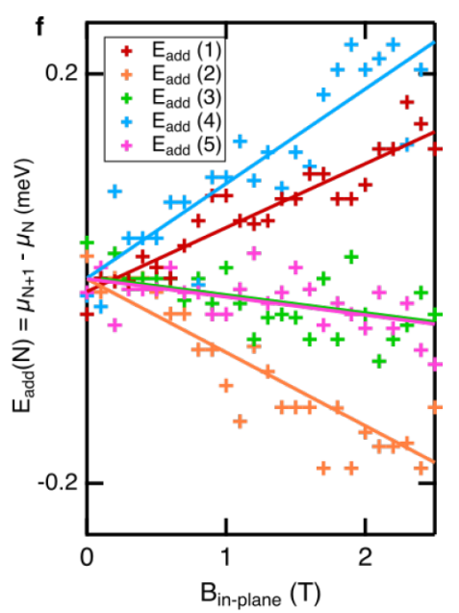
Spin filling and orbital structure I
dE_{add}(N)/dB depends on relative spin orientation of the (N+1)^{th} and N^{th} hole:
Slopes take one of three possible values

Slide 7
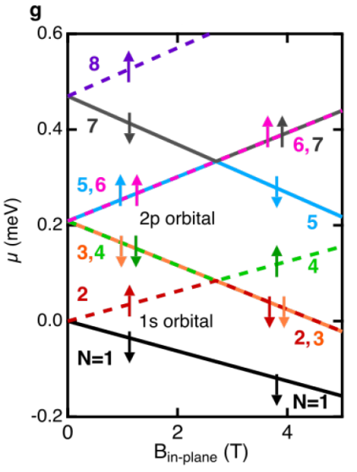
Spin filling and orbital structure II
Low field region: |B|< 2.7 T
High field region: |B|> 2.7 T
Change in slope
Magnetic field induced orbital level crossings
Hole orbital spectrum:
Degeneracy of the 2p_{x} and 2p_{y} orbitals -> circular confinement
Spin polarized filling of the 2p orbital (Hund’s rule)
Extracted g-factors:
Singlet-triplet splitting E_{ST} = 0.2 meV
Zeemann energy at crossover

Slide 8
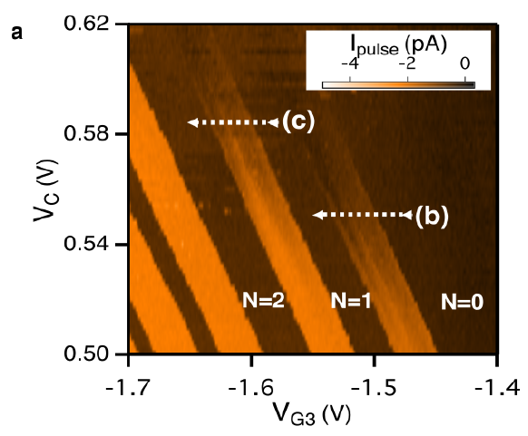
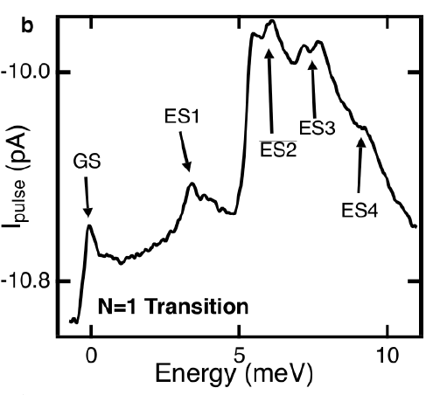
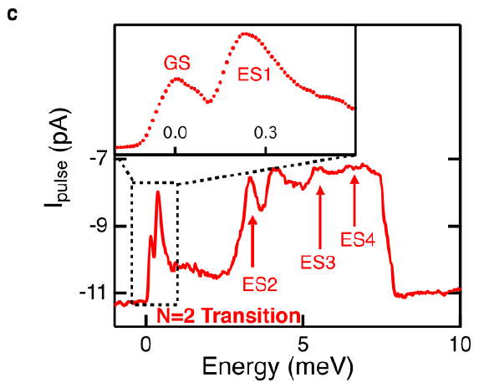
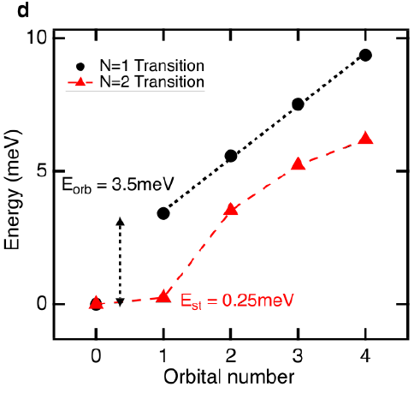
Excited state spectroscopy
a: charge stability diagram with V_{pulse} = 40 mV
Broadening of the charge transition lines
b: excited state spectrum of dot with one hole
ES energies plotted in d and show linear behaviour -> parabolic confinement
ES energy from plate cap. model yields 3mV -> in agreement with the measurement
c: excited state spectrum of dot with two holes
Reduction of GS – ES1 energy difference
E = 0.25 meV, consistent with E_{ST} = 0.2 meV from magnetospectroscopy
Hole interaction energy ̴90% of the orbital energy
Significant implications for PSB and quantum information applications
d: Excited states separations for N = 1 and N = 2

Slide 9
Summary and conclusions
Silicon MOS based quantum dot operating in the last hole regime
Determination of spin filling of the first 8 holes
Strong hole-hole interactions suppress singlet-triplet energy spacing
Thank you for your attention!

