Slide 1
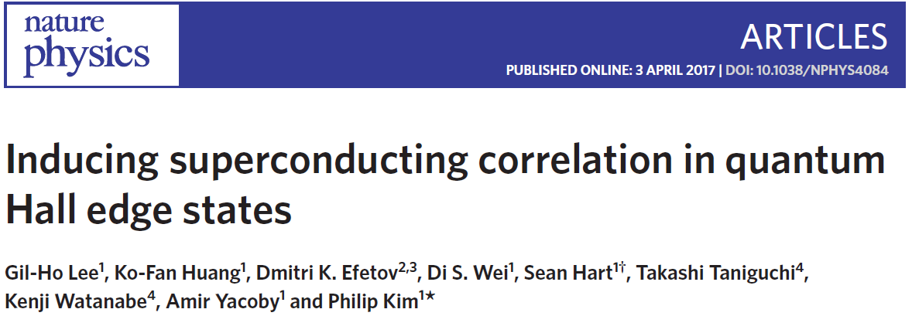
30.06.2017
Taras Patlatiuk
Zumbühl Group

Slide 2
Motivation
Inducing superconductivity in 2DEG
Non-Abelian zero modes
Crossed Andreev conversion

Slide 3
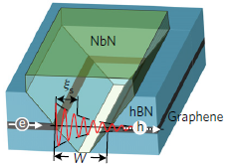
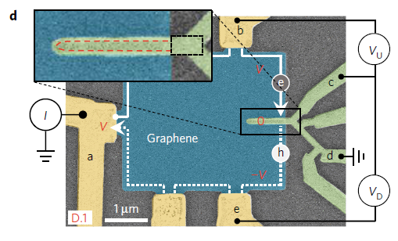
Device
Schottky barriers at the SC/semiconductor interfaces
Graphene: Ohmic contacts to SCs
hBN-encapsulation: high-mobility, QH effect at smaller field
SC: NbN, $B_{c2}\sim 25 T$, $T_{c}=12 K$

Slide 4
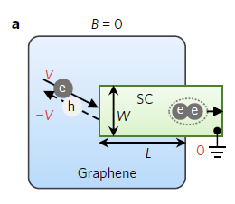
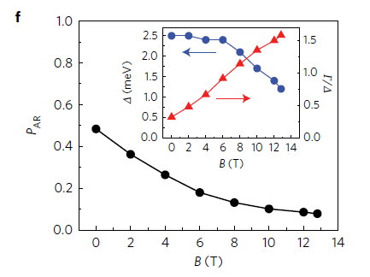
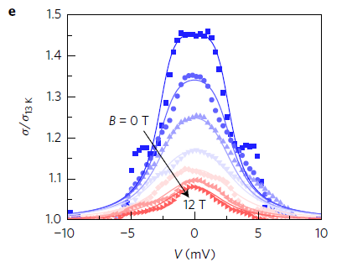
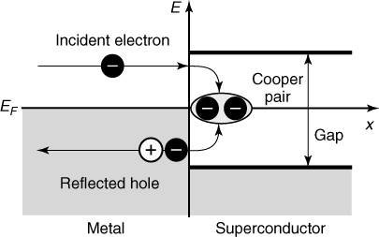
SC contact transparency
Local Andreev process
$P_{AR}$ - probability of each Andreev reflection
$V_{bg}=60 V$ no QH even at $B=14 T$
SC: NbN, $B_{c2}\sim 25 T$, $T_{c}=12 K$
BTK theory, $Z=0.18$ (barrier strength)
Notes:
45% enhancement at V=0 → SC/graphene junction reasonably transparent.
P_AR decrease with B → low

Slide 5
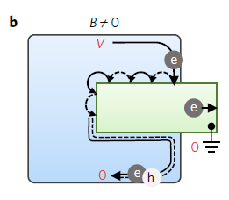
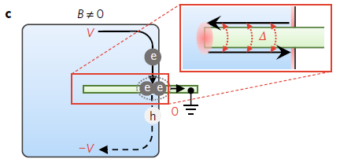
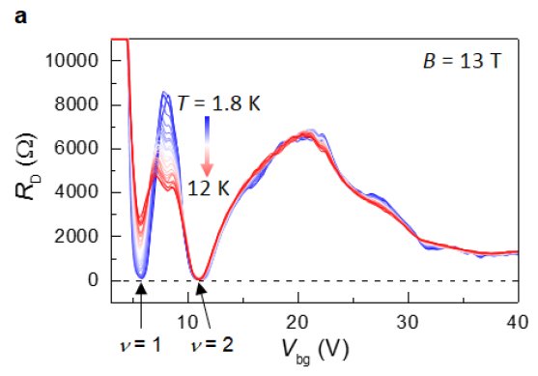
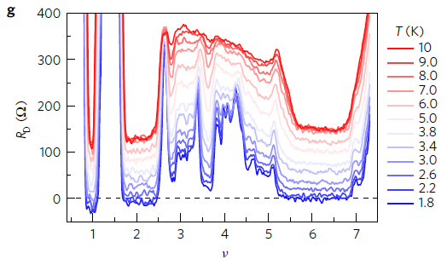
Negative non-local voltage
AES
CAC
Andreev edge state (AES)
Crossed Andreev conversion (CAC)
For $W≪ξ_{S}$ and $L≫{hv}_{F}/∆$
CAC corresponds to two non-Abelian anyons in resonance with QH edge states

Slide 6
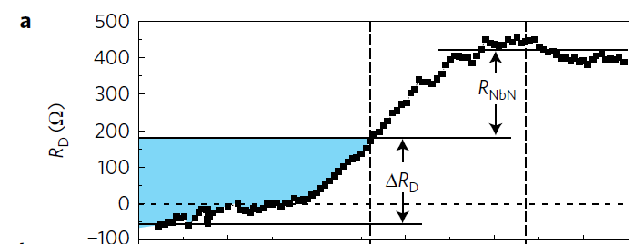
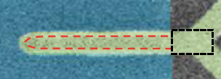
Temperature dependence
$T_{c,on}$ - onset critical temperature
$R_{NbN}$ - finite resistance of the NbN electrode
$R_{D}(T=T_{c})$ - finite SC/graphene contact resistance
$$R_{NbN}\sim 250 Ω$$
(4%)
net contribution of CAC process

Slide 7
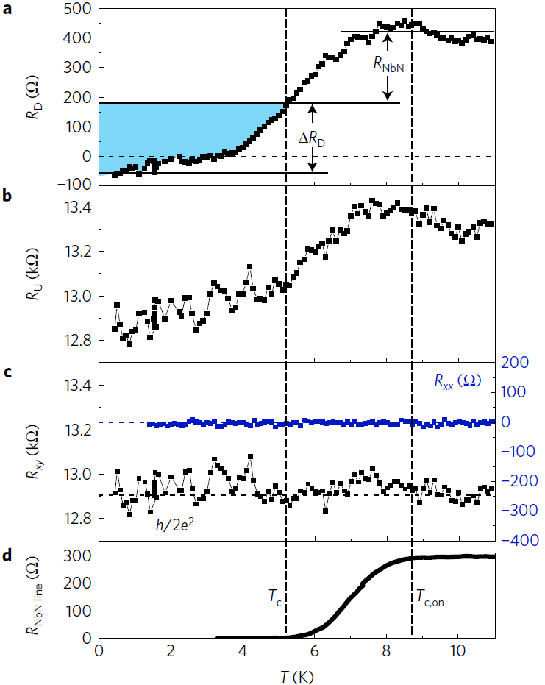
Temperature dependence
$R_{U}$ - changes (current-bias scheme)
$R_{xy}=R_{U}−R_{D}=h/2e^{2}$

Slide 8
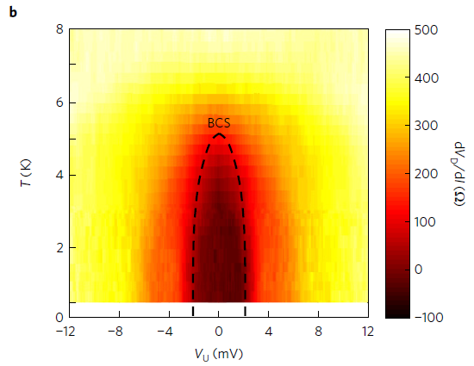
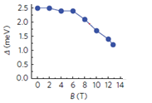
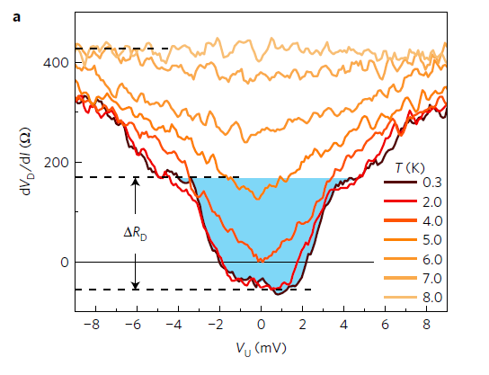
Bias dependence
Negative non-local signal:
ballistic electron transport
viscous electron backflow
$eV_{U}>∆$ : Andreev process supressed
$V_{U}=2 mV≈∆/e$
BCS-type temperature dependence on $∆$:
$R_{D}$ - related to superconductivity

Slide 9
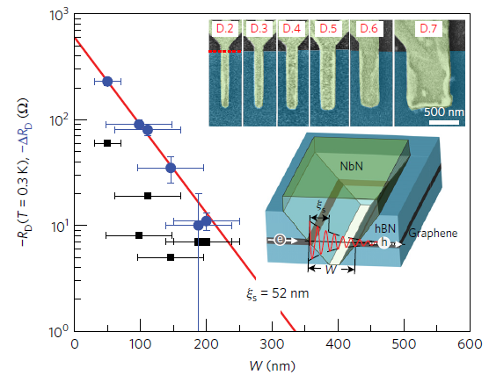
Width of superconductor
SC coherence length ($ξ_{s}$)
${W≤ξ}_{s}$ hole tunnel through SC
$W$: 50 to 600 nm
$∆R_{D,0}$ - max. CAC efficiency ($W=0$)
clean limit
dirty limit
$$P_{AR}\sim 0.1$$
$${P_{AR}∙∆R}_{D,max}\sim −640 Ω$$

Slide 10
Conclusion
Crossed Andreev conversion at $ν=2$
$ν=1$ state possible host of Majorana zero modes
CAC at $ν=1$ enabled by large spin-orbit coupling (NbN)

Slide 12
DOS of graphene
Bilayer graphene

Slide 13
Modified BTK

