Slide 1
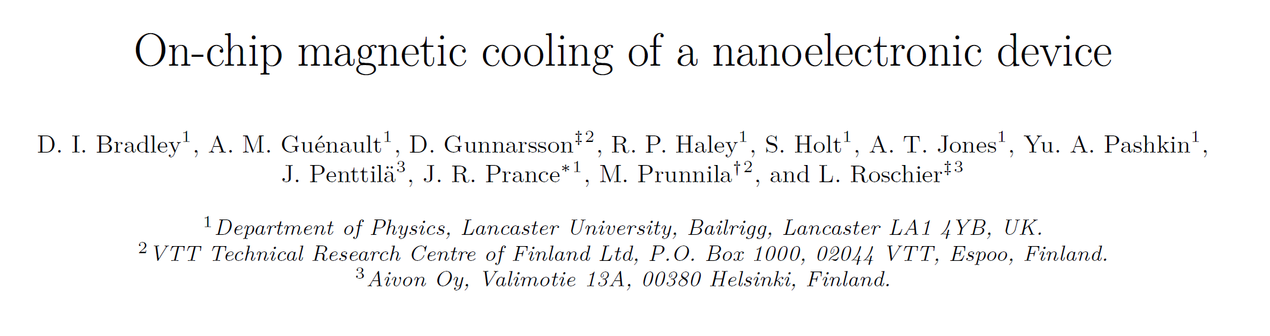
FMM 170317
MARIO PALMA

Slide 2
Motivation
Similar results
Figure out the model that they used to fit the data
Differences between their system and our system

Slide 3
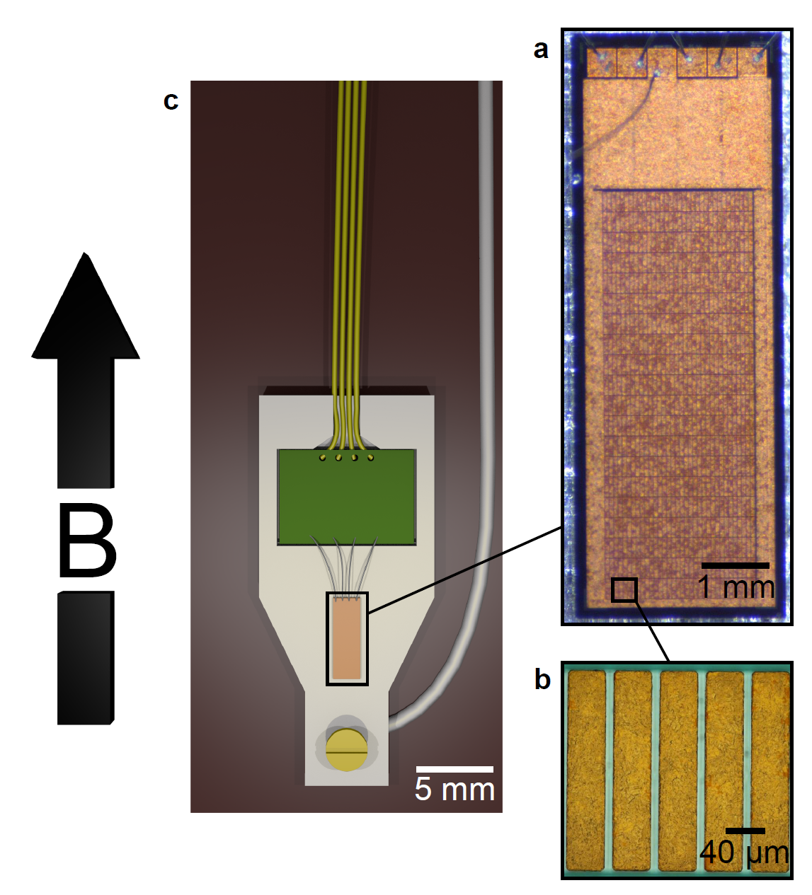
Device and set up
CBT consist of
  22 parallel row
  33 junctions in series
CBT is electroplated with Cu
  Island (39x206x6.14µm³)
  (40000 µm³)
  B parallel to the long axis
Closed Ag box
Thermalization to the MC
PCB board with RLC-low pass filters
Cu wires connected to the filters placed on the MC
Ag coated bond wires
Notes:
Area for my CBT????????

Slide 4
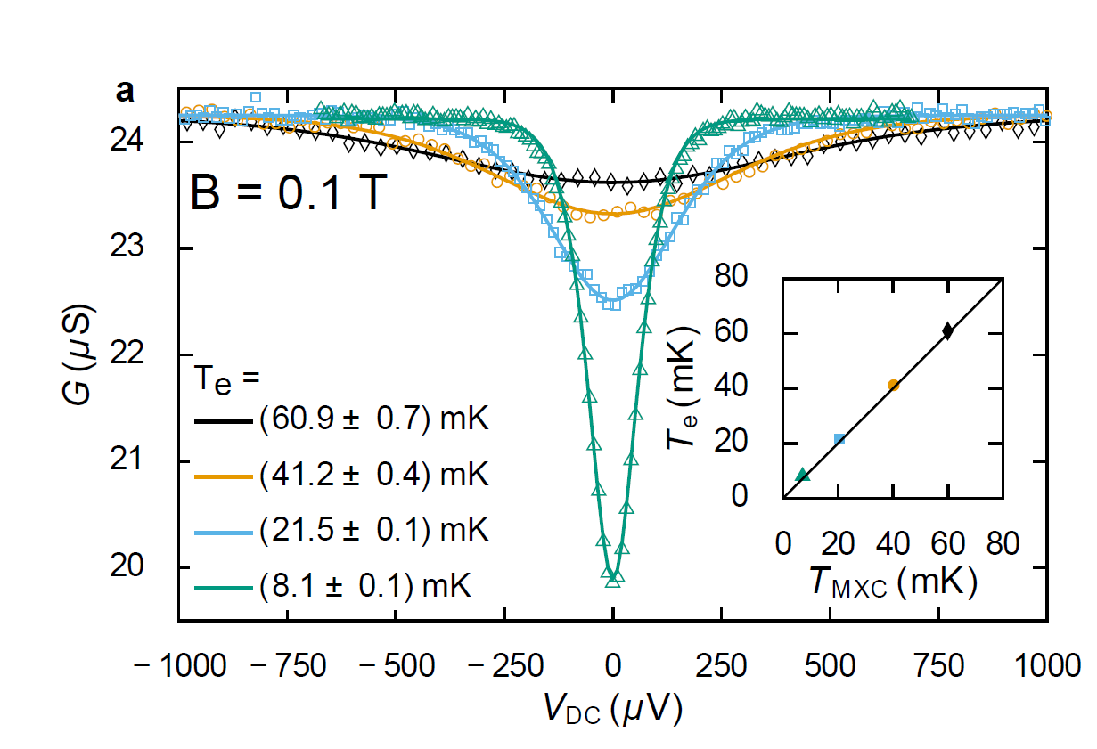
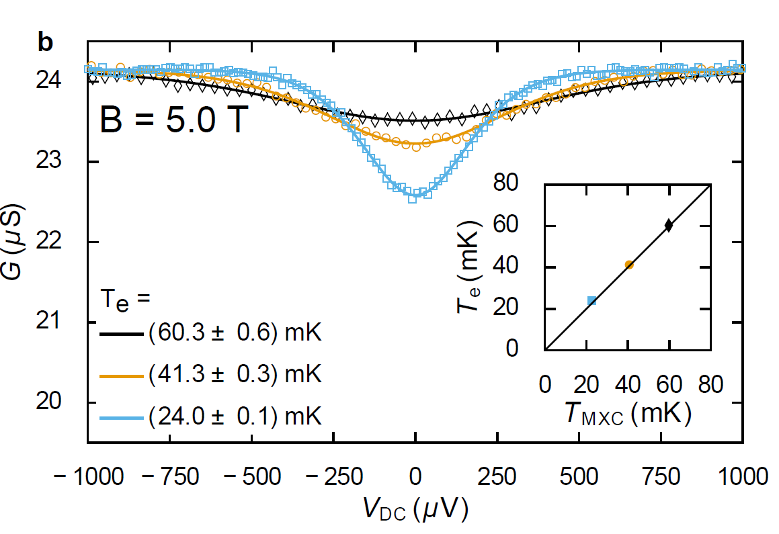


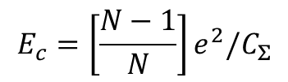
Calibration
Calibration at 3 different temperatures at 2 different B fields.
Full fit of the conductance with: R_{T},C_{Σ}, T
5T: R_{T}=25.10 ± 0.06 kΩ; C_{Σ} =191.9 ± 0.8fF
0.1T: R_{T}=24.99 ± 0.06 kΩ; C_{Σ} =192.4 ± 0.9fF
$$E_{c}=\left[\frac{N−1}{N}\right]e^{2}/C_{Σ}$$
$$u_{N}=E_{c}/k_{B}T$$
E_{C}= 9.37 mK
Secondary mode
T_{CBT}=8.1 mK -> T_{MXC}=7.1 mK after 5 hours
T_{CBT}=9 mK -> T_{MXC}=6.5 mK after 2 weeks
T_{CBT}=8.1 mK -> T_{MXC}=6.5 mK after 1 week

Slide 5
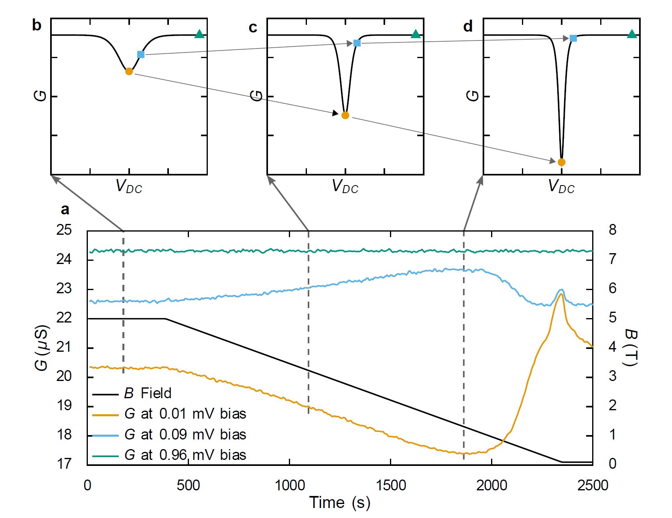
Demag
Precooling: T_{i}~9 mK; B_{i} =5T
Precooling time 14 hours!!!
Less thermal mass
w/o SC heat-switch!!!
Demag 5T->0.1T
ramp-rate: 2.5 mT/s(9T/hour)
Super fast ~ 4x
Overshoot
Adapt the ramp-rate

Slide 6
DMR170306
8T->0.08T; 2T/h
9T-> 8T; 1T/h

Slide 7
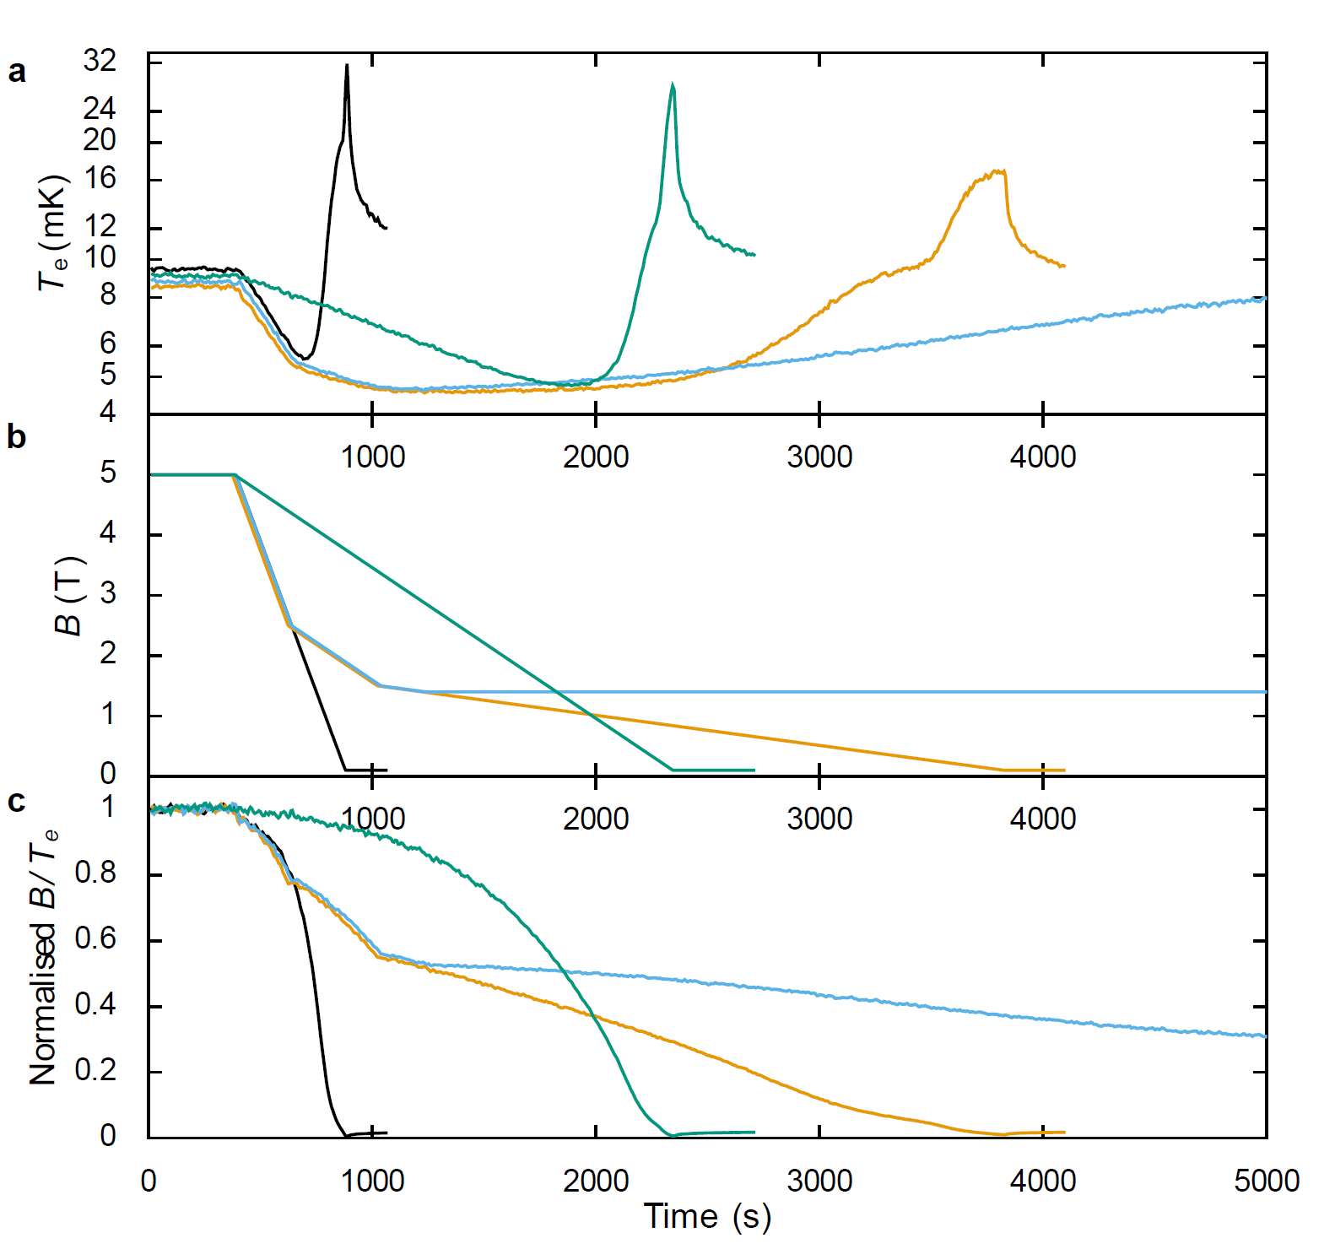
multi-rate
10 mT/s
2.5 mT/s
10 mT/s: T_{f} ~ 5 mK ;
hold time≪400s large overshoot
2.5 mT/s: T_{f} ~ 4.7 mK ;
hold time ~ 400s
10 mT/s
multi-rate demag: T_{f} ~ 4.5 mK
hold time ~ 1000s
2.5 T
Break at 1.4T
1.5 T
2.5 mT/s
0.5 mT/s
multi-rate demag: T_{f} ~ 4.5 mK
hold time ~ 1200s
multi-rate:
lower T_{f}
longer hold time

Slide 8
DMR170313
9T->8T 1T/h(0.28mT/s); 8T->2T 2T/h(0.56mT/s);2T 3 hours break; 2T->0.4T 1T/h; 0.4T->0.08T 0.5T/h
T_{i} =21.5 mK; T_{f} =4.4 mK; hold time: 1170 s

Slide 9
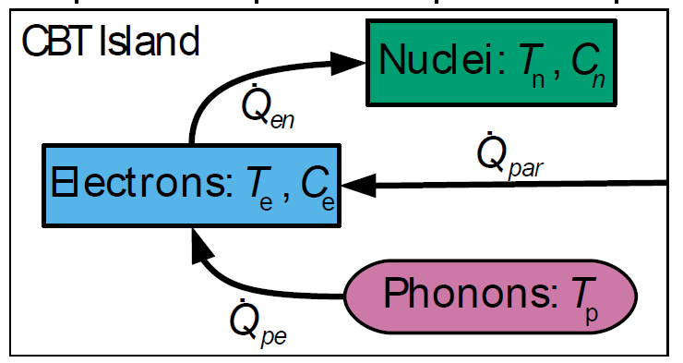
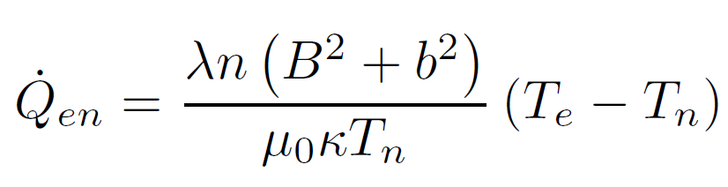
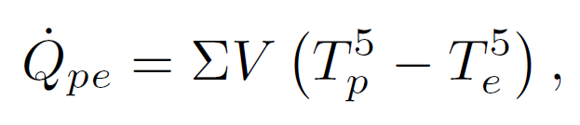
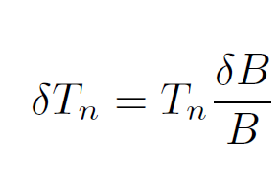
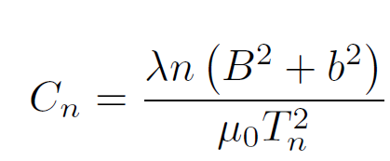
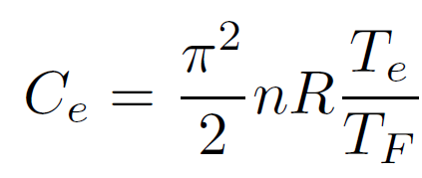
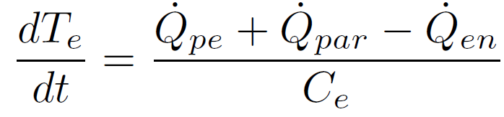
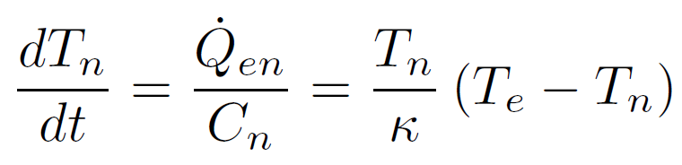

Model
Adiabatic Nuclear Demagnetization
$$T_{e}\left(t_{1}\right)=T_{e}\left(t_{0}\right)+{((\dot{Q}}_{pe}+{\dot{Q}}_{en}+{\dot{Q}}_{par})/C_{e})dt$$
$$T_{n}\left(t_{1}\right)=T_{n}\left(t_{0}\right)+{(T}_{n}\left(to\right)\left(T_{e}\left(t_{0}\right)−T_{n}\left(t_{0}\right)\right)−T_{e}\left(to\right)∗δB/B)dt$$
$$T_{n}\left(0\right)=T_{e}\left(0\right)=T_{i}$$

Slide 10
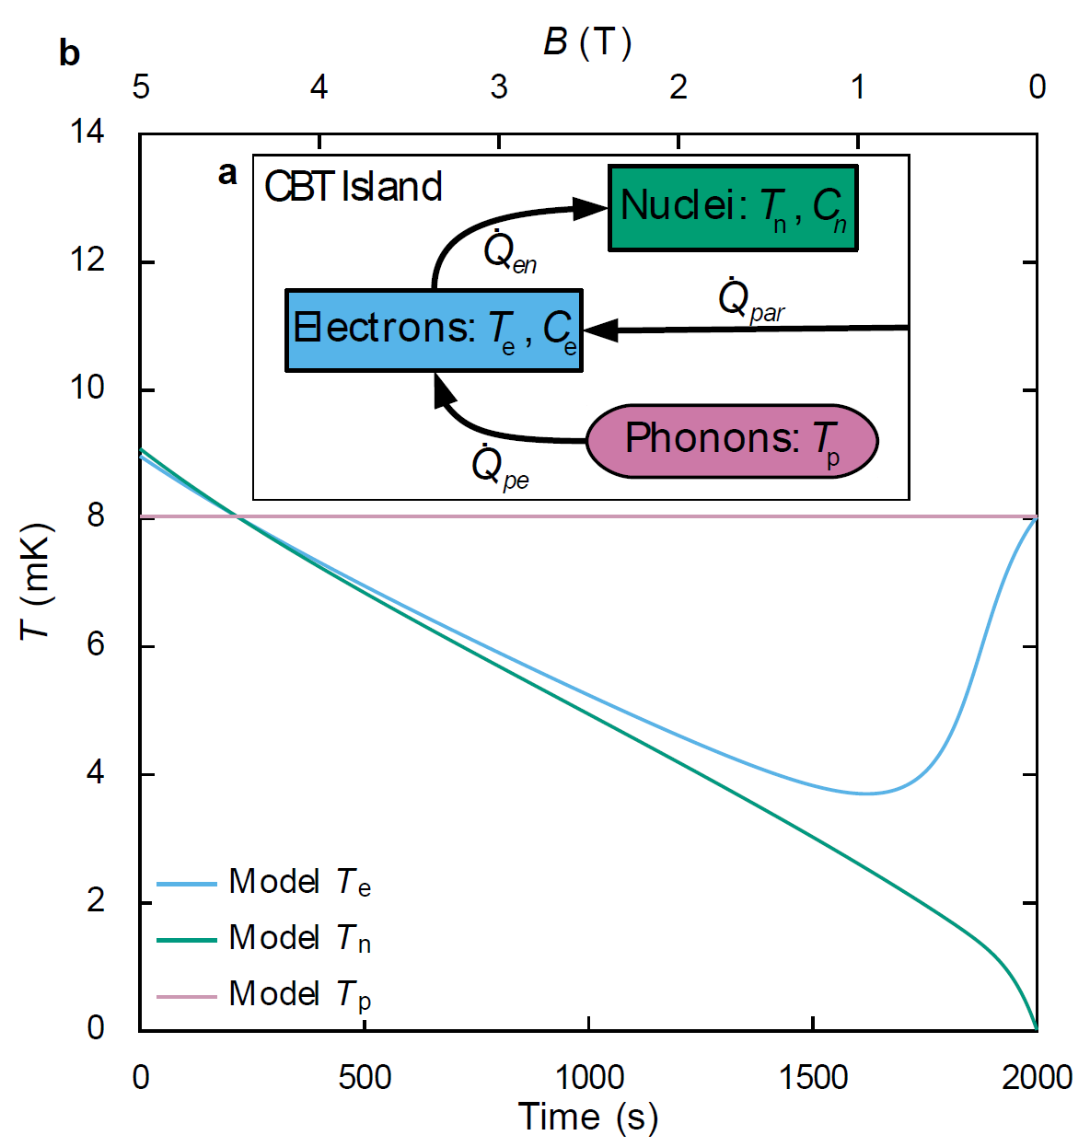




Model 2
Mario’s simulation
$$T_{n}\left(0\right)=T_{e}\left(0\right)=9 mK$$
$${\dot{Q}}_{par}=0$$
$$T_{p} \sim constant (8 mK)$$
$$T_{p} \sim constant (8 mK)$$
Ramp-rate 2.5 mT/s

Slide 11
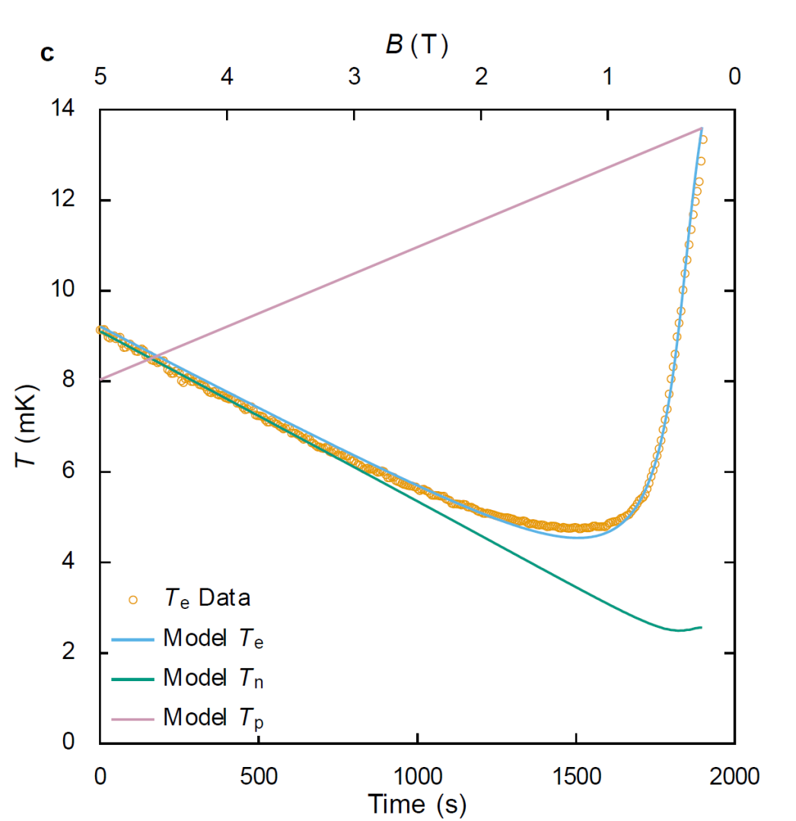
Model 3
Mario’s simulation
Assumptions: Q_{par}=6.317 fW;
T_{p}(t)=T_{p}(0)+2.960μK/s*t(???) eddy current heating
Effective volume ~ 12% island volume

Slide 12
Conclusions
Cooling of the CBT below 5 mK (2.7 mK)
New cooling technique ( magnetic cooling for electronic nanodevices)
Multi-rate demag increase the hold time and decrease the lowest T
Efficient precooling down to 9 mK (23 mK)
Poor demag efficiency a factor 2 (ξ=4%) (8(ξ=37%))

