Slide 1
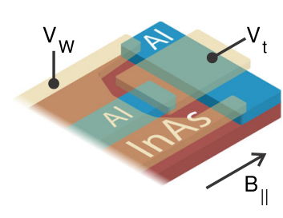
Scaling of Majorana Zero-Bias Conductance Peaks
F. Nichele, A.C.C. Drachmann, A.M. Whiticar, E.C.T. O’Farrell, H.J. Suominen, A. Fornieri, T. Wang, G.C. Gardner, C. Thomas, A.T. Hatke, P. Krogstrup, M.J. Manfra, K. Flensberg, and C.M. Marcus, PRL 119, 136803 (2017)
Kris Cerveny
26.01.2018
Friday Group Meeting Talk
Notes:
Logo of PASPS9 conference

Slide 2
Introduction
Motivation:
Interesting device integrating 1D physics in 2D architecture
Zero-bias peak scaling compatible with Majorana zero modes (MZM)
Excellent overview of analysis for MZM physics
Addresses discrepancy between experiment and theory of zero-bias peaks

Slide 3
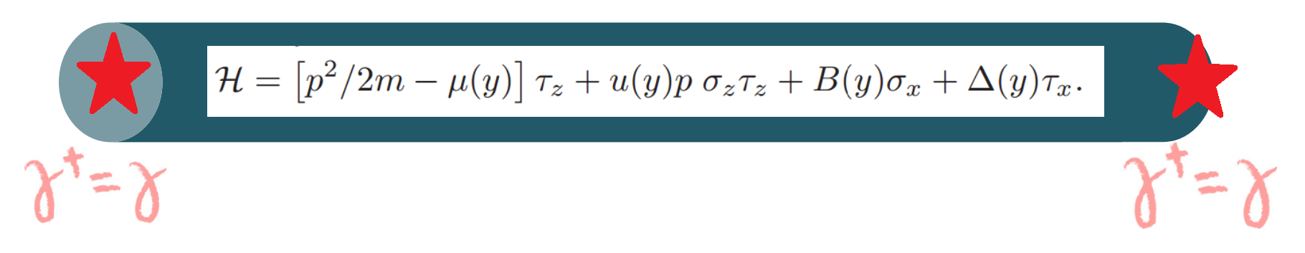

Basic Majorana Recipe
1D wire
Spin-orbit interaction
Superconductivity
Magnetic field
mimics spinless p-wave superconductor
With $E_{Z}>∆$ should have topological gap

Slide 4
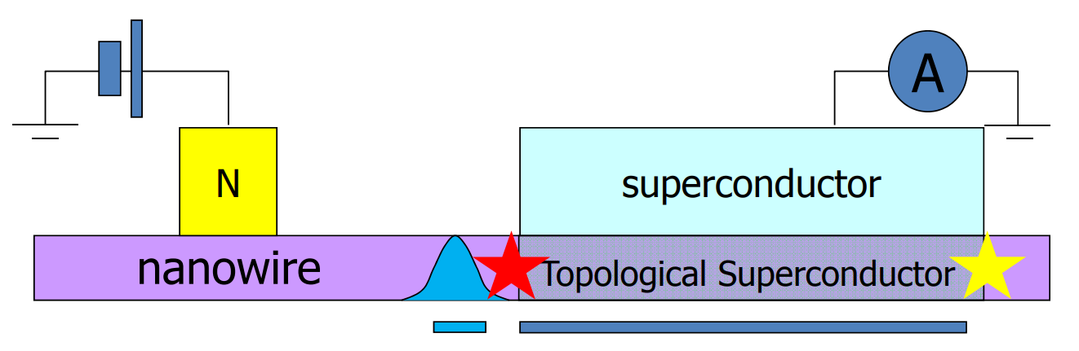


Majorana Schematic
$$B_{∥}$$

Slide 5
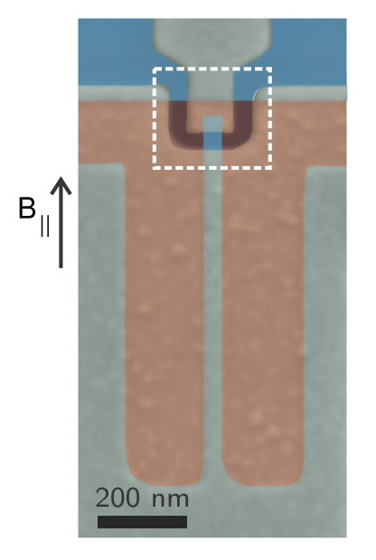
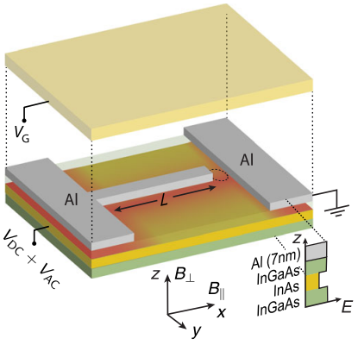
Device
[1] H.J. Suominen et al., PRL 119, 176805 (2017)

Slide 6
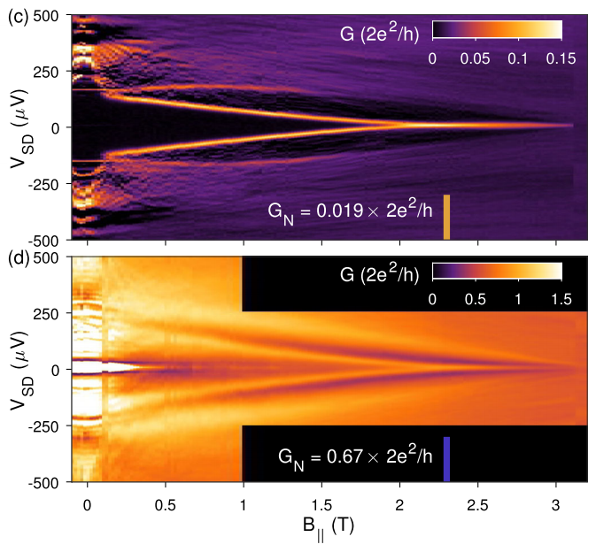
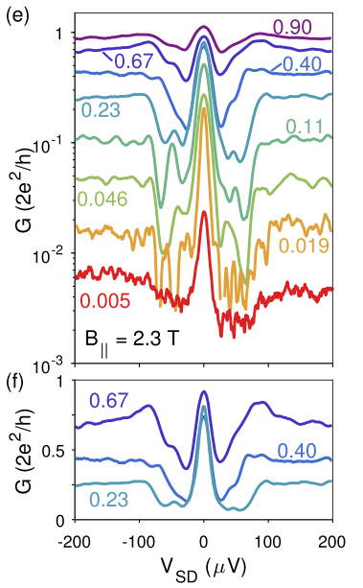



Zero-Bias Peaks
$G_{N}$: Normal state conductance
Coalescing of ABSs to ZBCPs
SIS with cond. peaks at $V_{SD}=±\frac{2Δ^{∗}}{h}\sim ±400 μV$
Conductance varied by tuning $V_{t}$

Slide 7
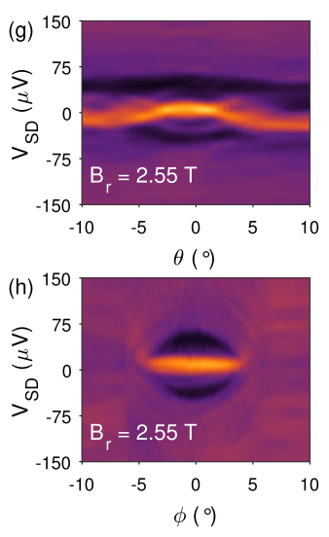
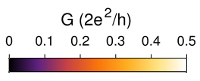


Anglular Dependence
$$G_{N}=0.12∙2e^{2}/h$$
$θ$: in plane magnetic field, 0 corresponds to along wire
$φ:$ out of plane angle ($B_{r}⊥B_{SO}$)

Slide 8
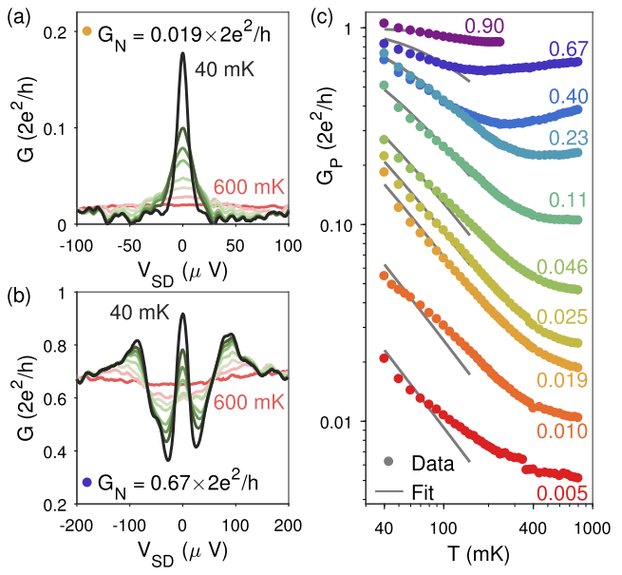
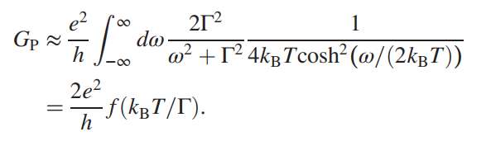

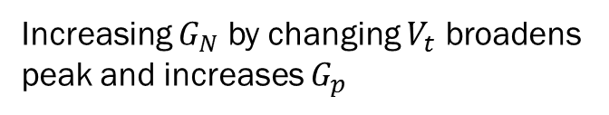
Temperature Scaling
for $k_{B}T≪Δ_{t}$, zero-bias conduction given as:
Increasing $G_{N}$ by changing $V_{t}$ broadens peak and increases $G_{p}$

Slide 9
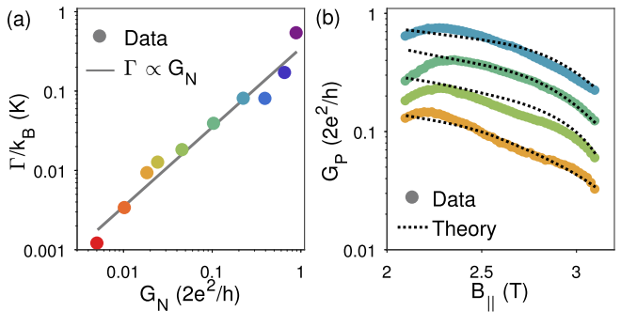
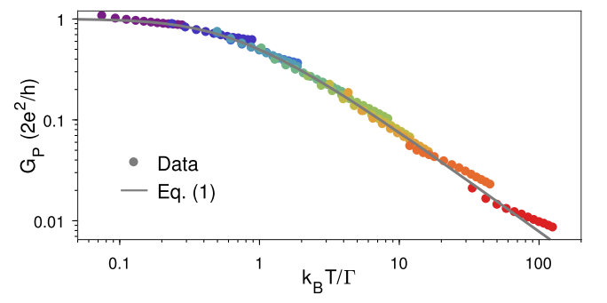


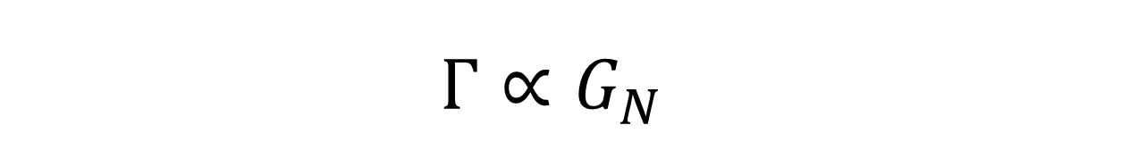
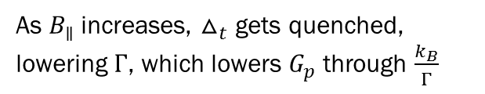
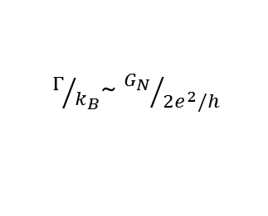
$$Γ∝G_{N}$$
$Γ/{k_{B}}$~ ${G_{N}}/{{2e}^{2}/h}$
$τ:$ transmission
$Γ≈\frac{τΔ_{t}}{2}$ →${ Δ}_{t}\sim 75 μeV$
As $B_{∥}$ increases, $△_{t}$ gets quenched, lowering $Γ$, which lowers $G_{p}$ through $\frac{k_{B}}{Γ}$

Slide 10
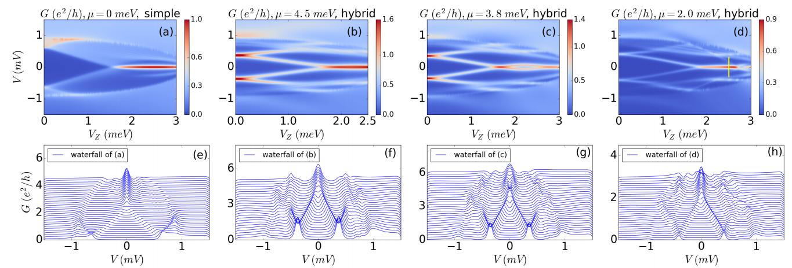
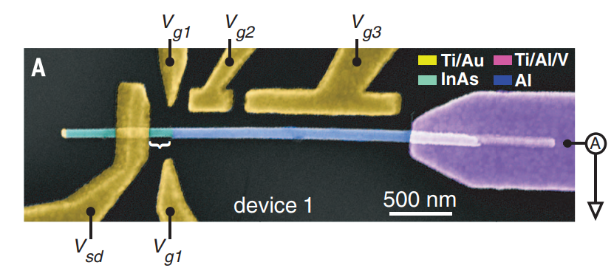

Trivial or Topological?
Topological quantum critical point separating trivial and topological phases:
$$V_{Z_{c}}=\sqrt{μ^{2}−∆^{2}}$$
[2] Liu, Sau, Stanescu and Das Sarma, PRB 96, 075161 (2017)
[3] Deng et al., Science 354, 6319 (2016)

Slide 11
Thanks for listening!!

Slide 12
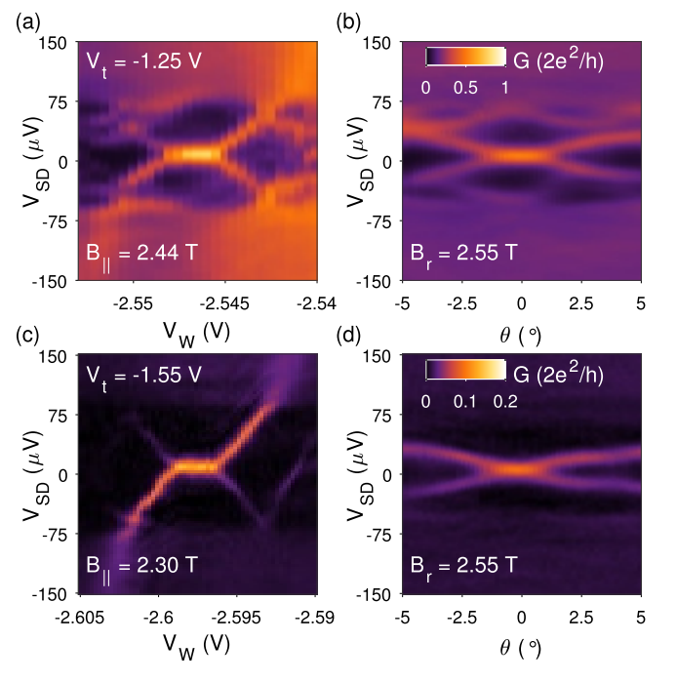


$$G_{N}=0.23∙2e^{2}/h$$
$$G_{N}=0.019∙2e^{2}/h$$

Slide 13
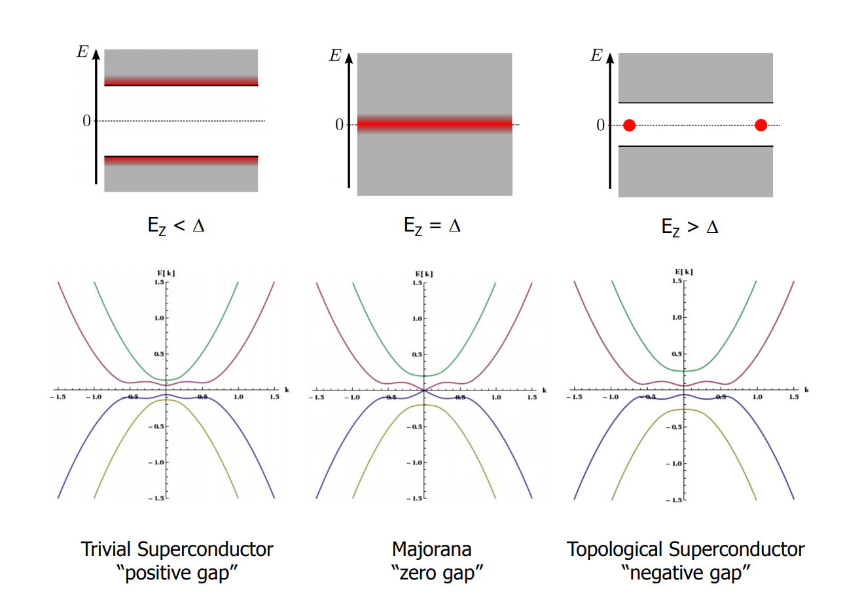
Topological Gap

