Slide 1
Quantum Hall effect
& Topology
Laughlin pumping argument
Kubo formula
Chern number
Aharonov Bohm
Euler characteristic
Corbino ring
Stoke’s theorem
Spectral flow
Percolation
Parallel transport
Berry phase,
Berry curvature
Gauss-Bonnet formula
Spin orbit interaction
Fluctuation dissipation theorem
Focault pendulum

Slide 2
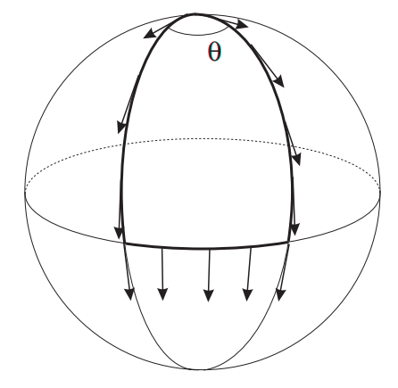
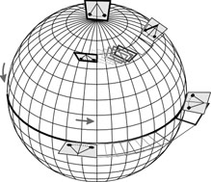
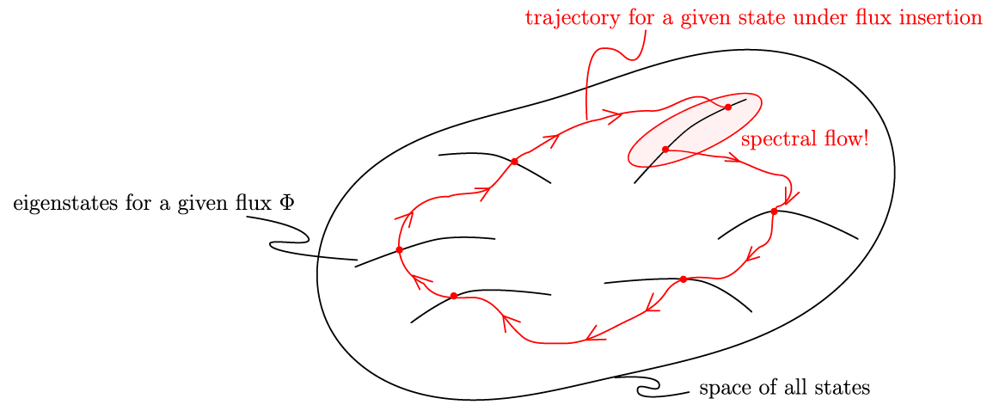
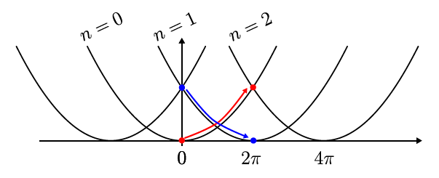
Parallel transport:
Spectral flow & parallel transport
Parallel transport:
  Easy to say what is parallel on flat surface
  How about on curved surface?
    → take pendulum, follow its oscillation plane
  Closed loop does not map state onto itself
Spectral flow (central for Laughlins pumping argument:
  Assume operation that maps Hamiltonian back to itself
  Degenerate ground state
  Track a given eigenstate Ψ₀
  => Ψ₀ may be mapped on different state
Examples:
  Electron on ring threaded by flux Φ (Aharonov Bohm)
  Focault pendulum
Motion along curved surface similar to charged particle in B-field
  Coincidence / more deep connection ?
  Both can be described by accumulation of geometric phase (→ Berry phase/curvature)

Slide 3
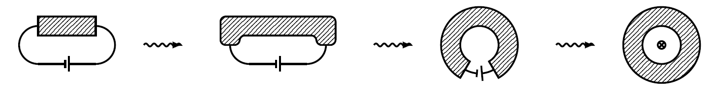


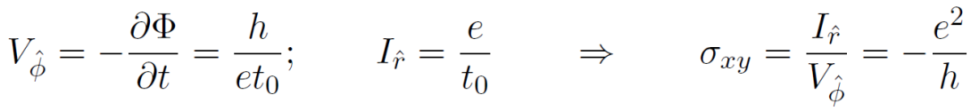



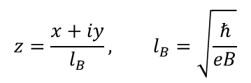



Laughlins pumping argument
Radial (circular) gauge
Quantum Hall resistance independent of details:
disorder, material, geometry
Given sample may deformed without altering QHE
Ribbon geometry may be deformed to Corbino ring
$Ψ\sim z^{m}e^{− \frac{z^{∗}z}{4}}$
$$z=\frac{x+iy}{l_{B}}, l_{B}=\sqrt{\frac{ℏ}{eB}}$$
I
I
$⇒Ψ\sim {e^{imΦ}r}^{m}e^{− \frac{r^{2}}{4l_{B}^{2}}}$
V
V
+Φ₀
+Φ₀
+Φ₀
Ψ_{tot}
I
I
V
V→$∂$_{t}Φ
Ground state wave-functions
Last step: replace voltage with electromotive force (Lenz rule)
$$πr_{m}^{2}B=2πml_{B}^{2}B=2πm\frac{ℏ}{eB}B=mΦ_{0}$$
Flux enclosed by m^{th} wave-function:
Add slowly ($t_{0}≫1/ω_{c}$, no excitation to higher LL) flux quantum $Φ_{0}$:
$$r_{m}\left(φ\right)→r_{m}\left(Φ+Φ_{0}\right)=r_{m+1}(Φ)$$
A$dding Φ_{0}$ transfers charge from inner edge to outer perimeter
To reach equilibrium, charge has to relax again

Slide 4
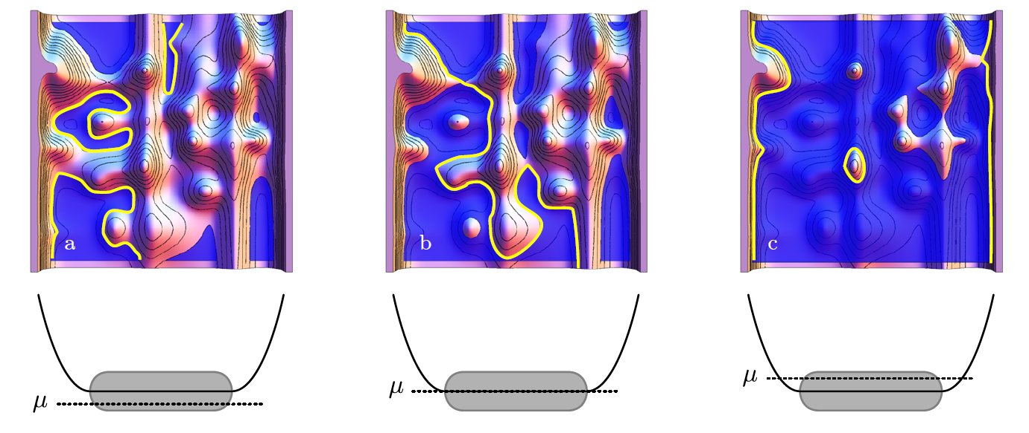
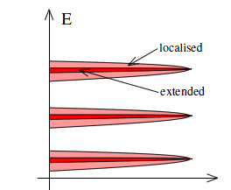
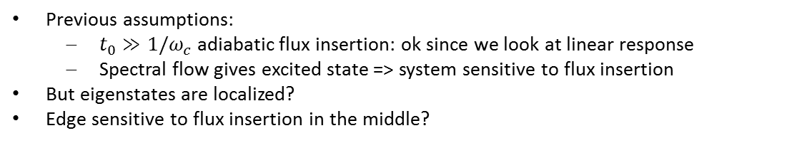
Percolation transition
Previous assumptions:
  $t_{0}≫1/ω_{c}$ adiabatic flux insertion: ok since we look at linear response
  Spectral flow gives excited state => system sensitive to flux insertion
But eigenstates are localized?
Edge sensitive to flux insertion in the middle?
Percolation transition
Finite amount of disorder → fill in electrons → lakes
Eigenstates in disordered LL move along equipotential lines
Fill in a lot more electrons => lakes → islands
At transition: the shoreline connects through the hole sample

Slide 5
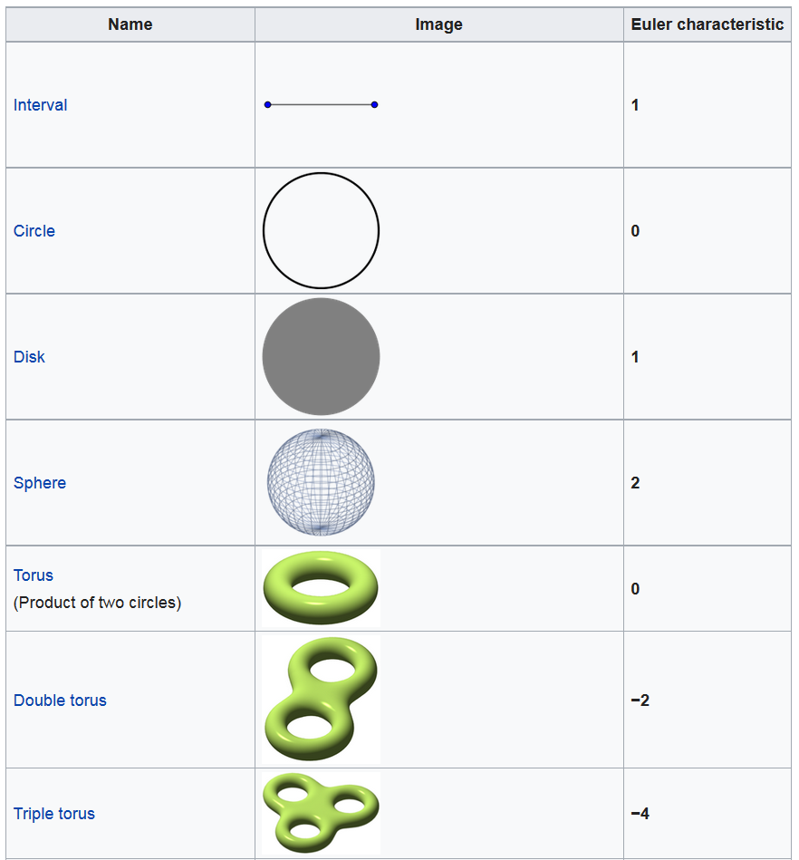
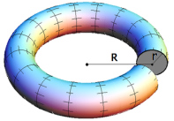
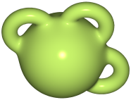
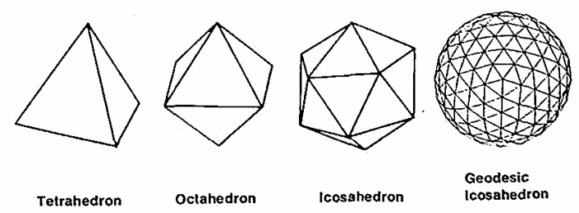







Euler characteristic
Start with Euler’s polyhedron formula (Euler characteristic): V-E+F=2
  V=Vertices
  E=Edges
  F=Faces
Proof: take e.g. tetrahedron, press it flat
Perform in each step either of the two operations that leave V-E+F unchanged
  Remove: 1 face, 1 edge
  Remove: 1 vertex, 2 edges, 1 face
General convex polyhedron → follows by induction
$$V−E+F=2−1+0=1$$
=
=
$$V−E+F=1−1+0=0$$
=
=
$$V−E+F=1−1+1=1$$
F → F-1
=
=
$$V−E+F=2−1+0=2$$
Torus + 2* =
= Sphere
=>
V-E+F=3-3+1(+1)=2
$$V−E+F=0$$
$$V−E+F=−2$$
Euler formula holds for sphere as well!
$$V−E+F=−4$$
Euler formula in higher dimension: V-E+F=2-2*g
g: genus = number of handles

Slide 6

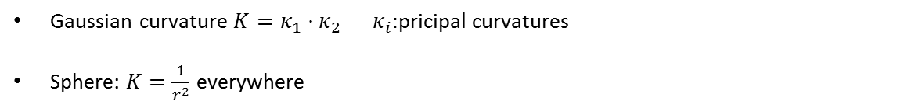
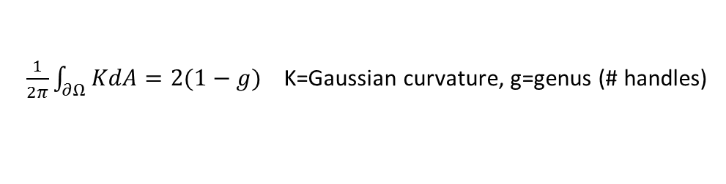

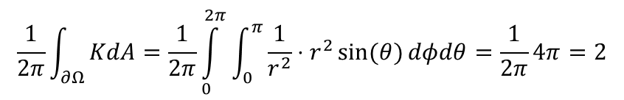
Gauss Bonnet Formula
Extension of Euler Formula to curved surfaces (rather than polyhedron)
$\frac{1}{2π}\int_{∂Ω}^{ }{KdA=2(1−g)}$ K=Gaussian curvature, g=genus (# handles)
Gaussian curvature $K=κ_{1}⋅κ_{2} κ_{i}:$pricipal curvatures
Sphere: $K=\frac{1}{r^{2}}$ everywhere
$$\frac{1}{2π}\int_{∂Ω}^{ }{KdA=\frac{1}{2π}\int_{0}^{2π}{\int_{0}^{π}{\frac{1}{r^{2}}⋅r^{2}\sin{(θ)}}dφdθ}=\frac{1}{2π}4π=2}$$
Torus: Sphere + “negative Sphere” (same curvature as sphere, but with negative sign ⇔ convex → concave)
# handles (holes) = # “negative Spheres”
⇒ Gauss Bonnet formula
$$\frac{1}{2π}\int_{∂Ω}^{ }{KdA=−2}$$

Slide 7


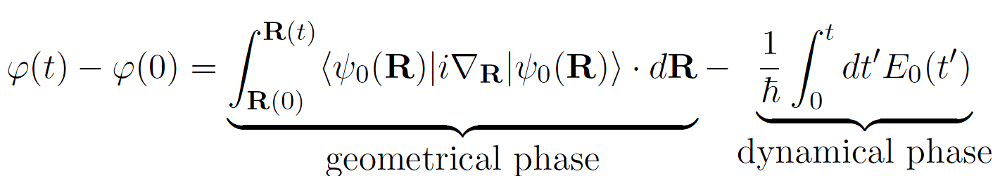
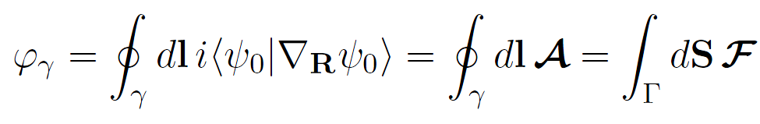
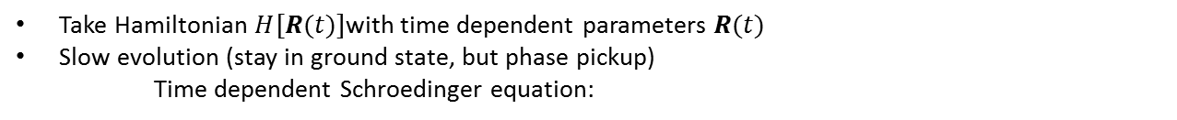
Berry phase & curvature
What is curvature?
Accumulated geometric phase when performing a small loop, divided by the loop area
Take Hamiltonian $H[R(t)]$with time dependent parameters $R(t)$
Slow evolution (stay in ground state, but phase pickup)
Time dependent Schroedinger equation:
Multiplying from the left with one obtains
Integrate expression:
PhAase along closed contour:
Berry phase
Some “field” (Berry connection)
Berry curvature

Slide 8

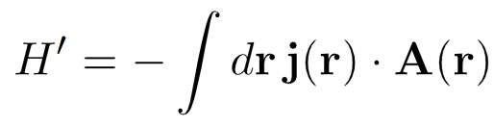



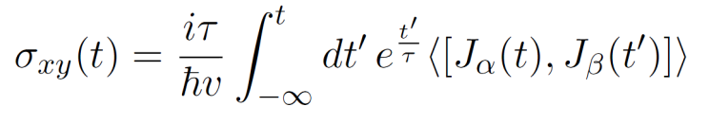
Linear response (Kubo formula)
Fluctuation dissipation theorem:
  Make perturbation to system
  Monitor (calculate) response / relaxation back to equilibrium
Need to calculate current density
With electric field:
And perturbing Hamiltonian:
U = F*s = e*E*s
= (e*s/dt)*(E*dt) = j*A
Expectation for current density:
: Unperturbed ground state
Slowly turn of field through torus:
Go to Fourier space, look only at q=0 component (dc response) => Kubo formula

Slide 9
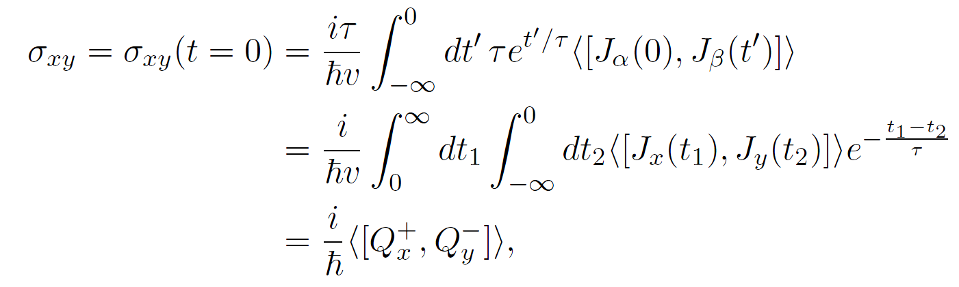

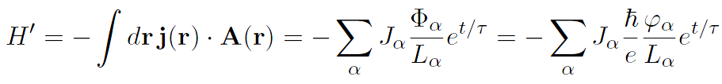



Kubo → Berry curvature → Chern number
Slowly turn of field through torus:
Go to Fourier space, look only at q=0 component (dc response) => Kubo formula
At t=0 one obtains:
…
Going back to original hamiltonian, and using dimensionless phases:
Write ground state at t=0 by evolving it from minus infinity:
Take derivative with respect to $∂/∂φ_{a}$
(During adiabatic turning on of field)
Berry connection
Berry curvature
DC-field: average phases over 2π interval
$$σ_{xy}=\frac{e^{2}}{h}\frac{1}{2π}\int_{M}^{ }{dφ_{x}dφ_{y}F_{xy}}=\frac{e^{2}}{h}C, C=\frac{1}{2π}\int_{M}^{ }{F_{xy} dΩ} ∈\text{ℤ}$$
C = Chern number

Slide 10



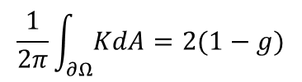
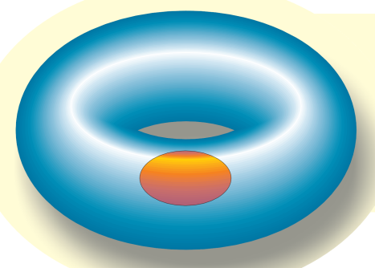

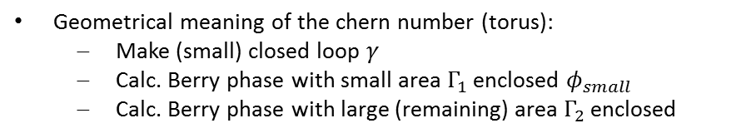


Quick summary
What is curvature?
→ Accumulated geometric phase when
performing a small loop, divided by the loop area
d/dt Φ : electromotive force Θ : Related to current
Applying Gauss-Bonnet formula we conclude that there must be some quantization
Chern number = difference in Berry phase / 2π = integer

Slide 11
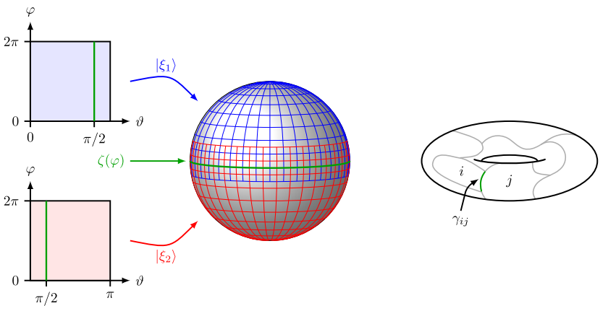
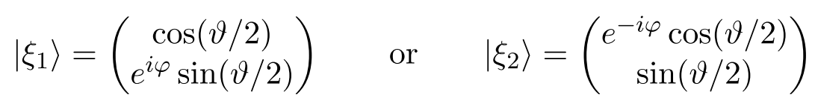
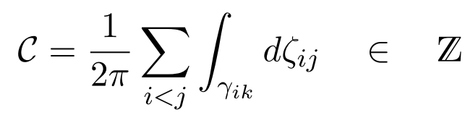
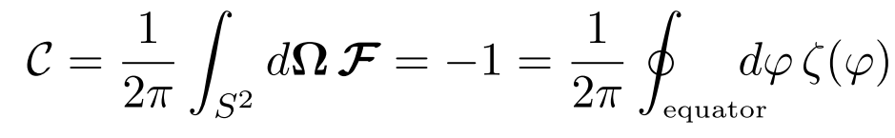
Spin up/down (Topology)

Slide 12
Summary
Parallel transport & spectral flow
Laughlin pumping argument & percolation model
Euler formula, extende Euler formula & Gauss-Bonnet fomula
Berry phase & Berry curvature
Fluctuation dissipation theorem & Kubo formula
Kubo formula to Chern number
Spin ½ particle

