Slide 1
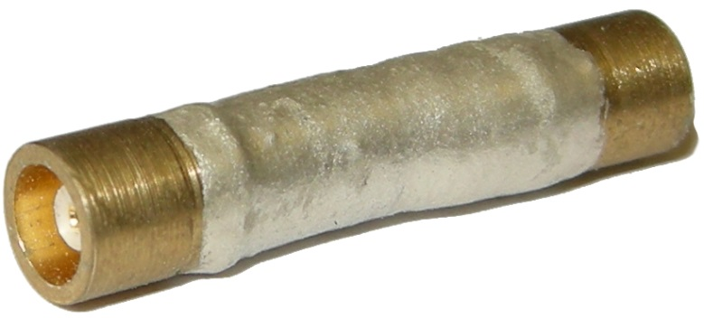
Approaching μK temperatures
in nanoscale devices
https://baselcryogenics.unibas.ch
baselcryogenics-physik@unibas.ch

Slide 2
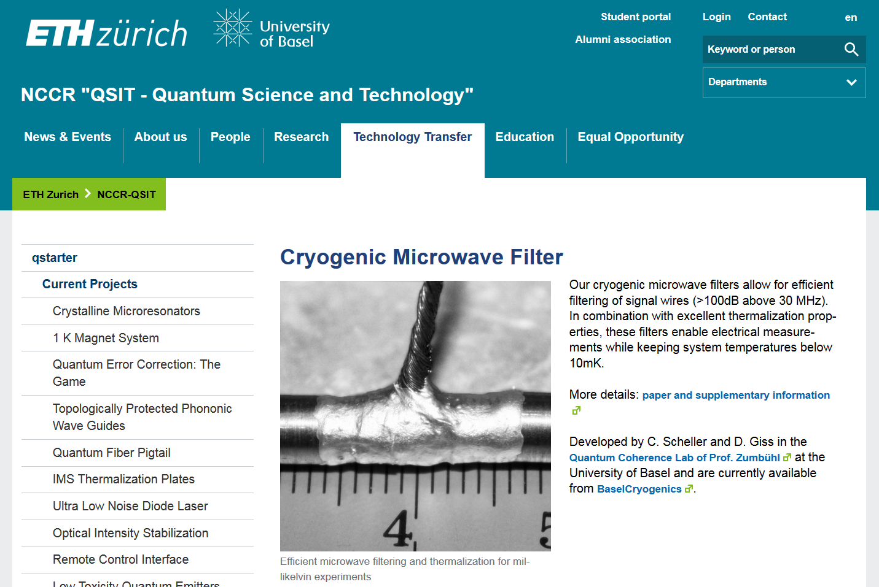
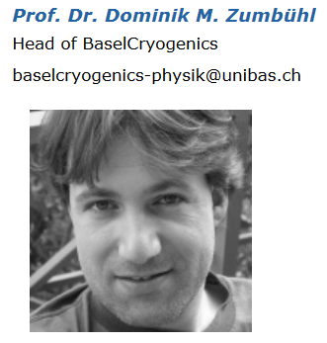
History and Company profile
https://baselcryogenics.unibas.ch
baselcryogenics-physik@unibas.ch
History
Publication: APL 104, 211106 (2014)
NCCR QSIT qstarter award (2014)
BaselCryogenics Startup:
homepage https://baselcryogenics.unibas.ch (2015/2016)
>100 Filters produced (mostly in-house use)
Product development: Low-T world record (2017)
People

Slide 3
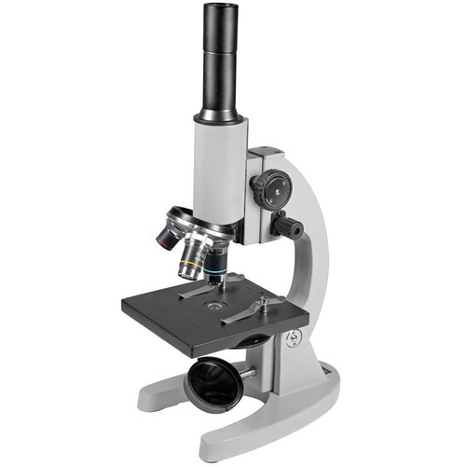
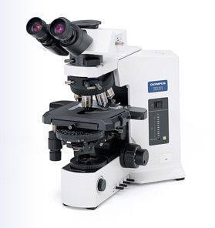
Low temperatures: Why?
https://baselcryogenics.unibas.ch
baselcryogenics-physik@unibas.ch
Temperature leads to blurring (temperature broadening, e.g. FD distribution)
Destroys fragile effects with small energy scale (novel phases)
Quasiparticle poisoning, decoherence (quantum computing)
=> Lower temperature ⬄ Microscope with better resolution

Slide 4
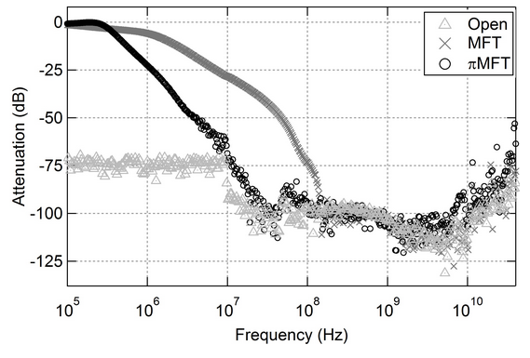
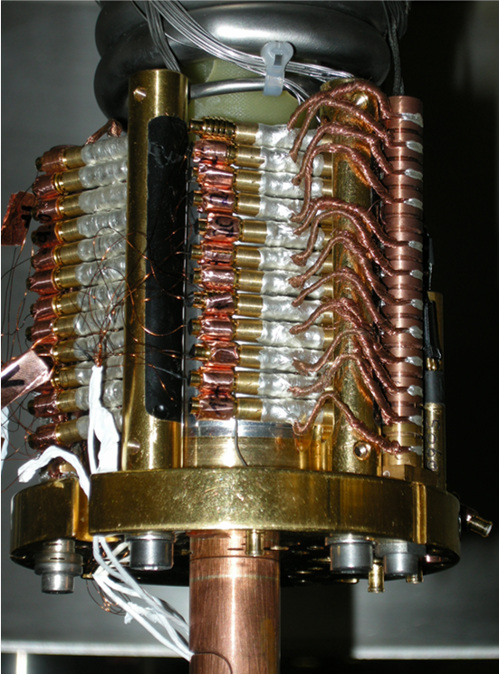
Low temperatures: How?
4K
1K
100mK
MC
https://baselcryogenics.unibas.ch
baselcryogenics-physik@unibas.ch
4 step process:
Proper shielding
Material choice
(low heat release / metal)
Filter leads (MW)
Thermalize leads
Our Filters:
Ultrastrong attenuation
Tight up to 50GHz
Small: 6mm*22mm
Ideal thermalizer: Long wire + conductive matrix
easy to cool/thermalize

Slide 5
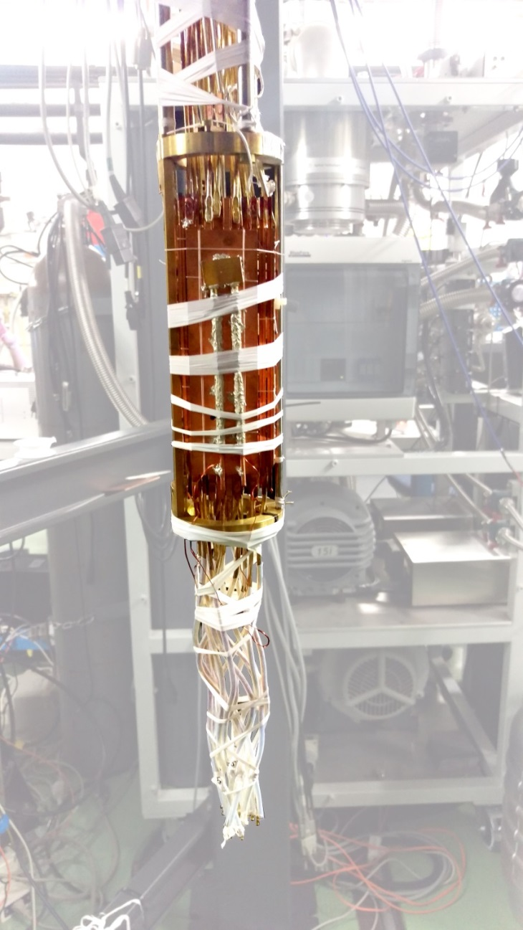
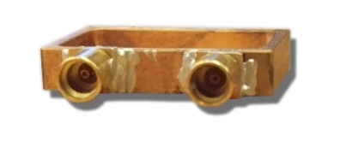
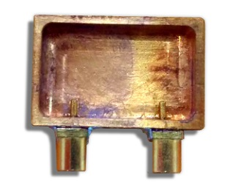
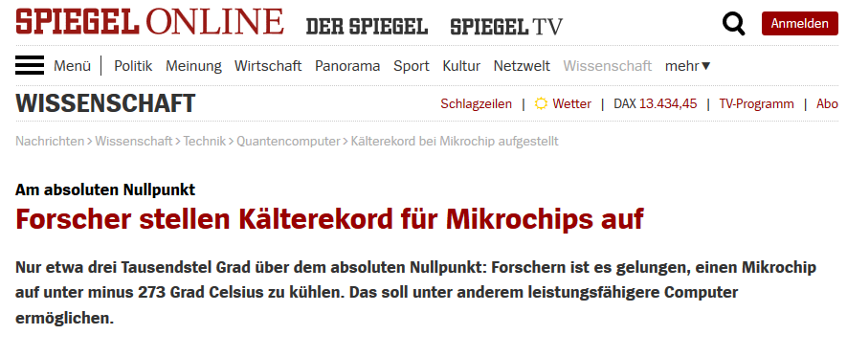
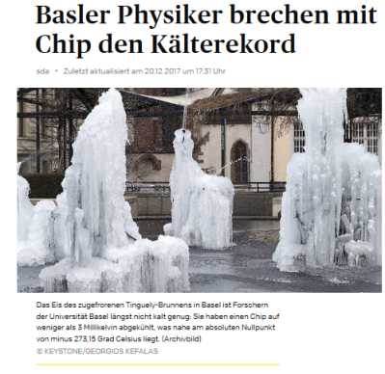
Results: Metallic coulomb blockade thermometer
https://baselcryogenics.unibas.ch
baselcryogenics-physik@unibas.ch
High resistance >100kΩ, cooling through leads not effective
Large Cu – islands => on chip nuclear demagnetization
Sample shield (Cu-box)
12cm Massive filter: 12cm, 0.3mm diam. Cu wire, Cu core
On Cu nucl.stage => on – off chip cooling: APL 111, 253105 (2017)
2.8 mK → World record

Slide 6
https://baselcryogenics.unibas.ch
baselcryogenics-physik@unibas.ch
Thank you for your attention
Cold electrons
Visit our webpage:
https://baselcryogenics.unibas.ch
Price:
1 Filter: 600 Eur
≥ 5 Filters: 510 Eur /pp
≥ 10 Filters: 400 Eur /pp
Contact us:
baselcryogenics-physik@unibas.ch
(Google: Basel Cryogenics)

