Slide 1
Dielectric
Lukas Schenk
Prof. Dr. Dominik Zumbühl | Miguel J. Carballido | Rahel Kaiser | Dr. Taras Patlatiuk | Simon Svab | et. al.
Notes:
summary

Slide 2
Motivation
$$Characterization$$
$$Improve$$
$$Knowledge$$
Notes:
$Characterization of amporhous Dielectrica$
$Improve Qubits$
$Knowledge about reliability of Qubits$
Imperfections
suitable

Slide 3
Goal
$$MOS−Capacitor$$
$$Palladium$$
$$Titan$$
$Dielectri$c
$$SiO_{2} (native Oxid)$$
$$p^{++}−doped Silicon$$

Slide 4
Goal
$Dielectri$c
${Al}_{2}O_{3}$
$$Palladium$$
$HfO_{2}$
$$Titan$$
${Si}_{3}N_{4}$
$Dielectri$c
$$SiO_{2} (native Oxid)$$
$$p^{++}−doped Silicon$$

Slide 5
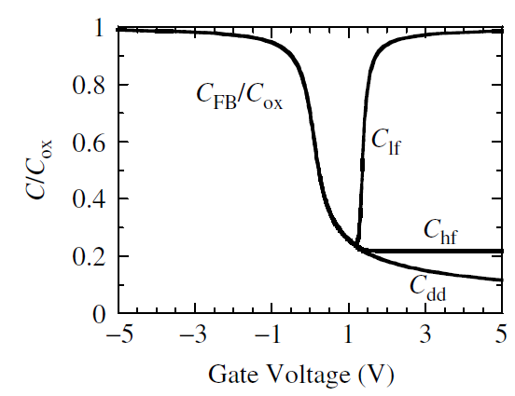
Goal
$$Low−Frequency$$
$$High−Frequency$$
$$Q: Schroder, Dieter K \left(2006\right):SEMICONDUCTOR MATERIAL AND DEVICE CHARACTERZATION. John Wiley \& Sons, Inc., Hoboken, New Jersey.$$
Notes:
Deviation

Slide 6
Fabrication
$C=\frac{ε_{0}ε_{rel}A}{d}⟺A=\frac{Cd}{ε_{0}ε_{rel}}$
$for 100pF<C<500pF$ $for 22nm<d<26nm$ $for {Al}_{2}O_{3} ε_{rel}=9$
$A_{a}=\frac{C_{a}d_{a}}{ε_{0}ε_{rel}}=\frac{300pF∗24nm}{8.85\frac{pF}{m}∗9}=9.039∗{10}^{−8}m^{2}$ $ΔA=\frac{C_{a}d_{a}}{ε_{0}ε_{rel}}−\frac{C_{l}d_{l}}{ε_{0}ε_{rel}}=\frac{300pF∗24nm}{8.85\frac{pF}{m}∗9}−\frac{100pF∗22nm}{8.85\frac{pF}{m}∗9}=6.277∗{10}^{−8}m^{2}$ $A=A_{a}±ΔA=9.039∗{10}^{−8}m^{2}±6.277∗{10}^{−8}m^{2}$
$l≈3∗{10}^{−4}m$
Notes:
Surface
Deviation

Slide 7
Fabrication
$$Fabricationstep$$
$$Lift−off$$
$$Evaporator$$
$$Photoresist$$
$$Develope$$
$$ALD$$
$$HF−Dipp$$
$$Plasma$$
$$Lithography$$
$$Cleaven$$
$w/$ $SiO_{2}$
$w/o$ $SiO_{2}$
$$Palladium$$
$$Titan$$
$$shortened Photoresist$$
$$Photoresist$$
${Al}_{2}O_{3}$ (24 nm)
$$SiO_{2} (native Oxid)$$
$$p^{++}−doped Silicon$$
Notes:
Top view
Side view
Bottom up
Top-down
Dissolved
Edges
2nm
48 nm
Adhere
Properties
remains
Subsequent
Ensuing
Following
attaching

Slide 8
Needleprober
$Devider: \frac{1}{1000}$
$Gain:{10}^{9}$
$Applied Voltage U_{in}:0.100 V$
$Frequency f AC:77,\overline{7} Hz$
$$Z=R+\frac{1}{iωC}=R+\frac{i}{i^{2}ωC}=R−i\frac{1}{ωC}=i\frac{−1}{ωC}=\sqrt{i^{2}\frac{{−1}^{2}}{ω^{2}C^{2}}}=\sqrt{−1\frac{1}{ω^{2}C^{2}}} for R=0$$
$$\left|Z\right|=\sqrt{\frac{1}{ω^{2}C^{2}}}=\frac{1}{ωC}=\frac{\left|U_{in}\frac{100}{99900+100}\right|}{\left|I\right|}(ergibt sich aus U=RI) for I=\frac{U_{y}}{{10}^{9}}$$
$$\frac{1}{ωC}=\frac{\left|U_{in}{10}^{−3}\right|}{\left|I\right|}⇔\frac{1}{C}=\frac{\left|U_{in}{10}^{−3}\right|}{\left|I\right|}ω⇔C=\frac{\left|I\right|}{\left|U_{in}{10}^{−3}\right|ω}=\frac{\left|I\right|}{\left|U_{in}{10}^{−3}\right|2πf}$$
$$Lock−in \\ Amplifier$$
$$∼$$
$$99.9 kΩ$$
$$Devider$$
$$Left$$
$$100 Ω$$
$$R_{Sample}$$
$$Right$$
$$IU−Converter$$
$$I∗{10}^{9}$$

Slide 9
Results Needleprobe
 | $${Al}_{2}O_{3} (native)$$ | $${Al}_{2}O_{3} (HF)$$ | $$HfO_{2}(native)$$ | $$HfO_{2}(HF)$$ | $${Si}_{3}N_{4}(native)$$ | $${Si}_{3}N_{4}(HF)$$
$$C calculated$$ | $$296 pF$$ | $$300 pF$$ | $$1003 pF$$ | $$1051 pF$$ | $$435 pF$$ | $$444 pF$$
$$C messured (0.1 V)$$ | $$135 pF$$ | $$270 pF$$ | $$645 pF$$ | $$620 pF$$ | $$226 pF$$ | $$230 pF$$
$$Difference$$ | $$161 pF$$ | $$30 pF$$ | $$358 pF$$ | $$431 pF$$ | $$209 pF$$ | $$214 pF$$
$$Not leaking$$ | $$48$$ | $$40$$ | $$11$$ | $$19$$ | $$64$$ | $$30$$

Slide 10
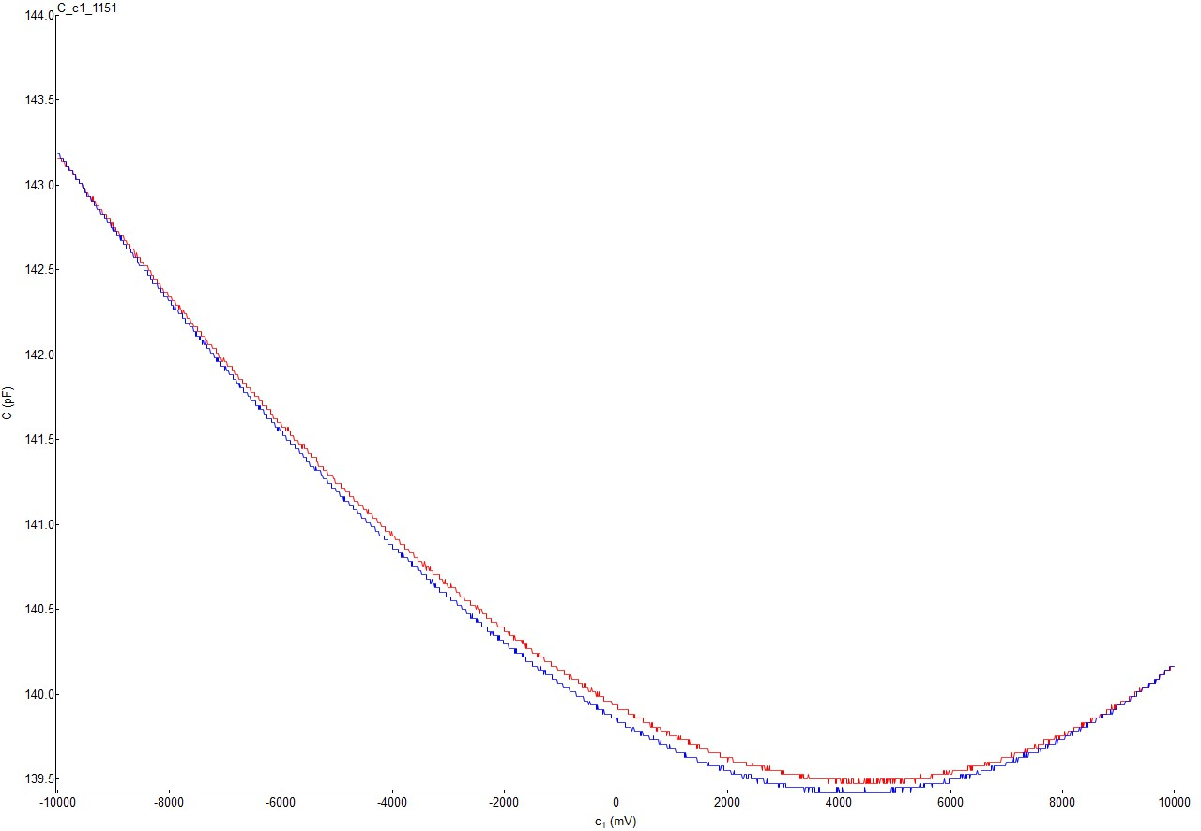
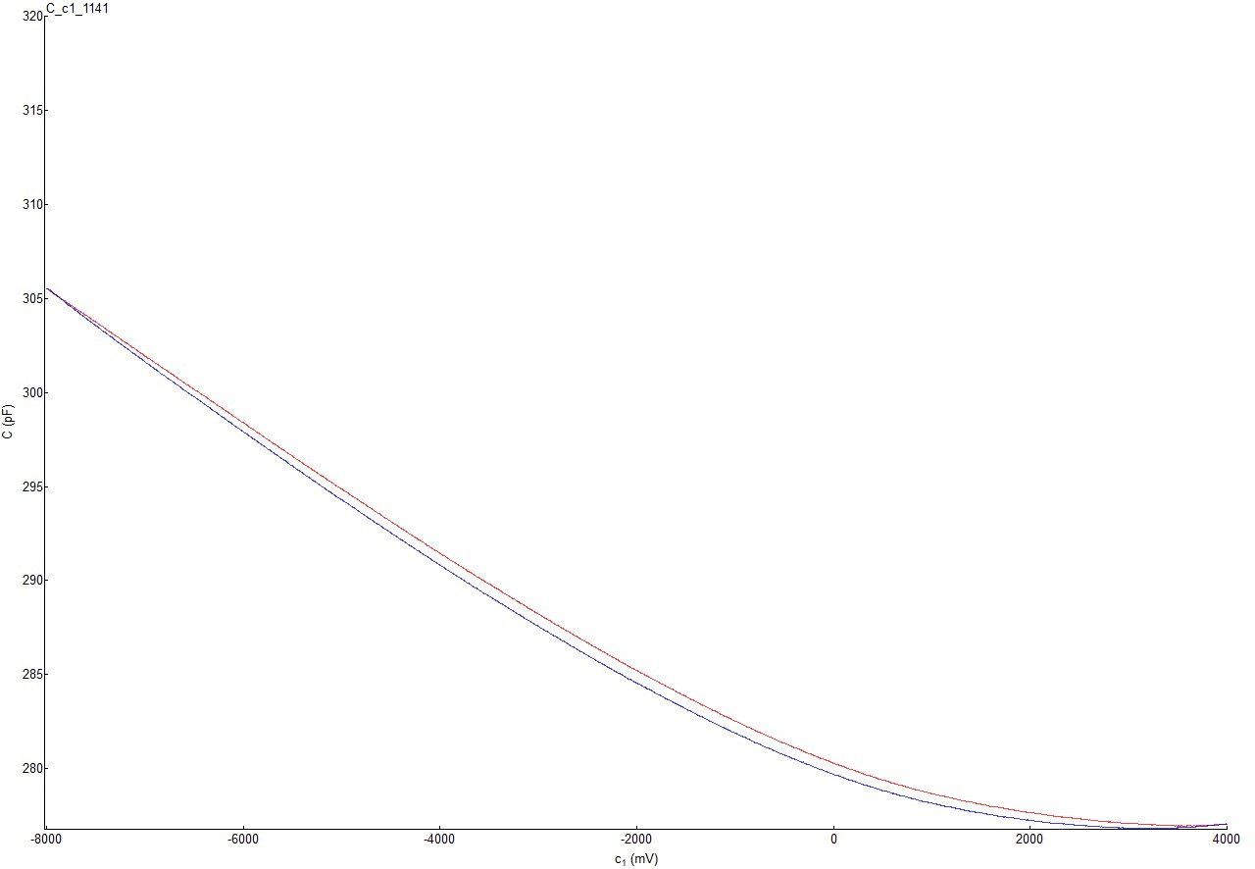
Results Dipstick
$${Al}_{2}O_{3} \left(native\right) \left| 20°C \right| 1243.333 hz$$
$${Al}_{2}O_{3} \left(HF\right) \left| 20°C \right| 1333.333 hz$$
$$−freq. ⟶+freq.$$
$$+freq. ⟶−freq.$$

Slide 11
Conclusion
$$Fabrication$$
$$CV−Measuring$$
$$Helium−Dip$$
$$Extract Parameter$$

Slide 12
Big Thanks!

