Slide 1
Spin-orbit interaction in a dual gated InAs/GaSb quantum well
A. Beukman et al. (Kouwenhoven Group) arXiv:1704.03482
Kris Cerveny
19.05.2017
Friday Group Meeting Talk
Notes:
Logo of PASPS9 conference

Slide 2
Introduction
Motivation:
InAs and GaSb have strong SOI
Rashba strength tunable with gating for InAs
Control of SOI necessary for spintronic devices
Strong SOI + large g-factor + inducible superconductivity ingredients for topological superconducting phase
Experiment:
Investigates SOI in dual-gated InAs/GaSb quantum well
Tune between single and double carrier regimes ($e^{−}$ and $e^{−}$ + holes)
Analyze difference in density of SO split bands
Extract zero-field density difference $∆n_{ZF}$
SOI near hybridization gap

Slide 3
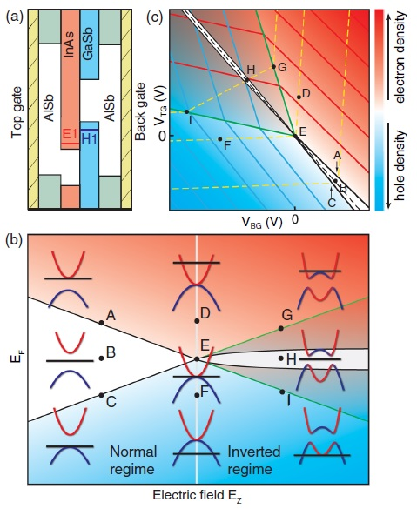
InAs/GaSb DQW
InAs + GaSb ➔ Interesting band structure [1]
GaSb valence band maximum higher in energy than InAs conduction band minimum [2]
Energy range where $e^{−}$ in InAs coexist with holes from the GaSb
Strong coupling ➔ $e^{−}$-hole hybridization ➔ gap when $n_{e^{−}}≈n_{h}$
[1] F. Qu et al., PRL 115, (2015)
[2] H. Kroemer, Physica E 20 (2004)

Slide 4
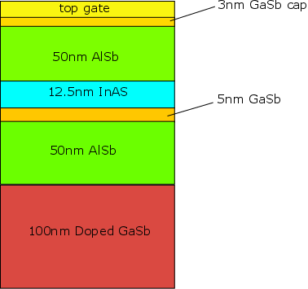
Sample
20μm x 80μm Hall bar
300mK Measurements
GaSb substrate lattice matched with subsequent layers ➔ no need for thick buffer as with GaAs ➔ better coupling between BG and wells!
[1] F. Qu et al., PRL 115, (2015)

Slide 5
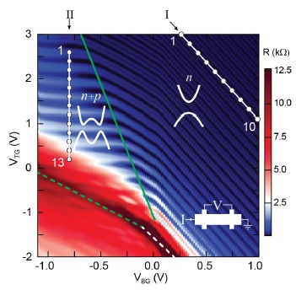
$R_{xx}$ as function of $V_{tg/bg}$
2T out of plane magnet
High $R_{xx}$ (dashed lines) → $E_{F}$ inside gap
Green line separates single- and dual-carrier regimes
Line $Ι$: $e^{−}$ mobility highest Line $ΙΙ$: close to hybridization gap

Slide 6
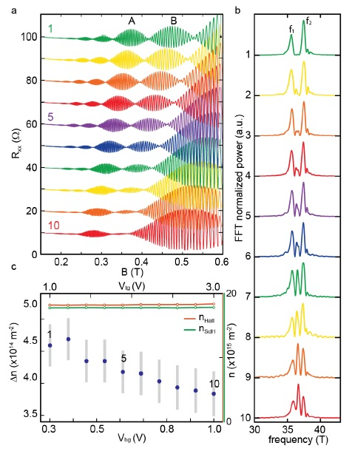
Electron-only Regime
Trace along line $Ι$ (fixed density)
Clear SdH oscillations in $R_{xx}$ → beating pattern as function of $B_{⊥}$
SdH osc. for each spin band periodic in $\frac{1}{B}$ $n_{i}=\frac{e∙f_{i}}{h}$
System favors one SO eigenstate ➔ $△n_{ZF}=n_{2}−n_{1}$ ➔ $△E_{ZFSS}=△n_{ZF}{(\frac{m^{∗}}{πℏ^{2}})}^{−1}$
Trends from 1-10:
Extra frequency peak
Asymmetry between beats (amplitude and oscillation #)
Decreased spacing of peaks (decreasing $△n_{ZF}$)
Increasing # of oscillations in A & B → nodes pushed to lower B fields

Slide 7
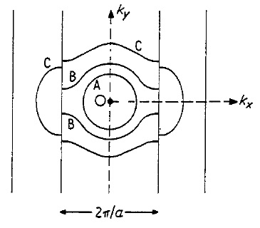
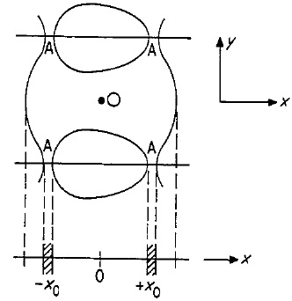
Center Frequency Peak
Emergent central peak does not correspond to a density
3 possible mechanisms can cause extra freq. components:
Magnetic inter-subband scattering
Magnetophonon resonances
Magnetic breakdown
Emergent central peak does not correspond to a density
3 possible mechanisms can cause extra freq. components:
Magnetic inter-subband scattering
Magnetophonon resonances
Magnetic breakdown:
→ Carriers tunneling between spin polarized Fermi-surfaces
[Schematics] W. G. Chambers, Proc. Phys. Soc., Vol 84, 1964

Slide 8
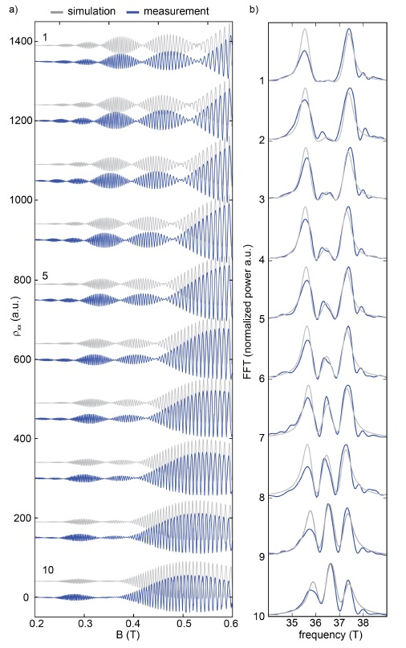
Simulation vs Measurement
Parameter tuning yields: $α_{1}=75 meVÅ$
$$β_{1}=28.5 meVÅ$$
$$γ_{1}=0 meVÅ^{3}$$
Solve for LL energies and extract $ρ_{xx}\left(B_{z}\right)$
$$α_{10}=53m eVÅ$$
$$β_{10}=28.5 meVÅ$$
$$γ_{10}=0 meVÅ^{3}$$
In 2D systems: $$β=\left\langle k_{z}^{2}\right\rangle γ ; \left\langle k_{z}^{2}\right\rangle ≈{\left(\frac{π}{d}\right)}^{2}$$
Compare data to QM LL simulations with the MB mechanism [4]
➔ Valid for infinite square well…
$$m^{∗}=0.04m_{0} ; g^{∗}=−11.5$$
Cubic Dresselhaus term set to zero for good fits!?!?
[4] R. Winkler, Spin-orbit Coupling Effects in Two-dimensional
Electron and Hole Systems, Springer 2003

Slide 9
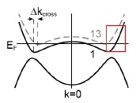
Two Carrier Regime
$e^{−}$ in InAs present with holes in GaSb simultaneously
Investigate influence of hybridization on $∆n_{ZF}$ through magnetoresistance traces on line $ΙΙ$
Hole concentration increases from point 1 to 13 → 13: $n_{h}≈n_{e^{−}}$
$E_{F}$near hybrid. gap

Slide 10
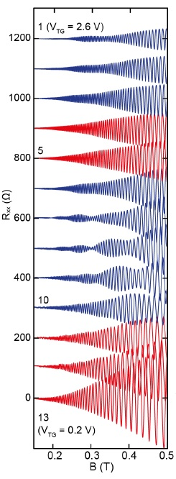
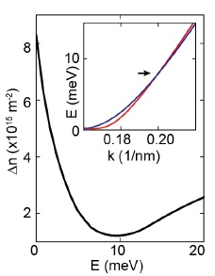
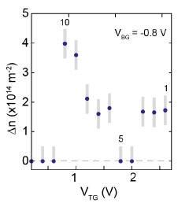
Magnetoresistance Data
Traces with and without beating
$∆n_{ZF,1−3}=1.7∙{10}^{14}{ m}^{−2}$ $∆n_{ZF,4−5}$ → no beating → no ZFDD extractable
Non-monotonic behavior!
Band structure calculations agree qualitatively for first 10 points

Slide 11
Lack of Beating
Two possible reasons:
Strong asymmetry between spin species determines visibility ($A_{up}≫A_{down}$)
$A_{SdH}∝{\left(\frac{eB}{m^{∗}}\right)}^{3}exp⁡\left(\frac{−π}{ω_{c}τ}\right)$ [5]
When approaching hybrid. gap $m^{∗}$ and $τ$ are very dissimilar → visibility reduced below experimental detection limits
Energy window with single spin band present [6]
No beating possible
They can not determine which is the cause
[5] J. Luo et al., PRB, 41, (1990)
[6] F. Nichele et al., ArXiv (2016), 1605.01241

Slide 12
Conclusion
Study of SOI in InAs/GaSb DQW by top and back gating
Tunable in electron-only regime ➔ extract Rashba and Dresselhaus
Non-monotonic spin splitting behavior in two carriers regime ➔ crossing of spin bands due to hybridization

Slide 13
Thanks for listening!!

Slide 14
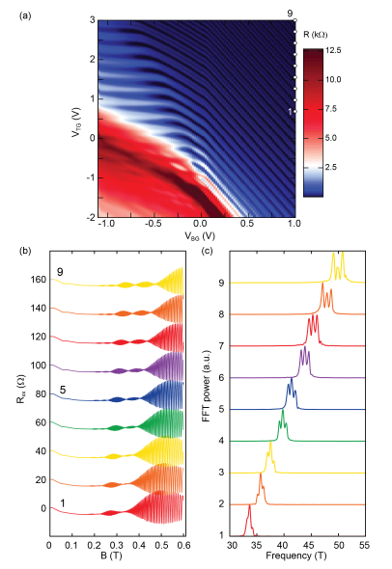
$$B_{⊥}=2T$$

Slide 15
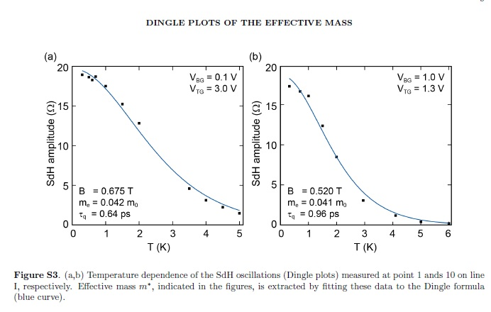

Slide 16
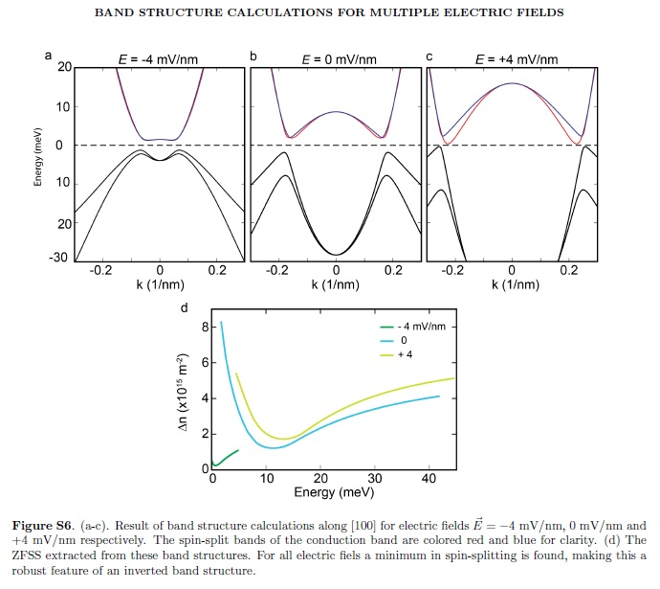

Slide 17
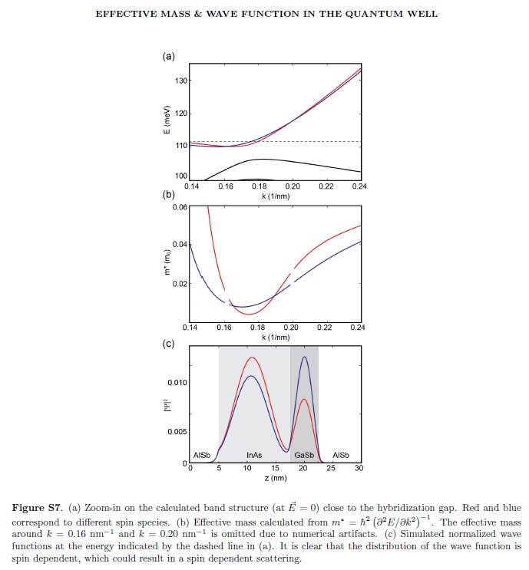

Slide 18
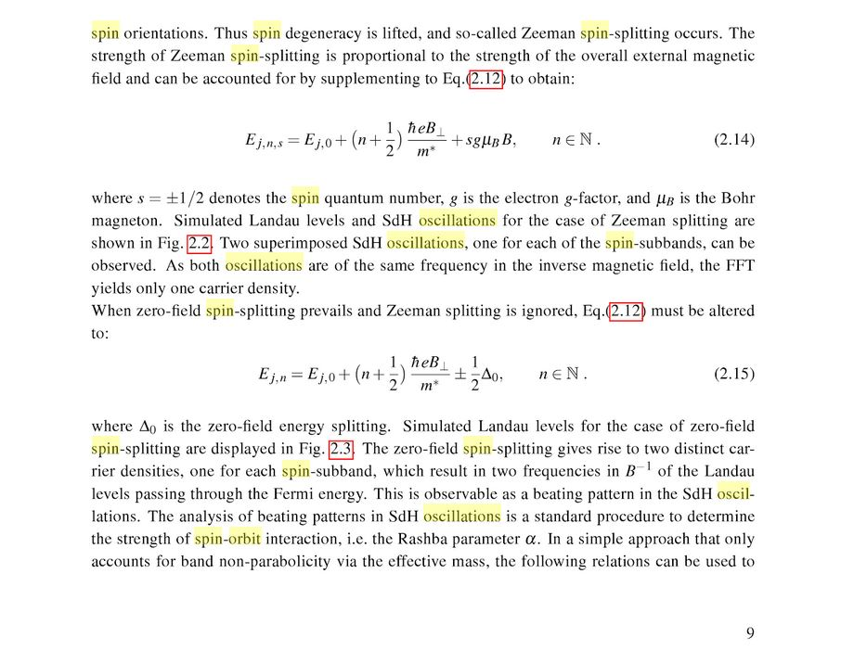
Christopher Schierholz – Rashba Spin-Orbit Interaction in Low and High Magnetic Fields

