Slide 1
Spin wave (magnons) transport in a quantum Hall ferromagnet
D. S. Wei, T. Van der Sar, S. H. Lee, K. Watanabe, T. Taniguchi, B.I. Halperin, & A. Yacoby
12.01.2018
Taras Patlatiuk
Zumbühl Group

Slide 2
Motivation
Spin waves transmit information without displacing charge
Study highly correlated states (frac. QH, bilayer graphene)
Spin superfluidity in Canted Antiferromagnet (CAF)
Bose-Einstein condensate of magnons
Magnons are charge-neutral: challenging to detect and study

Slide 3
Device
hBN/graphene/hBN
Scale bar: 1 µm
Dashed white lines: graphene flake
Solid yellow: leads (Ti/Au)
Transparent yellow: top gates
graphene (small SOI) -> long-lived spin waves

Slide 4
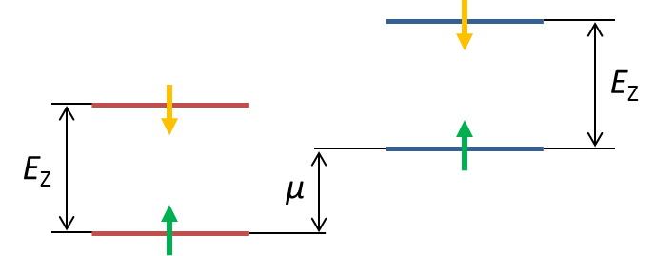
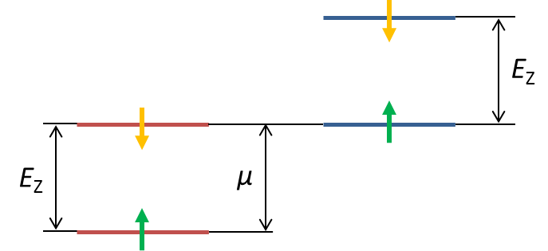
Spin wave generation
Bulk in tuned to ν = 1 (ferromagnetic)
Contact doping: additional edge states
Spin wave excitation energy: E_{Z}=gµ_{B}B
µ = -eV_{dc}
Reverse process affect conductance
(redistribute chemical pot.)
Do not equilibrate
Equilibrate

Slide 5
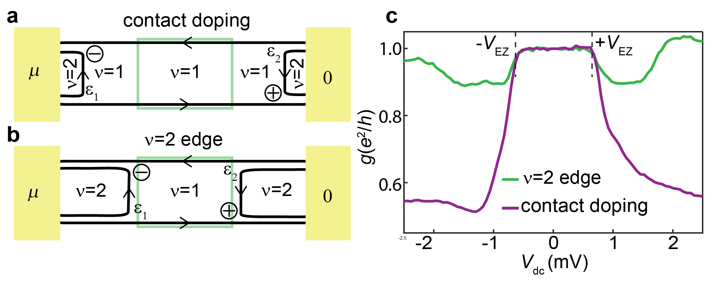
Verification using top gate

Slide 6
Tilted magnetic field
Relevant field: total B
E_{Z} = gµ_{B}B
Previous study: only depends on B⟘ (exchange gap excitations)

Slide 7
Two terminal conductance
$ε$_{i} - amount of redistributed chemical potential
$$\frac{dI}{dV}=\frac{1}{2R_{C}+R_{Q}} \left(1+\frac{dε_{2}}{dμ}−\frac{dε_{1}}{dμ}\right)$$
$ε$_{i} -proportional to the amount of absorbed magnons
Closer to the generation – stronger $ε$_{i}

Slide 8
Relative magnon absorption
$$\frac{dI}{dV}=\frac{1}{2R_{C}+R_{Q}} \left(1+\frac{dε_{2}}{dμ}−\frac{dε_{1}}{dμ}\right)$$
I_{P} = - I/e
dI/dV = dI_{P}/dµ

Slide 9
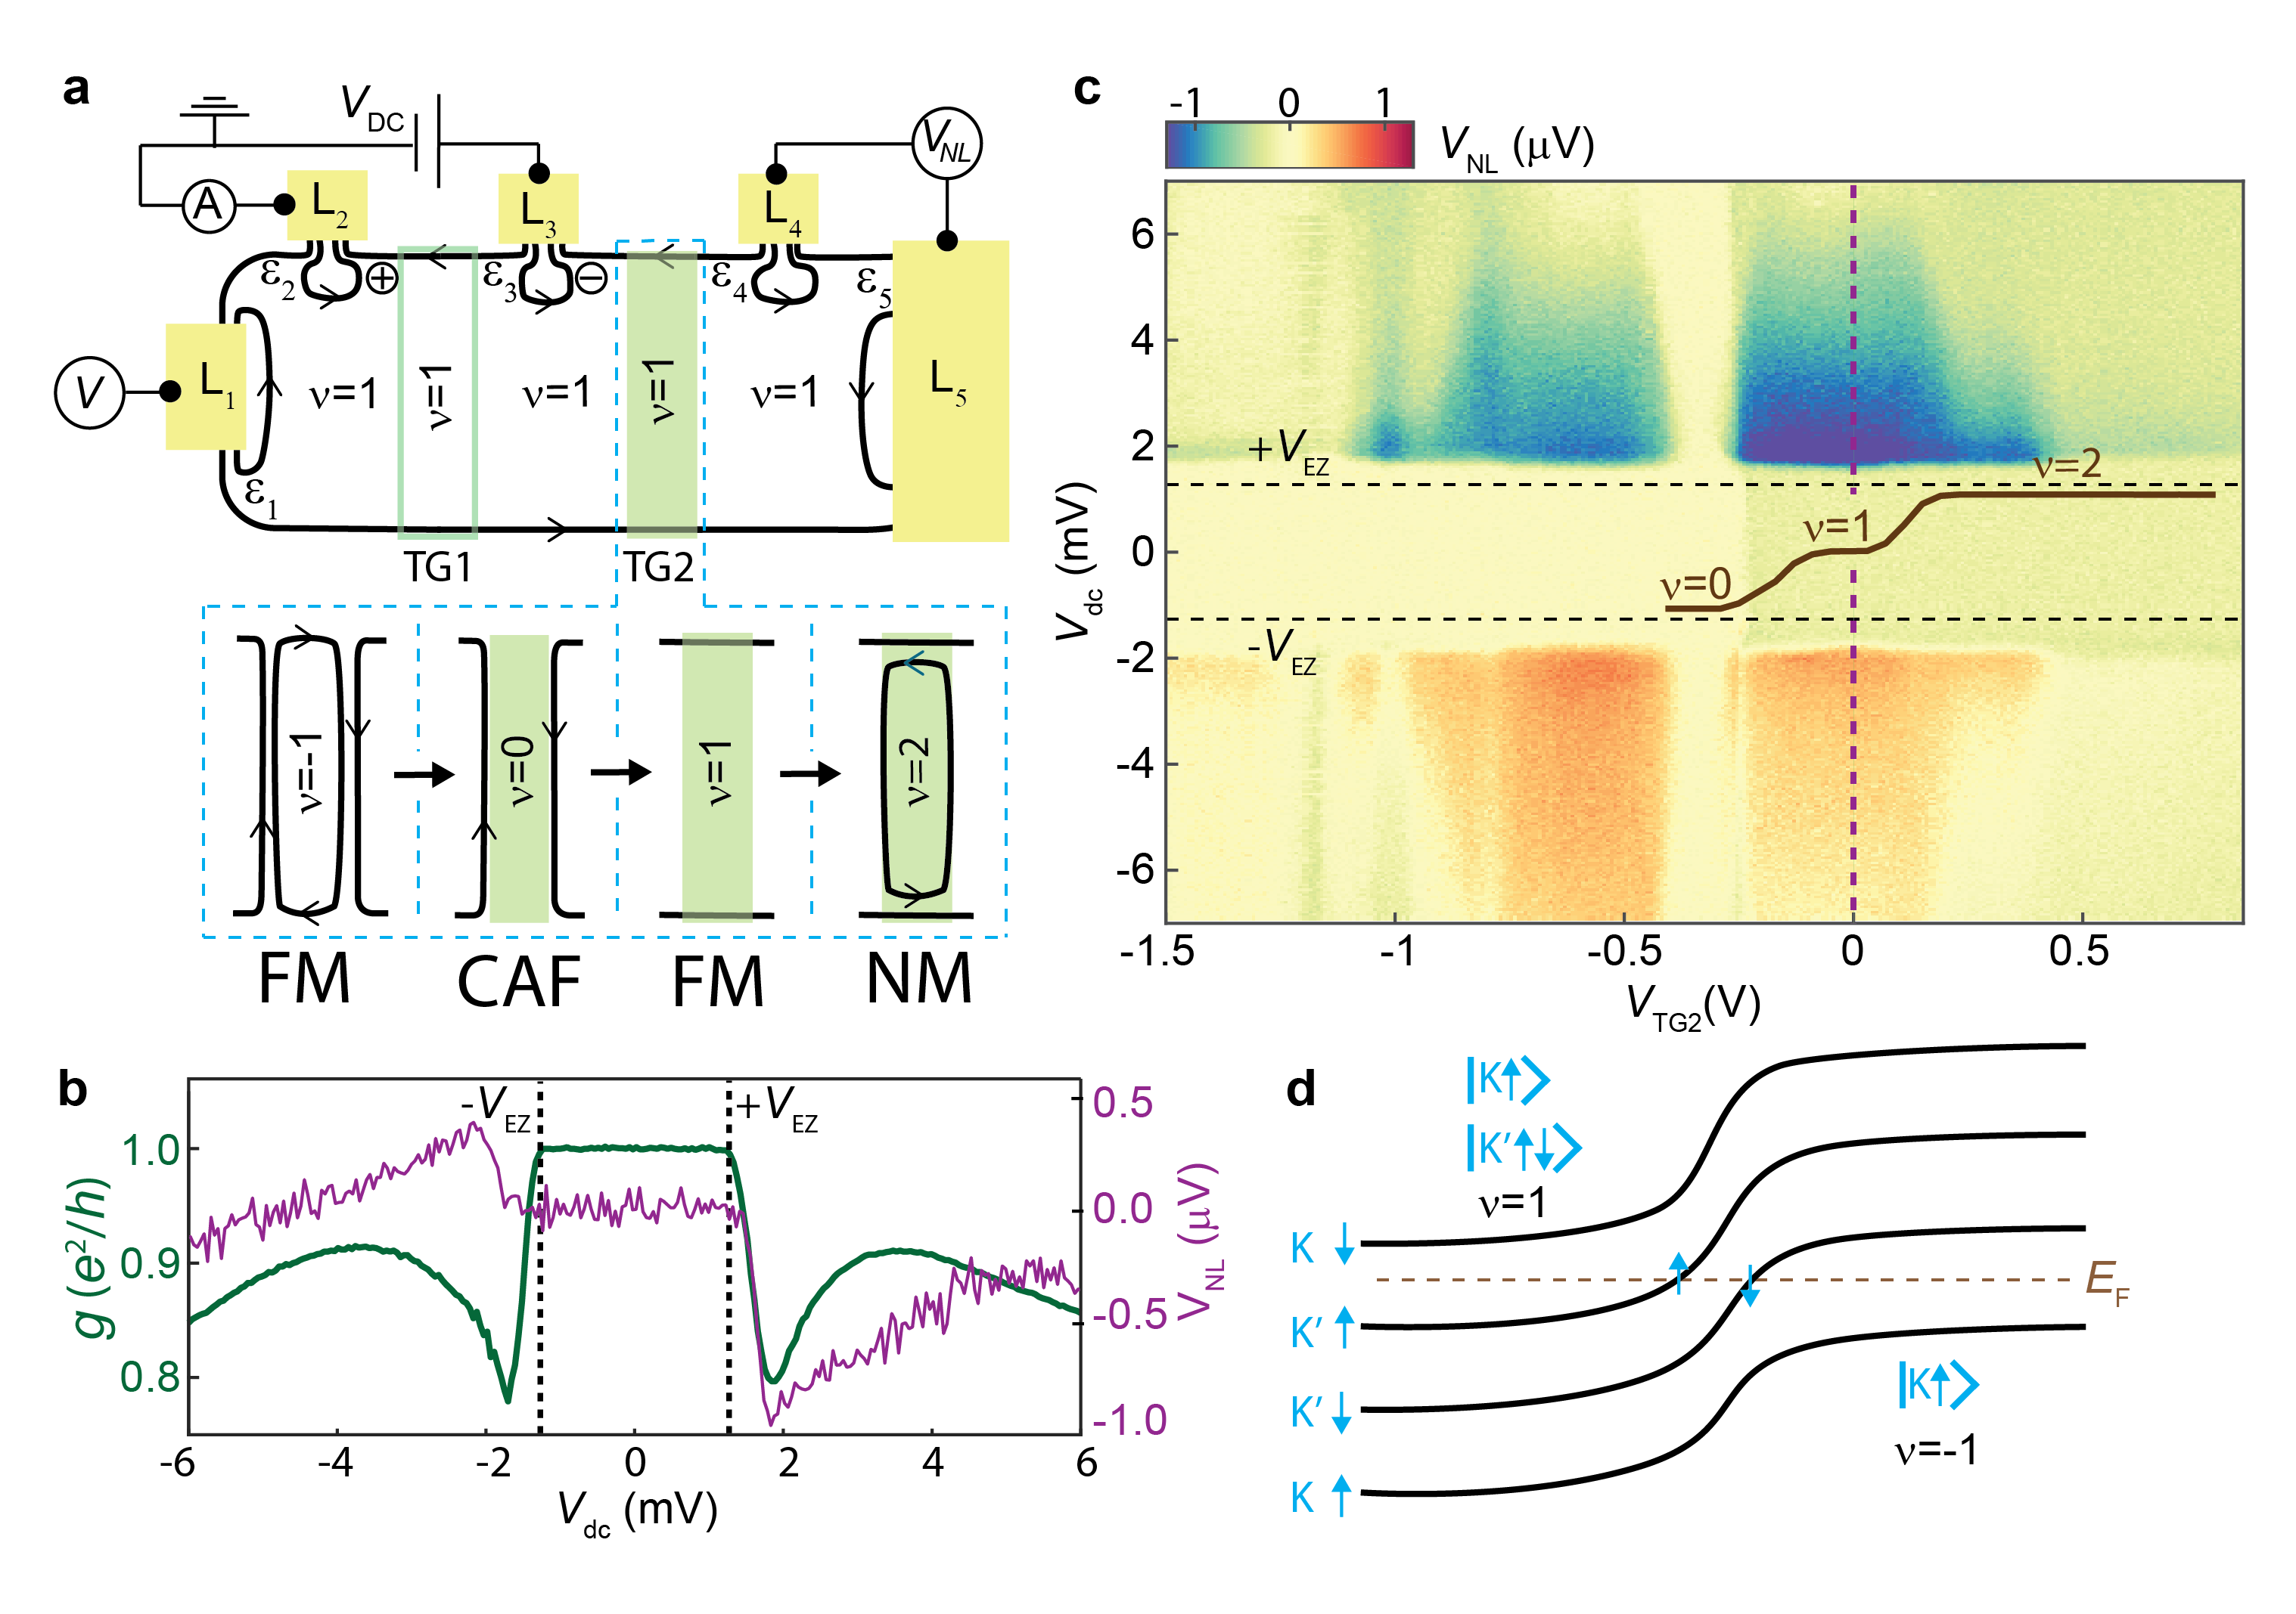
Non-local voltage signal

Slide 10
Conclusion
Magnon generation, propagation, detection
Unimpeded propagation through ν=0/ν=1 interface
Magnon propagation through insulating canted antiferromagnet

Slide 12
Magnons in quantum Hall ferromagnet

Slide 13
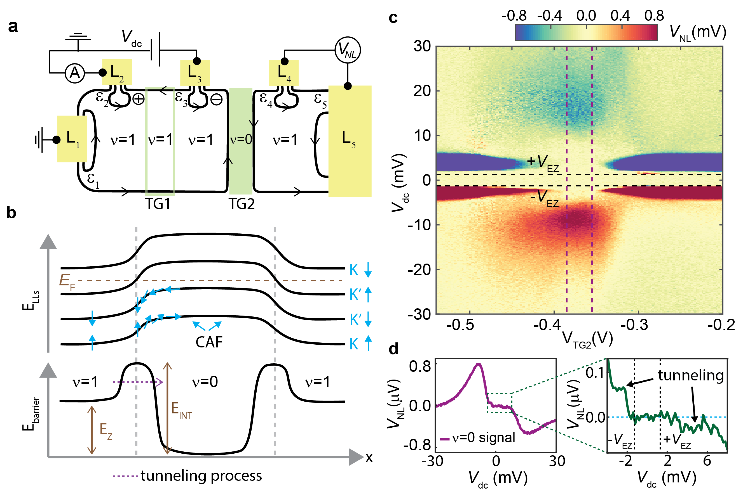
Non-local CAF

