Slide 1
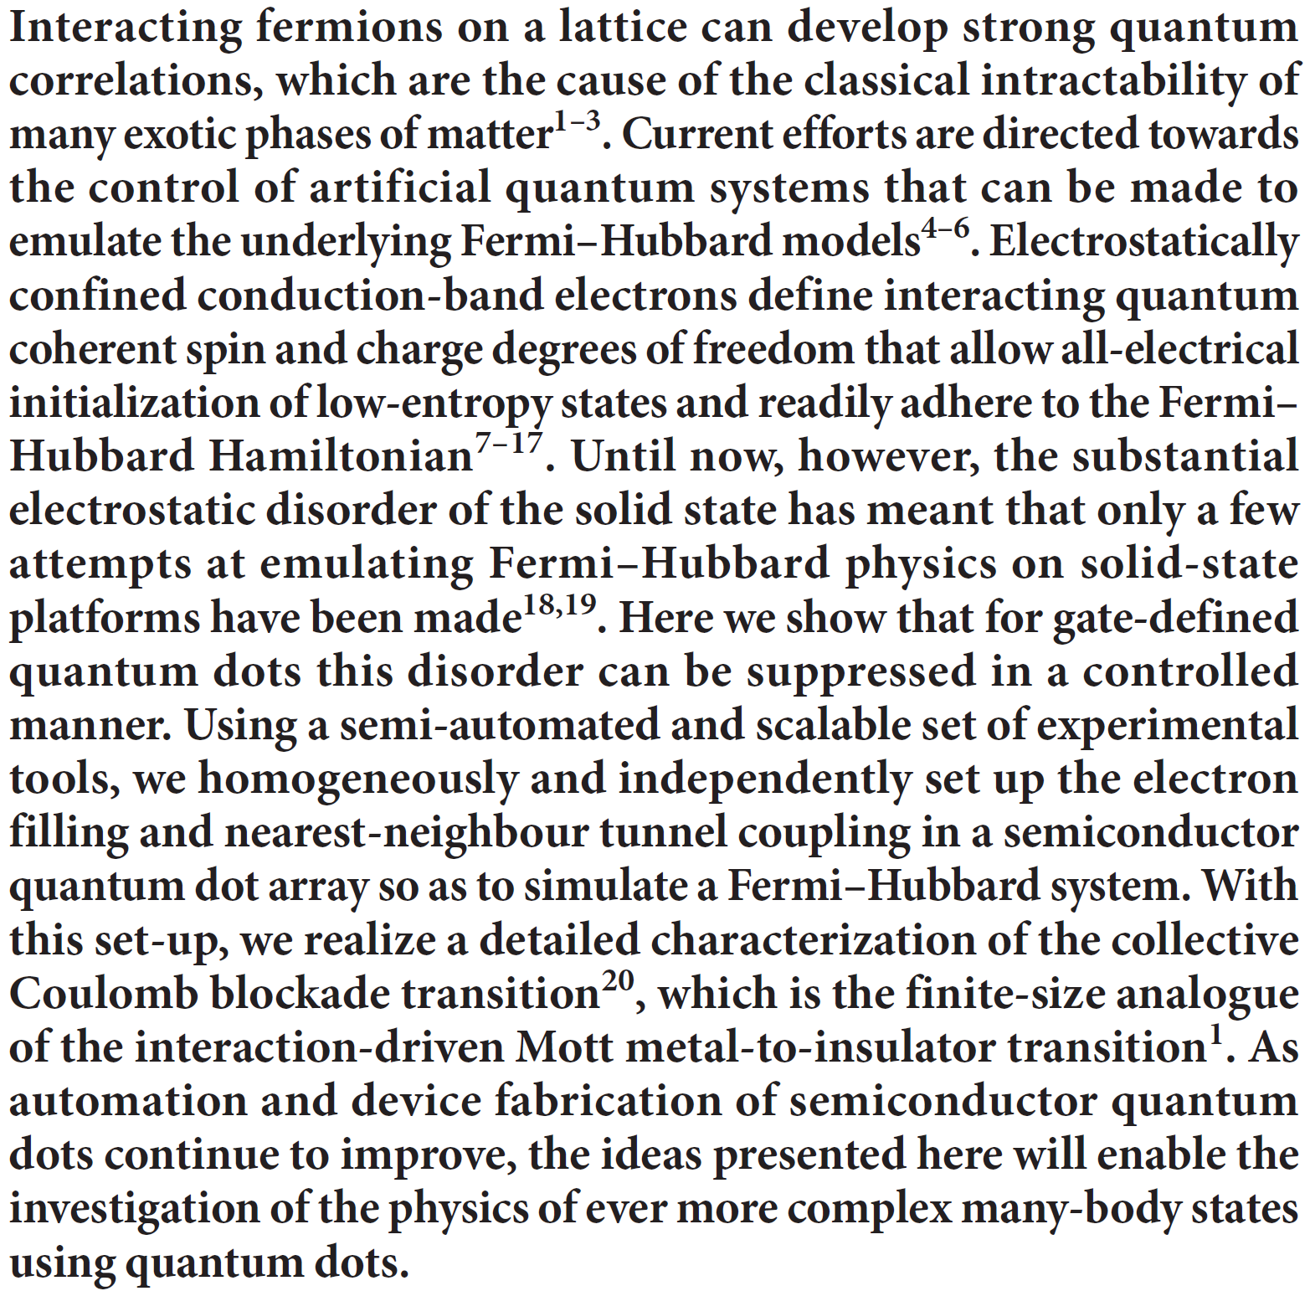
FAM 8.12.2017
Leon Camenzind

Slide 2
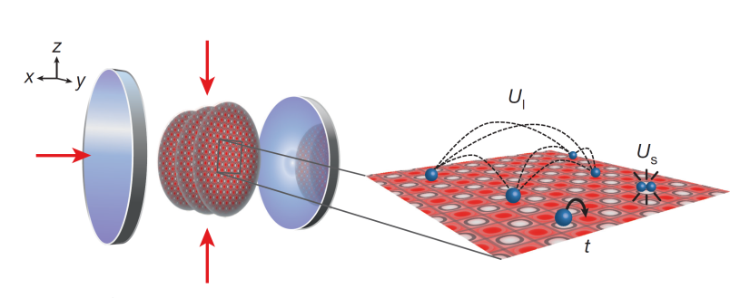
Motivation
Establish quantum dot arrays as quantum simulatons plattform
Cold atoms: Landig et al., Nature 532 (2016)
Technical: Calibration routines --> scaling up (paradigm for «virtual gates») Baart et al., APL108 (2016) «Computer-automated tuning of semiconductor double quantum dots into the single electron regime»
Isolated vs. collective Coulomb blockade Stafford and Das Sarma, PRL72 (1994): «Collective Coulomb Blockade in an Array of Quantum Dots: A Mott-Hubbard Approach”

Slide 3
Fermi-Hubbard Model
t
t
+U
Tight-binding
On-site coulomb
$$\hat{H}=−t\sum_{\left\langle i,j\right\rangle ,σ}{\left({\hat{c}}_{i,σ}^{†}{\hat{c}}_{j,σ}^{}+{\hat{c}}_{j,σ}^{†}{\hat{c}}_{i,σ}^{}\right)}+U\sum_{i=1}^{N}{{\hat{n}}_{i↑}{\hat{n}}_{i↓}}$$
Spin density operator for site i:
$${\hat{n}}_{iσ}={\hat{c}}_{i,σ}^{†}{\hat{c}}_{i,σ}^{}$$
Dot occupation operator:
$${\hat{n}}_{i}=\sum_{σ}{{\hat{n}}_{iσ}}$$
$\left\langle i,j\right\rangle$: nearest neighbor
${\hat{c}}_{i,σ}^{(†)}$: Fermionic creation/annihilation op.

Slide 4
Mott-Hubbard Insulator
Transition metal oxides are insulators
Tight-Binding/LCAO → metal
+ Hubbard U → insulator
NiO: competiion U and t in 3d orbitals
Mott gap: $E_{gap} \sim U−2zt$

Slide 5
Extented Fermi-Hubbard Model
t
t
$$V_{ij}$$
+U
$$V_{ij}$$
Inter-site coulomb
Tight-binding
On-site coulomb
$$\hat{H}=−t\sum_{\left\langle i,j\right\rangle ,σ}{\left({\hat{c}}_{i,σ}^{†}{\hat{c}}_{j,σ}^{}+{\hat{c}}_{j,σ}^{†}{\hat{c}}_{i,σ}^{}\right)}+U\sum_{i=1}^{N}{{\hat{n}}_{i↑}{\hat{n}}_{i↓}}+\sum_{i,j}^{N}{V_{ij} \hat{n_{i}}\hat{n_{j}}}$$
$\left\langle i,j\right\rangle$: nearest neighbor
Spin density operator for site i:
$${\hat{n}}_{iσ}={\hat{c}}_{i,σ}^{†}{\hat{c}}_{i,σ}^{}$$
Dot occupation operator:
$${\hat{n}}_{i}=\sum_{σ}{{\hat{n}}_{iσ}}$$
${\hat{c}}_{i,σ}^{(†)}$: Fermionic creation/annihilation op.

Slide 6
Setup and Hubbard model
$$k_{B}T\sim 6μeV$$
Dot energy
Hopping
Intra-dot Coulomb
Inter-dot Coulomb
$$H=−\sum_{i}{ε_{i}n_{i}}−\sum_{\left\langle i,j\right\rangle ,σ}{t_{ij}}\left({\hat{c}}_{i,σ}^{†}{\hat{c}}_{j,σ}^{†}+h.c.\right)+\sum_{i}{\frac{U_{i}}{2}}n_{i}\left(n_{i}−1\right)+\sum_{i,j}{V_{ij}n_{i}n_{j}}$$
Toolbox
Full (independent) control over parameterspace: define virtual gates $→$ linear combinations of physical gates 1. $\left\{P_{i}, B_{ij}\right\}→ \left\{μ^{′},δε_{i},t_{ij}\right\}$ 2. Measure $\left\{U_{i},V_{ij}\right\}$ 3. Simulation of Hubbard-Model using extracted & calibrated parameters

Slide 7
Uniform filling of the array
Isolated Coulomb blockade
$$t_{ij}<V_{ij}<U_{i}$$
Y-Axis: Combination of all seven gates (only $P_{1}$ values shown)
Tunnel couplings constant
Dot-Dot
Equal sweep of local fillings
$$(011)$$
$$(110)$$
Reservoir
$$(001)$$
$$(100)$$
$t=0$
Detuning of outer dots
$$V_{ij}=0;t=0$$

Slide 8
1. Virtual gates: separate variables in parameter space
Controlling Hubbard model means independent control of $ε_{i},{ t}_{ij}$
Virtual plunger gates $δε_{i}$
$$\frac{δB_{12}}{δP_{1}}=−\frac{α_{11}}{α_{14}}$$
$α_{i≠j}$: crosstalk (measured from charge transitions)
$α_{i=j} :P_{i} →ε_{i}$ (measured from polarization lines)
Matrix measured for variety of electron fillings
Virtual barrier gates $δB_{ij}^{∗}$
→ $ε_{i}=const$
Matrix measured for different interdot-couplings $t_{avg}\sim t_{12}\sim t_{23}$

Slide 9
1. Leverarm and tunnel coupling
$$hf=\sqrt{δε^{2}+{\left(2t_{12}\right)}^{2}}$$
(a) PAT strong coupling: DD hybridized charge state spectrum (bonding – antibonding)
(b) Polarization line width The excess charge transition is broadened both by an effective electron temperature and by the tunnel coupling
[1]
$V(ε)\sim \frac{ε}{Ω}\tanh{\frac{Ω}{2k_{B}T_{e}}}$ with $Ω^{2}=ε^{2}+4t_{ij}^{2}$
[1] Oosterkamp et al., Nature 395 (1998)

Slide 10
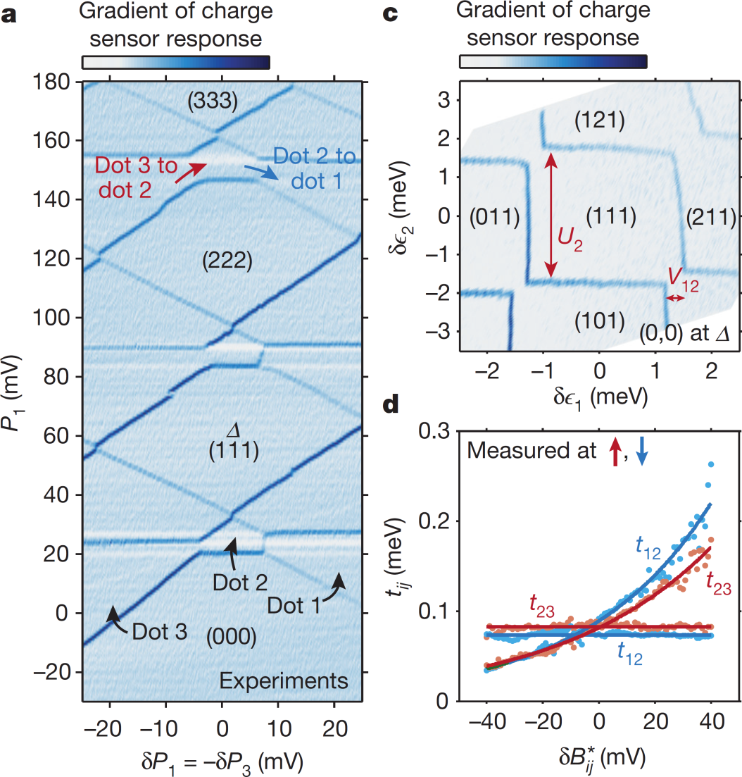
2. Calibrated charge-stability diagram $U_{2}$ and $V_{12}$ and barriers
Virtual plunger gate
$U_{i}$ = adding of second electron into shell
$V_{12}$ : $ε_{1}$ with $n_{2}=0$ vs. $n_{2}=1$
Virtual barrier gate
Change only $t_{12}$ or $t_{23}$ (other TB + $ε_{i}$ unaffected)
$t_{ij}\left(δ{B_{ij}^{}}^{∗}\right)\sim exp⁡({B_{ij}^{}}^{∗}$)

Slide 11
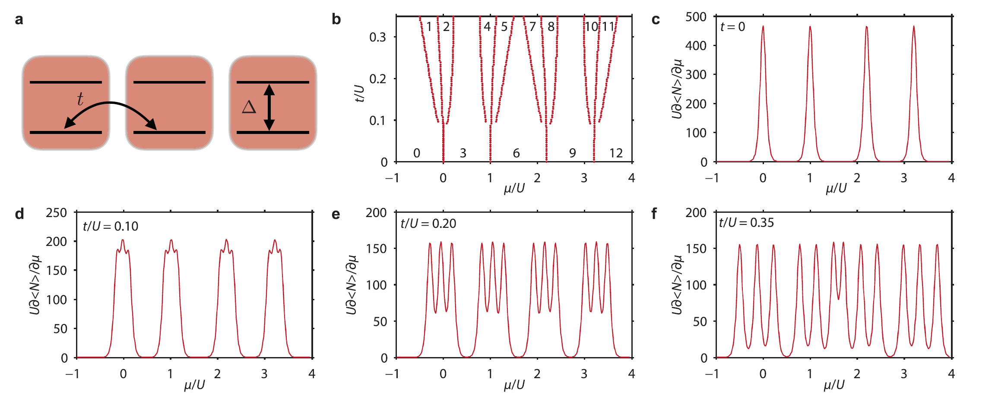
Simulations of collective Coulomb blockade for the simplified Hubbard model
$$2U+Δ$$
$$3U+Δ$$
Electron addition spectrum
$$U$$
Here: no inter-dot Coulomb ($V_{ij}$)
$t=0$: addition peaks triple degenerated (same addition cost)
$t≠0$: peaks split into “miniband” $→$ breakdown of Coulomb blockade in dots. But energy still gapped. Delocalized electrons: $n_{i}$ no good quantum number anymore.
Merging of bands
Limit: Merging into one large dot

Slide 12
Collective Coulomb blockade
Collective Coulomb blockade physics in the Fermi–Hubbard phase space
Homogenious filling by tune $ε_{1},ε_{2},ε_{3}$ vs. $t_{avg} (t_{12}\sim t_{23})$
$V_{ij}$ : inter-capacitance lifts degeneracy of addition peak at $t=0$
$t≠0$: ($n_{1} n_{2} n_{3})$ becomes bad quantum number. GS superposition of different charge states
Minibands collapse → from Mott insulator to metallic state
Comparison to theory: Measure $\left\{V_{ij }U_{i}\right\}$ and calc. from extended Hubbard model.

Slide 13
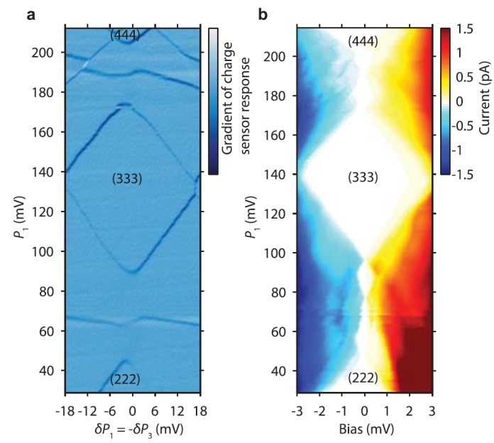
Transport signatures
$ε_{F}$ in in Mott gap
$$t \sim 0$$
$ε_{F}$ in miniband
$$t≠ 0$$
$\sim$ large dot: collective Coulomb blockade

Slide 14
Summary
From isolated to collective Coulomb blockade by increasing hopping term $t$
Proof of concept for completely separeted tuning of involved energies
Proof of a quantum simulator for a many-body problem in a semiconductor quantum dot array

Slide 15
Thank you for your attention

Slide 16
3d Orbitals

Slide 17
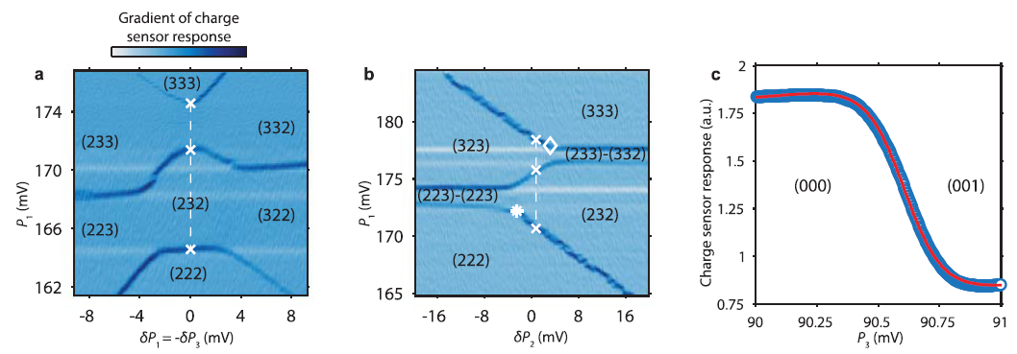
Miniband width and electron temperature

Slide 18
Determining lever arm and tunnel coupling
$$V_{ij}=0$$
$$V_{ij}≠0$$
$$V_{ij}≠0$$

Slide 19
Model parameters
$$t=0$$
$$t≠0$$
$\left(n_{1} n_{2} n_{3}\right)\sim$weight in superposition

